Slide 1

Your current GPS coordinates:
Lat: 42.4075 Lng: -71.1183
Finding your route
From Current Location
To Halligan Hall, Medford, MA, USA
Finding your route
From Current Location
To Halligan Hall, Medford, MA, USA
Choose starting point
(default to Current Location)
Time Elapsed:
Time Elapsed:
0:19
1:02
Choose destination
It’s been a while. Would you like to resend your request?
Go!
Retry
Please keep this app open and make sure you have adequate cell-reception.
Additional Msg rates may apply.
Please keep this app open and make sure you have adequate cell-reception.
Additional Msg rates may apply.
Home Page
Loading Page
(with timeout)
Loading Page

Slide 2
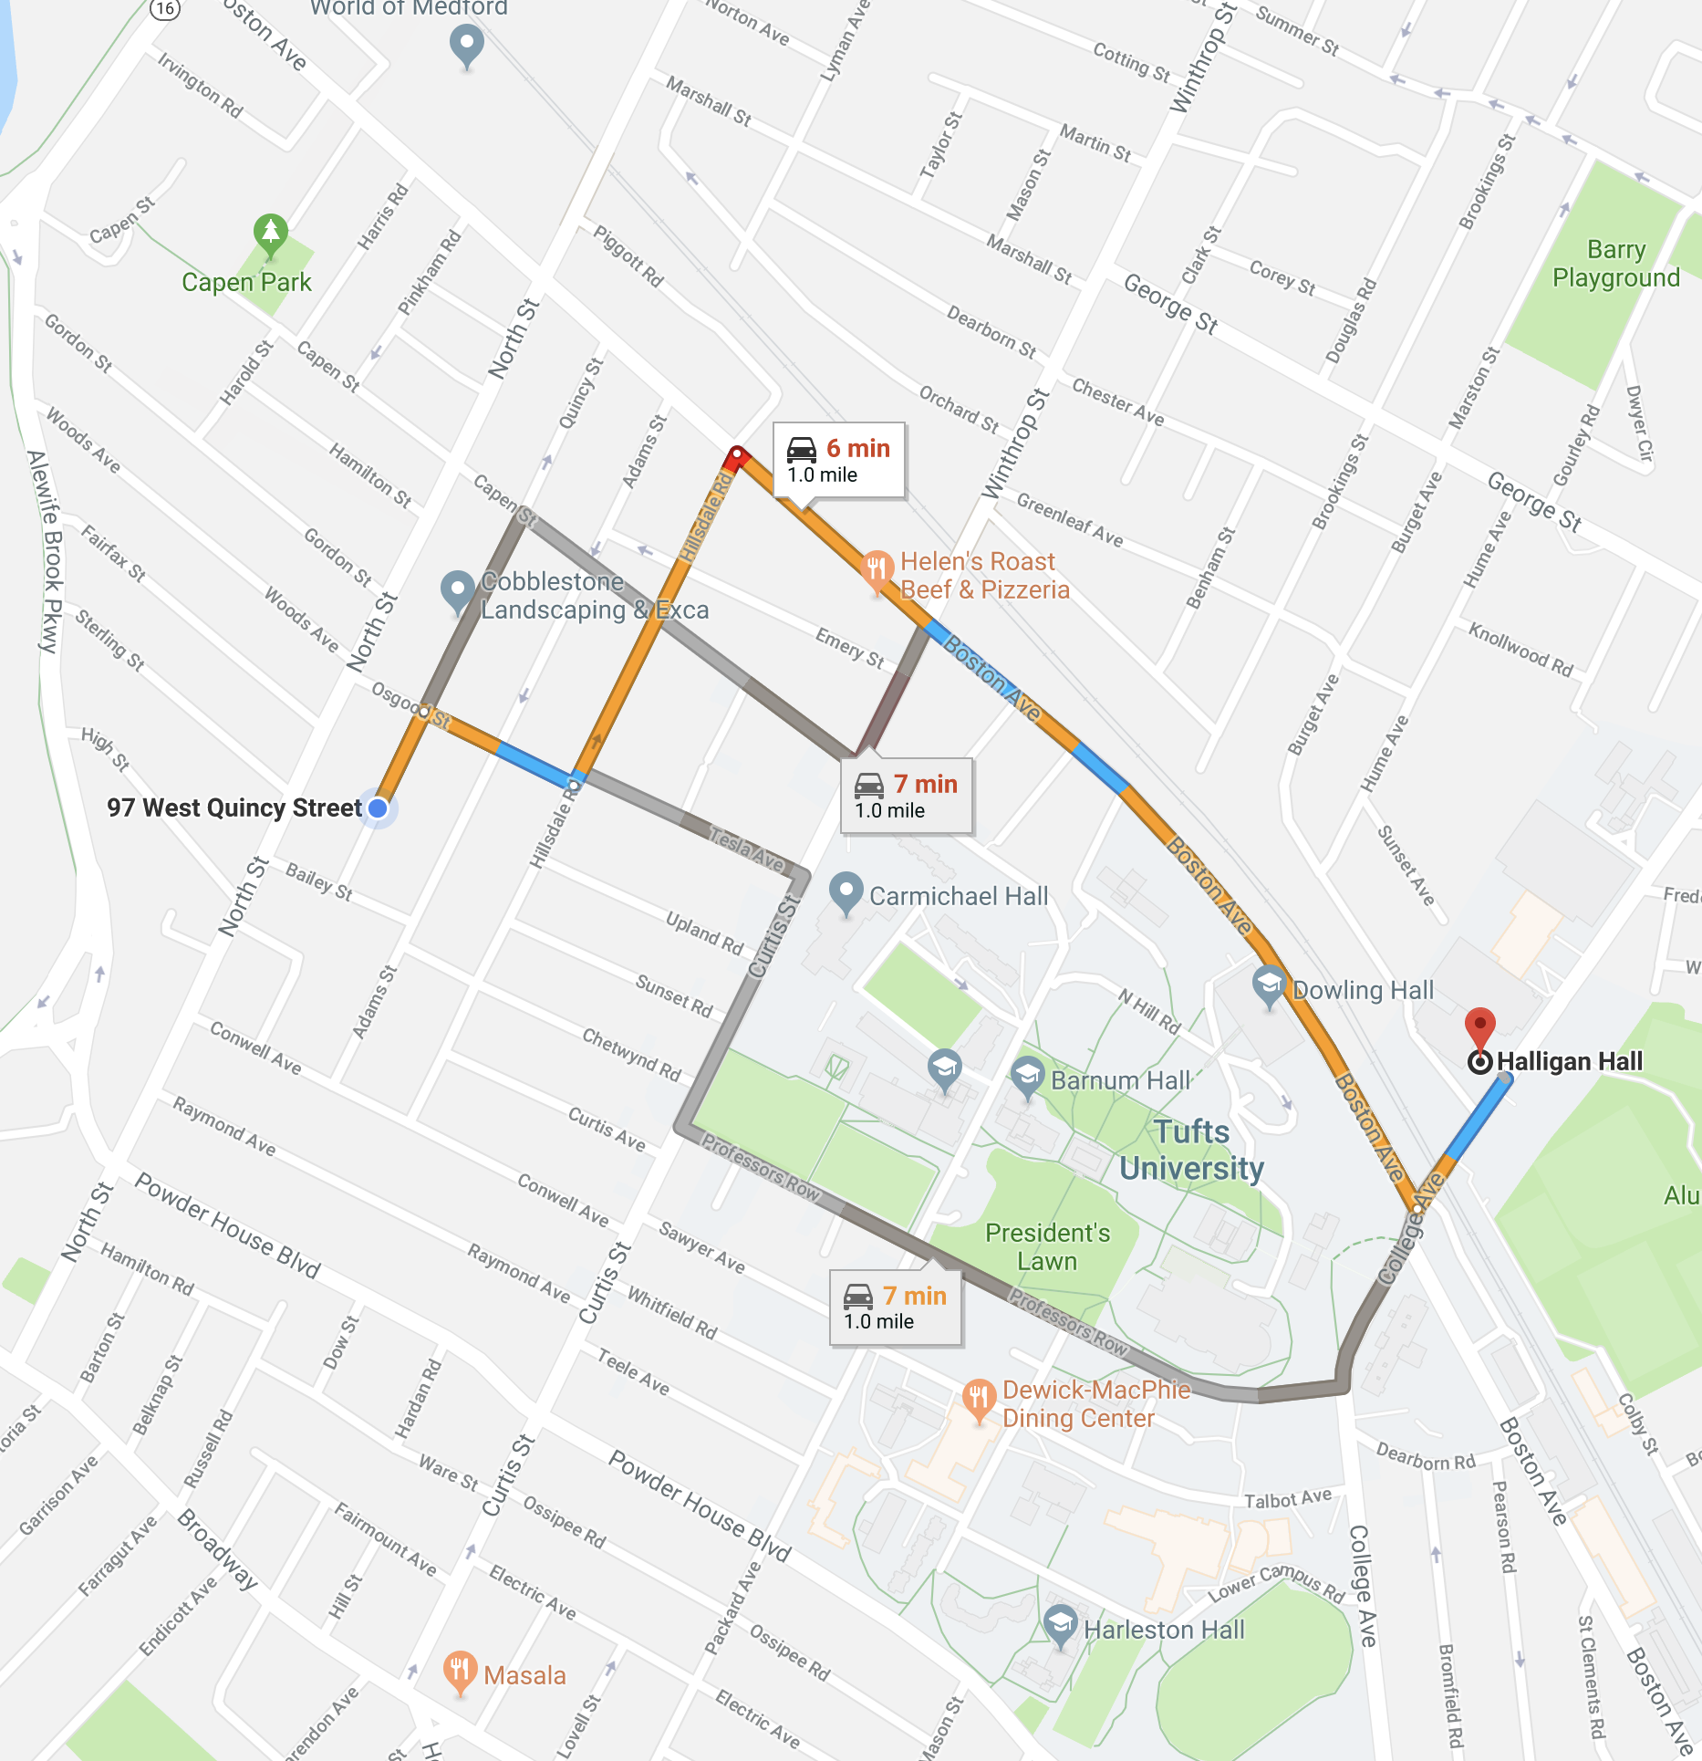
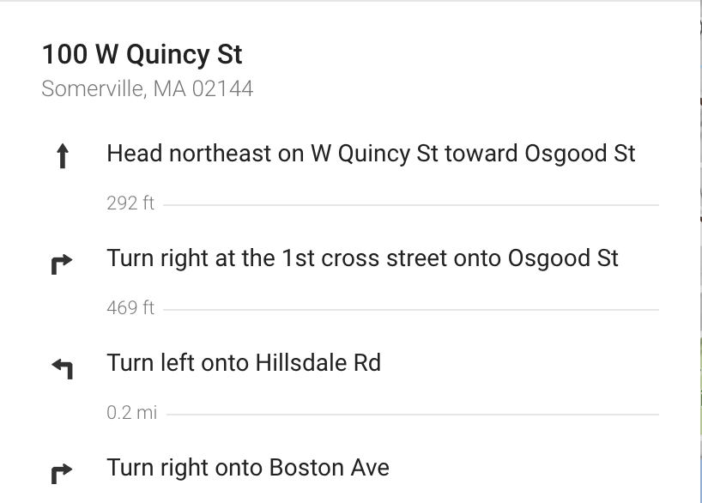
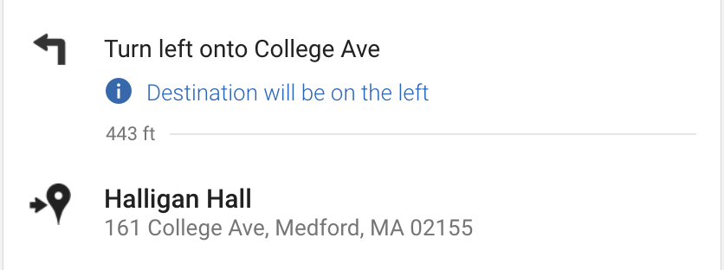
<| Return
<| Return
Current location overlaid on map
Button to expand instructions
Map Page
(with directions expanded)
Map Page (start)

