Slide 1
80K
70K
60K
50K
40K
30K
20K
Week: 1 2 3 4 5 6 7 8 9 10 11 12 13 14 15 16 17 18 19 20 21 22 23 24 25 26 27 28 29 30 31 32 33 34 35 36 37 38

Slide 2
Week 15
78K
55K
54K
55K
54K
54K
2020 2019 2018 2017 2016 2015

Slide 3
Week 15, 2020
0-4
5-17
18-49
50-64
65+
Total Deaths 78,779

Slide 4
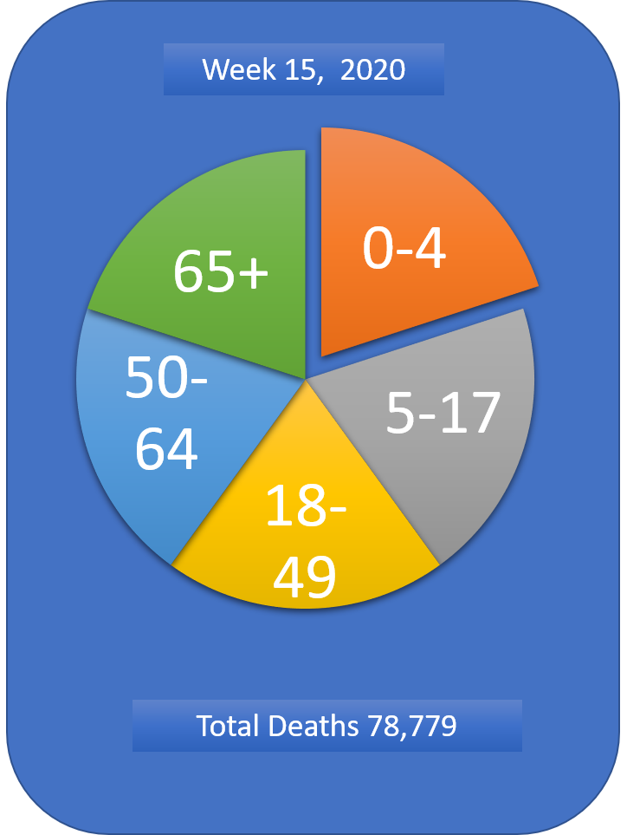
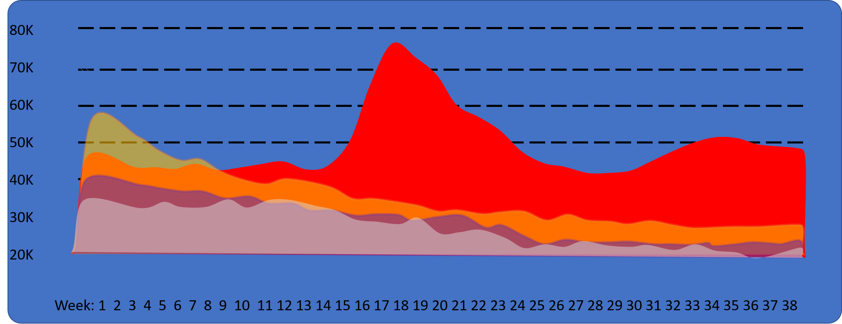
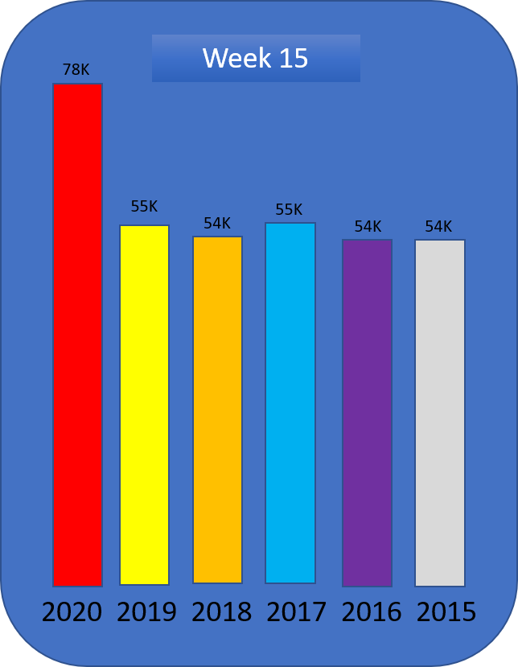

Slide 5
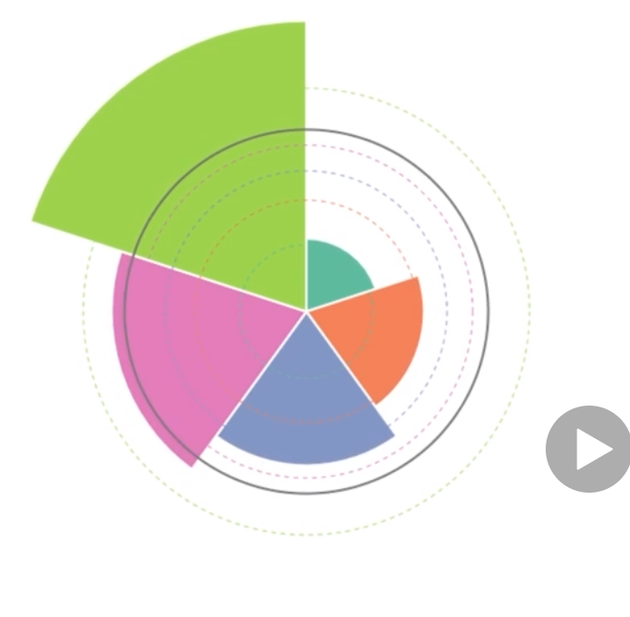

Slide 6
