Slide 1
NFT Generation 21st century Picasso
The future of ART!

Slide 2
Summary – Market Place

Slide 3
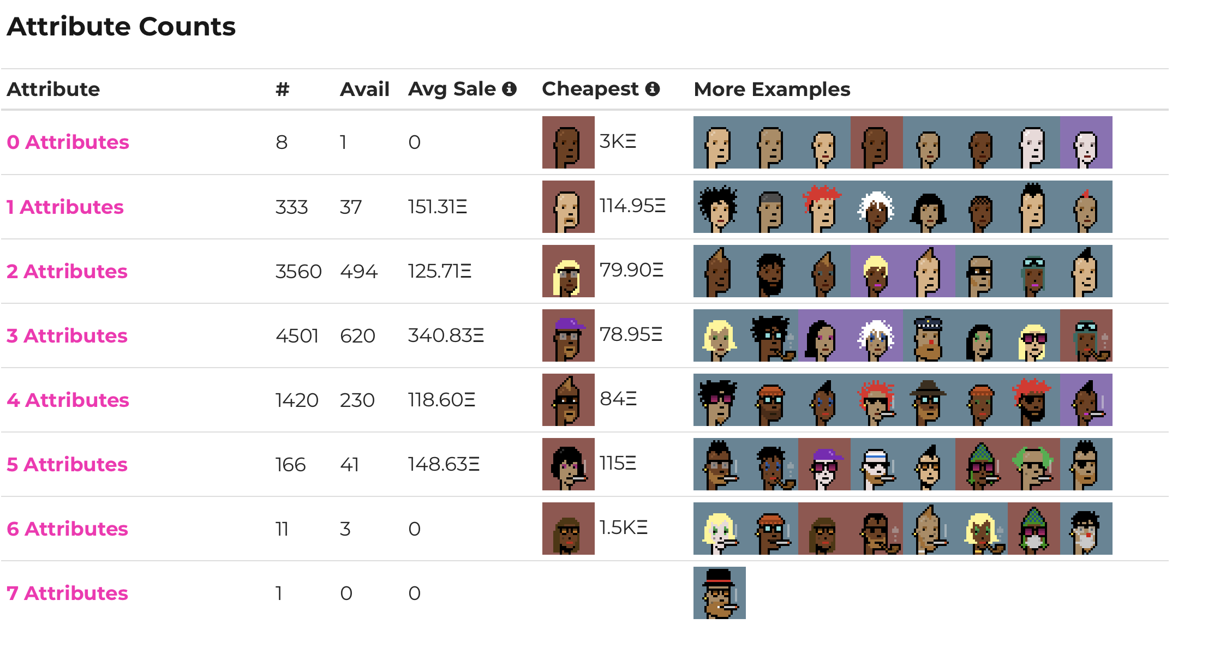
Summary – NFT Generator
NFT Generator: Takes in a variety of traits and randomly combines them into a unique photo. The more traits the more unique possibilities.
Crypto Punks: 10,000 unique Punks (6,039 males / 3,840 females)
3,200 owners / 728.9k ETH (volume traded)
Launced in mid -2017 and become one of the inspiration for the ERC-721 standard.

Slide 4
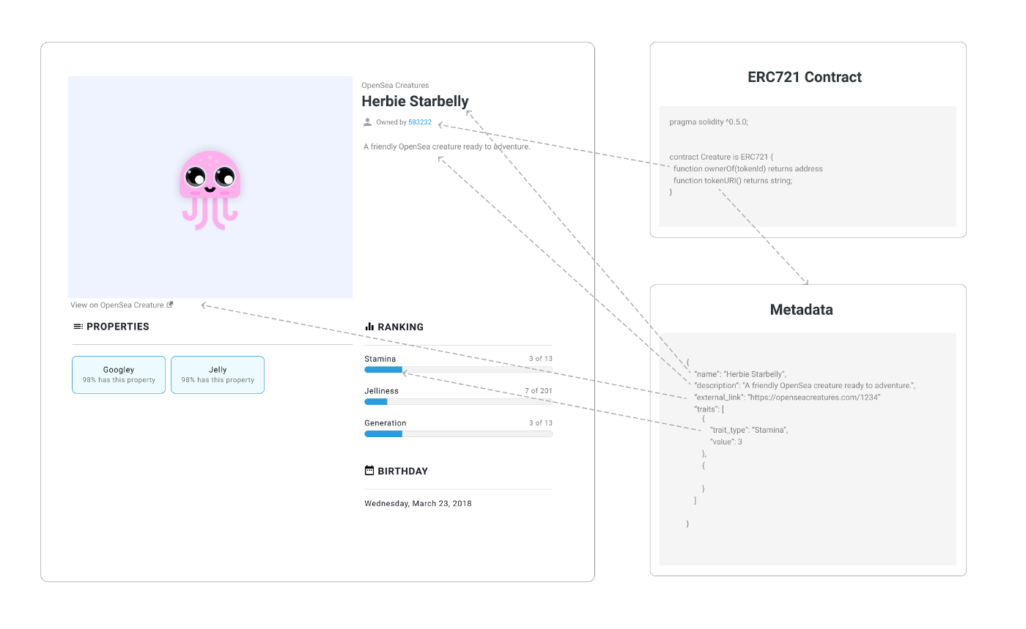
Metadata
Metadata is the core of an NFT, it is a JSON file that often contains: NFT’s name, Description, attributes, & link to the hosted image.
Uploading data to a blockchain can be expensive, for this reason NFTs store their images somewhere else and a link to this hosted image is included in the Metadata.

Slide 5
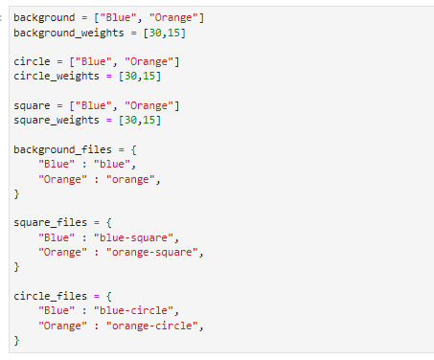
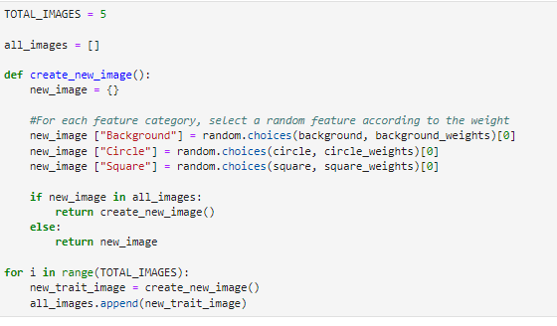
Code/Solutions
Using the random package in python, we were able to generate images, in which stores the metadata of the generated image into a JSON file

Slide 6
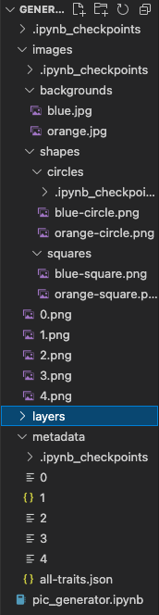






Results/Conclusions
We created a hierarchy which stores the images (traits) into subfolders and created a metadata folder to store the produced JSON file.
Backgrounds
Circles
Squares

Slide 7

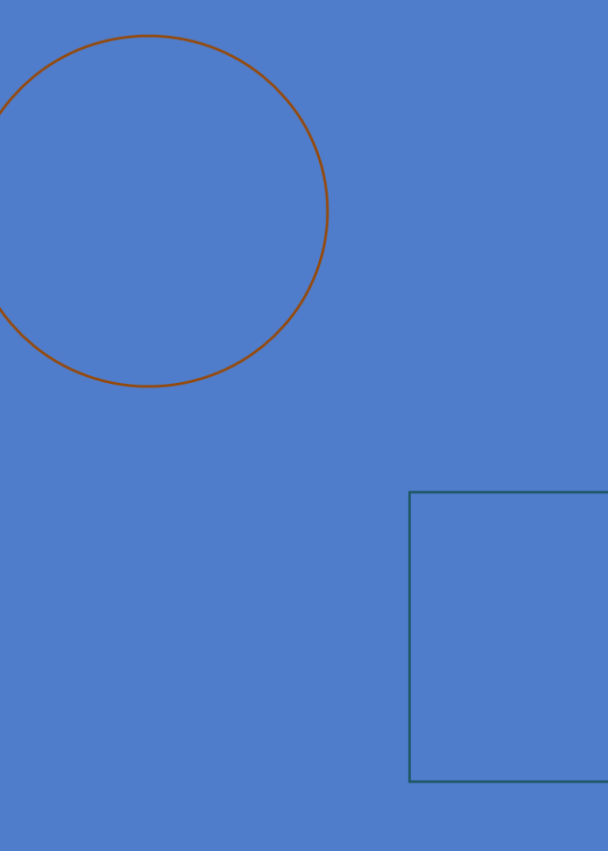

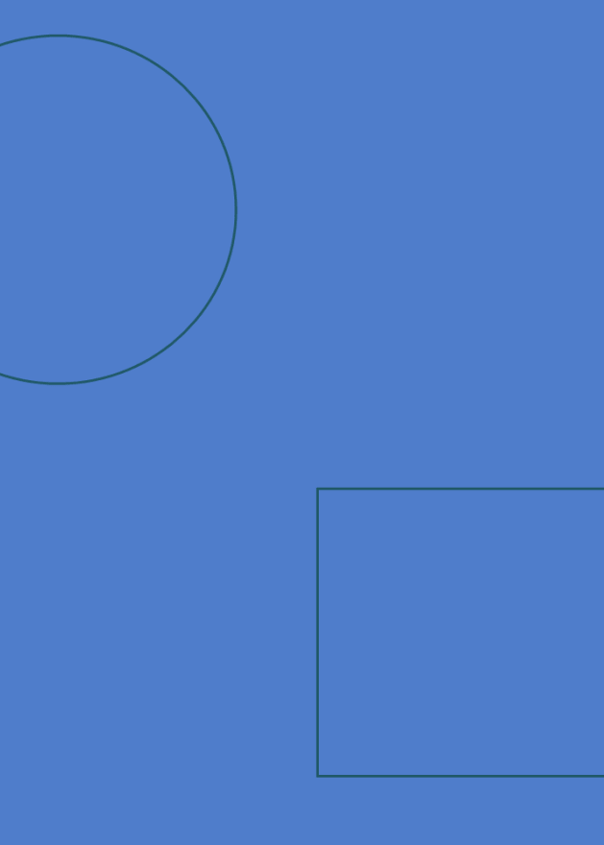

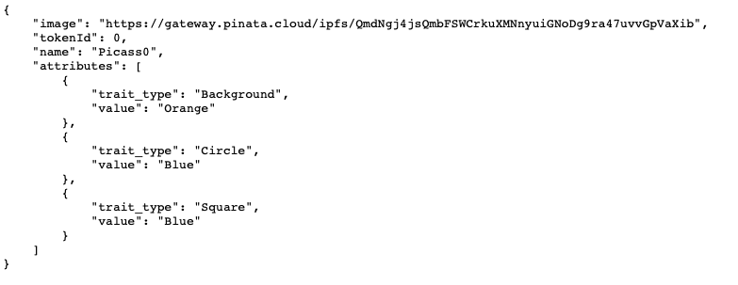
Picasso0
Picasso1
Picasso2
Picasso3
Picasso4

Slide 8
Technology used
Packages:
PIL from Image
Ipython from display
Random
Json
Jupyter Lab
Power shell
NexJS polygon
Metamass
Solidarty
Javascript
Open zeplin
Toxenonmics
Hard hat
Web3modal

