Slide 1
NFT Generation 21st century Picasso
The future of ART!

Slide 2
Summary

Slide 3
Data collection/Preparation

Slide 4
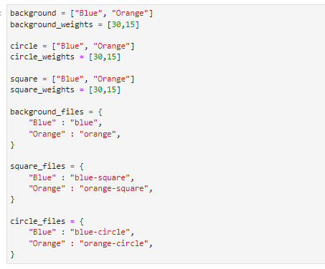
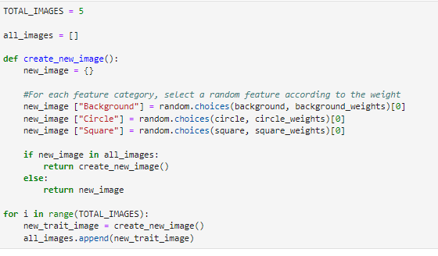
Code/Solutions
Using very simple code and the random package in python, we were able to generate images, in which the metadata is stored on the NFT

Slide 5
Results/Conclusions

Slide 6
Technology used
Packages:
PIL from Image
Ipython from display
Random
Json
Jupyter Lab
Power shell
NexJS polygon
Metamass
Solidarty
Javascript
Open zeplin
Toxenonmics
Hard hat
Web3modal

