Slide 1
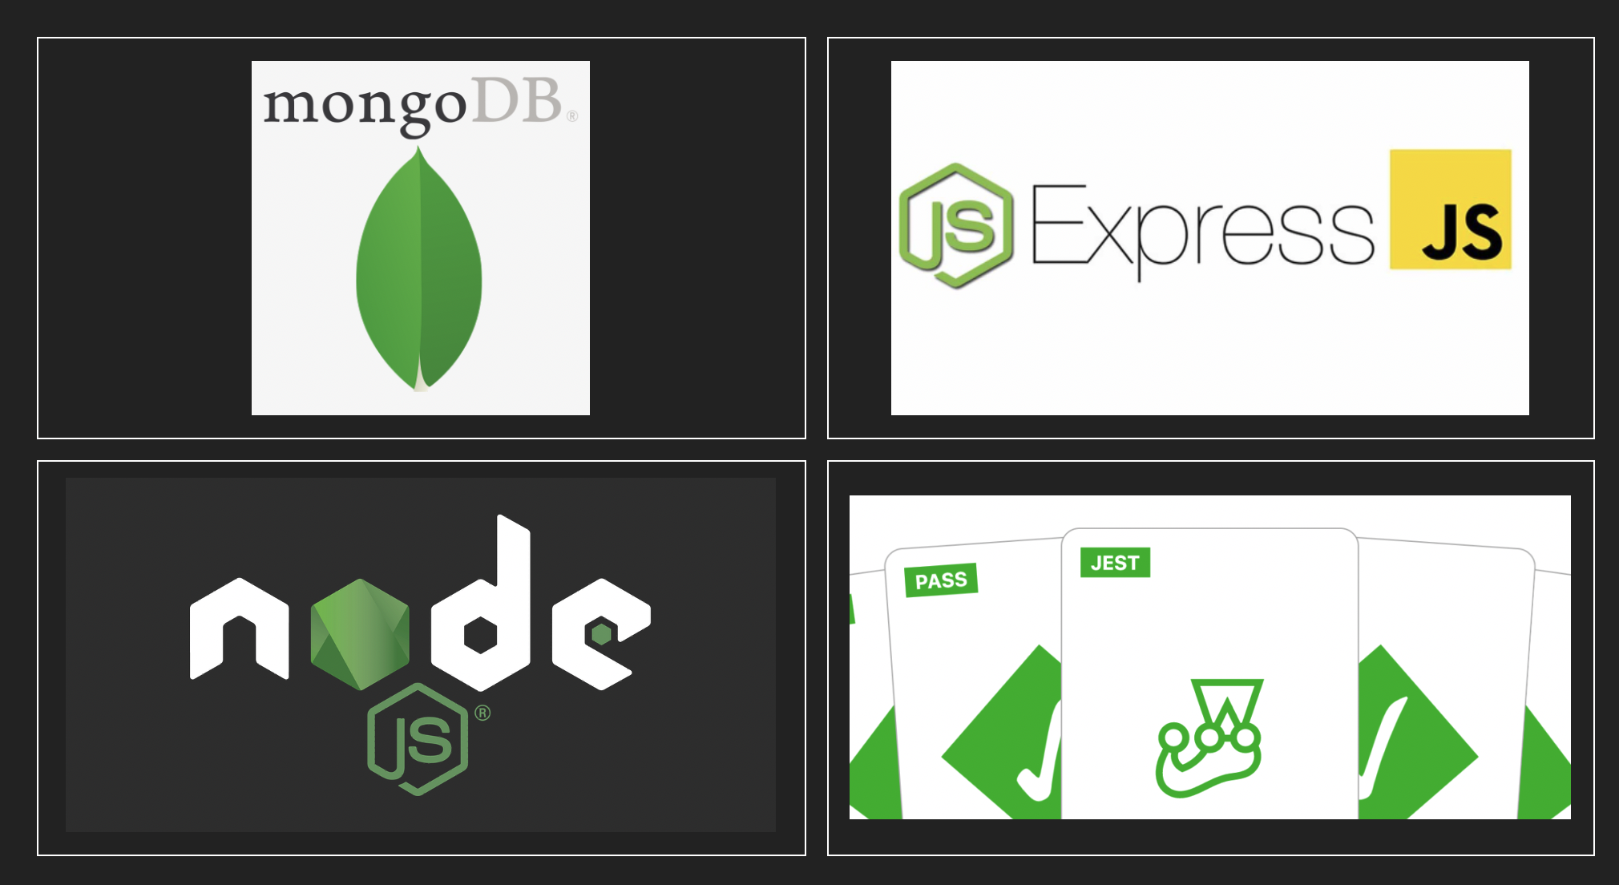

Slide 2

GITHUB REPO
https://github.com/robinpaul84/master-jest-expressjs-nodejs

Slide 3

What is Nodejs
Is a JavaScript run time built on Chrome V8 engine
Event Driven
Asynchronous and Single Threaded
Non Blocking I/O model
Lightweight and efficient

Slide 4

Yeah…Node is asynchronous
Main thread ( single thread) -------------------------------
WebAPI / NodeAPI (Multiple threads) --------------------------------------------
Event Queue ----------------------------------------------

Slide 5
Product Requirement
Web Server for employees , lets start it running locally initially on port 8080
Endpoint for
Creating Employee
Deleting Employee
Get Employee by id
Get All Employees
Update Employee by id
Login Employee

Slide 6

Product/Test Requirement
Mongo DB NOSQL Database
Proper Error handling
Unit Test Wide Coverage
Integration Test and Reports

Slide 7

CreateEmployee
POST http://localhost:8080/api/contacts
{
"name":"robin",
"email": "robin@gmail.com",
"password": "sdfsdfsd"
}
{
"_id": "5eb020dedfa98ff0b4c8c791",
"name": "robin",
"email": "robin@gmail.com",
"password": "$2b$10$zyg.a6KkxdM08hHQdKDuwOtmhFjaBYKz4Pl1Yd7oxyRhLC5ol1Qw.",
"created_date": "2020-05-04T14:04:14.454Z",
"__v": 0
}

Slide 8
Login Employee
POST http://localhost:8080/api/contacts/login
{
"name":"robin",
"email": "robin@gmail.com",
"password": "sdfsdfsd"
}
{
"_id": "5eb020dedfa98ff0b4c8c791",
"name": "robin",
"email": "robin@gmail.com",
"password": "$2b$10$zyg.a6KkxdM08hHQdKDuwOtmhFjaBYKz4Pl1Yd7oxyRhLC5ol1Qw.",
"created_date": "2020-05-04T14:04:14.454Z",
"__v": 0
}
& auth-token

Slide 9
GetEmployee
GET http://localhost:8080/api/contacts/5eb020dedfa98ff0b4c8c791
{
"_id": "5eb020dedfa98ff0b4c8c791",
"name": "robin",
"email": "robin@gmail.com",
"password": "$2b$10$zyg.a6KkxdM08hHQdKDuwOtmhFjaBYKz4Pl1Yd7oxyRhLC5ol1Qw.",
"created_date": "2020-05-04T14:04:14.454Z",
"__v": 0
}

Slide 10
GetEmployees
GET http://localhost:8080/api/contacts/
[{
"_id": "5eb020dedfa98ff0b4c8c791",
"name": "robin",
"email": "robin@gmail.com",
"password": "$2b$10$zyg.a6KkxdM08hHQdKDuwOtmhFjaBYKz4Pl1Yd7oxyRhLC5ol1Qw.",
"created_date": "2020-05-04T14:04:14.454Z",
"__v": 0
},
{
"_id": "5eb021d7dfa98ff0b4c8c792",
"name": "amy",
"email": "amy@gmail.com",
"password": "$2b$10$hw5QVHBQUJQqtP0D8BjB5enhLSFqeSxCDnR7DDwNjodHFABnWBCdm",
"created_date": "2020-05-04T14:08:23.764Z",
"__v": 0
},
…
]

Slide 11

DeleteEmployee
DELETE http://localhost:8080/api/contacts/5eb020dedfa98ff0b4c8c791
{
"_id": "5eb020dedfa98ff0b4c8c791",
"name": "robin",
"email": "robin@gmail.com",
"password": "$2b$10$zyg.a6KkxdM08hHQdKDuwOtmhFjaBYKz4Pl1Yd7oxyRhLC5ol1Qw.",
"created_date": "2020-05-04T14:04:14.454Z",
"__v": 0
}

Slide 12
UpdateEmployee
PUT http://localhost:8080/api/contacts/5eb020dedfa98ff0b4c8c791
{
"gender": "male"
}
{
"_id": "5eb020dedfa98ff0b4c8c791",
"name": "robin",
"email": "robin@gmail.com",
"password": "$2b$10$zyg.a6KkxdM08hHQdKDuwOtmhFjaBYKz4Pl1Yd7oxyRhLC5ol1Qw.",
"created_date": "2020-05-04T14:04:14.454Z",
"__v": 0
}

Slide 13

Login Employee
Create employee
login employee
Jwt token
update employee
Jwt token

Slide 14
Testing
Unit Test
Component Test
Integration Test
TDD – Test Driven Development

Slide 15
Test Private Functions
npm install babel-plugin-rewire --save-dev
npm install babel-jest --save-dev
.babelrc -> {
"plugins": ["babel-plugin-rewire"]
}

Slide 16
Integration Test Cases
Test | Function | Scenario | Expected Status
1 | Create Employee | Pass a valid body | 201
2 | Create Employee | Missing password | 400
3 | Create Employee | Already existing email | 400
4 | Get Employees | Valid contents in database | 200
5 | Get Employees | Database empty | 404
6 | Get Employee by ID | Pass a valid id | 200
7 | Get Employee by ID | Id not present in database | 404
8 | Get Employee by ID | Id with invalid format(not 16 char string / 32 char hex) | 500
9 | Delete Employee by ID | Pass a valid id | 200
10 | Delete Employee by ID | Invalid id | 404
11 | Update Employee by ID | Valid id and body | 201

Slide 17
Integration Test Cases
Test | Function | Scenario | Expected Status
12 | Update Employee by ID | Invalid ID | 400
13 | Login Employee | Valid body | 201
14 | Login Employee | Wrong Email | 400
15 | Login Employee | Wrong Password | 400

