Slide 1
Fundamental Ajax
Jason M. Carey
ITT

Slide 2
Overview
Brief Introduction to Ajax
Architectural Styles
Survey of Popular Libraries
Real World Considerations

Slide 3
Why Ajax?
HTML and HTTP are weak
Limited user experience
Coarse-grained Updates
Why HTML and HTTP?
Pervasiveness of Internet
No software installation
Ajax enables browsers-based Active Content
Alternative technologies
Flash/Flex
Microsoft Silverlight
Adobe AIR
JavaFX

Slide 4
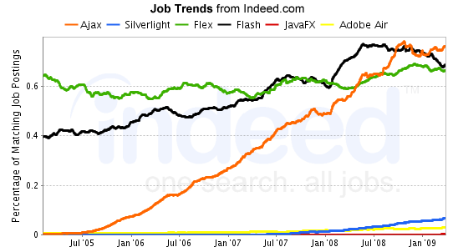
Browser Technology Trends
Graph generated by www.indeed.com

Slide 5
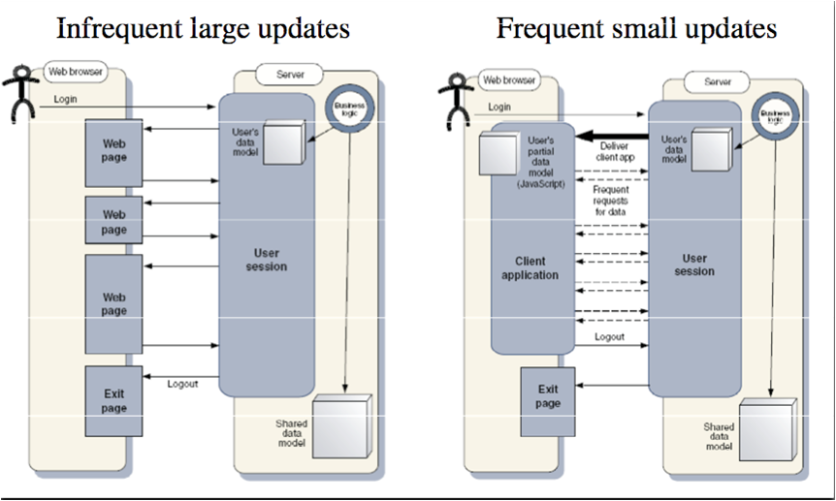
Web Apps: Traditional vs. Ajax Enabled
Diagrams from Ajax in Action by Dave Crane et. al., Manning Press

Slide 6
Revealing the Magic of Ajax
JavaScript
Define an object for sending HTTP requests
Initiate Request
Designate an anonymous response handler function
Initiate GET/POST request
Send data
Handle Response
Wait for readystate code of 4 (e.g., response ready)
Extract payload from response
Do something with result
HTML
Load JavaScript
Designate control to initiate request

Slide 7
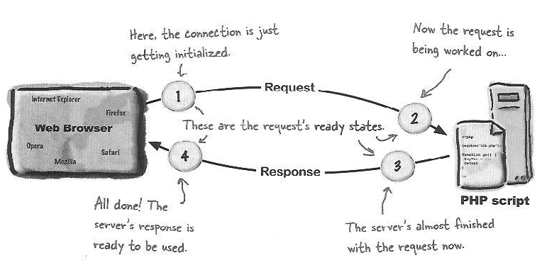
What are Ready States?
Diagram from Head Rush Ajax by Brett McLaughlin, O’Reilly Media Inc.

Slide 8
Hello Ajax Example
Define a Request Object (ajax-utils.js)
/* Creates and returns a new request object */
function getRequestObject() {
if(window.XMLHttpRequest) { // FF, Safari, IE7/8, Chrome
return new XMLHttpRequest();
} else if(window.ActiveXObject) { // IE 5.5/6
return new ActiveXObject(“Microsoft.XMLHTTP”);
} else {
return null; // fails on older and nonstandard browsers
}
}

Slide 9
Hello Ajax Example
Initiate Request (ajax-utils.js)
/* Makes Ajax GET request to static HTML page */
function sendRequest() {
// create local request object
var request = getRequestObject();
// assign response handler
request.onreadystatechange = function() { handleResponse(request) };
// open connection
request.open(“GET”, // request type
“HelloAjaxMessage.html”, // server resource
“true” // we want asynchronous request
);
// make request
request.send(null); // POST data, null for GET
}

Slide 10
Hello Ajax Example
Handle Response (ajax-utils.js)
/* Response handler that displays the response in an alert box */
function handleResponse(request) {
// response is complete and successful
if(request.readyState == 4 && request.status == 200) {
alert(request.responseText); // text of response
}
}

Slide 11
Hello Ajax Example
HTML (HelloAjaxExample.html)
Load JavaScript
<head>
…
<script type=“text/javascript” src=“ajax-utils.js”></script>
</head>
Designate Control
<body>
<form action=“#”>
<input type=“button” value=“Show Message” onclick=“sendRequest()” />
</form>
</body>
You want to use XHTML
and a DOCTYPE. Why?

Slide 12
Hello Ajax Example
Server Resource (HelloAjaxMessage.html)
Welcome to the Land of Ajax!

Slide 13
Hello Ajax Example Demo

Slide 14
Architectural Styles
Content-Centric Ajax
Server sends HTML to be displayed
Client inserts content into page
Client may apply CSS to received content
Good when server data is tightly coupled with a specific HTML form on client
Data-Centric Ajax
Server sends raw data to client
Popular data formats: XML, JSON, Text
Server code can provide format based on request
Client parses the data and builds HTML
Good when server data is used in different ways by different pages
Notes:
Ajah, Ajax, Ajaj, Ajat

Slide 15
Data-Centric Format Comparison
Use “text/xml” for response content type
Can apply XML validation before sending to client
XML
<?xml version=“1.0” encoding=“UTF-8”?>
<customers>
<headings>
<heading>First Name</heading>
<heading>Last Name</heading>
</headings>
<customer>
<firstName>John</firstName>
<lastName>Doe</lastName>
</customer>
<customer>
<firstName>Jane</firstName>
<lastName>Doe</lastName>
<customer>
</customers>

Slide 16
Data-Centric Format Comparison
JSON
{
headings: [“First Name”, “Last Name”],
customers: [[“John”, “Doe”], [“Jane”, “Doe”]]
}
Use JavaScript eval function on response data
var jsObj = eval( “(“ + jsonDataStr + “)” );
Use “text/javascript” for response content type
Most Common format used for data-centric Ajax
Not as verbose as XML
Easier to parse than XML and Text
No standard for validation
Tedious to create on server, use a library!

Slide 17
Data-Centric Format Comparison
Text
First Name#Last Name
John#Doe
Jane#Doe
Use “text/plain” for response content type
Parse using JavaScript String.split() and regular expression support
Requires custom client/server routines for data parsing/generation

Slide 18
Survey of Popular Ajax Libraries
Ajax flourished due to powerful libraries
Don’t forget that Ajax is a BIG kludge!
JavaScript is a non-standard technology
IE uses Microsoft JScript
JavaScript and JScript provide features outside of ECMAScript
Many common headaches in client-side web development
Event registration/bubbling, DOM element styling, viewport
To get an idea of differences in event handling, visit:
http://www.quirksmode.org/dom/events/index.html
Ajax libraries alleviate many of the headaches by providing a cleaner and more convenient API

Slide 19
Ajax Library: AjaxTags
Goal
Provide Ajax capabilities to Java-based web applications without requiring the developer to have much knowledge of JavaScript.
Background
Leverages JSP custom tags to simplify the use Ajax
Built on top of Script.aculo.us and Prototype libraries
http://ajaxtags.sourceforge.net

Slide 20
Ajax Library: AjaxTags
Pros
Very low learning curve
Requires limited knowledge of JavaScript
Moderately powerful
Autocomplete, Tab Panel, In-place Editor, Tree, …
Source code available: http://sourceforge.net/project/showfiles.php?group_id=140499
Cons
Moderately difficult to extend
Moderately powerful
Requires use of JSP technology on server

Slide 21
Ajax Library: JSON-RPC
Goal
Simplify Ajax calls by enabling client code to act as though it is calling a method on the server (not accessing a URL).
Background
Standard for remote calls with JSON data
http://json-rpc.org
jabsorb -- popular implementation
http://jabsorb.org/Download
Other implementations
http://json-rpc.org/wiki/implementations
Alternative RPC-to-Java libraries
Direct Web Remoting (http://directwebremoting.org)
Google Web Toolkit (covered later)

Slide 22
Ajax Library: JSON-RPC
Pros
Simpler client syntax
No explicit use of XmlHttpRequest object
Simpler server syntax
Implement regular methods, not doXXX methods
Can pass and return data directly
Primitives and “simple” objects
Lightweight alternative to GWT, but much less flexible
Cons
Requires Java on the server
Requires extra code on both the client and server
Only provides an RPC mechanism, no widgets

Slide 23
Ajax Library: Prototype
Goal
Provide powerful extensions to JavaScript and a convenient API for general purpose Ajax apps
Background
One of the earliest Ajax libraries
Arguably the most popular
AjaxTags and Script.aculo.us built on top of Prototype
Supports FF 1.5+ and Chrome
http://www.prototypejs.org/download

Slide 24
Ajax Library: Prototype
Pros
JavaScript Extensions
An abundance of syntactic sugar
Powerful methods
methodize, curry, wrap
Great support for JavaScript OOP
Ajax Capabilities
Requester, Updater, PeriodicUpdater
Response properties: responseText, responseXML, responseJSON
Cons
Extends native JavaScript types (e.g., Array, Object)
No native widgets (look at Script.aculo.us Library)

Slide 25
Ajax Library: Prototype
Ajax with and without Prototype
With Prototype
new Ajax.Request( “some-url”, { onSuccess: someHandler } );
With basic JavaScript
function getRequestObject() {
if(window.XMLHttpRequest) {
return new XMLHttpRequest();
} else if(window.ActiveXObject) {
return new ActiveXObject(“Microsoft.XMLHTTP”);
} else { return null; }
}
function sendRequest() {
var request = getRequestObject();
request.onreadystatechange = function() { someHandler(request); }
request.open(“GET”, “some-url”, true);
request.send(null);
}

Slide 26
Ajax Library: jQuery
Goal
Provide powerful DOM manipulation utilities and a convenient API for general purpose Ajax apps
Background
Mixes CSS selectors with XPath syntax to provide easy access and manipulation of the DOM
Promotes “Unobtrusive” JavaScript and Method Chainability
http://docs.jquery.com/Downloading_jQuery

Slide 27
Ajax Library: jQuery
Pros
Leverages CSS and XPath syntax
Extremely powerful DOM manipulation utilities
Well-designed (but few) widgets
Tabbed Panels, Accordian, Date Picker, a few others
Extensible framework
Hundreds of plug-ins published
Very active community
Cons
Poor OOP support
Few widgets
Backwards Compatibility Issues

Slide 28
Ajax Library: GWT
Goal
Implement cross-browser Ajax applications using Java
Background
Can write both client-side and server-side code in Java
Client-side uses an API similar to Swing
Cross-compiles Java into optimized JavaScript that automatically works across all major browsers
http://code.google.com/webtoolkit/download.html

Slide 29
Ajax Library: GWT
Pros
No JavaScript syntax errors
Can use complex Java on the client
Can send complex Java types to/from the server
Standalone test environment
Support by major company
Cons
Less incremental
Big learning curve
Nonstandard approach to HTML and JavaScript
Only for Java developers
Difficult to tweak generated JavaScript

Slide 30
Real World Considerations
Ajax Development Tools
For Firefox, use Firebug
Debugs JavaScript
Shows DOM (including dynamic values) and CSS
For Internet Explorer, try
IE Web Developer
DebugBar
FirebugLite
For CSS, use TopStyle Lite
Visual previews of styles
Free version is better than DW and Eclipse plug-ins
For HTML Validation, use CSE HTML Validator
Free version is better than DW and Eclipse plug-ins

Slide 31
Real World Considerations
Only use JavaScript/Ajax if you need it
What browsers will your application support
Why is JavaScript/Ajax necessary to the application
What will be custom JavaScript vs. leveraged by library?
Good practice not to mix libraries
Caching Considerations
Browsers can cache responses for GET requests
Solutions
POST requests should not be cached by browser
Append “Cache Busting” parameter to query string
Cache Control response headers

Slide 32
Real World Considerations
Network Considerations
Request takes too long
Employ timeouts and abort/retry the request after a specified time period has elapsed
Error Response received
Client-induced errors (e.g., wrong URL/parameters)
Server-side errors (e.g., permission problem)
Optional Considerations
Session Management
How to handle expired sessions?
Common Browser Functions
Do you need to support page reloads?
What about the “Back” button?
And Bookmarking?

