Slide 1
Recruiting strategies
Jason M. Carey
Asymmetrik

Slide 2
A person’s desire to work for Asymmetrik depends on their location in the company’s social network.

Slide 3
E
E
E
It all starts with us.

Slide 4
+1
+1
+1
E
E
+1
+1
E
+1
+1
+1
We have influence over those that have worked with us.

Slide 5
R
R
R
+1
+1
+1
R
R
E
E
+1
+1
R
R
E
+1
+1
+1
R
R
R
R
Our reputation exceeds our direct relationships.

Slide 6
C
C
C
C
C
C
C
C
C
C
R
R
R
+1
C
+1
+1
C
R
R
C
E
E
+1
+1
R
C
R
E
C
C
+1
+1
C
C
+1
R
R
C
C
R
R
C
C
C
C
C
C
C
C
But our reputation extends only so far.

Slide 7
Different parts of our social network require different recruiting strategies.

Slide 8
C
C
C
C
C
C
C
C
C
C
R
R
R
+1
C
+1
+1
C
R
R
C
E
E
+1
+1
R
C
R
E
C
C
+1
+1
C
C
+1
R
R
C
C
R
R
C
C
C
C
C
C
C
C
We can influence those closest to us by reminding them of our accomplishments and what our company values.

Slide 9
Recruiting Strategy 1: Award Lanyard Pins

Slide 10
C
C
C
C
C
C
C
C
C
C
R
R
R
+1
C
+1
+1
C
R
R
C
E
E
+1
+1
R
C
R
E
C
C
+1
+1
C
C
+1
R
R
C
C
R
R
C
C
C
C
C
C
C
C
We can influence those outside our immediate social network by showcasing the projects we lead.

Slide 11
Recruiting Strategy 2: Host Open Houses

Slide 12
What about everyone else?

Slide 13
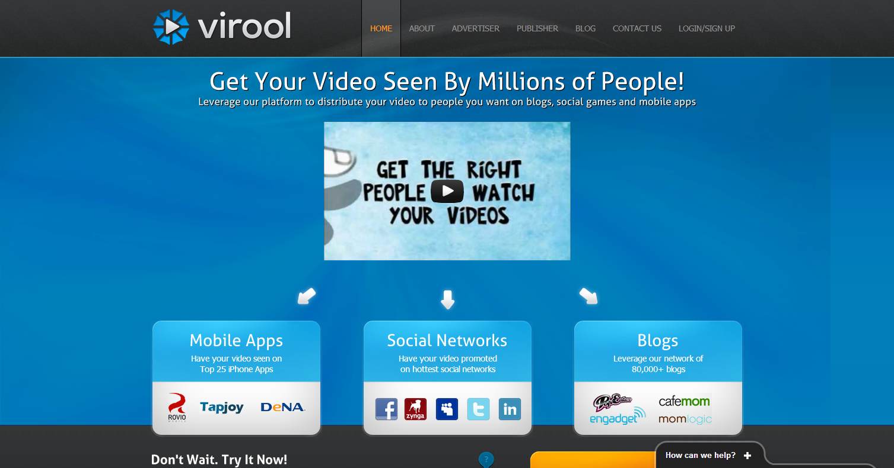
Recruiting Strategy ³: Go Viral

Slide 14
Thank You

