Slide 1
Reconciliation Process Improvement

Slide 2

Agenda
Process
AS IS
TO BE
High Level Design
Dependencies
Time Line
Resources
Business Impact
Cost and Implementation Plan

Slide 3
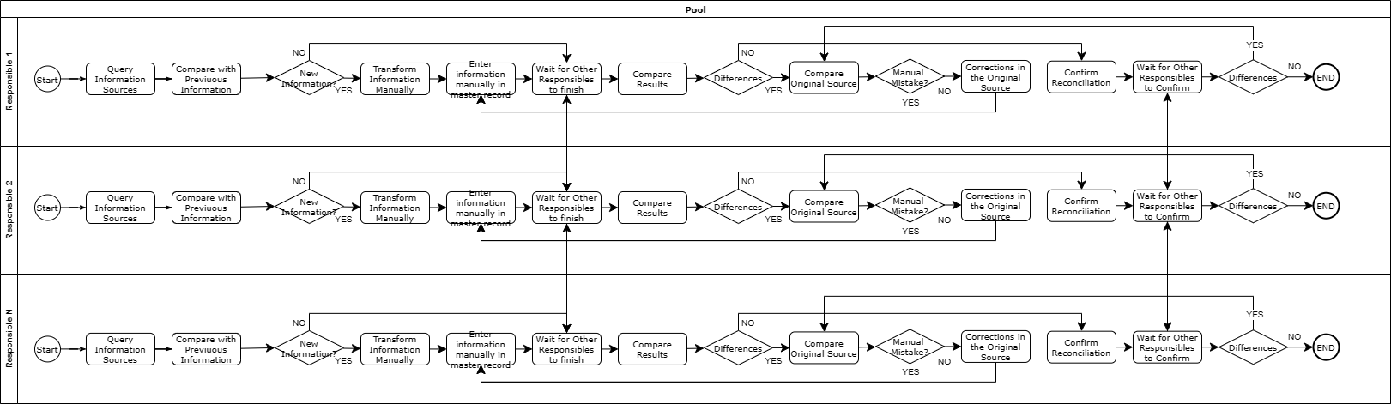
Process AS IS

Slide 4
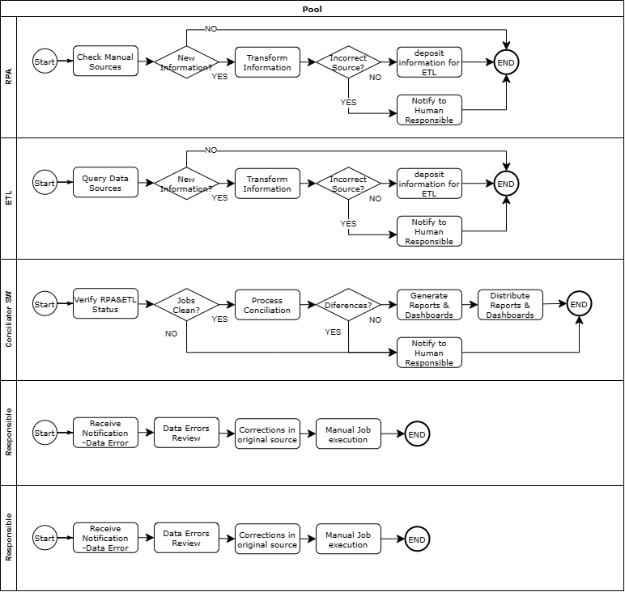
Process TO BE

Slide 5
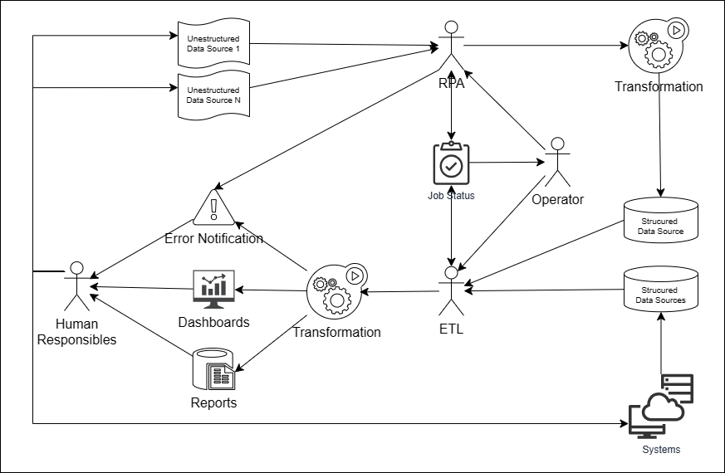
High Level Design

Slide 6















Dependencies
Processing and storage capacity.
Structured Data Sources Availability.
Technology and Team Selection
Unstructured/Manual Data Sources Processing Definition
Budget and Time
Reports & dashboards Definition.

Slide 7
Time Line

Slide 8
Resources
Scrum Master
Product Owner
RPA Team Leader
RPA Staff 1
Steering committee
RPA Staff 2
Developer Team Leader
ETL/DEV Staff 1
ETL/DEV Staff 2
Change and engage Leader
Staff Analyst 1
Staff Analyst 2
Steering Committee: Sponsor, and decision makers
Scrum Master: Planning Leading and Support
Change and Engage Manager: Lead in charge of communication and engagement
RPA Leader: Leader in charge of Technical RPA team
Developer Leader: Leader in charge of Technical ETL team
Product Owner: Lead in charge to define and maintain the backlog, and Analyst team

Slide 9
Business Impact
Precision: The RPAs, ETLs and Reconcilliator software will not make mistakes copying Information, and the Information transformation will be consistent as a repeatable process.
Improved efficiency: The processes will run as expected and the manual intervention will be focused on real issues, the information will be available for interested as soon as it will be generated
Timely Information: The automated processes will run faster and can be run as often as the Information is generated then the product dashboards and reports will be more available and updated, and will be the same for all of interested
Resource optimization: The people will focus on real issues and not use their time in manual and repetitive tasks, then their time will be more available to be used on analytic and more productive tasks
Risk reduction: No manual Information entry means less human errors, computer scheduling means no forgotten, automatic processing means less human dependency and more confidence about the information processing methods

Slide 10
Costs
Supuestos:
Resources:
4 Staff Engineers Full Time 1500 USD x 9 months = 54000 USD
2 Team Leader Engineer Full Time 2000 USD x 9 months = 36000 USD
2 Analyst Full Time 1500 USD x 9 months = 27000 USD
1 Engage and Change Lead ¼ Time 2000 USD x 9 months = 4500 USD
1 Scrum Master Full Time 2500 USD x 9 months = 22500 USD
1 Product Owner Full Time 2500 USD x 9 months = 22500 USD
TOTAL 146500 USD
Capacity: (It is expected to be provided/estimated by IT)
Staff equipment To Be Confirmed
Processing To Be Confirmed
Storage To Be Confirmed
Licensing To Be Confirmed

Slide 11

Thank you!

