Slide 1









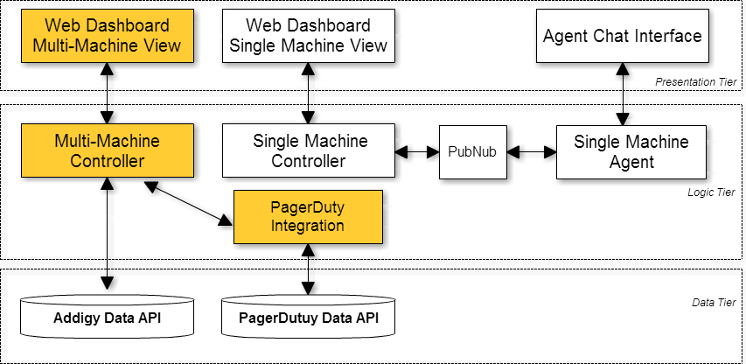
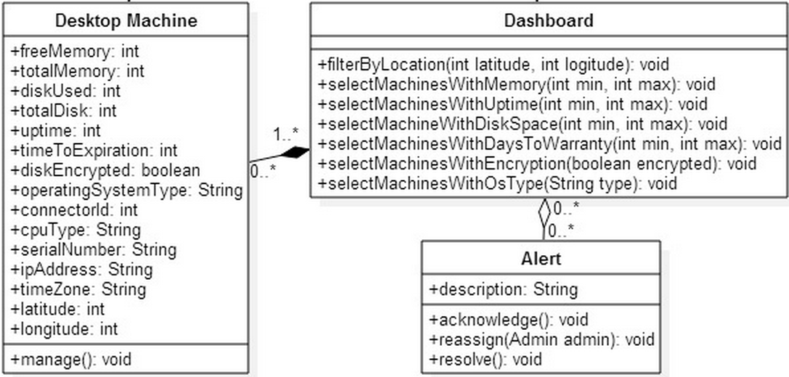
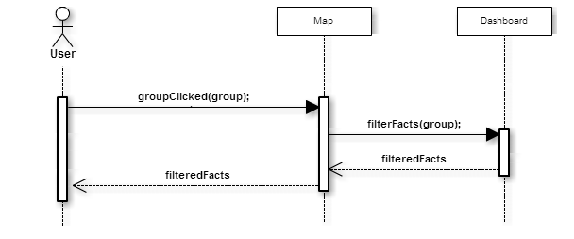
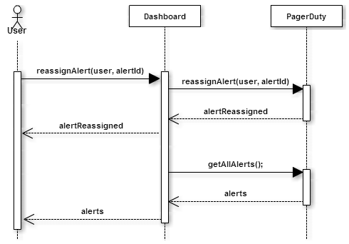
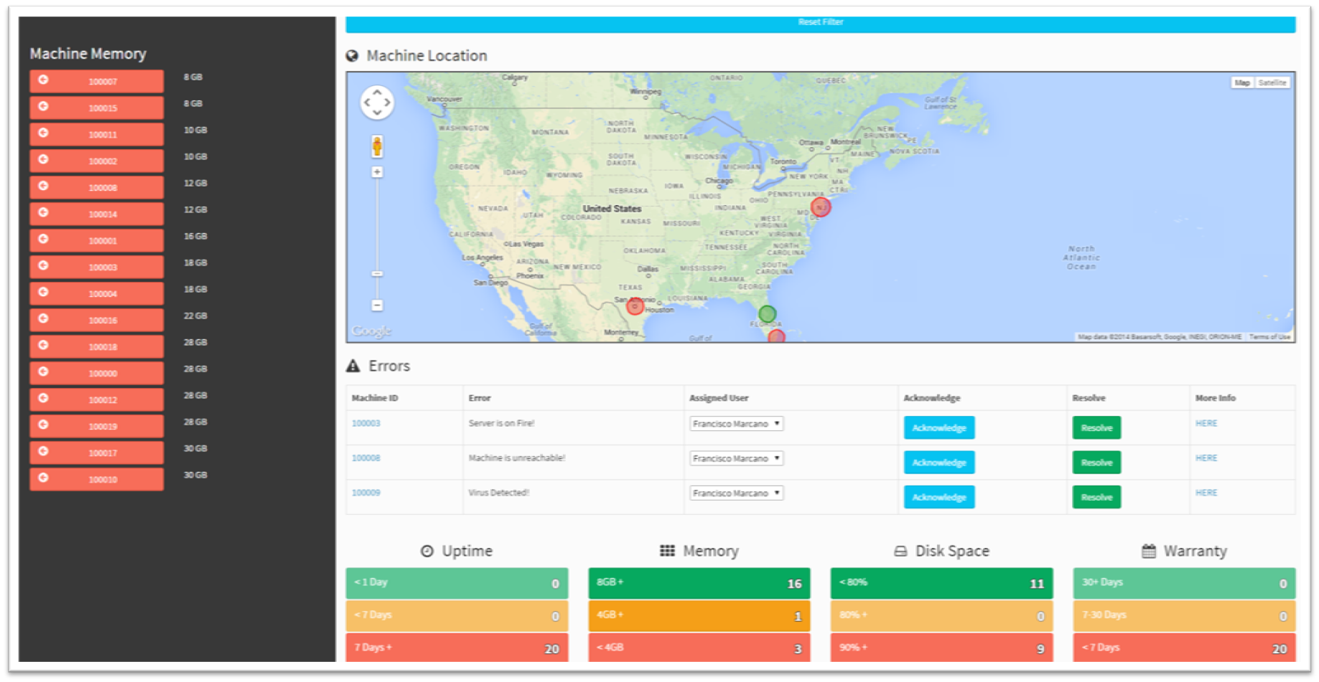
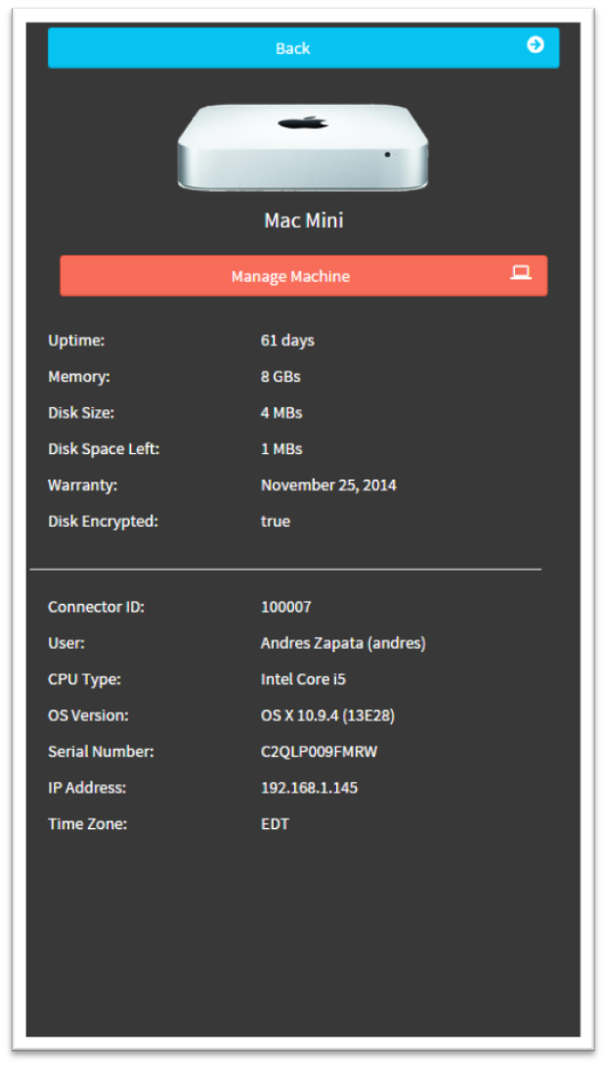
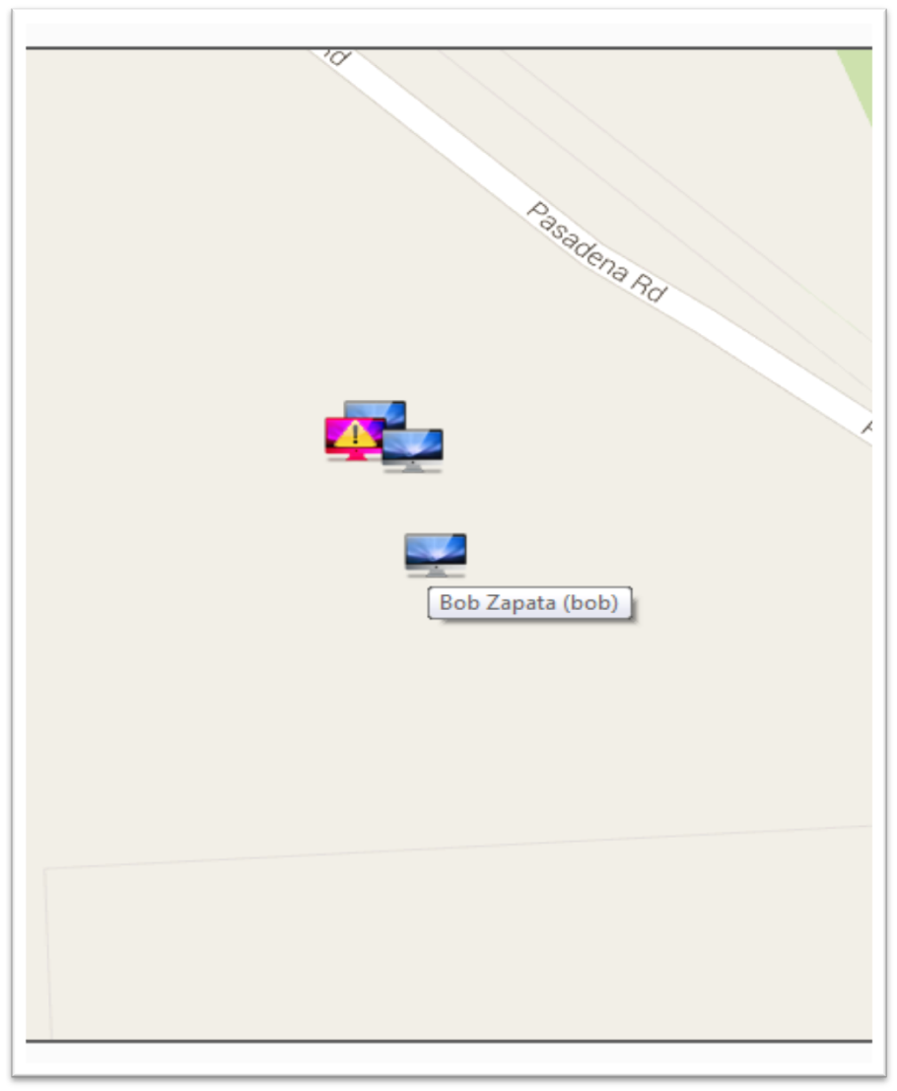
Senior Project, 2014, Fall
Web Dashboard for Addigy
Student: Francisco Marcano, FIU
Mentor: Jason Dettbarn, Addigy
Instructor: Masoud Sadjadi, FIU
Problem
Current System
Requirements
Large IT Management Solutions record vast amounts of information regarding the machines that they are currently monitoring.
In order to look at critical information about a machine, they need to parse through log files and meticulously look at data that might be out of normal ranges.
Some solutions out there provide extra functionality that some users find difficult to use or do not need for their monitoring needs.
Most solutions do not provide information regarding specific Macintosh machine assets that companies with larges amount of these machines would find useful.
The Addigy platform is a cloud based IT management solution which collects information about machines that are currently running the special agent provided.
The Addigy platform provides API endpoints to access all of this data securely.
PagerDuty is an alerting platform which provides email, phone, and mobile application alerts based on a service that is created by the user. This system also provides API endpoints for Triggering, Acknowledging, Resolving, and Re-Assigning alerts.
FUNCITONAL REQUIREMENTS
The system shall…
Show what status the computer groups are in from the map (green/healthy or red/issue).
Show how many machines have encrypted disk or are unencrypted.
Show the uptime of the machines.
Show Apple warranty data such as whether the machines are still under warranty, warranty expiring within 30 days, or out of warranty.
Display computers geographically.
Display alerts based on critical machine states.
Allow users to mark alerts as acknowledged.
Allow users to mark alerts as resolved.
Allow users to re-assign alerts to other Admin users.
System Design
Object Design
Implementation
Figure 3 – Location Filter
Sequence diagram designed by Francisco Marcano
This diagram depicts when a user clicks on a map group. The main modules are all filtered based on the machines currently displayed on the map.
Figure 1 – System Design
Color coded sections were implemented by Francisco Marcano
As a new project, we had the liberty to start from an idea, to a complete system. This uniqueness, allowed us to carefully choose the system design from scratch.
We opted to follow a MVC pattern design, proven to handle large amounts of data in an organized way. This allowed us to concentrate on structuring our code first and allowing our interfaces to benefit from the data provided by our models.
The following are the frameworks and libraries I used in my implementation in order to provide the functionalities needed by the client:
AngularJS
A MVC framework for JavaScript, used for creating rich web applications. Used for our main application
PagerDuty
A framework used for alerting users through a variety of formats. Used for machine alerting
Google Maps API
A set of JavaScript libraries used for interacting with the Google Maps application. Used in the map module
Figure 2 – Object Design
Object definition designed by Francisco Marcano
Using the data provided by the Addigy Web API, I decided to create the following objects which would store some of the data provided.
Using the information provided I was able to create a set of modules each of which use special filtering algorithms in order to display the information necessary to the user based on the action performed.
Finally the Alerting integration with PagerDuty shows what features have been integrated into the new system.
All of these together make up the new system designed to provide users with easy-to-digest data and functionality.
Screenshots
Figure 4 –Alert Reassign
Sequence diagram designed by Francisco Marcano
This diagram depicts when a user clicks on an alert’s assigned user dropdown, and selects another user. At that point, the alert is escalated to the selected user.
MVC and AngularJS
In order to create a robust system which would be expandable in the future, I opted to use AngularJS as our framework of choice. This framework enforces an MVC approach to Web Development which is needed in web applications that handle large amounts of data.
Verification
Due to the nature of this application, I had to create a lot of test data in order to be able to cover all possible scenarios. For this reason, I developed a small Java application that generates randomized machine data and exports it into JSON format.
Using a local server, all testing was done first hand. The main reason for this was that functional requirements were being created dynamically, as our client did not have a complete picture in mind as to what features he needed in the application. By doing this type of testing, it allowed me to see results and quickly alter implementation based on requirements that I thought would fit our client’s needs.
Extensive use of the Google Chrome’s Developer Tools was used in order to check a variety of errors including: JavaScript parsing errors, network errors, CSS faulty rules, runtime slowdowns using the Audit tool, etc.
Summary
Figures 5-7 – Dashboard Screenshots
Large companies need a way to see their computer’s assets (especially Macs) in a light weight, user friendly format.
My main contribution to the project was…
My proposed solution allows companies to achieve this by providing them with the following features:
Displaying machine asset information in an intuitive and friendly way.
Allow the users to see machine groups based on important assets such as: warranty, ram, disk space, etc.
Allow the users to see and filter machine groups based on their location. Also, allow them to click on the filtered machines for complete list of machine assets.
Allow the users to see critical machine alerts and allow them to reassign, acknowledge and resolve them.
Acknowledgement
The material presented in this poster is based upon the work supported by Francisco Marcano. I am thankful to the help that I received from my teammate Javier Carmona and my mentor Jason Dettbarn.

