Slide 1
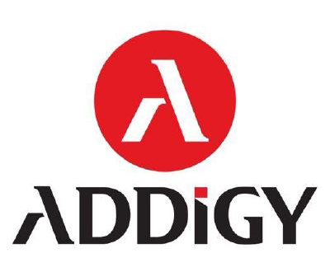

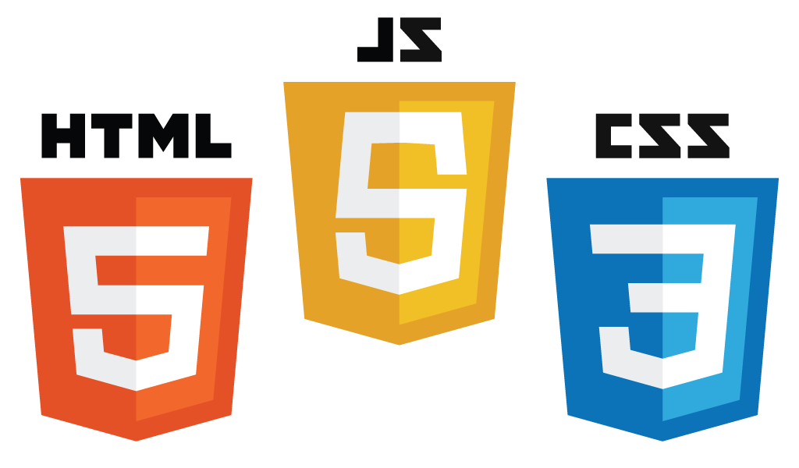



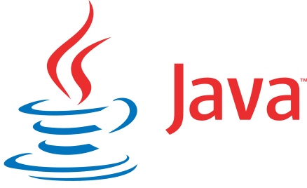

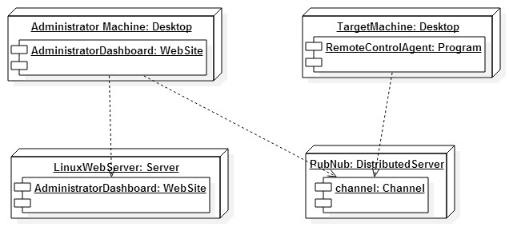
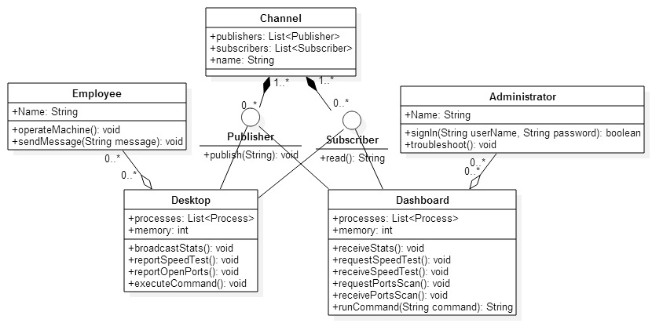
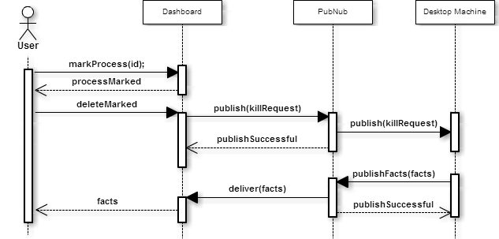
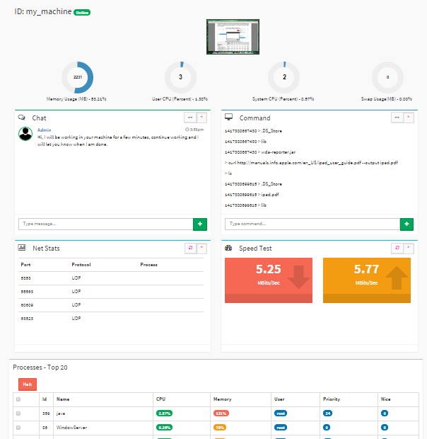
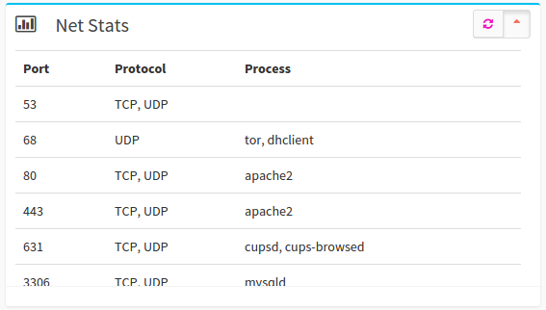
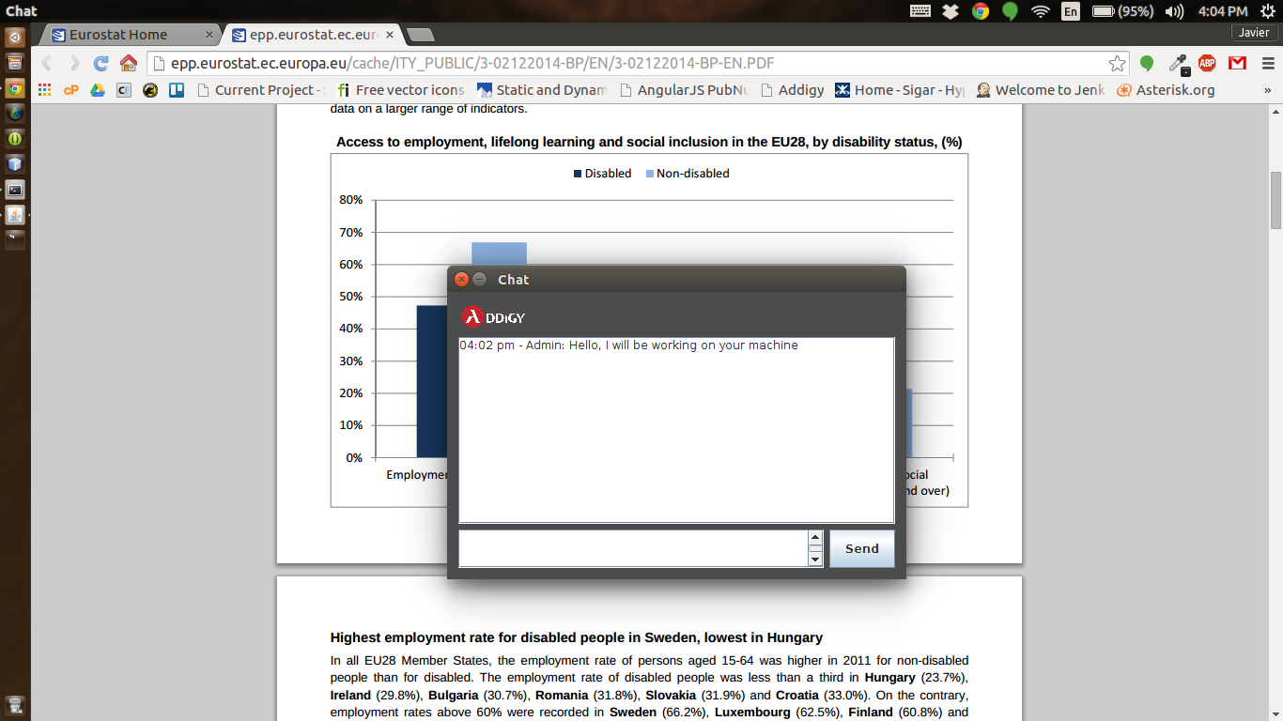
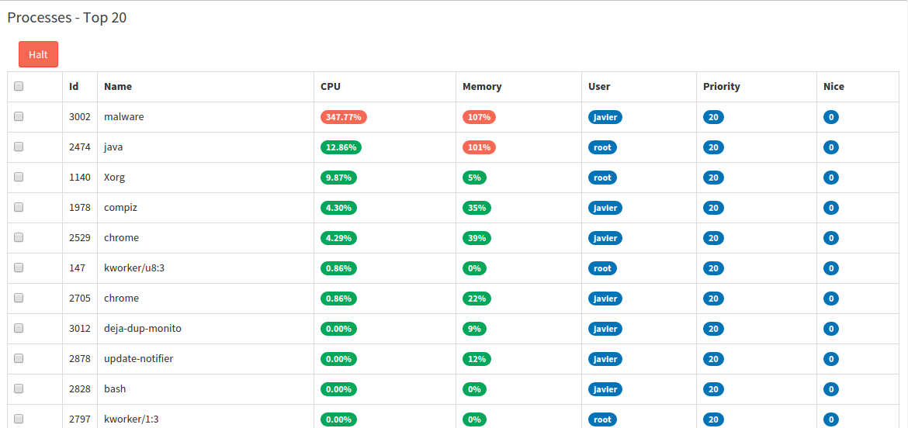
School of Computing & Information Sciences
Senior Project, 2014, Fall
Web Dashboard for Addigy
Student: Javier Carmona Florida International University
Mentor: Jason Dettbarn, Addigy
Instructor: Masoud Sadjadi, Florida International University
1
Problem
2
Current System
3
Requirements
Many remote control tools are disruptive to productive employees.
Most remote control tools are difficult and time consuming to integrate for organizations.
Existing tools require extensive training.
There are few remote control systems with support for Mac OS platform.
Addigy currently has infrastructure to handle the behind the scenes deployment of software into registered machines. This system takes advantage of that infrastructure in order to easily deploy the software necessary for it to be usable in the machines being remote controlled.
PubNub provides a scalable infrastructure for sending data across different machines. This is used to handle communication between the administrator dashboard and the remote controlled machine.
The system shall be able to show real time data for a single computer, including memory usage, CPU utilization, and swap usage.
The system shall show the different processes running on a single computer.
The system shall be able to start or stop different processes running on a single computer.
The system shall be able to run and report bandwidth stats such as download and upload speeds.
The system shall report what ports are being used in the target machine and report the ports with the used protocols.
4
System Design
5
Object Design
6
Implementation
A Publish-Subscribe architecture was used to handle one-to-many communication between the target machine software, written in Java, and administrator dashboards, using AngularJS from a browser.
Kill Process:
7
Verification
Manual exploratory testing was used to test the different components of the system.
8
Summary
9
Screenshots
Contribution to the Addigy Dashboard:
A web dashboard to easily identify, troubleshoot, and fix problems on a targeted machine.
Software that run on a targeted machine silently reporting machine specific information and handling tasks assigned by the IT professional maintaining or troubleshooting the system.
Platform independence for every feature of the system.
Bandwidth test and reporting.
A chat system in order for the administrator using the dashboard to communicate with the user that is utilizing the target machine.
The agent running on the target machine uses a factory architecture in order to achieve platform independence by having a factory object generate different commands depending on the platform of the machine.
The dashboard is built using HTML5, JavaScript, CSS3, Bootstrap, and AngularJS, using a Model-View-Controller architecture in order to keep the dashboard up to date.
Acknowledgement
I am thankful to the help that I received from my group member Francisco Marcano and mentor Jason Dettbarn

