Slide 1
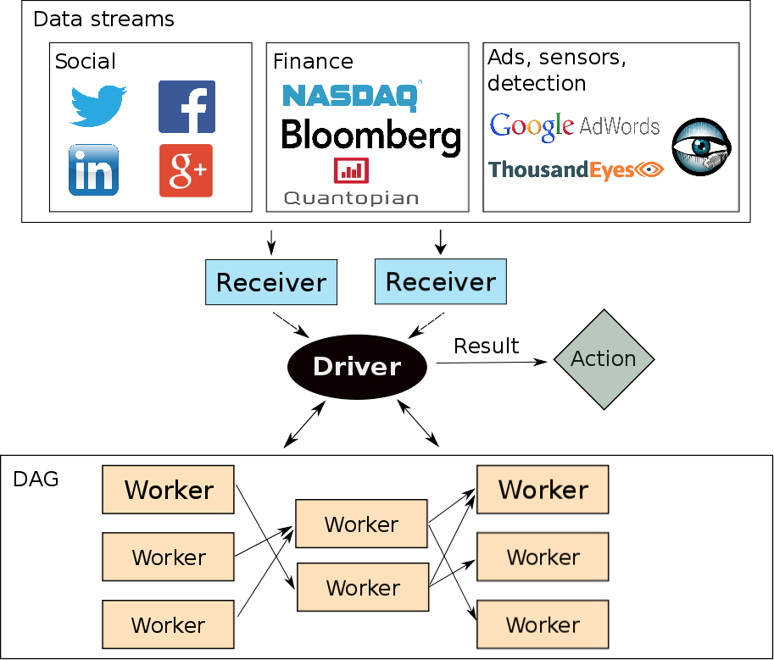


Optimizing Latency and Throughput
Trade-offs in a Stream Processing System
Joao Carreira (joao@berkeley.edu) Jianneng Li (jiannengli@berkeley.edu)
Motivation
Streaming systems can process data in two ways: record-by-record or micro-batch, favoring latency and throughput respectively
Spark Streaming is a micro-batch stream processor built on top of Spark, and offers high throughput and targets 0.5 to 2 seconds of latency
Because Spark Streaming also has other desirable properties such as fault tolerance, we want to explore what it takes for the system to provide low latency while maintaining reasonable throughput
Techniques
1)
Contribution
1) We provide an evaluation of the performance of Spark Streaming across two major metrics: latency and throughput
2) We show that Spark Streaming currently cannot provide high throughput and low latency for realistic workloads
3) Techniques/lesson to improve end-to-end latency:
a)
Evaluation
W
Lessons
Serialization:
Batch window:
Scheduling scalability:
Throughput:

