Slide 1
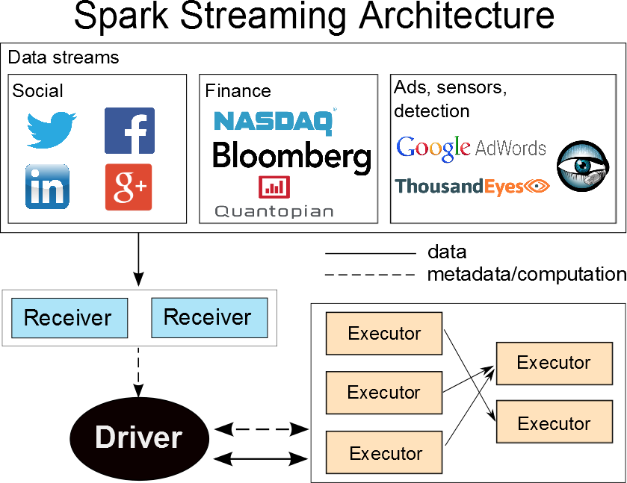


Optimizing Latency and Throughput
Trade-offs in a Stream Processing System
João Carreira (joao@berkeley.edu) Jianneng Li (jiannengli@berkeley.edu)
Motivation and Objective
Streaming systems can process data in two ways: record-by-record or micro-batch, favoring latency and throughput respectively
Spark Streaming is a micro-batch stream processor built on top of Spark, and offers high throughput while targeting 0.5 to 2 seconds of latency
Because Spark Streaming also offers several desirable properties such as fault tolerance, we explore what it takes for a system with this architecture to provide low latency while maintaining reasonable throughput
Implementation and Evaluation
Reduce overhead in task deserialization
Lazily instantiate configuration object while updating dependencies
Cache task binary instead of sending same information every time
Experimental decentralized task scheduler
Contributions
We provide an evaluation of the performance of Spark Streaming across two major metrics: throughput and latency
For a stream processor following the architecture of Spark Streaming, we analyze the performance bottlenecks and suggest potential areas of improvements
Data ingest: to receive input at a greater rate, use more receivers
Task overhead: we reduced the overhead of running a task in Spark Streaming through lazy instantiation of objects and caching
Scheduling overhead: we did not encounter scheduler bottlenecks in our experiments, but as the system scales out, a decentralized scheduler can be potentially useful
Network overhead: we did not find significant network bottleneck either in our experiments, but as the number of tasks per second increases, hardware technology such as InfiniBand can be used to decrease communication time between the driver and executors
We show that for the best latency in Spark Streaming, the batch window should be slightly larger than the time it takes to process a batch
Experiments
One node
Given a fixed throughput, 1) find end-to-end latencies of data for various batch windows and 2) find average breakdown as well as cumulative distribution functions (CDFs) of those latencies
For a configuration with stable end-to-end latencies, find average breakdown of times for running tasks
Multiple nodes
Given a throughput and batch window, compare latencies and breakdowns per-node to that of one-node deployment

