Slide 1
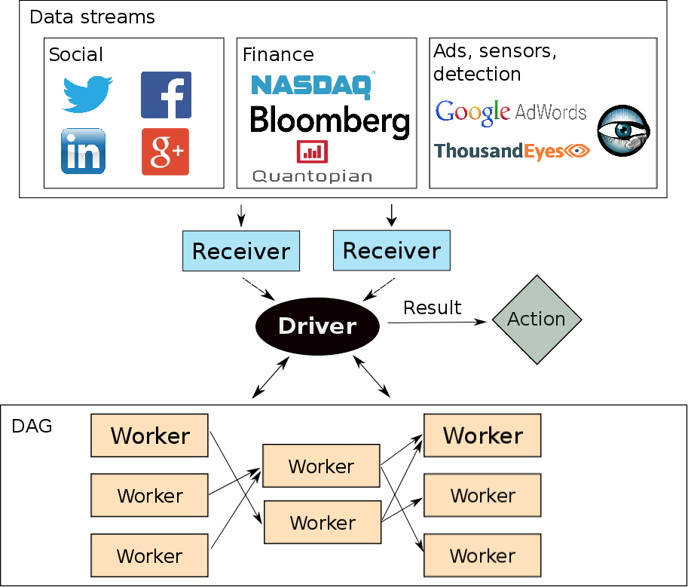


Optimizing Latency and Throughput
Trade-offs in a Stream Processing System
João Carreira (joao@berkeley.edu) Jianneng Li (jiannengli@berkeley.edu)
Motivation and Objective
Streaming systems can process data in two ways: record-by-record or micro-batch, favoring latency and throughput respectively
Spark Streaming is a micro-batch stream processor built on top of Spark, and offers high throughput and targets 0.5 to 2 seconds of latency
Because Spark Streaming also has other desirable properties such as fault tolerance, we want to explore what it takes for a system of its architecture to provide low latency while maintaining reasonable throughput
Implementation
Task overhead
Evaluation
W
Architecture
Lessons
Serialization:
Batch window:
Scheduling scalability:
Throughput:
1) We provide an evaluation of the performance of Spark Streaming across two major metrics: latency and throughput
2) We show that Spark Streaming currently cannot provide high throughput and low latency for realistic workloads
3) Techniques/lesson to improve end-to-end latency:
a)
Experiments
One node
Given a throughput, find end-to-end latencies of data for various batch windows; as well, find average breakdown as well as cumulative distribution function (CDF) of those latencies
For a configuration with stable end-to-end latencies, find average breakdown of times for running tasks
Multiple nodes
Given a throughput and batch window, compare latencies and breakdowns per-node to that of one-node deployment

