Slide 1
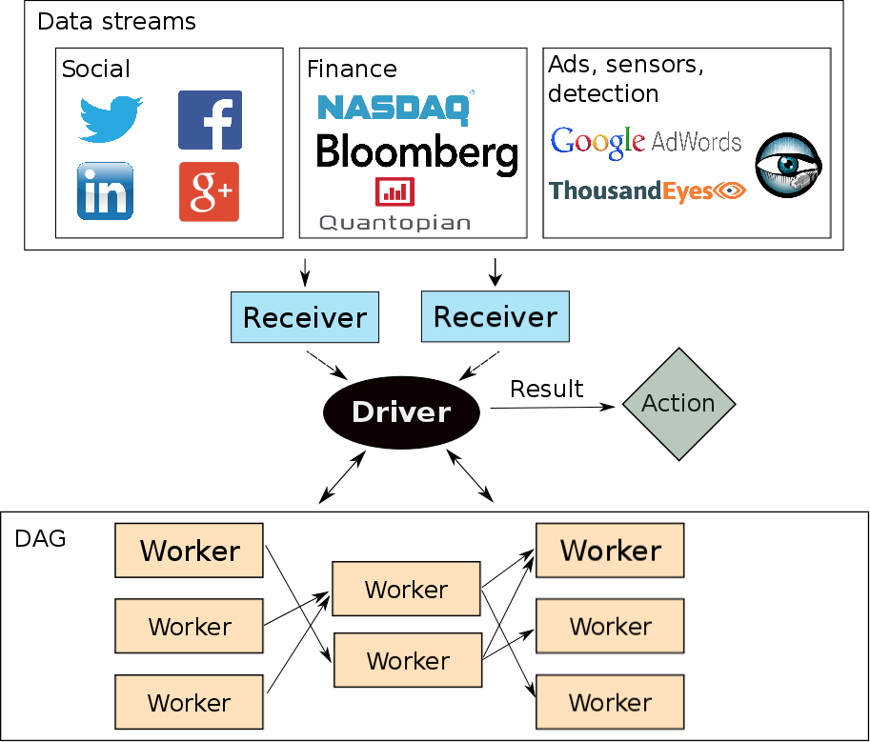


Optimizing Latency and Throughput
Trade-offs in a Stream Processing System
João Carreira (joao@berkeley.edu) Jianneng Li (jiannengli@berkeley.edu)
Motivation and Objective
Streaming systems can process data in two ways: record-by-record or micro-batch, favoring latency and throughput respectively
Spark Streaming is a micro-batch stream processor built on top of Spark, and offers high throughput and targets 0.5 to 2 seconds of latency
Because Spark Streaming provides several desirable properties such as fault tolerance, we explore what it takes for a system with this architecture to provide low latency while maintaining reasonable throughput
Implementation and Evaluation
Reduce overhead in task deserialization
Lazily instantiate configuration object while updating dependencies
Cache task binary instead of sending same information every time
Experimental decentralized task scheduler
Architecture
Contributions
We provide an evaluation of the performance of Spark Streaming across two major metrics: throughput and latency
For a stream processor following the architecture of Spark Streaming, we analyze the performance bottlenecks and suggest potential areas of improvements
Data ingest: to receive input at a greater rate, use more receivers
Task overhead: we reduced the overhead of running a task in Spark Streaming through lazy instantiation of objects and caching
Scheduling overhead: as the number of tasks generated per second increases, scheduling will eventually be a bottleneck, and can potentially be alleviated by using a decentralized scheduler
Network overhead: as the number of tasks executed by the system per second increases, hardware technology such as InfiniBand can be used to make the worker and scheduler communicate faster
We show that for the best latency in Spark Streaming, the batch window should be slightly larger than the time it takes to process a batch
Experiments
One node
Given a fixed throughput, 1) find end-to-end latencies of data for various batch windows and 2) find average breakdown as well as cumulative distribution function (CDF) of those latencies
For a configuration with stable end-to-end latencies, find average breakdown of times for running tasks
Multiple nodes
Given a throughput and batch window, compare latencies and breakdowns per-node to that of one-node deployment

