Slide 1
An Analysis of Amazon Reviews
Joao Carreira

Slide 2
Outline
Dataset and Methodology
Sanity checks
Dataset Analysis
Characterization
Products
Users/Reviews
Conclusion

Slide 3

Dataset - Overview
Amazon founded in 1994
Amazon reviews 1995-2013 (18 year span)
34M reviews, 7M users, 2M products
35Gb of uncompressed data
Dataset is available for research purposes [1]
An analysis of review text is available [2]
[1] https://snap.stanford.edu/data/web-Amazon.html
[2] J. McAuley and J. Leskovec. Hidden factors and hidden topics: understanding rating dimensions with review text. RecSys, 2013.

Slide 4

Dataset - User Reviews
product/productId: 0131097601
product/title: C Programming in the Berkeley Unix Environment
product/price: unknown
review/userId: A1KLBWKUQHSQVW
review/profileName: Eugene Mah "physics geek"
review/helpfulness: 0/0
review/score: 4.0
review/time: 994291200
review/summary: indispensible title on my computer bookshelf
review/text: This has been one of those books that I constantly refer to. Not only is it good for learning some of the unique C things that apply to Unix, but you can also learn how to get around in Unix. This is the book I learned C from, and it's still one of the first ones I go to when I need to refresh my brain about something.

Slide 5
Dataset - Other Records
1. Product Brand
B0000C2LFS Gifted Horse
2. Product Categories
0131097601
Books, Computers & Technology, Microsoft, Development, C & C++ Windows Programming
Books, Computers & Technology, Programming, APIs & Operating Environments, Unix
Books, Computers & Technology, Programming, Languages & Tools
Books, Computers & Technology, Software
Books, Education & Reference
Books, Science & Math, Mathematics
3. Product description
product/productId: 1878972405
product/description: Portuguese author Fernando Pessoa (1888-1935) published little in his lifetime, but his rediscovery
in the 1990s has been as central to postmodernism as the rediscovery of Kafka in the 1950s was to modernism.
4. Related products
B000K85RMI also purchased 0684803305 0805062904

Slide 6



Methodology
Exploratory analysis of the dataset
This analysis focus on products and users
No textual analysis - NLP - of reviews
Perl + R
Code, graphs and slides available @ github.com/jcarreira/amazon-study

Slide 7


Sanity Checks
Sanity Check | Description | Check ?
Correct timestamps | Time between 95 and ‘13
Helpfulness <= 1 | Helpfulness factor at most 1
Price | Price is positive (and reasonable)
Score 1-5 | Score is a 1-5 value
Review entries complete | All reviews have all entries
Product price fluctuation | Different reviews for the same product may have different prices
Review product title consistency | Review product title matches product title
Daily activity cycle | Less reviews during night and more during day
Products categories | All products have categories

Slide 8
Sanity Checks
Timestamps: Some are missing (e.g., “-1” entries)
Timestamp hour at 4pm or 5pm
Helpfulness: Some factors are > 1
product/productId: 1930771142
product/title: You Can Have Your Cheese and Eat It Too!
product/price: unknown
review/userId: A1VYC3XNQU72RF
review/profileName: William Cottringer
review/helpfulness: 2/1
Price: Some products have price 0$. Others “unknown”
Product price: prices are constant through time — not what happens in reality
Some reviews do not have text (just summary)
Some products have no category

Slide 9
Dataset Characterization
How many reviews are made per year?
What are the “biggest” products in amazon?
How much do products cost?
What are the most expensive categories?
How often do users review products?

Slide 10
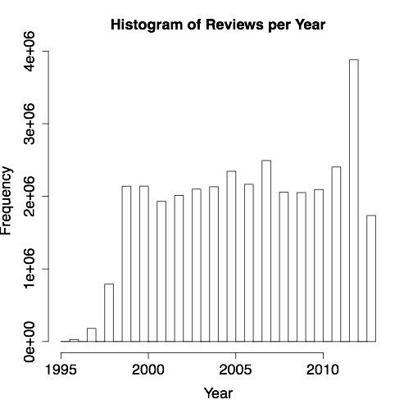
Reviews per Year

Slide 11
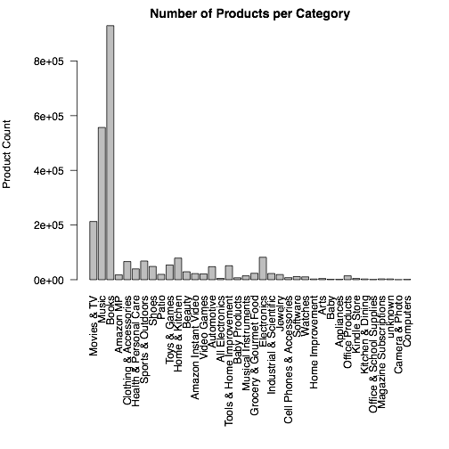
Product Categories

Slide 12
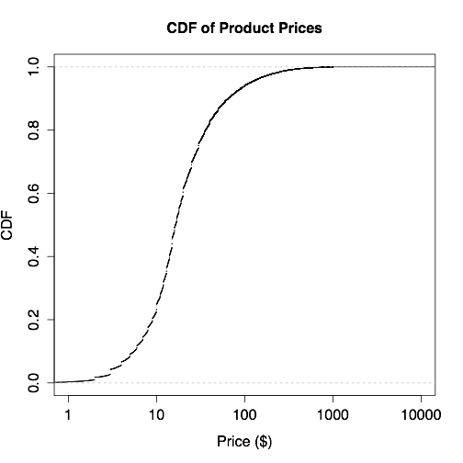
Product Prices
Most products cost < 50$
Prices capped at 999.99$

Slide 13
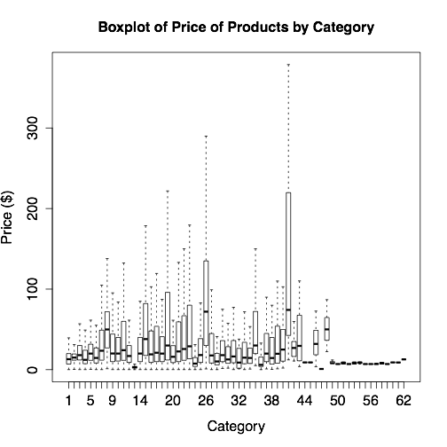
Product Prices
Outliers ignored
Purchase circles - bestsellers lists for specific groups
Purchase Circles
Tools &Home Imp.

Slide 14
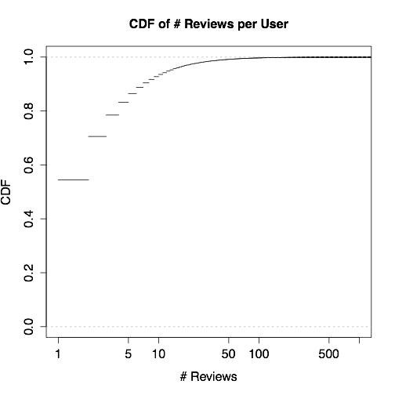
Users Reviews
> 80% of users do not review more than 5 times

Slide 15
Products - Questions
Subject | Question | Expectations
Life Expectancy | What is the life expectancy of a product? | Strong variations
 | Do reviews affect the life expectancy of products? | Probably
 | Do product life expectancy varies per product category? | Yes (e.g., books vs technology)
Reviews | Do review scores decay over time? | Depends on product category
 | Do reviews cluster at specific times (e.g., product launch)? | Should follow curve of adoption

Slide 16
Products - Life Expectancy
Life expectancy: average number of years of life
Considered only products with
> 50 reviews (frequently reviewed products)
last review before 2010 (no review likely means the product ‘died’)
This filters reviews down to 4K products

Slide 17
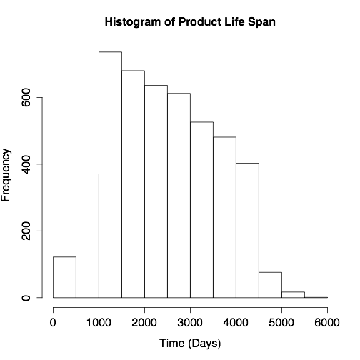
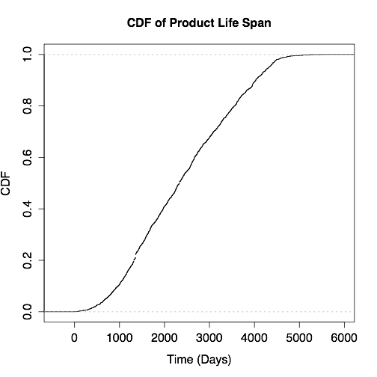
Products - Life Span

Slide 18
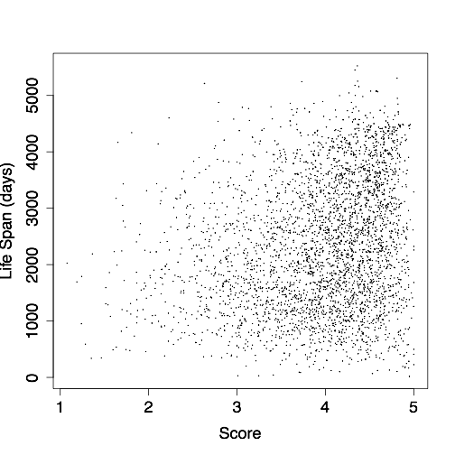
Products - Scores vs Life Expectancy
Correlation coefficient = 0.22 -> Scores do not affect life expectancy

Slide 19
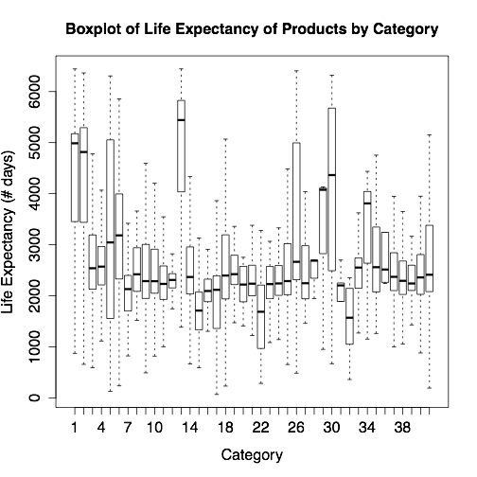
Product Life Expectancy by Category
Music
Books
Video Games
Office Prod.
Health
Home
Cross-classification of books and kindle
Kindle

Slide 20
Review Scores Decay
Compute the average decay of review scores over the years
For each product scores are normalized to the first year average score
Normalized scores are averaged per year after a product’s first review
Products with less than 5 years of reviews and 3 reviews per year are ignored
-> 28976 products

Slide 21
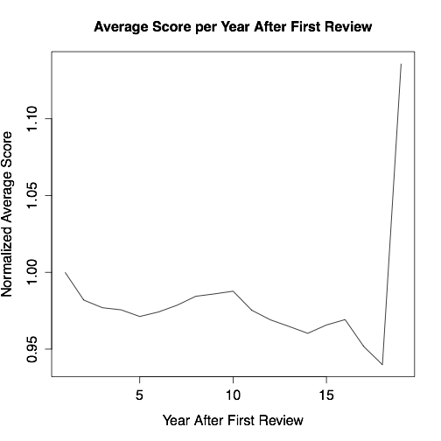
Review Scores Decay

Slide 22
Reviews Curve
Compute reviews clustering throughout a product’s life — should follow curve of adoption
For each product # of reviews is normalized
# of reviews is averaged per year after a product’s first review
Only “dead” products with no “holes” and at least 3 reviews per year considered
-> 136 products

Slide 23
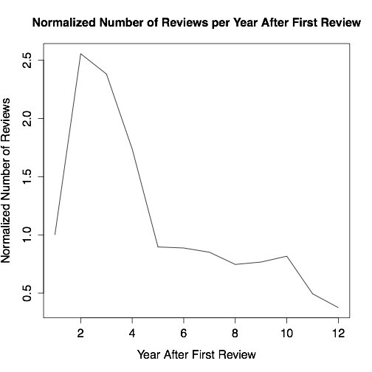
Reviews Curve

Slide 24
User Reviews - Questions
Question | Expectations
Do users tend to review a product when they are either very satisfied or unsatisfied? | Yes
Do positive / negative reviews tend to cluster in individual users, i.e., are there 'negative' users and 'positive' users? | Probably yes
Do users review products in a specific area of expertise or across different product categories? | Don’t know
Do users tend to be active reviewers over long periods of time? | No
What features of a review make it helpful? | Probably user experience and reviewer depth

Slide 25
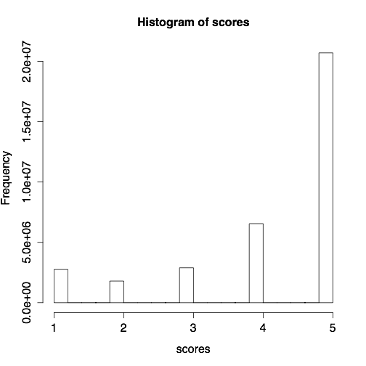
Users - Scores
- Most reviews are positive

Slide 26
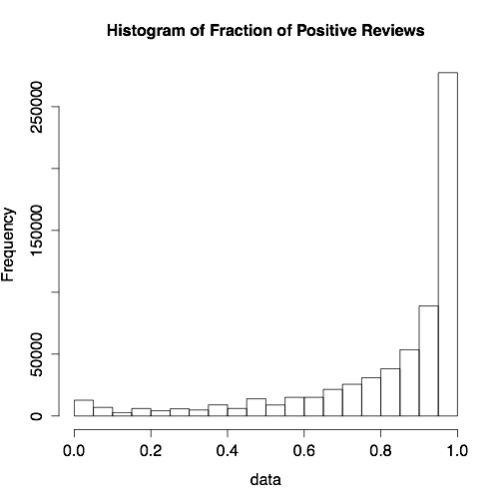
Users - Positive vs Negative Reviews
Users with less than 10 reviews not considered
Many “positive” users

Slide 27
Are Reviewers (1 Cat.) Experts?
Check how many reviews are focused on a single category for each reviewer
Ignore reviewers with less than 5 reviews

Slide 28
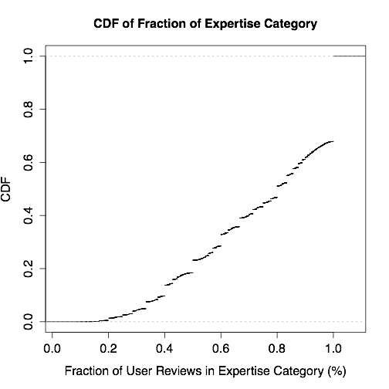
Are Reviewers (1 Cat.) Experts?

Slide 29
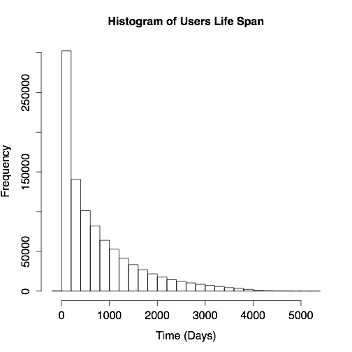
Users Life Expectancy

Slide 30
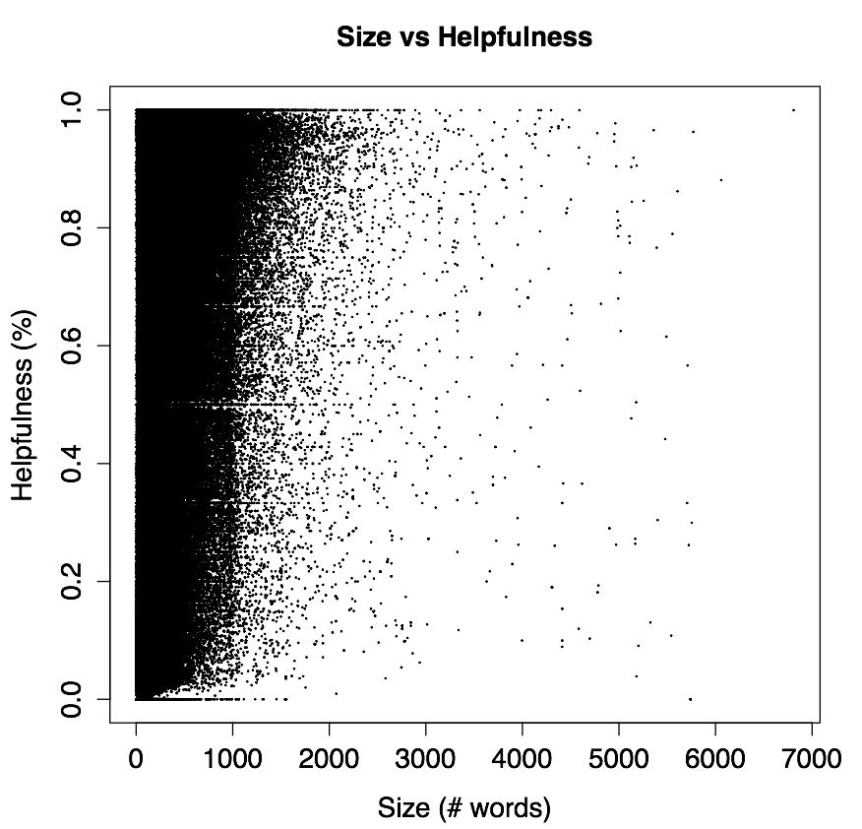
Reviews Size vs Helpfulness
Correlation coefficient = 0.24

Slide 31
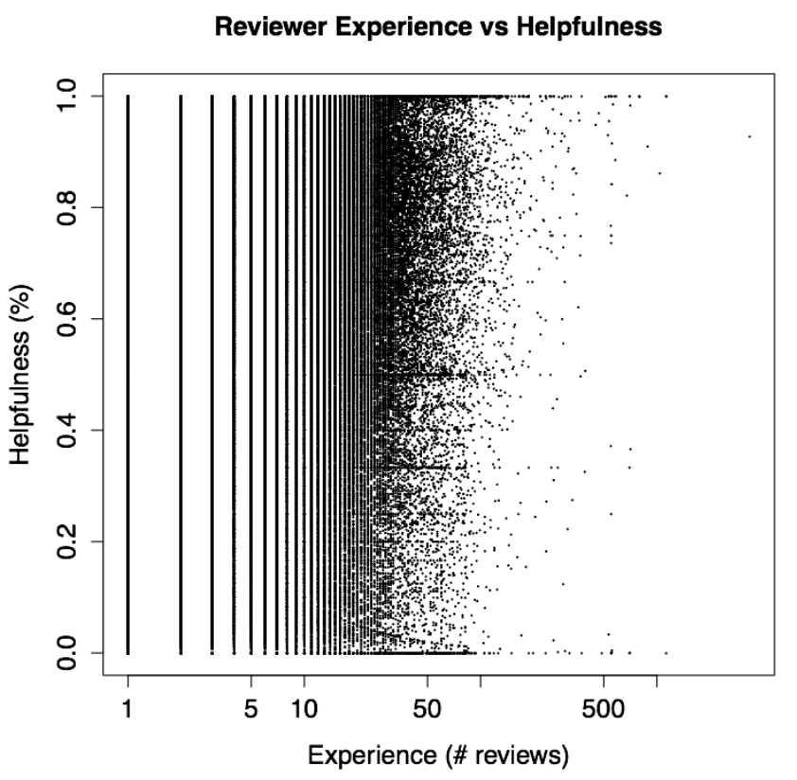
Reviewer Experience vs Helpfulness
Correlation coefficient = -0.041

Slide 32
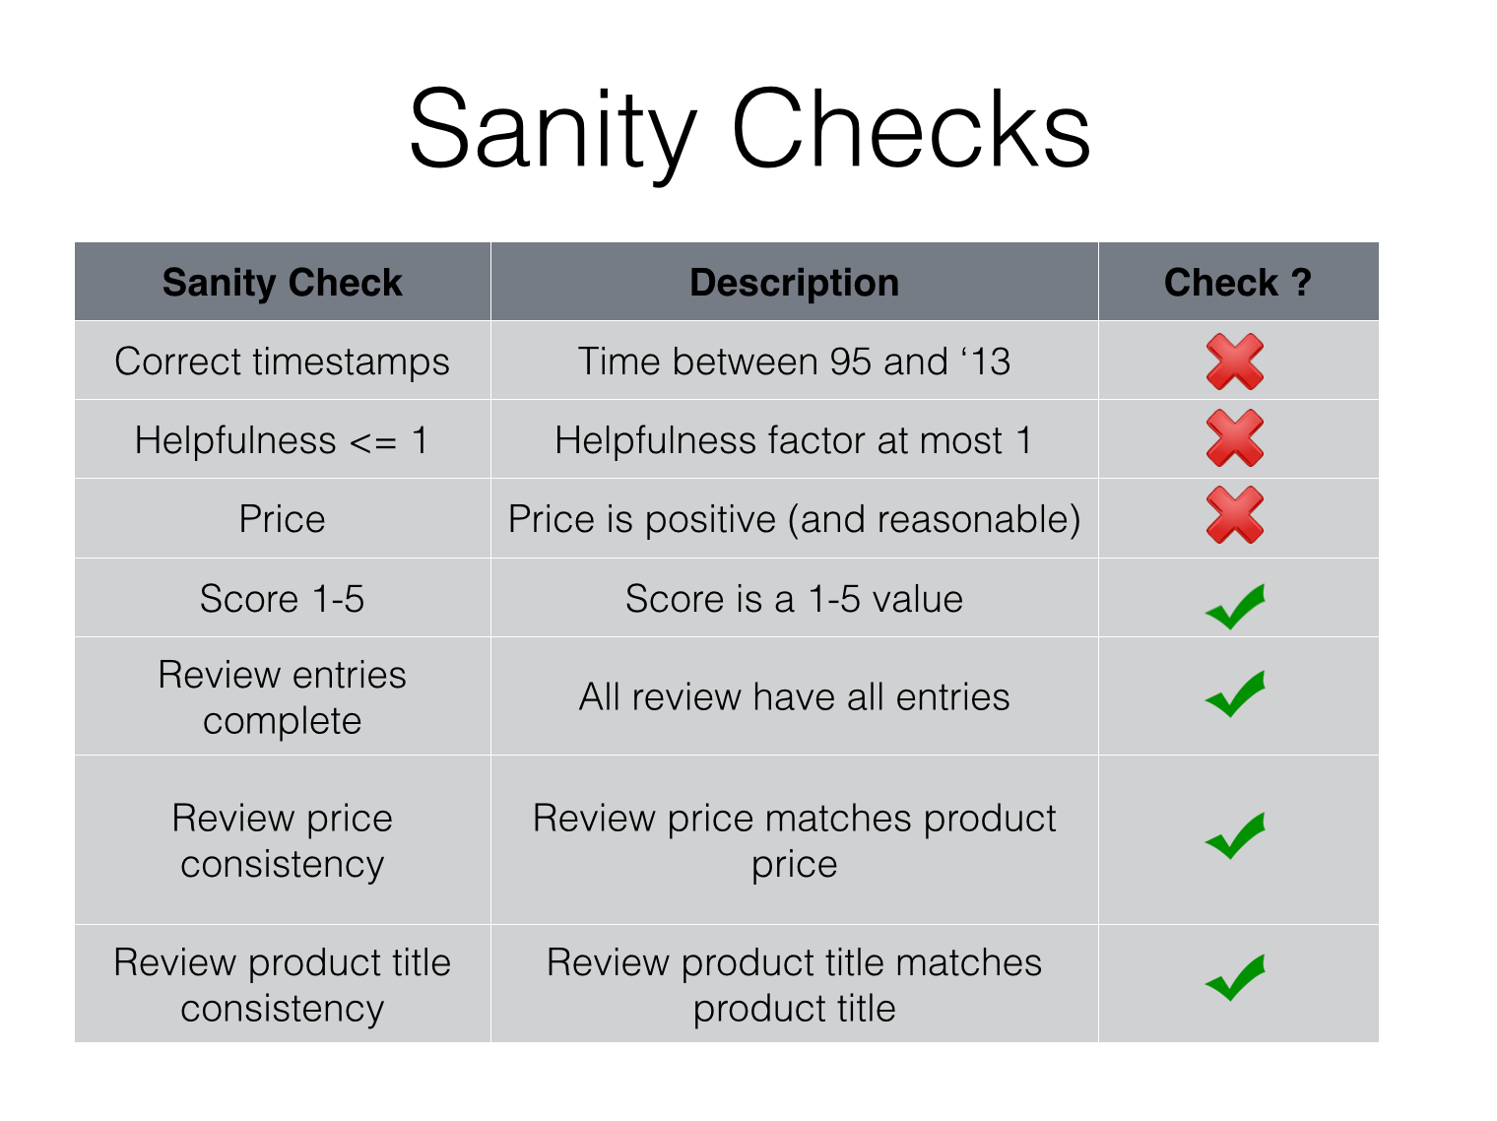
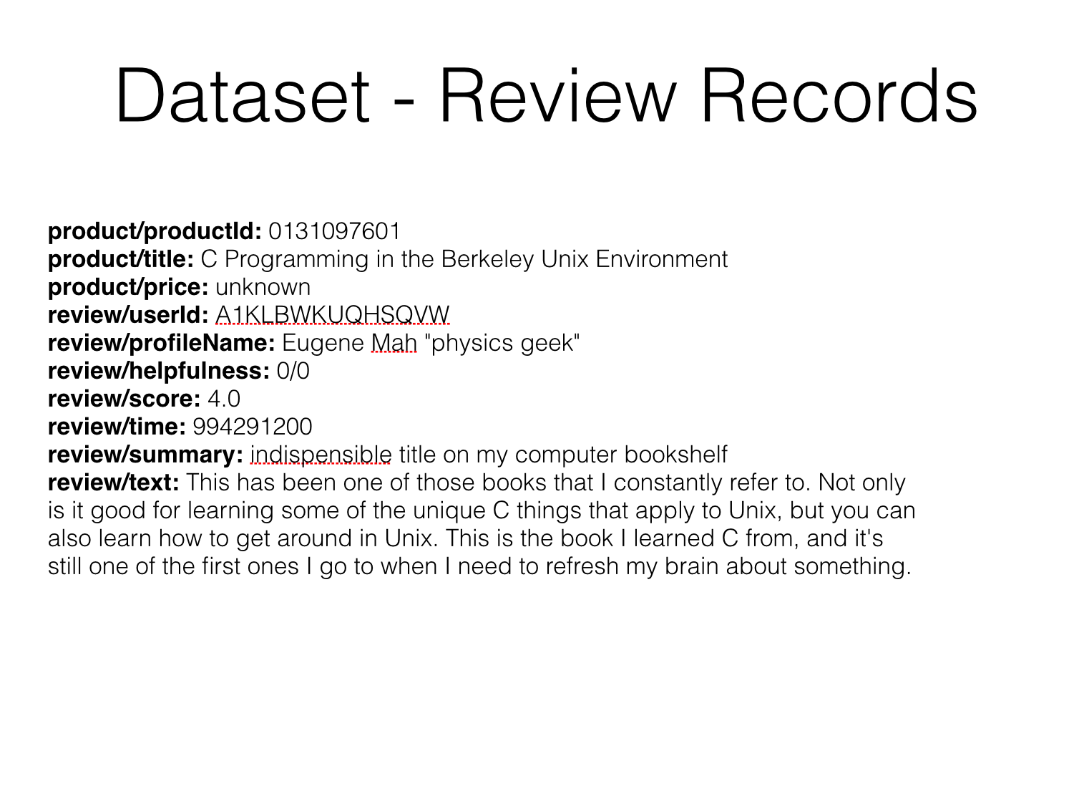
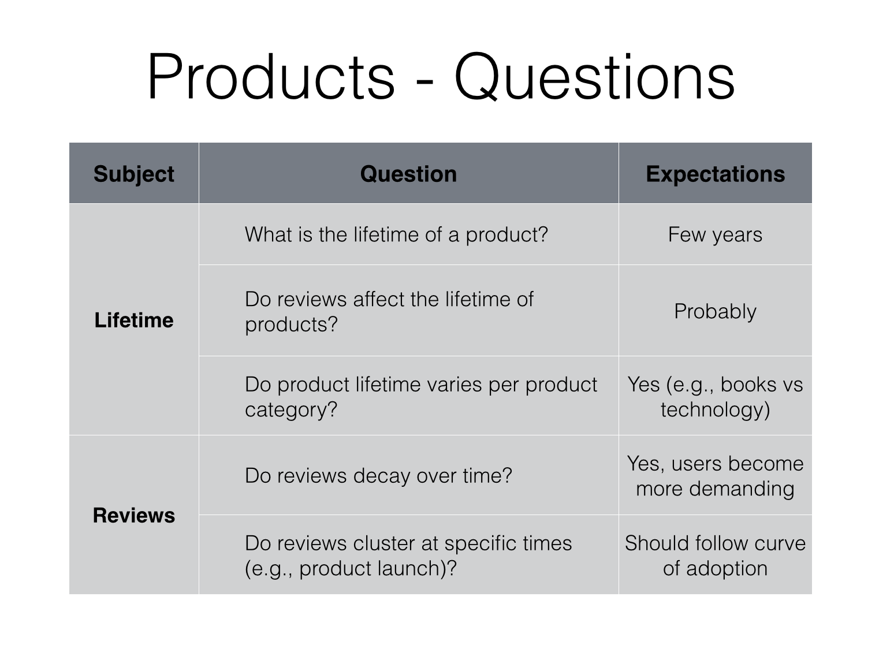
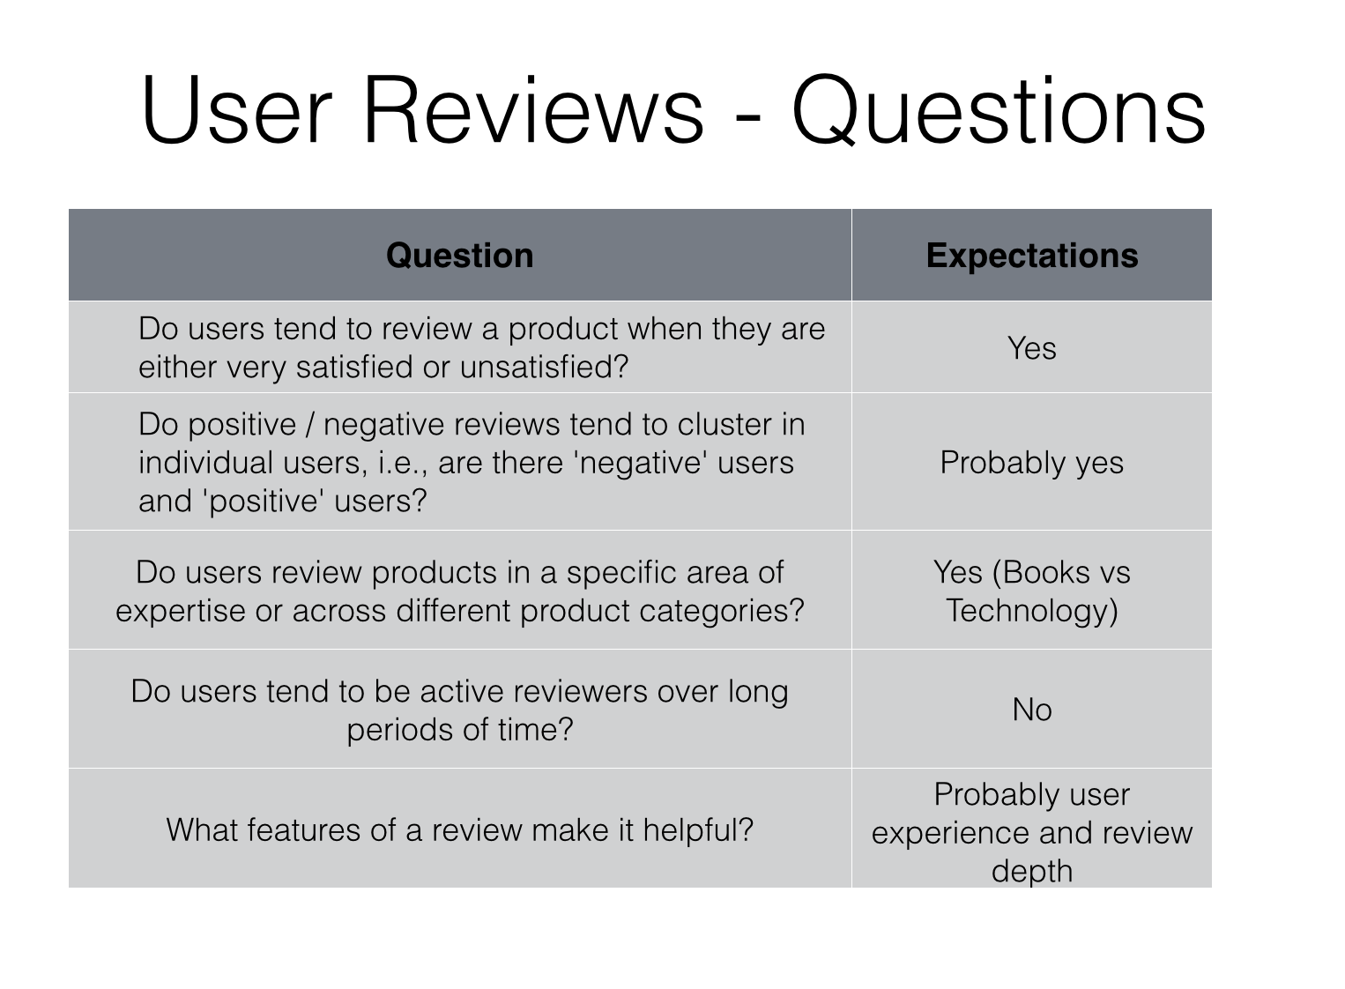
Questions?
github.com/jcarreira/amazon-study

