Slide 1


Prototyping
Firebox-0
Nathan Pemberton Joao Carreira Zach Rowinski Martin Maas
+ The Entire Firebox Group
Krste Asanović Randy Katz

Slide 2
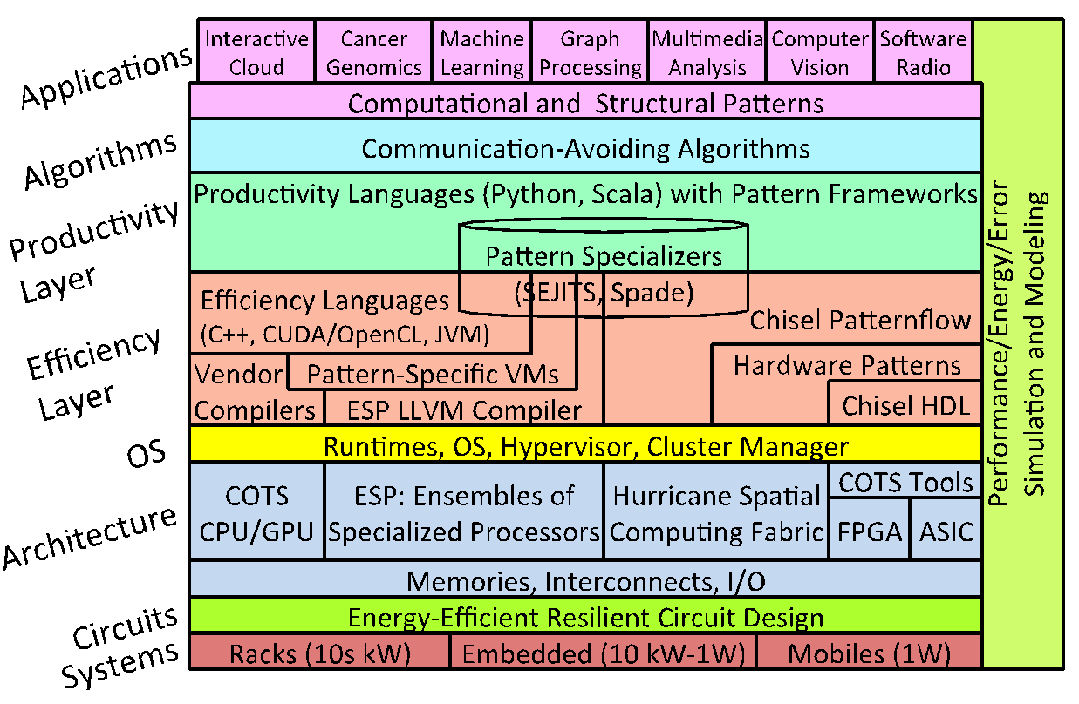
FireBox-0
Notes:
Please put in notes here to explain poster so that someone else could summarize what your poster is about

Slide 3
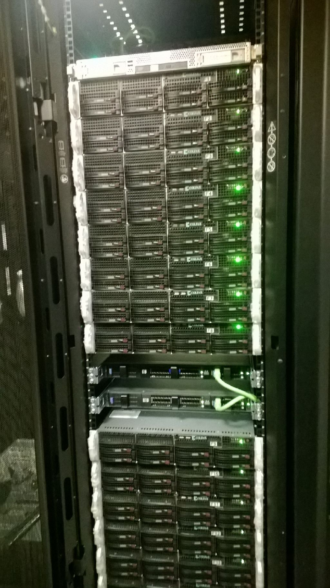
What is Firebox – 0?
- Firebox – 0 Cluster:
16-node cluster
1 Infiniband switch
1 Ethernet switch
- Node configuration:
Intel Ivy Bridge 8Cores / 16Threads 3.0GHz 25MB
64GB RAM (1TB aggregate)
2 Samsung SSDs (120GB + 480GB) (9.4TB aggregate)
Infiniband: Mellanox ConnectX-3 VPI FDR QSFP 56Gbps
Ethernet: Mellanox ConnextX-3 EN QSFP 40Gb
Running Ubuntu 14.04 (Linux 3.13.0)
Notes:
Brief overview of Hardware / Software configuration of Firebox
Aggregate memory and disk capacity:
- 1TB of RAM
- ~9.4TB of SSD storage

Slide 4
FireBox Software Stack
App
App
New component
Modified existing component
Unmodified existing component
Hadoop
Spark
Batch
Batch
Interactive
Cluster Manager (Mesos + interactive)
Bulk Memory API (RAMCloud + transactions)
“WSC Executive” (Xen + resource partitioning)
Network (Ethernet + Infiniband)
Notes:
Please put in notes here to explain poster so that someone else could summarize what your poster is about

Slide 5
Tessellation
App
App
New component
Modified existing component
Unmodified existing component
Hadoop
Spark
Batch
Batch
Interactive
Cluster Manager (Mesos + interactive)
Bulk Memory API (RAMCloud + transactions)
“WSC Executive” (Xen + resource partitioning)
Network (Ethernet + Infiniband)
Notes:
Please put in notes here to explain poster so that someone else could summarize what your poster is about

Slide 6


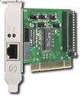
Tessellation
Resource
Assignments
Performance
Reports
Adaptive Resource Centric Computing (ARCC)
Package applications into cells with explicit resource allocation and QoS guarantees
Manage cells and resource allocation through a thin control plane
Service-oriented
Cells subscribe to services provided by other cells
Service subscriptions == resource allocations
Control
Plane
Running System
(Data Plane)
Application1
Application1
Cell
Cell
Channels
QoS-aware
Scheduler
QoS-aware
Scheduler
QoS-aware
Scheduler
GUI
Service
Block
Service
NW
Service

Slide 7
Implementation
Observation: If the Tessellation kernel looks like a hypervisor, why not just use a hypervisor?
Tessellation implements these concepts on top of Xen
Xen Domains become Cells
Pluggable Schedulers allow us to implement custom scheduling policies
Build network or other services in stub-domains (Xen domains intended to run drivers)
Run Linux or a custom Library OS in the cells instead of mandating a particular interface

Slide 8
Tessellation
Traditional virtual-machine
approaches continue to work
Most cells run modified
OS and applications to take
full advantage of Tessellation
features
Resource allocation broker provides QoS and ARCC policy
Traditional Cell
User App
Exec Framework
Tess Cell
RAB
Service
Cluster Manager
User App
Linux
LibOS
Unified Inter-node
and Intra-node IPC
interfaces
Tessellation OS (modified Xen)
Cell Scheduler
Resource Monitor
Cell Communication Channels
Tess kernel
Provides QoS and ARCC mechanisms
Physical Node

Slide 9
Tessellation: Status
Scheduling
Implemented gang scheduler to enable more effective 2-level scheduling
Results show potential for some workloads but reduced CPU utilization for others
Needs more experimentation with complex user-level frameworks
CellOS
CellOS is a stripped down OS Based on Guk¹ and newLib²
Supports a subset of POSIX
Pthread based benchmarks have been ported (e.g. CoEVP and CoHMM)
Experiences
Some single-application benchmarks are slower on CellOS than on Linux
Debugging is very difficult
More work is needed to improve performance and usability

Slide 10
Firebox-0 Benchmarks
Set of benchmarks across the Firebox-0 stack:
Network (RDMA latency / bandwidth)
Key-value stores (RAMCloud, Aerospike Cassandra)
Interactive (Apache Solr)
App
App
Hadoop
Spark
Batch
Batch
Interactive
Cluster Manager
Bulk Memory API
“WSC Executive”
Network
Notes:
Please put in notes here to explain poster so that someone else could summarize what your poster is about

Slide 11
Firebox-0 Network
App
App
New component
Modified existing component
Unmodified existing component
Hadoop
Spark
Batch
Batch
Interactive
Cluster Manager (Mesos + interactive)
Bulk Memory API (RAMCloud + transactions)
“WSC Executive” (Xen + resource partitioning)
Network (Ethernet + Infiniband)
Notes:
Please put in notes here to explain poster so that someone else could summarize what your poster is about

Slide 12
Firebox-0 Network Latency / Bandwidth
RDMA Ping Pong Benchmark:
RDMA connection is setup through
TCP/IP
Sequential RDMA reads with different
sizes
Latency:
Latency of 1.7us for small packets
High latency for big (>1MB) packets
Bandwidth:
Low bandwidth for small packets
Maximum bandwidth of ~5 GB/s
Notes:
Raw benchmark of Firebox Network
TODO:

Slide 13
Key-value stores on Firebox-0
App
App
New component
Modified existing component
Unmodified existing component
Hadoop
Spark
Batch
Batch
Interactive
Cluster Manager (Mesos + interactive)
Bulk Memory API (RAMCloud + transactions)
“WSC Executive” (Xen + resource partitioning)
Network (Ethernet + Infiniband)
Notes:
Please put in notes here to explain poster so that someone else could summarize what your poster is about

Slide 14
Benchmark of Key-value stores
Key-value stores benchmarked:
RAMCloud (RAM storage system with low-latency RPCs)
Aerospike (flash-optimized key-value store)
Cassandra (semi-structured and scalable key-value store)
Name | Atomicity / Consistency | Durability / Replication | Latency
RAMCloud | Atomic single-key updates. Supports conditional updates | Data is replicated to other nodes (RAM) and written to disk asynchronously | Ultra-low
Aerospike | Atomic single-key update. Supports atomic multi-key reads | Data is replicated and written to disk sync/asynchronously | Low
Cassandra | Tunable / linearizable consistency No atomic writes across replicas | Data is replicated and written to disk sync/asynchronously | Low -Medium
Notes:
Key-value stores.
1) What is RAMCloud?
DRAM-based storage system
The case for RAMCloud
http://delivery.acm.org/10.1145/1970000/1965751/p121-ousterhout.pdf?ip=2.83.55.65&id=1965751&acc=OPEN&key=4D4702B0C3E38B35%2E4D4702B0C3E38B35%2E528120C21059793D%2E6D218144511F3437&CFID=551422919&CFTOKEN=31387118&__acm__=1420299996_3806cb8ae5b1fc2b0b8d8d4351f9242b
http://web.stanford.edu/~ouster/cgi-bin/papers/ramcloud-recovery.pdf

Slide 15
RAMCloud
ClusterPerf:
RAMCloud test suite (eg., multiReads)
We use one test (sequential read/write of
random objects)
RAMCloud:
4 nodes, replication factor = 0
Latency / Bandwidth:
67-107% higher read bandwidth
45-53% lower read latency
Challenges:
ACID multi-key transactions with
low-latency and at scale
Notes:
Mention best hardware
Remove ‘basic’

Slide 16
AeroSpike + Cassandra (YCSB)
YCSB:
32 concurrent clients
6 workloads
Aerospike and Cassandra setup:
4 nodes
Replication factor = 3
YCSB results:
Sub-millisecond average read latency for
both Aerospike and Cassandra
Aerospike with higher throughput for workload
D (read latest) and E (short ranges)
Notes:
Two key-value stores:
Aerospike:
In-memory NoSQL key-value store. Optimized for flash storage. Can achieve high throughput
Cassandra:
How does YCSB work:
1)
2)
3)
- YCSB
Workloads:
A:
B:
C:
D:
E:
F:

Slide 17
Interactive Applications on Firebox-0
App
App
New component
Modified existing component
Unmodified existing component
Hadoop
Spark
Batch
Batch
Interactive
Cluster Manager (Mesos + interactive)
Bulk Memory API (RAMCloud + transactions)
“WSC Executive” (Xen + resource partitioning)
Network (Ethernet + Infiniband)
Notes:
Please put in notes here to explain poster so that someone else could summarize what your poster is about

Slide 18
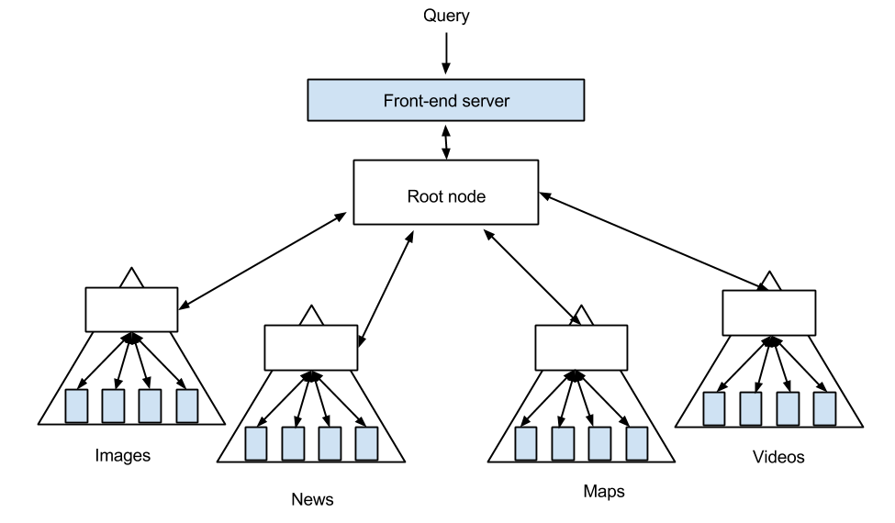
Benchmarking Distributed Search:
Apache Solr on Firebox-0
Distributed search architecture
Goal: Test latency sensitive (interactive) applications on Firebox-0
Apache Solr is a popular open source program for text search with widespread use
Fan-out pattern -- many machines piece together the search response for a user

Slide 19
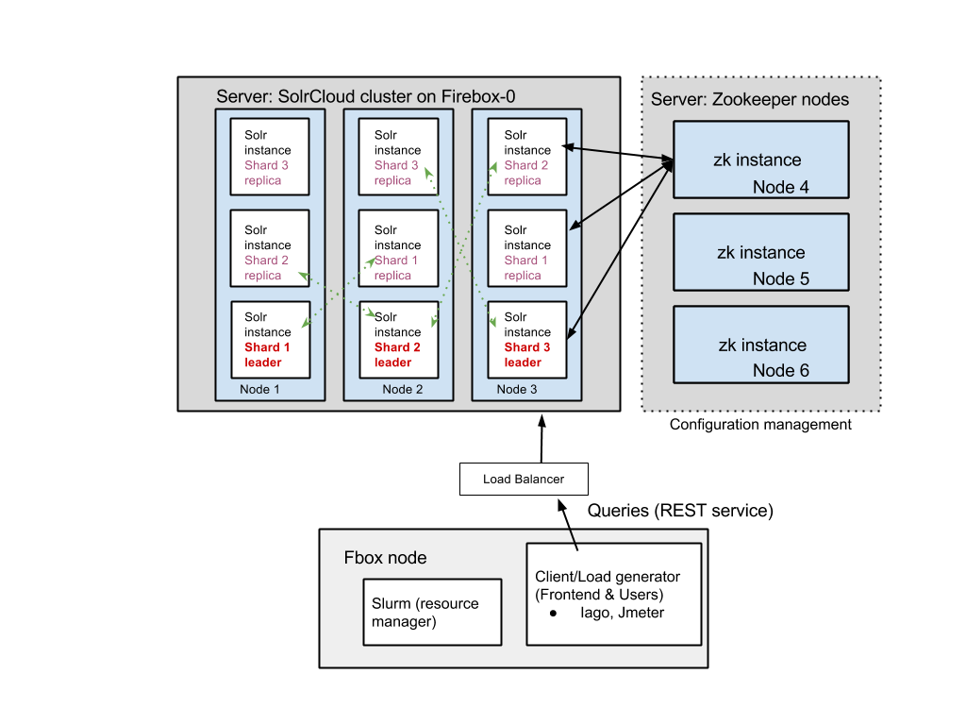
Solr on Firebox-0
Solr cluster: 1 Solr instance -> 1 core. Data sharded evenly amongst instances and stored locally.
Zookeeper for cluster management.
Hadoop and HDFS (optional)
Notes:
This is what Solr looks like on Firebox now
Solr on Firebox has two major components, the server and client. The server consists of a cluster of solr instances spread across many machines, together with a separate set of machines hosting Zookeeper. Zookeeper is responsible for cluster management and synchronization amongst the Solr instances; it knows if and when a node goes offline and communicates that to the Solr instances so they can reroute traffic accordingly. Each solr instances locally maintains a part of the index (shard) as well as maybe replicas.

Slide 20
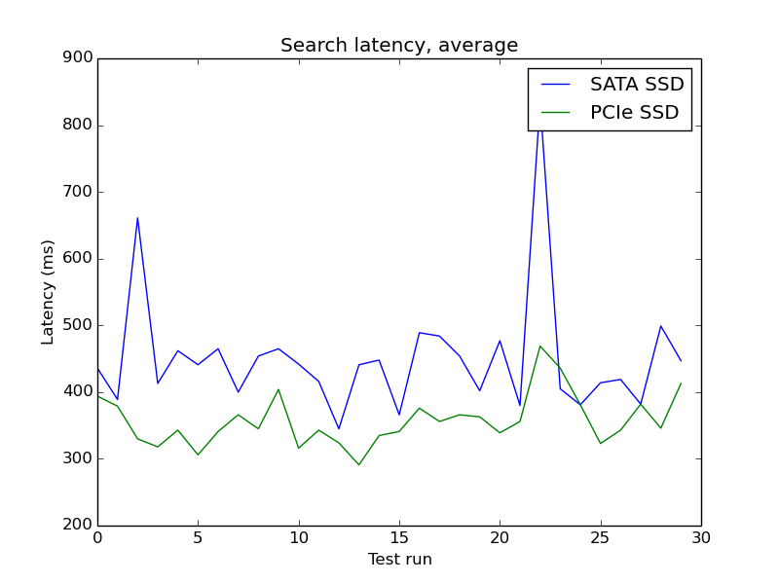
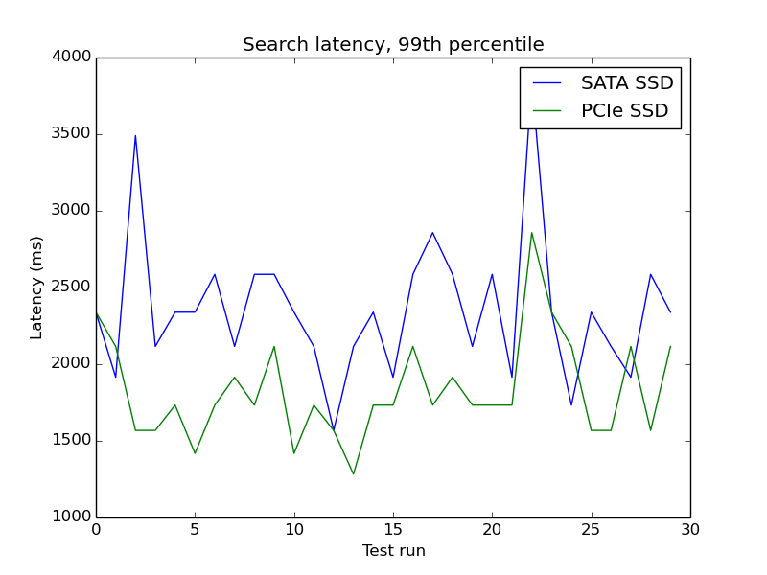
Experiment: Latency and IO
Samsung SATA vs. PCIe, 2 shards, no replicas, 50 million indexed documents, 4 GB heap max, default GC settings
PCI-Express ~25% lower latency
Challenges benchmarking large distributed systems
many free parameters
exogeneous factors that disrupt performance can be hard to find and diagnose
Caching effects at the disk, OS, and program level have a significant impact on latency
Java GC is unpredictable
Notes:
This experiment is designed less for low latency or high query rate than it was to take advantage of disk bandwidth. You can see the PCIe SSD interface is roughly 25 % in this experiment. In this case, the Solr index is large (~30 GB a shard). It can fit in memory but suffers from high GC activity that kill latency performance.
What happens if attempt to keep search index on disk, rather than load it into memory...

Slide 21
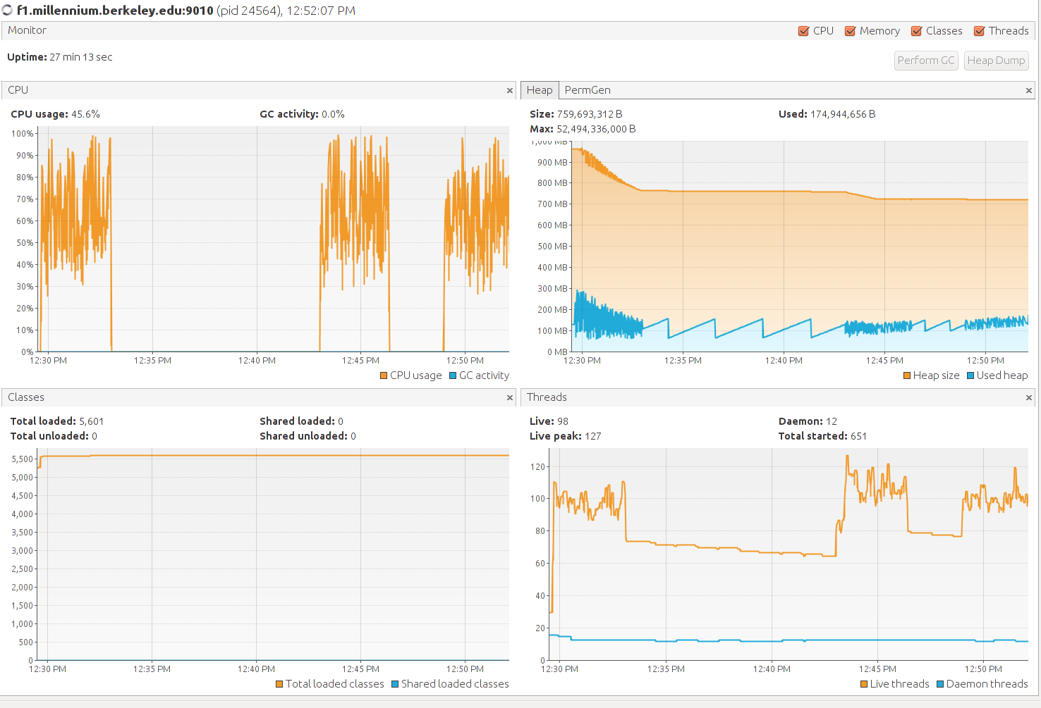
Testing Framework (BITS)
Python scripts for
Setup and takedown of application and data
Visualizing results with Matplotlib
Orchestrating tests & gathering data from tools
Make use of common performance monitoring tools
Load generators: Iago, Jmeter.
CPU & Memory: VisualVM, Sematext SPM, Ganglia
Network: bwm-ng (coarse monitoring), IO: iotop
VisualVM: CPU and Memory monitoring

Slide 22
Future Work
Tessellation
Still early days: Most features yet to be implemented
Big area of interest: 2-level scheduling and resource allocation
Gang scheduling needs deeper analysis and more sophisticated implementation
Advantages of minimal OS vs Linux
Need to run Firebox benchmarks on Tessellation
Increase number of benchmarks
A number of genomics and big-data style workloads are running on EC2, need to run on Firebox-0
Other important workloads we are missing?
Understand Aerospike vs Cassandra results

Slide 23
Questions

Slide 24
Backup Slides

Slide 25
Gang Scheduling Experiments
Micro-benchmark
Run identical, compute-bound tasks on multiple threads repeatedly
Record each time a thread completes its task more than a full iteration behind the others (a missed deadline)
Macro-Benchmarks
HPC benchmark that models solid deformation in extreme environments
Ran multiple instances of the benchmark
Batch: Each instance ran one after the other
Credit: Simultaneous execution on Xen’s default (non-gang) scheduler
Gang: Simultaneous execution with gang scheduling

Slide 26
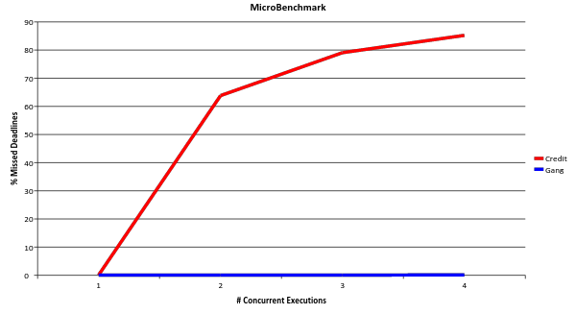
Micro Benchmark Results

Slide 27
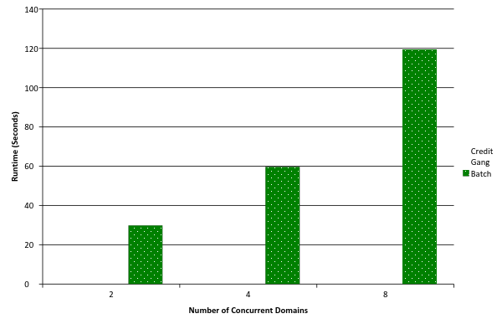
Macro Benchmark Results

Slide 28
Firebox Network
SockPerf Ping Pong Latency in Fbox
Without VMA* | 4.8 us
With VMA | 1.3 us
RDMA Ping Pong Latency
Firebox v0 | 1.7 us
RAMCloud HW [1] | 3.1 us
*VMA = Mellanox socket library with kernel bypass
Notes:
Raw benchmark of Firebox Network
TODO:

Slide 29
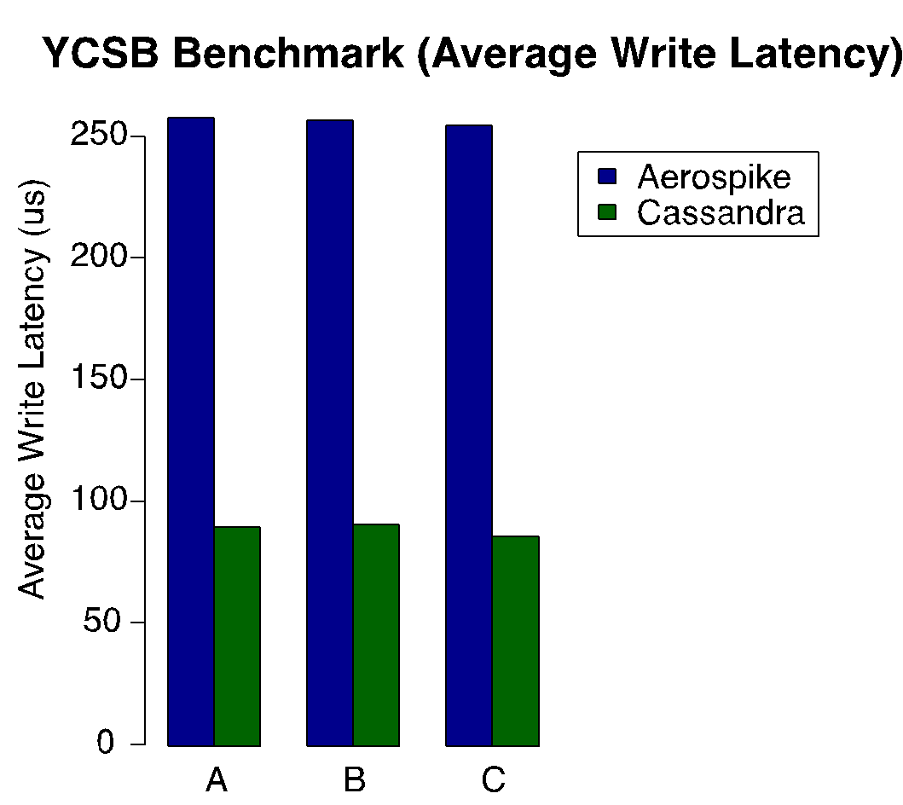
Aerospike/Cassandra Write Latency
Notes:
Raw benchmark of Firebox Network
TODO:

