Slide 1
Watermarked
IBM Call for Code 2019 Submission
“to address natural disasters, with emphasis on community and individual health and wellbeing”
Submission by J. Carroll
for 7/29/2019 Challenge

Slide 2
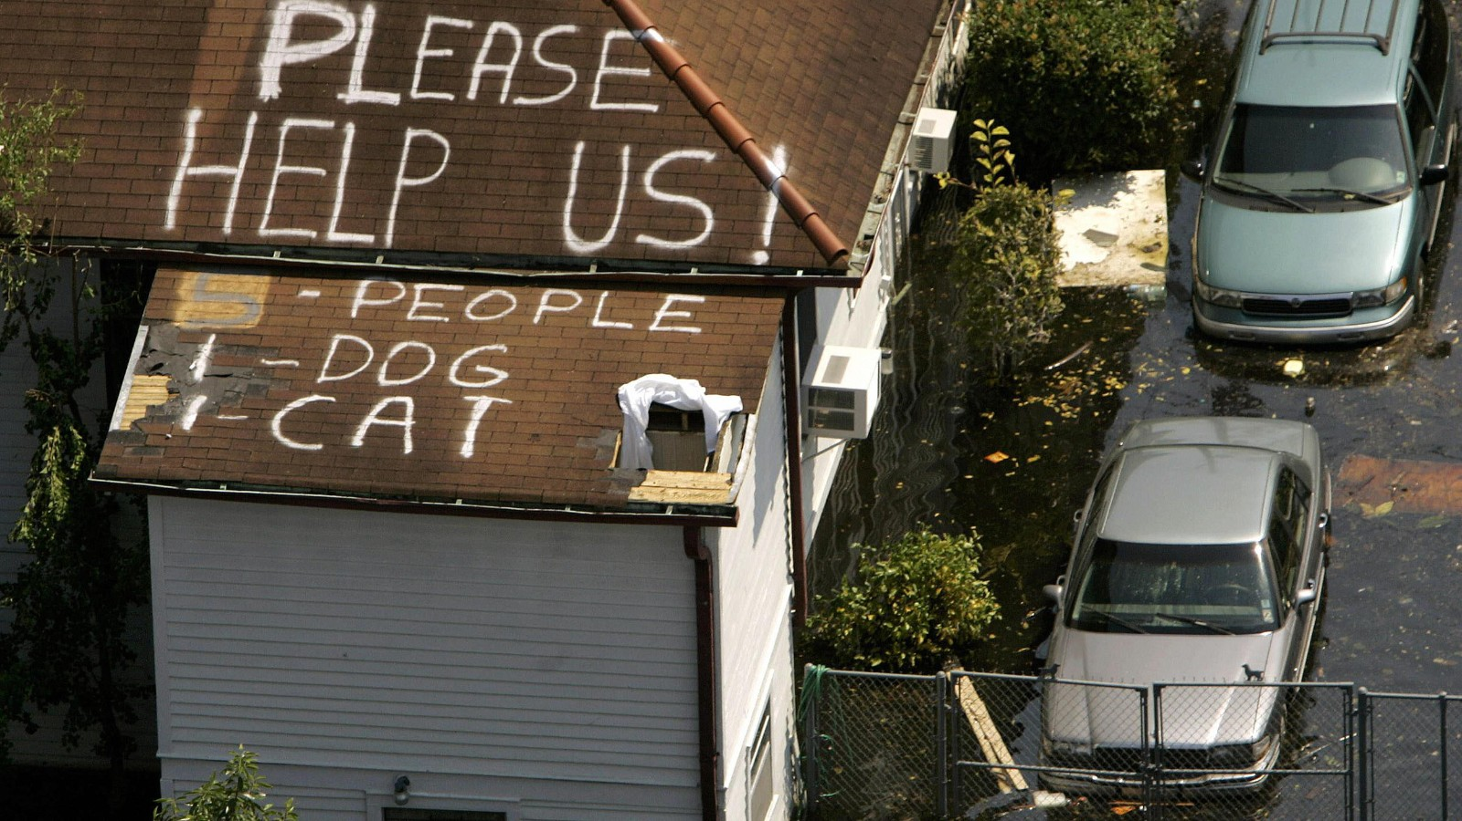

Natural Disasters
Floods are an increasing threat...
“If you thought that floods are natural disasters that happened only in poorer continents like Africa and Asia, then you are wrong. First, not all floods are caused by nature. They are man-made too. And second, even countries like the USA and the UK get floods that cause huge losses to life and property…”
http://wwf.panda.org/knowledge_hub/teacher_resources/webfieldtrips/natural_disasters/floods/
image cnn - https://www.cnn.com/2013/08/23/us/hurricane-katrina-statistics-fast-facts/index.html

Slide 3
FLOOD
Factors in Individual Health and Wellbeing ..
Preparedness
Forewarning
Emergency Response
Safety – Family and Pets
Property Recovery

Slide 4
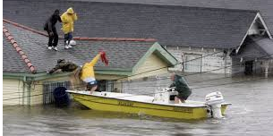
FLOOD
Factors hindering human survival ..
Electric Power OFF
Internet OFF
Warning Systems may be defeated
Communication Systems may be defeated
Pet and Property Recovery threatened

Slide 5

Flood Warning and Recovery Solution
Ideal Attributes
Affordable Consumer-Grade Solution
Flood detection and forewarning
Passive (low / no energy consumption when not in use; off-grid energy rig triggered by flood sensors)
Self-Powering
Locational Beacon for Pet and Property Recovery
No internet reliance – mesh network over RF channel

Slide 6



System Activation Flow
Flood Detection Trigger Radiates Upward in Watermarked Home Network
GPS / RF
Property Track
Water Sensor
passive home network switched to ON by base water sensor
Top Tier - Solar-powered “Home Base” emits GPS beacon and RF Mesh Network Repeater / Communications Node
Middle Tier – Bluetooth / Wearable GPS tags are attached to non-portable valuables and pets to speed emergency recovery tracking.
Base Tier – Water leak sensors are strategically placed at the lowest breach point. Sensor breach triggers Middle and Top Tier Power-over-Ethernet boot for Home Automation app.

Slide 7

Home Network Diagram
Once Armed, A Watermarked Home Becomes a Small Fort
BEACON
A consumer-grade solar-battery pair powers a deep-cycle AGM marine battery to provide days-to-weeks of power to GPS beacon and RF network repeater.
TAGS
Property tags allow homeowners to directly locate valuables when water recedes. Pets with wearable tags may be identified and tracked by owner.
Water sensors provide basis for early warning and arming of home automation.
Sensors
.

Slide 8


Prototype Components
Elements of Working Proof-of-Concept
Hardware and Devices
Layer 3 – Broadcast
Solar Energy Source for Home Automation
Voltaic System Arc 20W Charger with V88 Power Bank
GPS Beacon, RF Node, RF Repeater
GoTenna Mesh (Repeater) GPS, RF, and SMS Device
Radacat GPS Repeater Beacon Device
Raspberry Pi 3
Layer 2 – Track
Mesh Network (Passive)
Particle XENON IoT Mesh BT Network Node/Repeater
Raspberry Pi 3
Zigbee IoT
Zigbee Arduino
Zigbee Add-on Module for Raspberry Pi
BT XBee Shield for Zigbee Arduino
Wearable Tracking
FLORA wearable microcontroller (Arduino compatible)
FLORA wearable GPS module
Layer 1 - Alert
Sensors
Insteon Wireless Waterleak Sensor w Phone Alerts
Samsung “Smart Things” Water Leak Sensor
Dome Home Automation Leak Sensor
Software
IBM Software Solutions
Node-RED – Used for flow-control logic to manage devices
Eclipse Mosquitto message broker
IBM Public Cloud (optional push notifications)
Open Software
(Raspberry Pi)
Home Assistant Config (HACS)
Home Assistant IoT Protocol gateway
GoTenna Mesh SDK
HASS.IO
(iPhone)
Particle IoT

Slide 9
END

