Slide 1
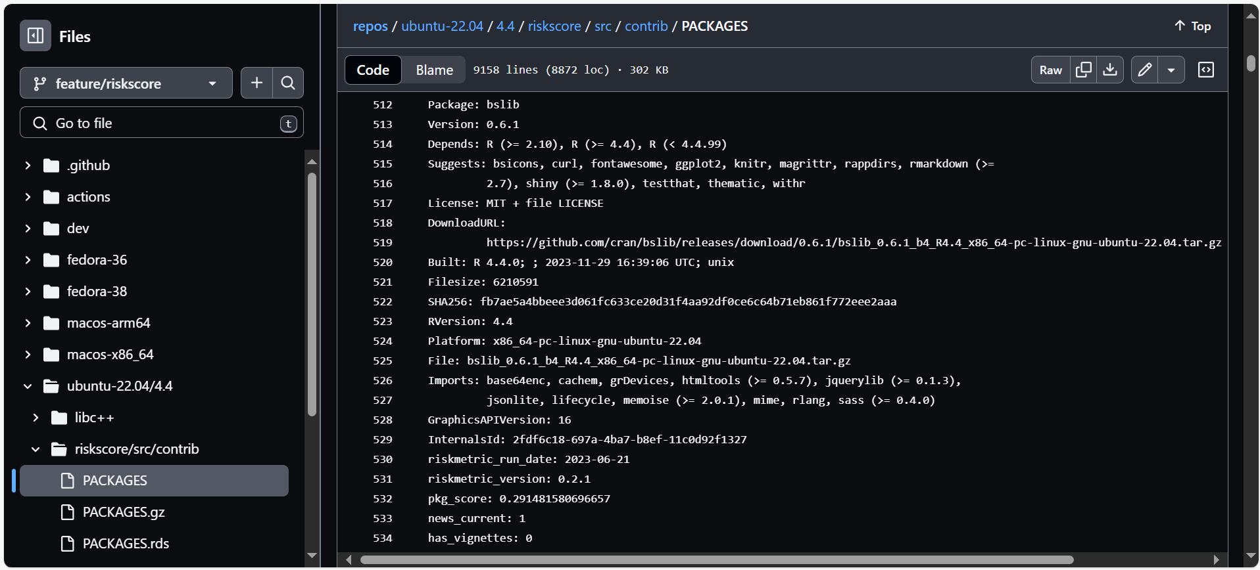
Original repo
Added using {riskmetric}

