Slide 1



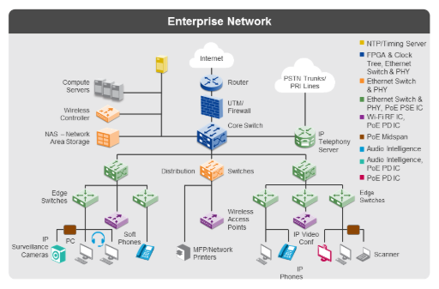
Hybrid Cloud Integration
Modern Cloud Connectivity
Modern APIs enable seamless data access without costly ETL processes for hybrid cloud environments.
Docker container support with built-in networking from Communications Server Sysplex Distributor.
Automatic load balancing routes traffic without external load balancers, maintaining mainframe-level reliability.
Real-time integration allows applications to access mainframe data directly in cloud-native architectures.
Strategic Advantage: z/OS 3.2 bridges traditional mainframe reliability with modern cloud flexibility, enabling true hybrid architecture without compromising security.

