Slide 1



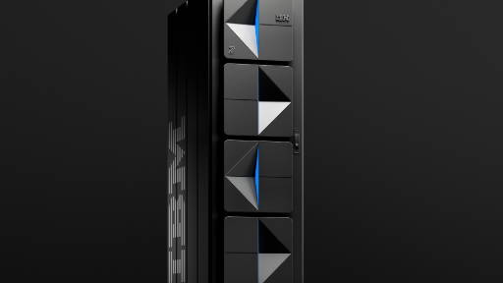
AI-Infused Capabilities & IBM z17 Support
Revolutionary AI Integration
Telum II processor delivers hardware-accelerated AI with 1ms response time for real-time inferencing.
AI-driven workload management optimizes CPU usage and network batching through intelligent pattern analysis.
AI threat detection analyzes behavioral patterns to identify security threats in real-time with automated containment.
WLM Policy Advisor provides AI-powered recommendations for optimizing workload distribution and performance tuning.
Key Innovation: z/OS 3.2 enables running both traditional and generative AI models directly on sensitive data in-place, minimizing data movement risks.

