Slide 1
The Obesity Problem
By: Sawyer Mason & John Cason

Slide 2
Background
Obesity is a disease involving having so much body fat that it leads to other health risks.
It is estimated that 69% of the US population is overweight and 36% of that are obese.
Data was collected from Mexico, Peru, and Colombia.
Finding the leading factors to Obesity

Slide 3
Tools used
We used Anaconda to run Python
Python to write the code
Pandas to import the dataset and to get dummy variables
Matplotlib was used to create the pie chart
Numpy was used to create our arrays
Seaborn was used to create the heat map
SKlearn was used to create the training and test sets as well as the label encoder and creating the logistical regression model.

Slide 4
Exploratory Analysis
Dataset contains 17 attributes and 2111 records.
This dataset has 8 Float64 variables and 9 Object variables.
All data was kept the same while looking through statistics and plots.
Logistical Regression required extra data cleaning steps

Slide 5
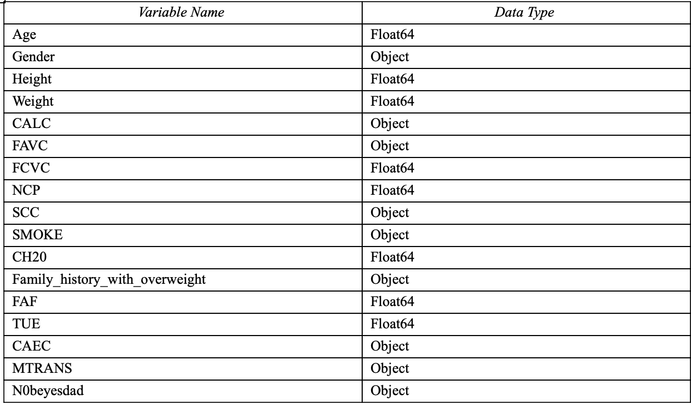

Slide 6
Exploratory Analysis Continued
Object variables FAVC, SCC, SMOKE, Family_history_with_overweight, and CAEC were changed through One-Hot encoding to binary code with 1=yes 0=no.
N0beyedsdad was encoded using Label encoding.
Insufficient weight = 0
Normal weight = 1
Obesity level I = 2
Obesity level II = 3
Obesity level III = 4
Overweight level I = 5
Overweight level II = 6

Slide 7
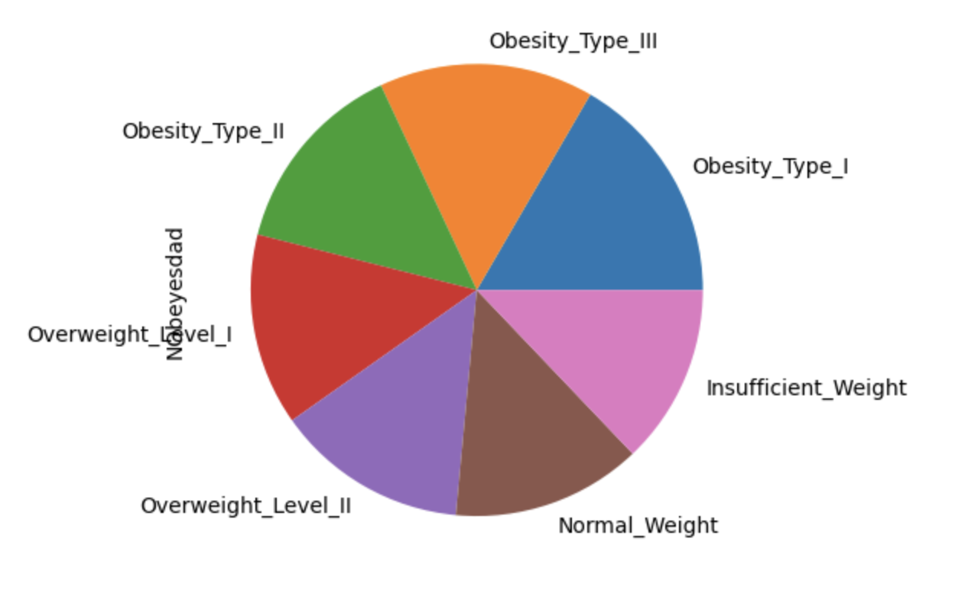

Slide 8
Data Preparation
No data normalization was required for this dataset
No variables were dropped
One-Hot encoding was used for the Object variables FAVC, SCC, SMOKE, Family_history_with_overweight, and CAEC in order to make them binary
Label encoding was used to convert the “N0beyesdad” object into integer values between 0-6 inclusive.

Slide 9
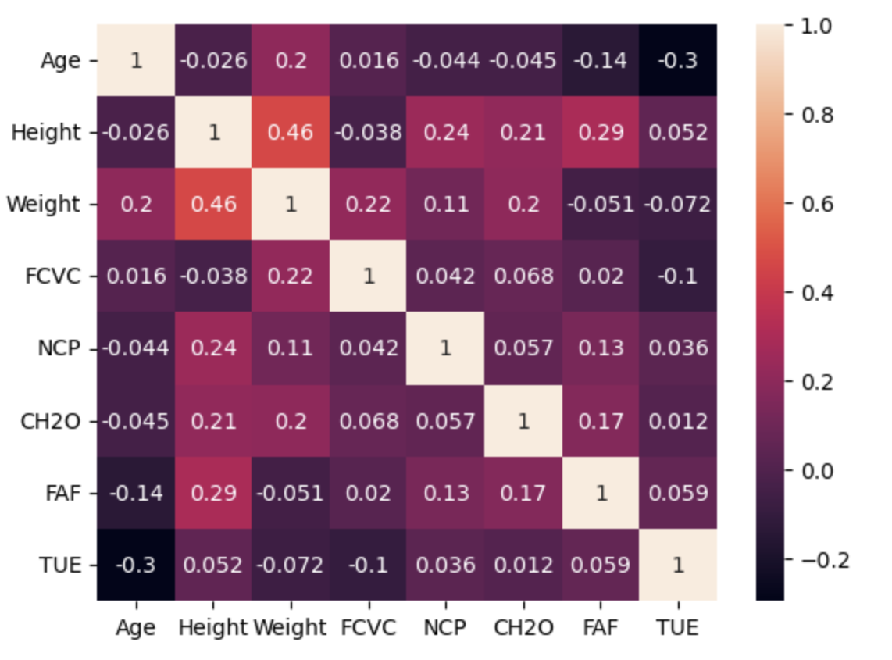
Heat Map
No good linear correlations
Logistic regression

Slide 10
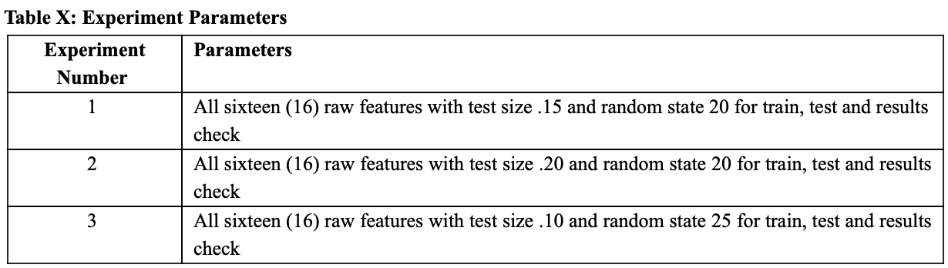
Experimental Design
The

Slide 11
Results
Testing success rate
Model 1: 4 tests, 100% success
Model 2: 3 tests, 33.33% success
Model 3: 3 tests, 33.33% success
Classification Report scores: f1, recall, precision
Model 1: 71%, 72%, 71%
Model 2: 69%, 70%, 69%
Model 3: 71%, 72%, 72%

Slide 12
Findings
Model 1 and 3 had similar classification reports
Model 2's was slightly worse
Model 1 is the best regression model due to classification scores and our testing

Slide 13
Problems and Solutions
Encoding of the data
Two different types of encoding
Test whether or not or model predicted the correct result for the dependent variable.

Slide 14
Future Improvements
Improvement of the dataset
More objective measures
More actually collected data
Improved model
More complex logarithmic models
Further testing
Further adjustment of experimental parameters

Slide 15
Conclusion
Some difficulty
Categorical variable encoding
3 experiment parameters used for the model
Experiment model 1 is the best model
Possibility for improvement

