Slide 1

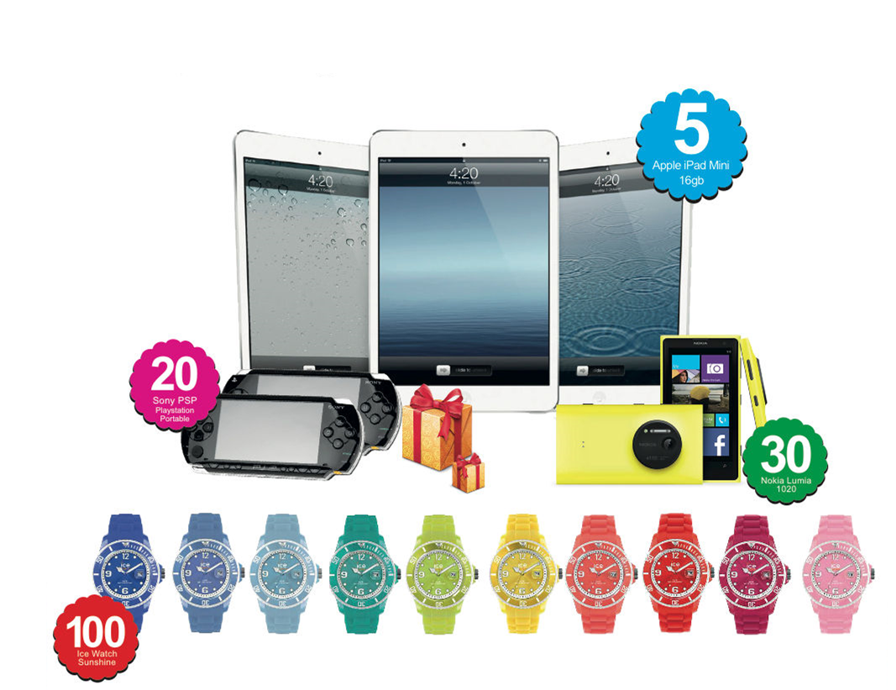
LUCKY DRAW
PRIZES
WIN PRIZES WEEKLY WORTH OVER RM 13,500
From 1 January 2014 – 30 June 2014

Slide 2

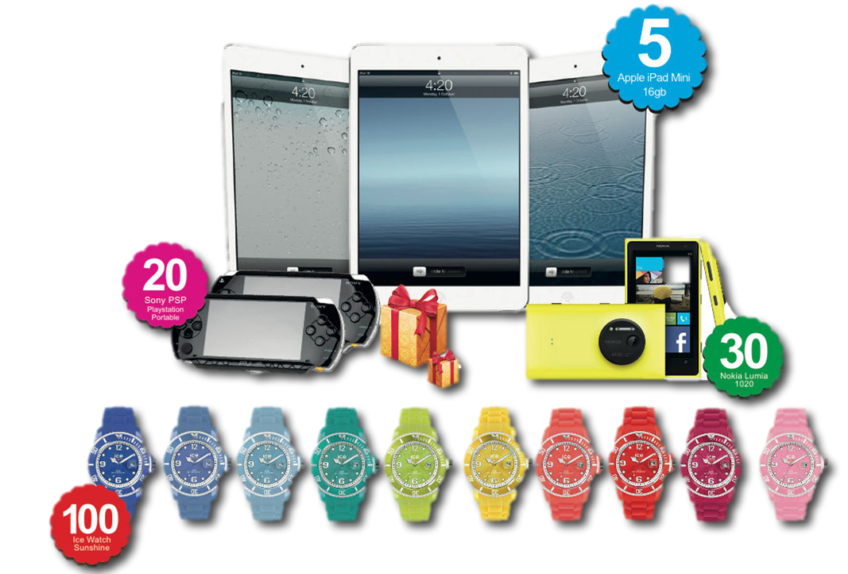
EASY BUBBLE O2
WIN
LUCKY DRAW
PRIZES
WIN PRIZES WEEKLY WORTH OVER RM 13,500
FROM 1st JANUARY – 30th JUNE 2014
GRAND PRIZE
APPLE IPAD MINI X 5
SECOND PRIZE
PLATSTATION PORTABLE X 20
THIRD PRIZE
NOKIA LUMIA 1020 X 30
CONSOLATION
ICE WATCH SUNSHINE X 100
FREE GIFT X 1000

Slide 4



