Slide 1

Microsoft SQL Server 2014
AlwaysOn Availability Groups
Percy Reyes
Sr. SQL DBA with over 10 years
SQL Server MVP, MCITP DBA, MCITP Dev, MCTS, MCP
Author at MSSQLTips.com
SQL PASS Peru Chapter Leader
www.percyreyes.com

Slide 2
Protect What?
Application data stores: Databases, Files, Other data repositories
Database services: DBMS availability for applications
Databases are the heart of most information systems. They deserve the highest
affordable protection.

Slide 3
Database Failure Scenarios
Logical Data Failures
Physical Infrastructure Failures
Storage subsystem:
Disk
Controller
Network
Server
Power
Operator errors
DBMS interruption
Drops / deletes
Application defects
DBMS defects
Data corruption

Slide 4
Business Case for High Availability
Keep business-critical applications available
Secondary: Server maintenance
Business Case for Disaster Recovery
Protect against loss of data center
Secondary:
Application upgrades
Infrastructure upgrades

Slide 5
Business Data Recovery Requirements
Requirements | Backup and Restore | Log Shipping | Replication | Mirroring | Failover Clustering | AlwaysOn Failover Clustering | AlwaysOn Availability Groups
Cost | Low | Low/Med |  | Medium | High | High | Medium
Separate Server | YES/NO | YES/NO | YES/NO | YES | NO | NO | YES
Separate Storage | YES/NO | YES/NO | YES/NO | YES | NO | NO | YES
Relative complexity | Low | Low | Medium | Medium/High | High | High | Medium/High
Data loss | Possible | Latest log | Possible/None | Possible/None | None | None | Possible/None
Scope of duplication | Database | Database | Objects | Database | DBMS | DBMS | Database
Failover | Manual | Manual | Manual | Manual/Automatic | Manual/Automatic | Manual/Automatic | Manual/Automatic
Client redirect | Manual | Manual | Manual | Automatic | Automatic | Automatic | Automatic
Rolling upgrades & maintance | No | No | NO | OS & DB | OS | OS | OS & DB
ReadOnly Access data on secondary | After Restore | YES, standBy | YES | YES, Snapshot | No | No | YES
Geographic separation | YES | YES | YES | YES (Latency?) | YES - Via VLAN,Latency? | YES - Native Support,Latency? | Latency?

Slide 6
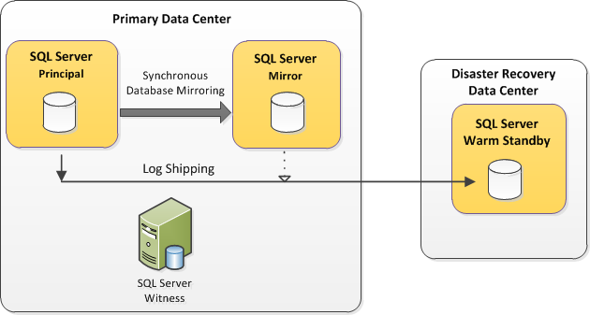
Legacy Architecture: Database Mirroring for High Availability and Log Shipping for Disaster Recovery

Slide 7
Legacy Architecture: FCI for high availability and database mirroring for disaster recovery

Slide 8

Maximum Availability with SQL Server 2014 Running Always On…. maximum uptime!
AlwaysOn ≠ Availability Groups
Availability Groups ≠ Database Mirroring
AlwaysOn = (SQL Server Failover Cluster Instances + Availability Groups)
High Availability (Local HA): Availability within a data center
Disaster Recovery (DR): Availability across data centers
Notes:
Customers require 24x7 uptime
It’s no longer the case that the world is full of companies who serve single geos and operate 9 to 5. That’s a 50-year-old world. Most companies today have a global presence, they have 24x7 operations and the word “maintenance window” is becoming a problem, not an opportunity. For this, required 9s and uptime is no longer a nice to have, it’s simply expected.
For SQL Server 2012, the cornerstone of Mission Critical Confidence is really a new feature called AlwaysOn that will help get organizations to their required 9s more easily. Customers in production are already experiencing 2x faster failovers which is leading to even greater uptime for their must-have mission critical applications.

Slide 9
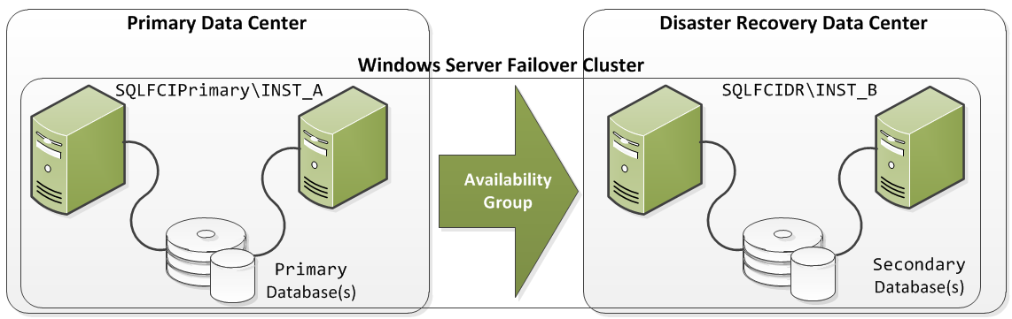
Maximum Availability with SQL Server 2014 Running Always On…. maximum uptime!
NATIVE AlwaysOn Multi-site Failover Cluster Instance IS HERE!
Notes:
Customers require 24x7 uptime
It’s no longer the case that the world is full of companies who serve single geos and operate 9 to 5. That’s a 50-year-old world. Most companies today have a global presence, they have 24x7 operations and the word “maintenance window” is becoming a problem, not an opportunity. For this, required 9s and uptime is no longer a nice to have, it’s simply expected.
For SQL Server 2012, the cornerstone of Mission Critical Confidence is really a new feature called AlwaysOn that will help get organizations to their required 9s more easily. Customers in production are already experiencing 2x faster failovers which is leading to even greater uptime for their must-have mission critical applications.

Slide 10
SQL Server AlwaysOn Solutions Maximize uptime for mission critical applications
Notes:
Customers require 24x7 uptime
It’s no longer the case that the world is full of companies who serve single geos and operate 9 to 5. That’s a 50-year-old world. Most companies today have a global presence, they have 24x7 operations and the word “maintenance window” is becoming a problem, not an opportunity. For this, required 9s and uptime is no longer a nice to have, it’s simply expected.
For SQL Server 2012, the cornerstone of Mission Critical Confidence is really a new feature called AlwaysOn that will help get organizations to their required 9s more easily. Customers in production are already experiencing 2x faster failovers which is leading to even greater uptime for their must-have mission critical applications.

Slide 11
Readable Secondary – Data Latency
Primary
Secondary
DB1
Log Capture
Network
DB1
Log Capture
Log Receive
Commit
Log Pool
Redo Thread
Log Cache
Log Cache
Redo Pages
Log Flush
Log Hardened
DB1 Log
DB1 Data
Acknowledge Commit
DB1 Log
DB1 Data
Secondary read is always behind primary during transaction activity
Notes:
Explain that the log cache is flushed when either it is full or a transaction has committed.
Sync implies no data loss
Explain why it is only close to real time and never real time even when the mode is synchronous
What happens
On Async Replica when network is slow (data loss)
What happens if the REDO thread is slow to apply the log

Slide 12
SQL Server 2012/2014 HA & DR Solutions
1 | Multi-site Failover Cluster Instance (FCI) for HA & DR | Shared Storage solution Instance Level HA Instance Level DR Doesn’t require database to be in FULL recovery model
2 | Availability Group for HA & DR | Non-Shared Storage solution (Group of) Database Level HA (Group of) Database Level DR DR replica can be Active Secondary Requires database to be in FULL recovery model
3 | Failover Cluster Instance for local HA & Availability Group for DR | Combined Shared Storage and Non-Shared Storage Instance Level HA (Group of) Database Level DR DR replica can be Active Secondary Requires database to be in FULL recovery model

Slide 13
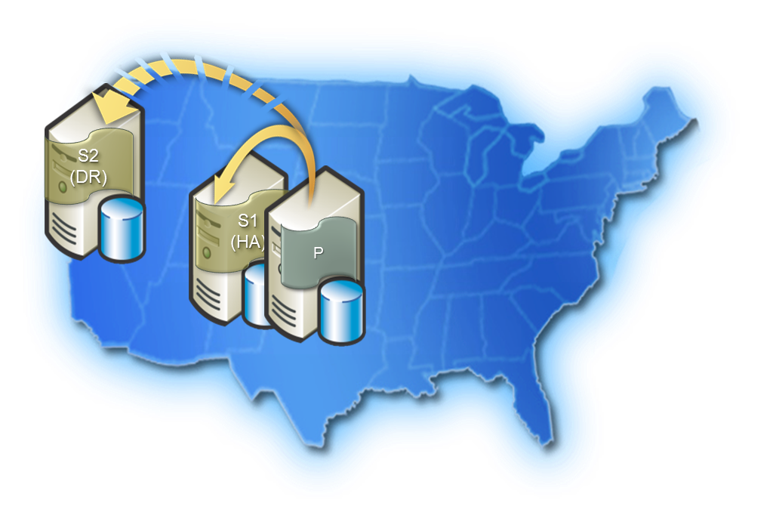
Disaster Recovery between On Premise and Azure
WHY?
An event can cause on-premise SQL Server to become unavailable
Temporarily (e.g. gateway failure)
Permanently (e.g. flooding, fire)
Disaster recovery site is expensive
Site rent + maintenance
Hardware
Operations

Slide 14
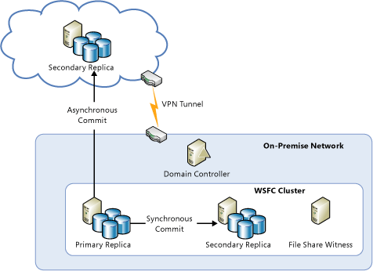
Example of Availability Group spanning On-premise and Azure
Notes:
Provide additional benefits
Integrated HA/DR
Offload Read workloads to Azure
Connect reporting/BI apps
Migrate apps and run against local secondaries
Offload Backups to Azure
A solution for policy compliance
Remember it requires
Same Windows Domain
Needs an Active Directory Domain Controller

Slide 15
AlwaysOn Availability Groups
Multi-database failover
Multiple secondaries
Total of 8 secondaries
2 synchronous secondaries
1 automatic failover pair
Synchronous and asynchronous data movement
Built in compression and encryption
Auto-page repair
Automatic and manual failover (new design)
Flexible failover policy
Flexible
Application failover using virtual name
Configuration Wizard
Dashboard
System Center Integration
Rich diagnostic infrastructure
File-stream replication
Replication publisher failover
Integrated
Active Secondary
Readable Secondary
Backup from Secondary
Improves primary server performance by offloading work to secondary
Monitoring and Troubleshooting enhanced
Automation using PowerShell
Efficient
Notes:
Stuff in Orange is not new.

Slide 16
Availability Group Listener
Provide client connectivity to availability group databases
Client Access Point Clustered Resource
DNS name
One or more IP addresses
Listener port
Create listener for availability group in SQL Server
Availability group resource dependency on listener resource
Listener Advantages
Connect to the primary replica (read/write)
Read intent connection routed to secondary
Multiple subnet Listener (stretch cluster, multi-site, remote site)
Notes:
It is a single connection point for an availability group.
It always connects application to the primary replica.
The dependency ensures that both resources failover together.
Completes the high availability story.
Following failover, applications redirected to new production server

Slide 17
Client Connectivity
Client connection behavior determined by the Availability Group Replica option
Replica option determines whether a replica is enabled for read access when in a secondary role and which clients can connect to it
Choices are:
No connections
Only connections specifying Application Intent=ReadOnly connection property
All connections

Slide 18
ReadOnly Routing
Read-only Routing enables redirection of client connection to new readable secondary after a failover
Connection specifies the Availability Group Listener Virtual Name plus Application Intent=ReadOnly in the connection string
Possible for connections to go to different readable secondaries if available to balance read-only access
Standard connections are routed to the Primary server for read/write operations
ReadOnly connections are routed to a readable secondary based on ReadOnly routing configuration

Slide 19




AlwaysOn Active Secondaries
AlwaysOn Active Secondary enables efficient utilization of high availability hardware resources to improve overall IT efficiency
IT EFFICIENCY AND COST-EFFECTIVENESS ARE CRITICAL FOR BUSINESSES
Idle hardware is no longer an option.
Active Secondary uses
Read-only workloads
Offloading Backups

Slide 20
Mechanisms to Monitor AlwaysOn Health
Cluster and Cluster State
sys.dm_hadr_cluster
sys.dm_hadr_cluster_members
Availability Group, Replica, Database
select * from sys.availability_groups
select * from sys.availability_replicas
select * from sys.availability_databases_cluster
State Information
sys.dm_hadr_availability_group_states
sys.dm_hadr_availability_replica_states
sys.dm_hadr_database_replica_states
sys.dm_hadr_database_replica_cluster_states
Notes:
AlwaysOn Dynamic Management Views
- Provides real-time state and performance details.
- T-SQL to query state, performance
Use in alerts, jobs
- No historical data

Slide 21

Stay Involved!
Sign up for a free membership today at sqlpass.org
Linked In: Professional Association for SQL Server
Facebook: SQL PASS Peru
Twitter: @SQLPASSPERU
The Web Site: peru.sqlpass.org
Email: sqlpassperu@sqlpass.org

Slide 22
Thank You: Q&A
PERCY REYES
Twitter: @percyreyes
Web Site: www.percyreyes.com
Email/Skype/Facebook: percy.reyes@live.com

