Slide 1
Pimcore
Fundamentals
03/16/2020

Slide 2
On this session…
Pimcore ecosystem
Overview: what is and what isn’t Pimcore?
Pimcore architecture
Pimcore in a nutshell
Getting started
System requirements

Slide 3
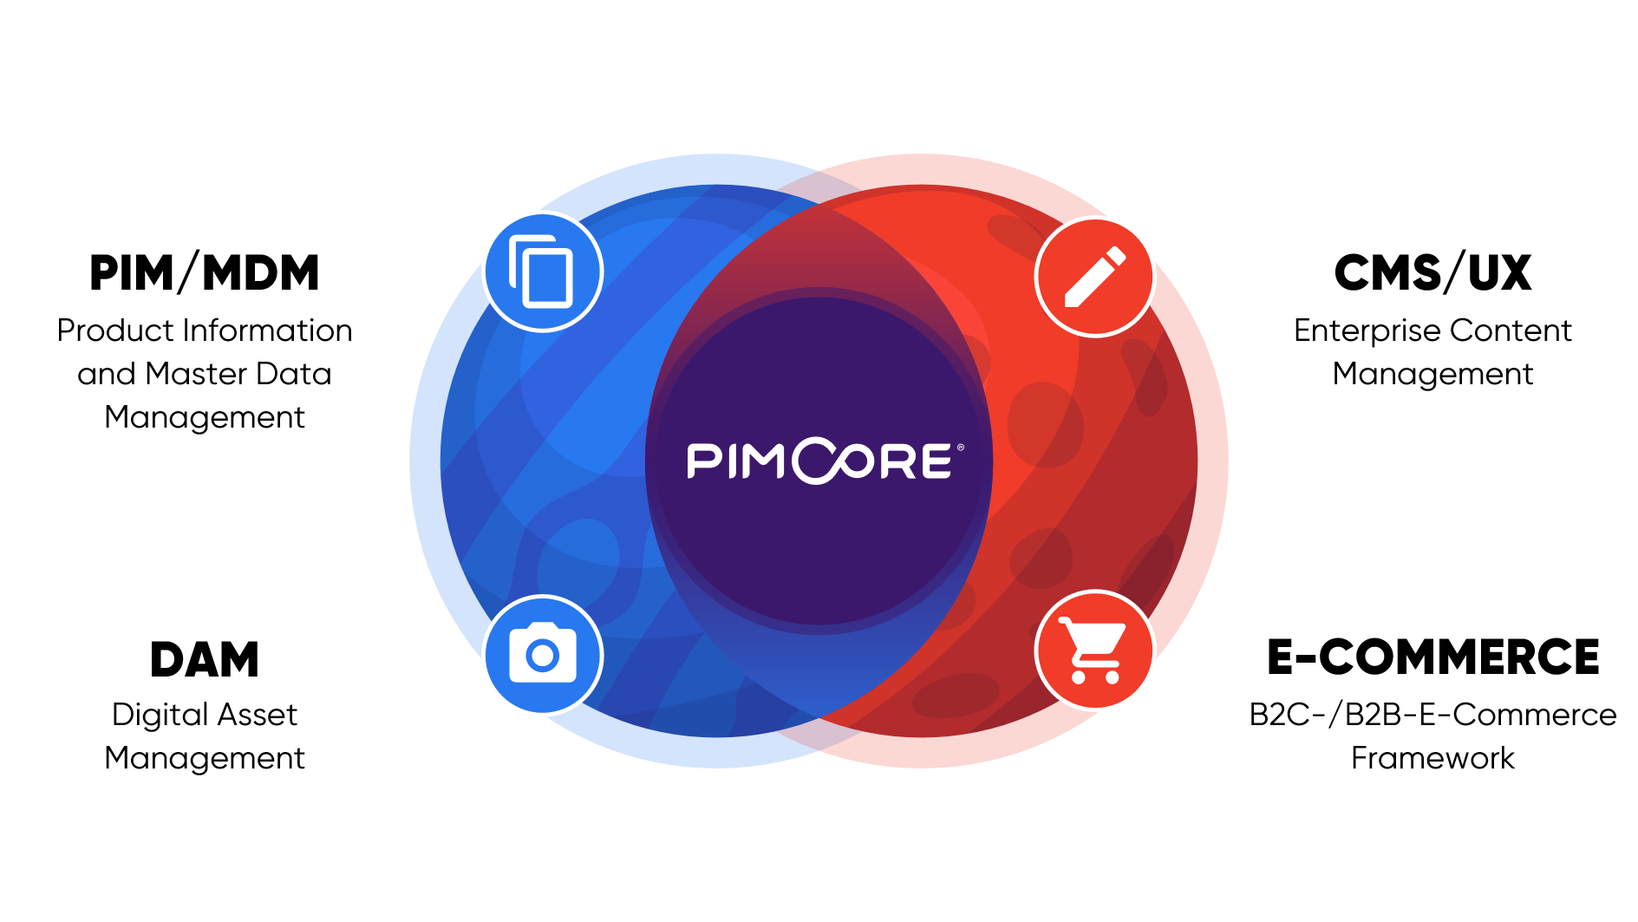
Overview: what is and what isn’t Pimcore?
Pimcore is the leading open source platform for managing digital data and a fully integrated software stack for
CMS, DAM, PIM and Commerce.
As a platform, pimcore provides a solid foundation with generic functionality for all kinds of web applications and
therefore allows rapid application development and building customer solutions really fast.
Pimcore is built for developers and should empower them to build great digital experiences easily. As a consequence, Pimcore is NOT an ‘out-of-the-box’ software product like Wordpress, Magento, Akeneo, WooCommerce, Shopify and others. You need a developer to get started.

Slide 4
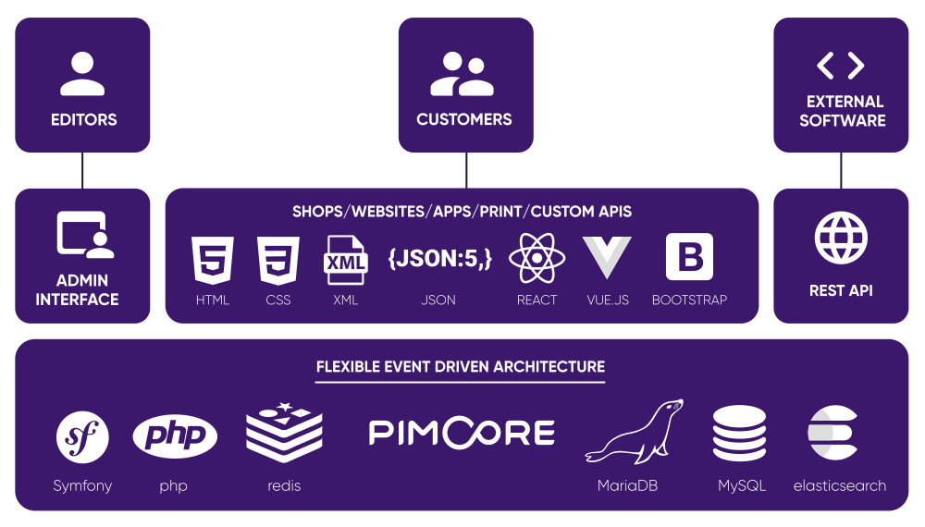
Pimcore architecture

Slide 5



Pimcore in a nutshell
Pimcore is intended to provide ONE platform for ANY data, ANY channel, ANY process and ANY one.
ANY Data. In Pimcore every digital content can be managed and put in relation with each other, so we're also talking about master data management. There are three main element data types in Pimcore:
Assets are the DAM part of Pimcore. Within assets every digital file (images, videos, pdfs, …) can be stored and managed in a folder structure.
Documents are the CMS part of Pimcore and can be used to manage unstructured data. Based on a template, documents can contain any content and can be used to create webpages, print pages or any other output format.
Objects are the PIM/MDM part of Pimcore and are the way to go for managing structured data within Pimcore. Based on a class definition that defines the structure and attributes, objects can be used for pretty much any structured data – may it be products, categories, persons, customers, news, orders, blog entries, …

