Slide 1
Docker / Rkt
Orchestration
05/02/2020

Slide 2
On this document…
What is container orchestration?
Doing rkt orchestration
Rkt integration
Doing Docker orchestration
Docker Swarm

Slide 3
What is container orchestration?

Slide 4
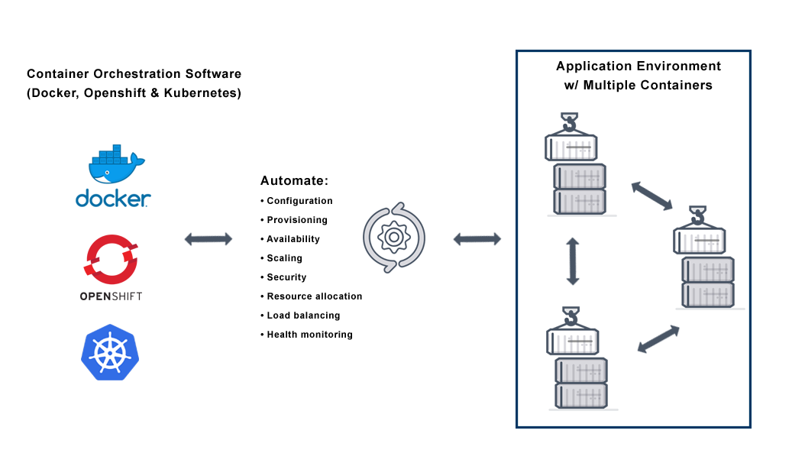
Getting started with orchestration
Container orchestration is the automatic process of managing or scheduling the work of individual containers for applications based on microservices within multiple clusters. The widely deployed container orchestration platforms are based on open-source versions like Kubernetes, Docker Swarm or the commercial version from Red Hat OpenShift.

Slide 5
Orchestration allows us to perform a lot of tasks automatically in a large scale like:
• Configuring and scheduling of containers
• Provisioning and deployments of containers
• Availability of containers
• The configuration of applications in terms of the containers that they run in
• Scaling of containers to equally balance application workloads across infrastructure
• Allocation of resources between containers
• Load balancing, traffic routing and service discovery of containers
• Health monitoring of containers
• Securing the interactions between containers

Slide 6
Doing rkt orchestration

Slide 7

Rkt integration
One of the most important tools rkt has integration is Kubernetes. Kubernetes is a system for managing containerized applications across a cluster of machines. Kubernetes runs all applications in containers. In the default setup, this is performed using the Docker engine, but Kubernetes also features support for using rkt as its container runtime backend. This allows a Kubernetes cluster to leverage some of rkt's security features and native pod support

Slide 8
Doing Docker Orchestration

Slide 9
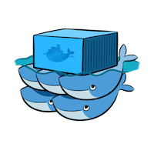
Docker Swarm
In 1.12, Docker introduced Swarm Mode. Swarm Mode enables the ability to deploy containers across multiple Docker hosts, using overlay networks for service discovery with a built-in load balancer for scaling the services.
Swarm Mode is managed as part of the Docker CLI, making it a seamless experience to the Docker ecosystem.

Slide 10
Key concepts
Docker Swarm Mode introduces three new concepts which we'll explore in this scenario.
Node: A Node is an instance of the Docker Engine connected to the Swarm. Nodes are either managers or workers. Managers schedules which containers to run where. Workers execute the tasks. By default, Managers are also workers.
Services: A service is a high-level concept relating to a collection of tasks to be executed by workers. An example of a service is an HTTP Server running as a Docker Container on three nodes.
Load Balancing: Docker includes a load balancer to process requests across all containers in the service.

Slide 11
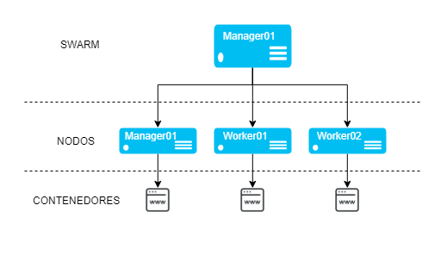
Key concepts

Slide 12
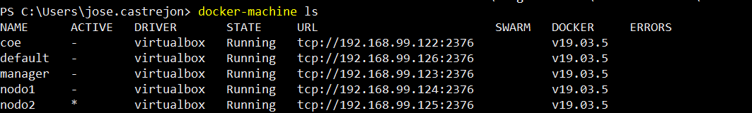
Getting started
We have this scenario:
Three Docker Machines named manager, nodo1 and nodo2 which will be part of our Docker Swarm

Slide 13
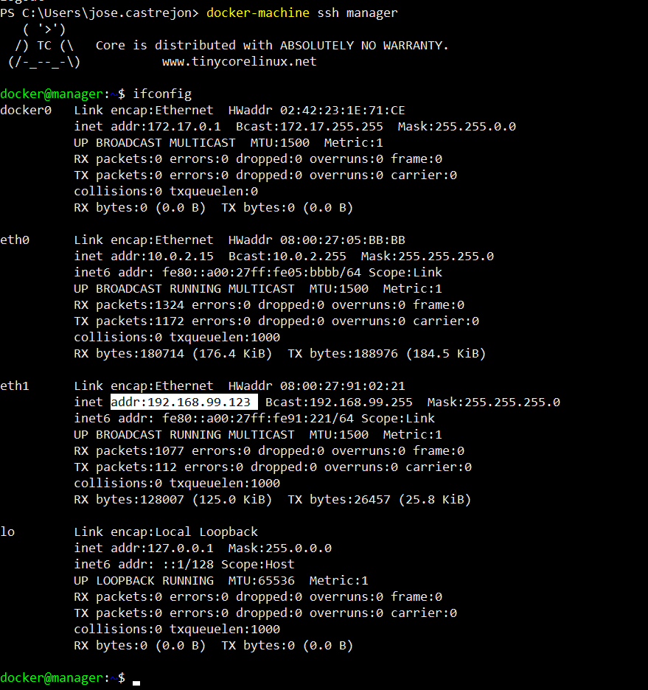
Getting started
First step is obtaining the IP address of our manager

Slide 14
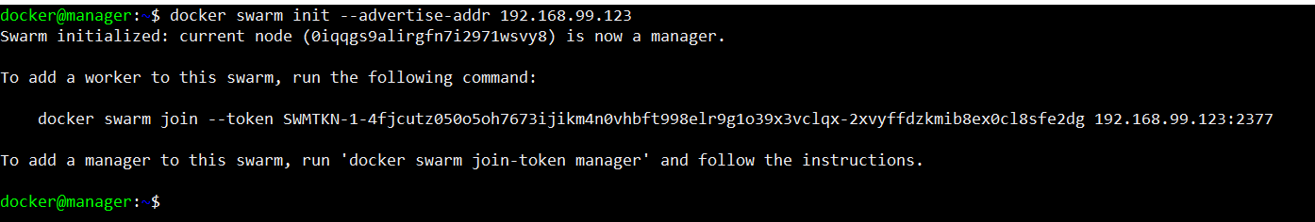
Initizalizing swarm mode
docker swarm join --token SWMTKN-1-4fjcutz050o5oh7673ijikm4n0vhbft998elr9g1o39x3vclqx-2xvyffdzkmib8ex0cl8sfe2dg 192.168.99.123:2377

Slide 15
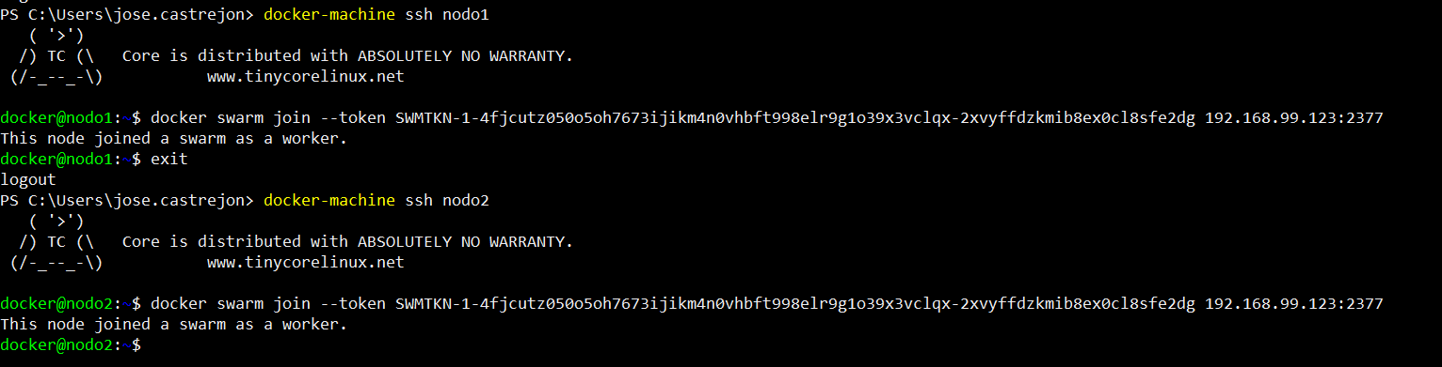
Adding workers to swarm
Just exectute docker swarm join - -token !

Slide 16
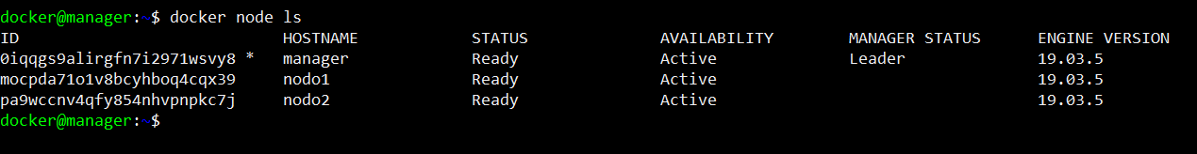
We’re all set!

Slide 17
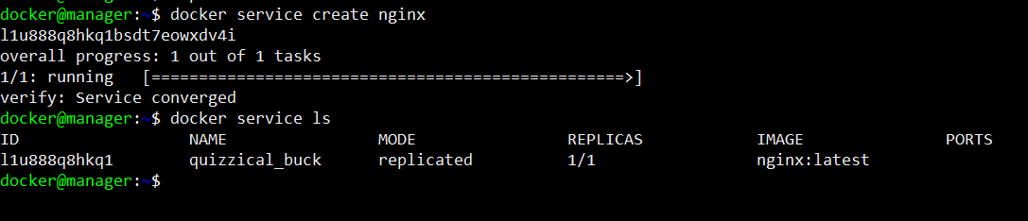
Deploying a service

Slide 18
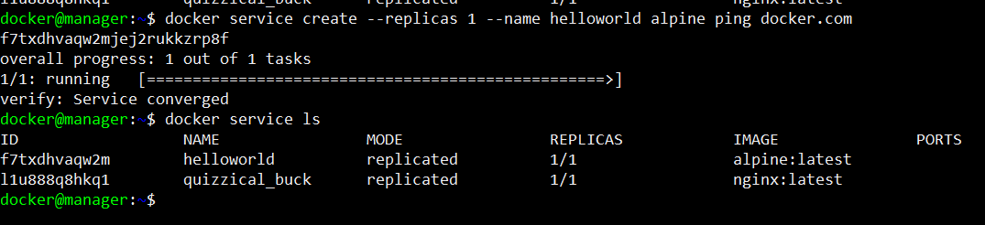
Deploying a service

Slide 19
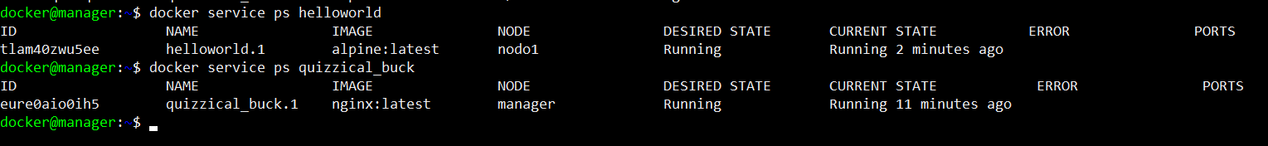
Listing a service

Slide 20
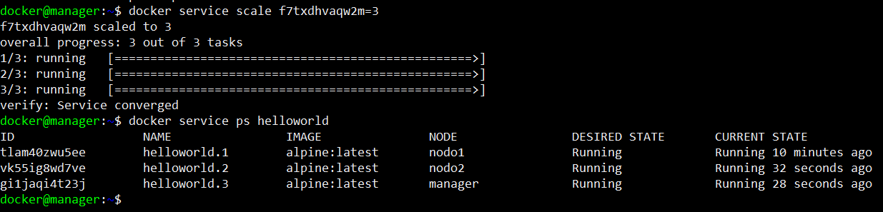
Scaling a service

Slide 21
if(questions == FALSE) console.log(“Stay in touch next week!”);

Slide 22

José Castrejón Aguilar
jose.castrejon@softtek.com

