Slide 1
Docker
Manage sensitive data with Docker Secrets
03/13/2020

Slide 2
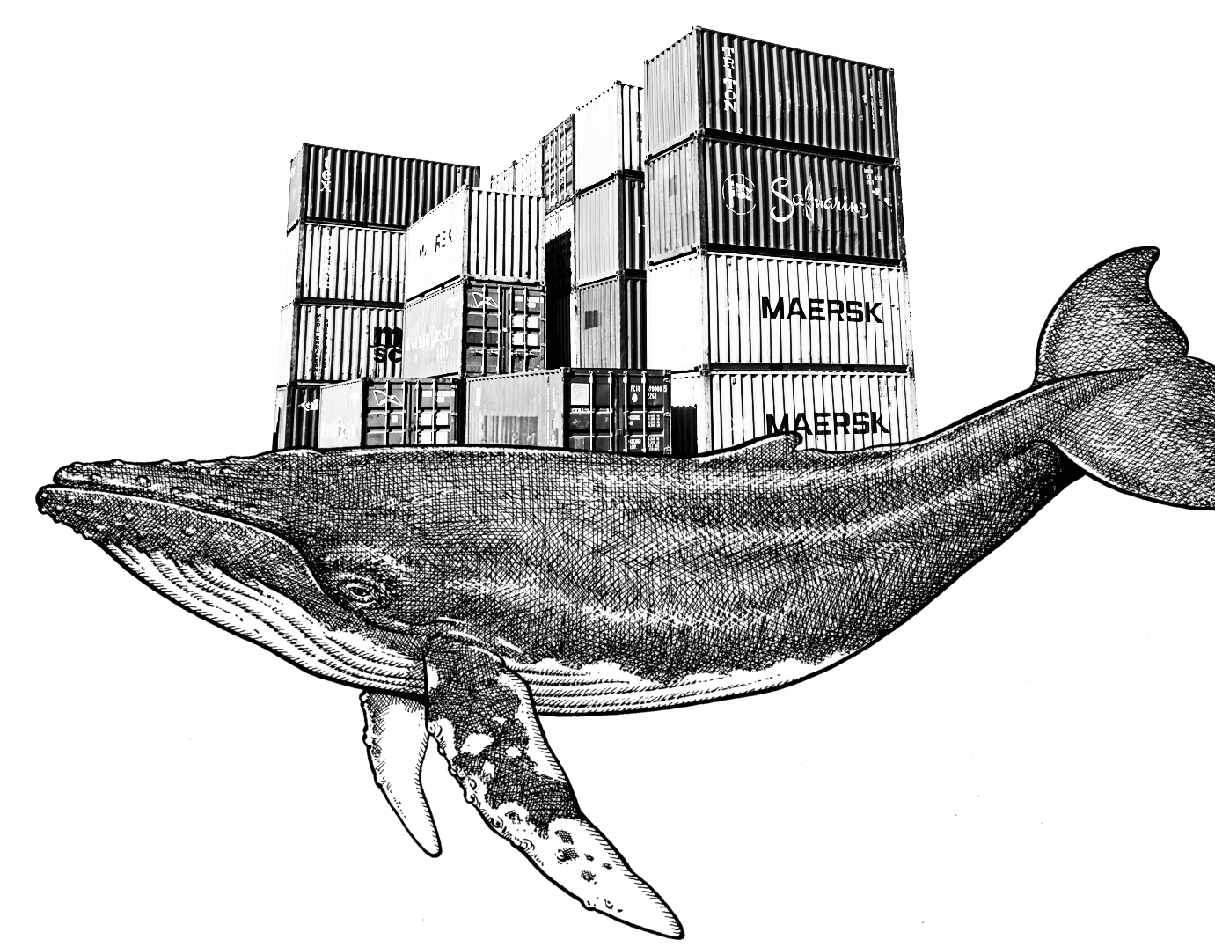
On this session…
About secrets
How Docker manages Secrets
The docker secret command
Examples with Secrets

Slide 3
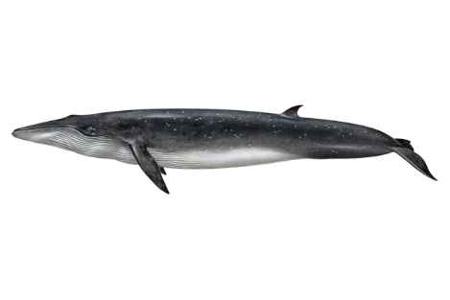
About secrets: your security matters

