Slide 1
Docker
Working with stacks
03/05/2020

Slide 2
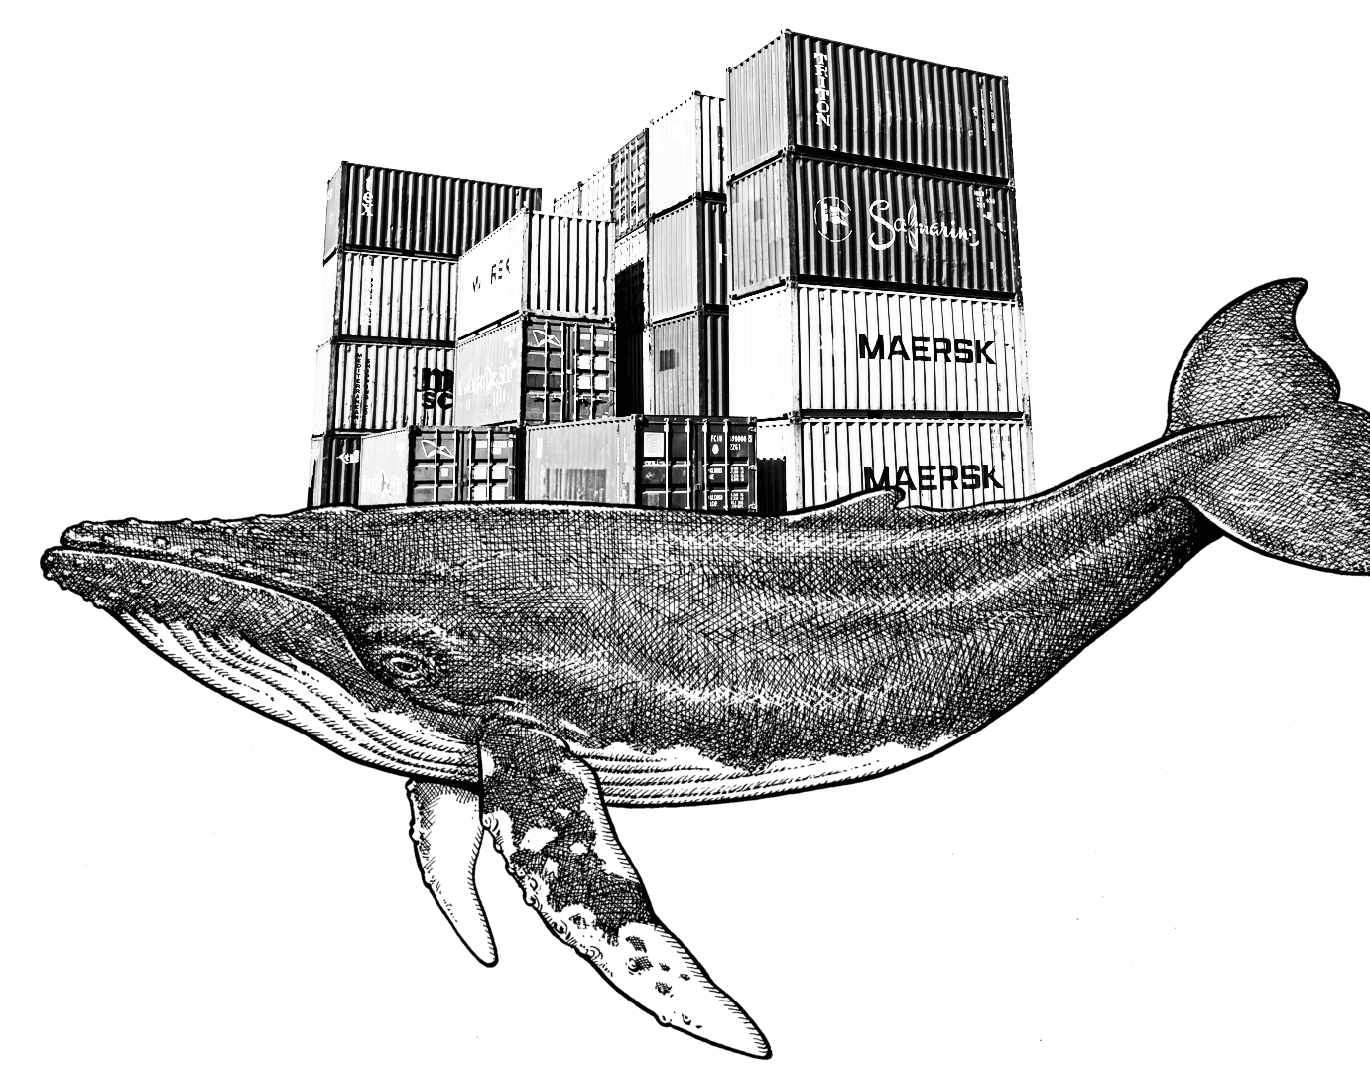
On this session…
What area stacks?
Changes on .yml files: no more ‘build’ required
Analizing the .yml file
The docker stack deploy command

Slide 3
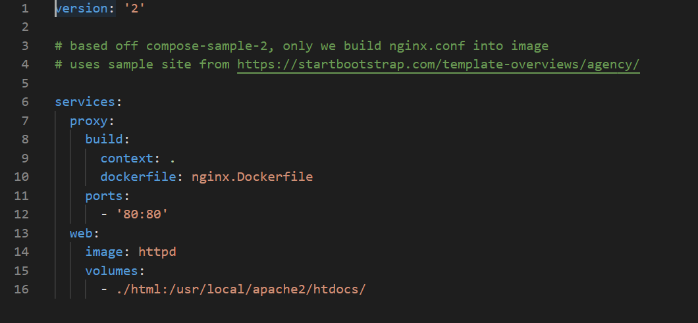
What are stacks?
First… do you remember Docker Compose? Docker Compose is an official tool that helps you manage your Docker containers by letting you define everything through a docker-compose.yml file. Here’s an example:
REMEMBER THAT IT IS INTENDED TO USE ONLY AT DEVELOPMENT STAGES

Slide 4
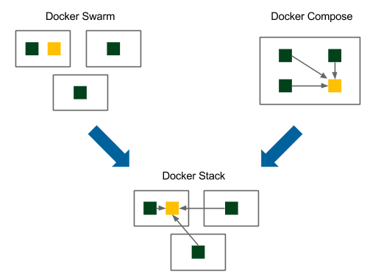
So, whats the difference?
Docker stack is ignoring “build” instructions. You can’t build new images using the stack commands. It need pre-built images to exist. So docker-compose is better suited for development scenarios.
Internally, it uses the Docker API to bring up containers according to a specification. You still have to install docker-compose separately to use it with Docker on your machine.
The Docker Stack functionality, is included with the Docker engine. You don’t need to install additional packages to use it Deploying docker stacks is part of the swarm mode.

Slide 5
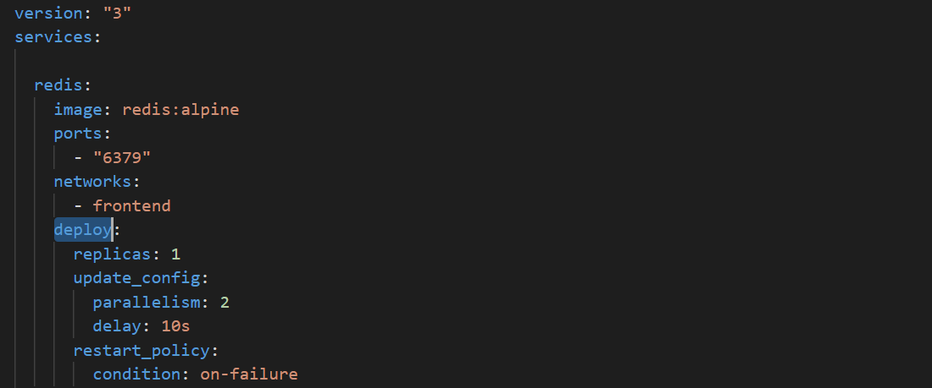
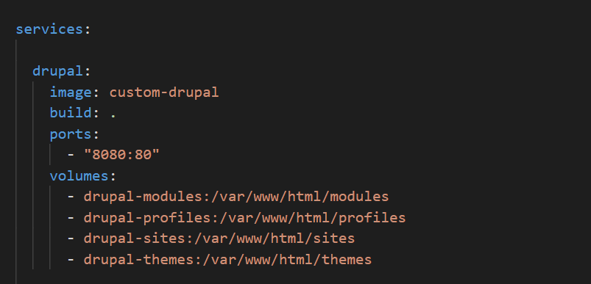
Changes on .yml file: no more build required
In some cases, certain features that only work with docker stack are ignored by Docker Compose, and likewise, unsupported features of Docker Compose are ignored by the docker stack command.
For example, the deploy property is ignored by Docker Compose and depends_on is ignored by docker stack. There are other differences too. You can find them out by checking out the official Compose file reference. It will call out Compose or Stack specific properties.

Slide 6
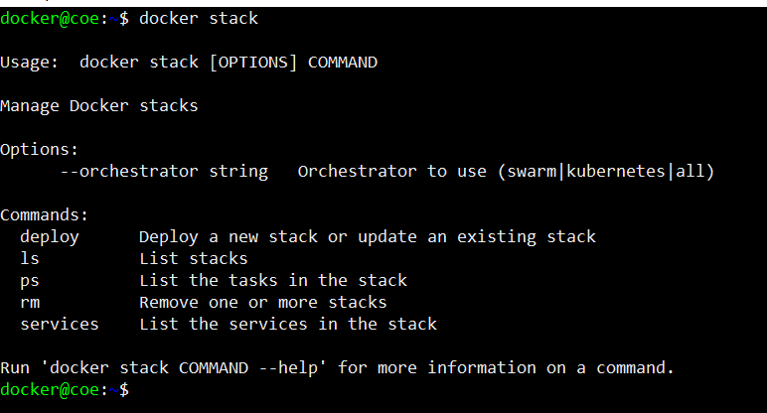
The docker stack deploy command
When running Docker Engine in swarm mode, you can use docker stack deploy to deploy a complete application stack to the swarm. The deploy command accepts a stack description in the form of a Compose file.
The docker stack deploy command supports any Compose file of version “3.0” or above.

Slide 7
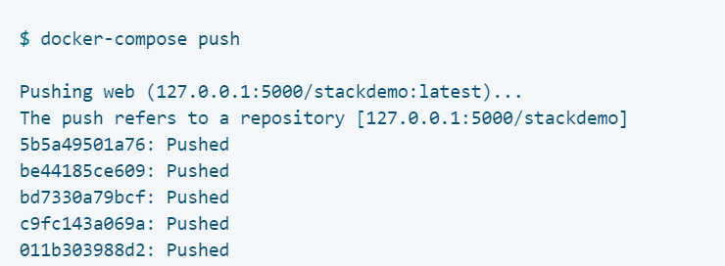
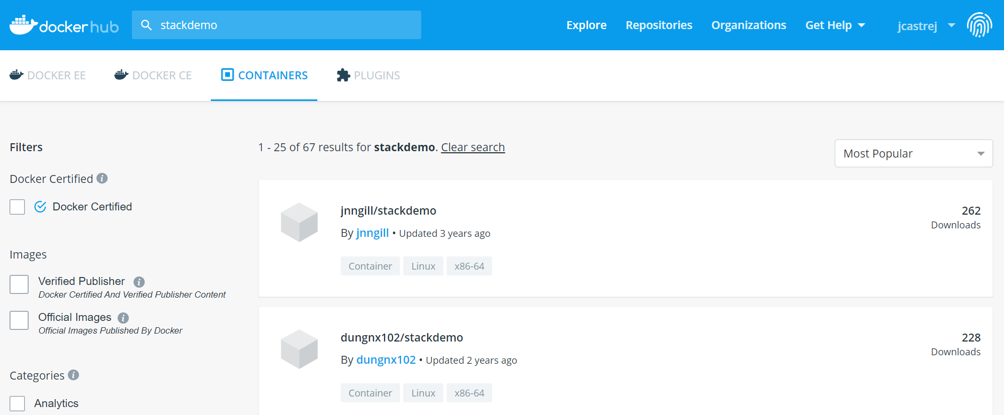
Prerrequisites for use docker stack
As we said previously, docker stack command needs pre built images to run. That images need to be on Docker Hub
To distribute the image across the swarm, it needs to be pushed to the registry you set up earlier. With Compose, this is very simple:

Slide 8
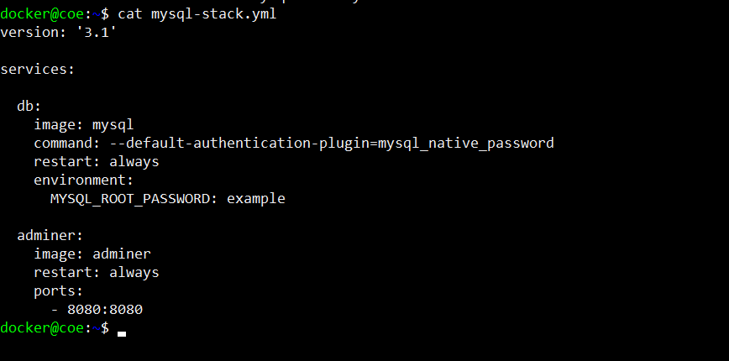
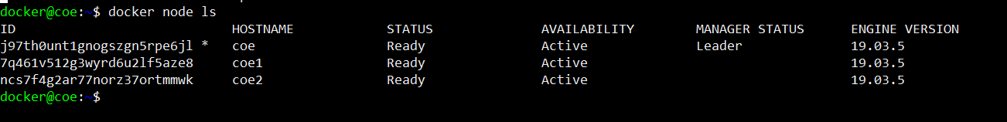
A tiny example
Let’s deploy a simple MySQL db instance with an Adminer image. Here’s the .yml file. For running it you only need a simple command:
$docker stack –c mysql-stack.yml SERVICE_NAME
Remember: you must have a Docker Swarm cluster prevoulsy configurated

Slide 9
Let’s see a more elaborated scenario
6 services
2 networks
1 volume for data persistence

