Slide 1
Docker / Rkt
Volumes
21/02/2020

Slide 2
On this document…
Some concepts about volumes
How Docker manages the volumes?

Slide 3
Some conceptos about volumes

Slide 4

Volumes are the preferred mechanism for persisting data generated by and used by Docker containers. While bind mounts are dependent on the directory structure of the host machine, volumes are completely managed by Docker. Volumes have several advantages over bind mounts:
Volumes are easier to back up or migrate than bind mounts.
You can manage volumes using Docker CLI commands or the Docker API.
Volumes work on both Linux and Windows containers.
Volumes can be more safely shared among multiple containers.
Volume drivers allow you to store volumes on remote hosts or cloud providers, to encrypt the contents of volumes, or to add other functionality.
A new volume’s contents can be pre-populated by a container.

Slide 5
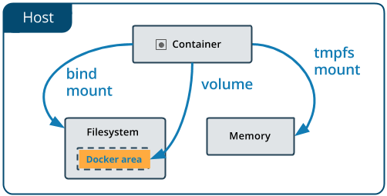
In addition, volumes are often a better choice than persisting data in a container’s writable layer, because using a volume does not increase the size of containers using it, and the volume’s contents exist outside the lifecycle of a given container.

Slide 6
How Docker manages volumes?

Slide 7
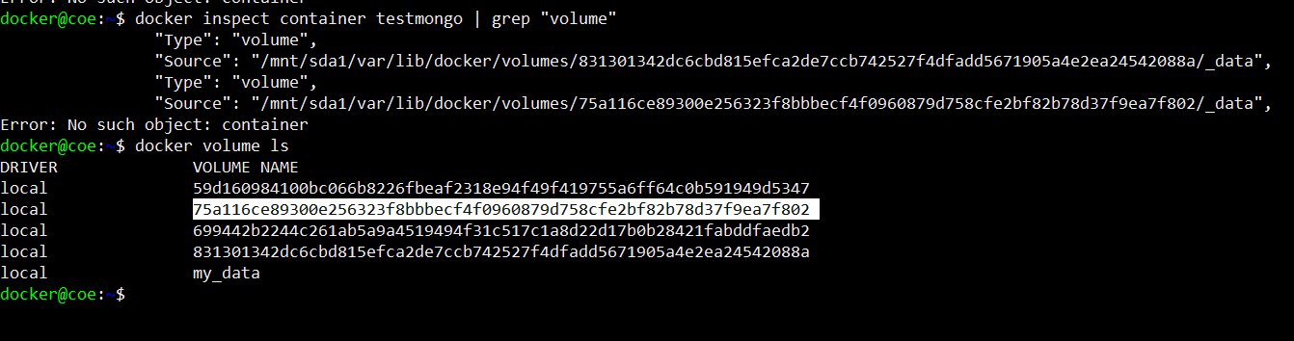
You data matters!
By creating a new container with data interaction (i.e. a MySQL or MongoDB container) Docker will assign a default volume identified by a hash.

Slide 8

There is some helpful commands
docker volume COMMAND has the following options:
create Create a volume
inspect Display detailed information on one or more volumes
ls List volumes
prune Remove all unused local volumes
rm Remove one or more volumes

Slide 9
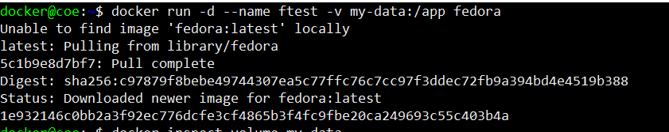
Attaching volumes to containers
We can attach an existing (or not) volume to a new container by using the –v or –-mount options when typing docker run command on our terminal

Slide 10
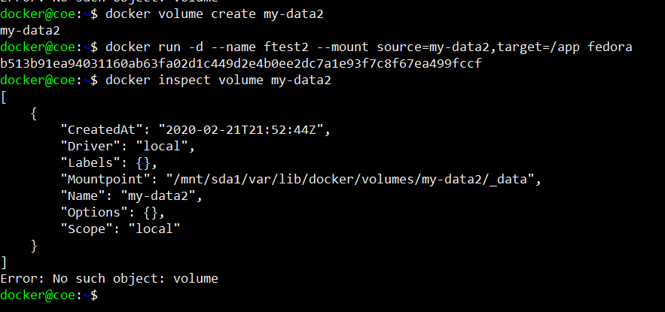

Slide 11
if(questions == FALSE) console.log(“Stay in touch next week!”);

Slide 12

José Castrejón Aguilar
jose.castrejon@softtek.com

