Slide 1
Fastai Lesson 12a review
Joseph Catanzarite
Fastai Deep Learning From The Foundations
TWiML Study Group Meetup
Saturday, 11/02/2019

Slide 2
Overview
Today
Start Lesson 12
Watch video, up to 48:45
Study, run and play with notebooks
10b_mixup_label_smoothing
10c_fp16
11_train_imagenette
Next 3 meetings: continue in Lesson 12
Nov 9th:
11_train_imagenette
Nov 16th:
Watch video, 48:45 up to 1:15:12
Study, run and play with notebooks
11a_transfer_learning
12_text
Nov 23th:
Watch video, 1:15:12 to end
Study, run and play with notebooks
12_awd_lstm
12c_ulmfit

Slide 3
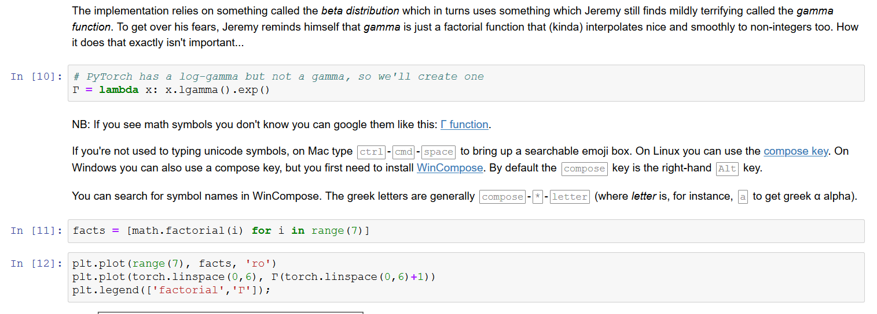
Factorial, Gamma, Beta

Slide 4
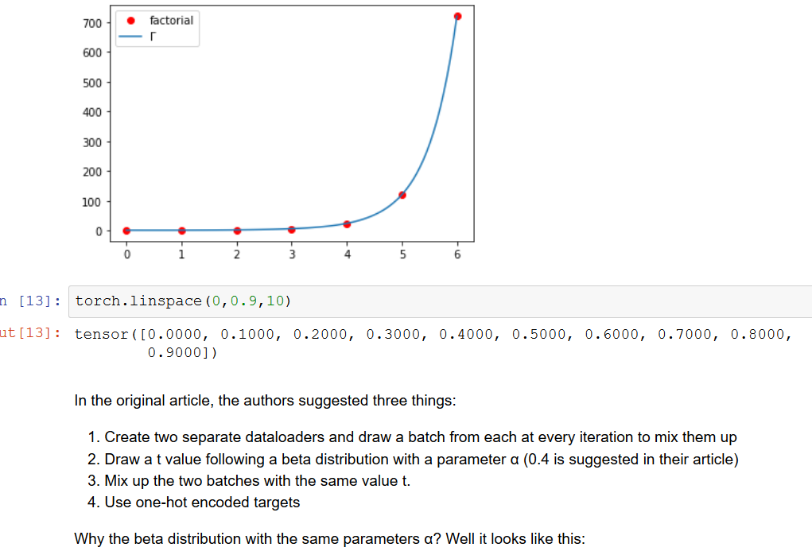

Slide 5
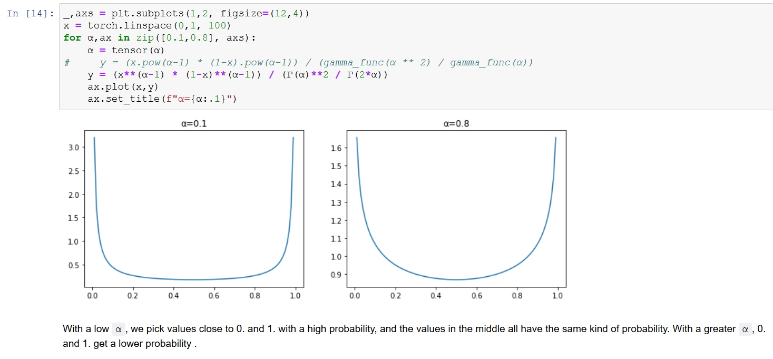
Beta Distribution

Slide 6
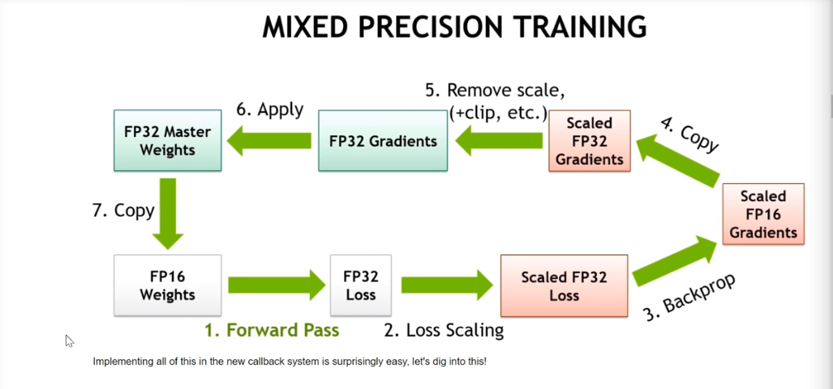
Mixed Precision

Slide 7
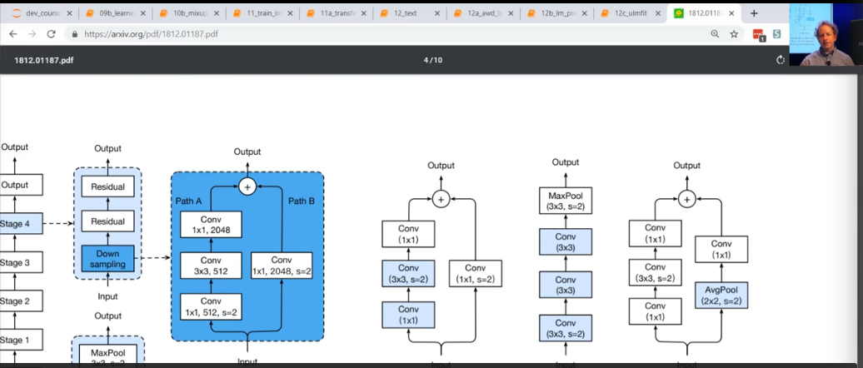
ResNet

