Slide 1
Fastai Lesson 11a review
Joseph Catanzarite
Fastai Deep Learning From The Foundations
TWiML Study Group Meetup
Saturday, 10/12/2019

Slide 2
Overview
Today:
Start Lesson 11:
Notebooks:
07a_lsuv
08_data_blockThis week
Next meeting:
Notebooks:
09_optimizers

Slide 3
Questions about RunningBatchNorm in Lesson 10
https://forums.fast.ai/t/questions-about-runningbatchnorm-in-lesson-10/56331

Slide 4
Simplified RunningBatchNorm in Lesson 11
https://forums.fast.ai/t/simplified-runningbatchnorm-in-lesson-11/56340

Slide 5
LSUV Implementation Question:
In the paper “All you need is a good init” the authors say that their Algorithm 1 is intended to follow a certain orthonormal initialization procedure: “We thus extend the orthonormal initialization Saxe et al. (2014) to an iterative procedure, described in Algorithm 1. Saxe et al. (2014) could be implemented in two steps. First, fill the weights with Gaussian noise with unit variance. Second, decompose them to orthonormal basis with QR or SVD decomposition and replace weights with one of the components.”
Question @Sylvain, @stas or anyone else who knows: why did Fastai omit the Saxe et al. (2014) orthonormal initialization procedure?
https://forums.fast.ai/t/lesson-11-discussion-and-wiki/43406/366

Slide 6
A minor tweak that fixes the LSUV algorithm normalization
https://forums.fast.ai/t/lesson-11-discussion-and-wiki/43406/365

Slide 7
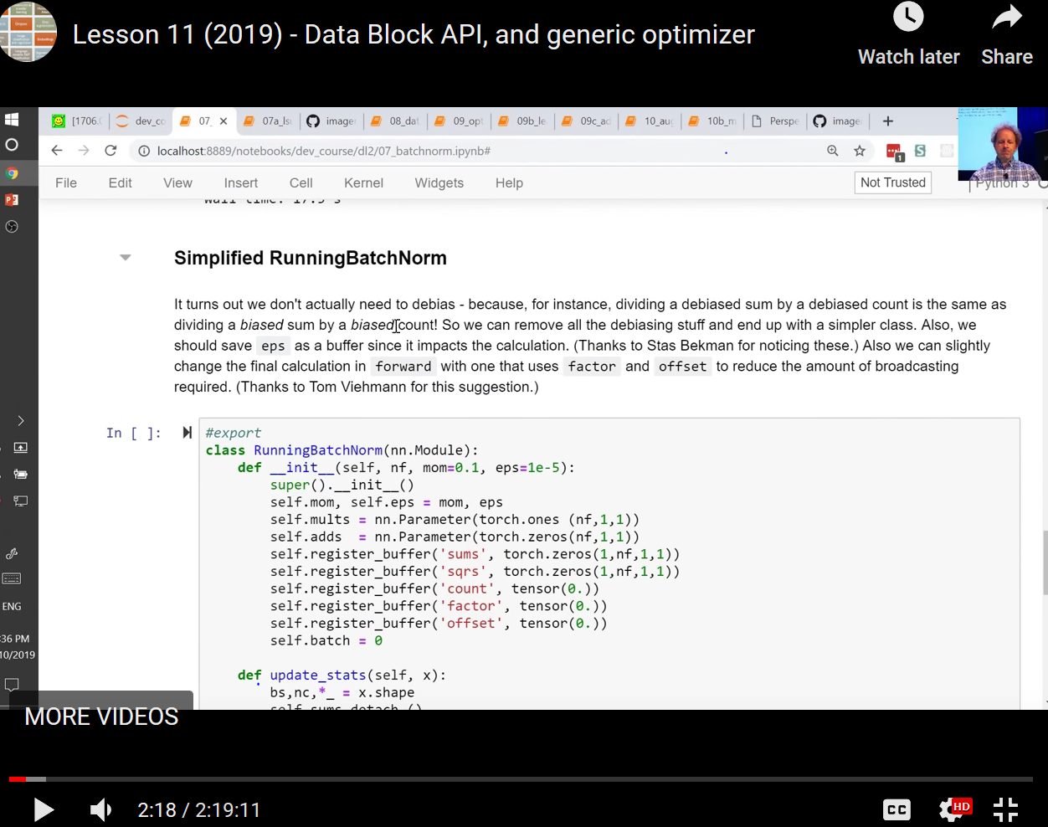

Slide 8
Running the Lesson 11 notebook 08_data_block.ipynb
https://forums.fast.ai/t/running-the-lesson-11-notebook-08-data-block-ipynb/56346

