Slide 1
Fastai Lesson 10a review
Joseph Catanzarite
Fastai Deep Learning From The Foundations
TWiML Study Group Meetup
Saturday, 8/17/2019

Slide 2
Overview of Lesson 10a
Software Engineering
Softmax discussion
Notebooks:
05_anneal
05a_foundations
05b_early_stopping
We’ll stop at 1:00:40 in Lesson 10 video
We’ll cover the rest of Lesson 10 next week

Slide 3
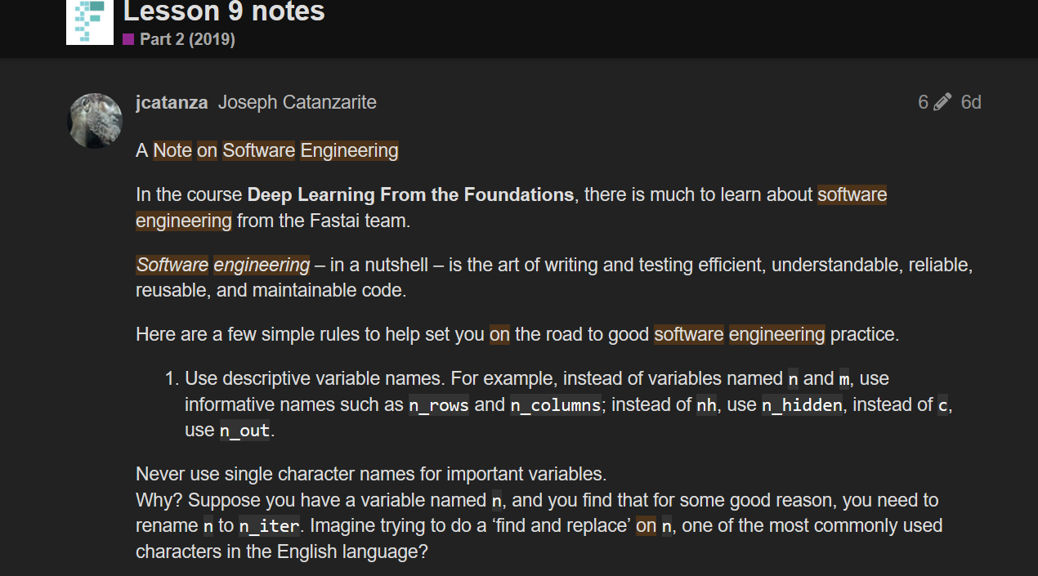
A Note on Software Engineering

Slide 4
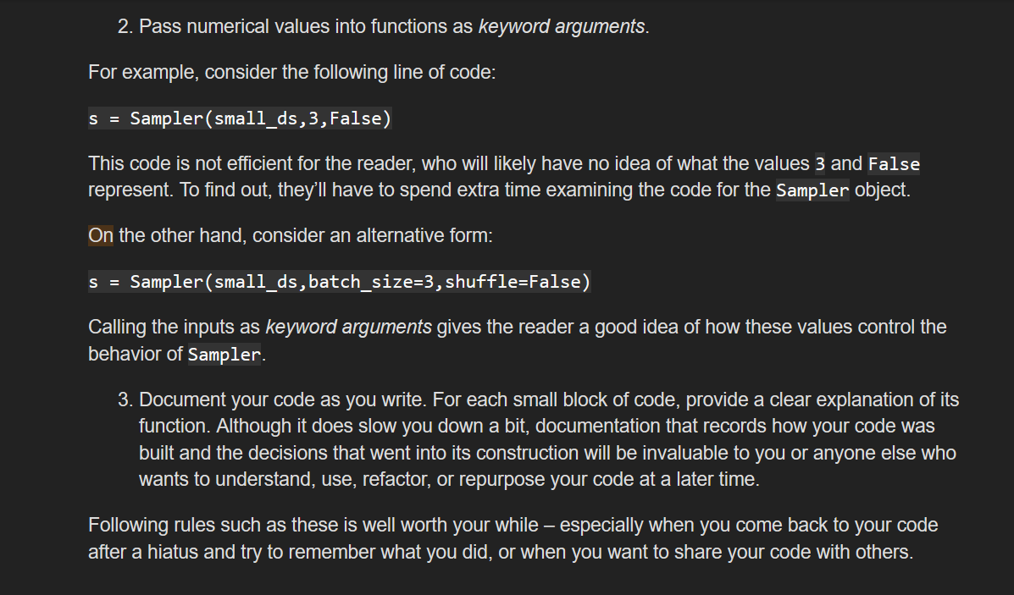
Software Engineering, cont’d.

Slide 5
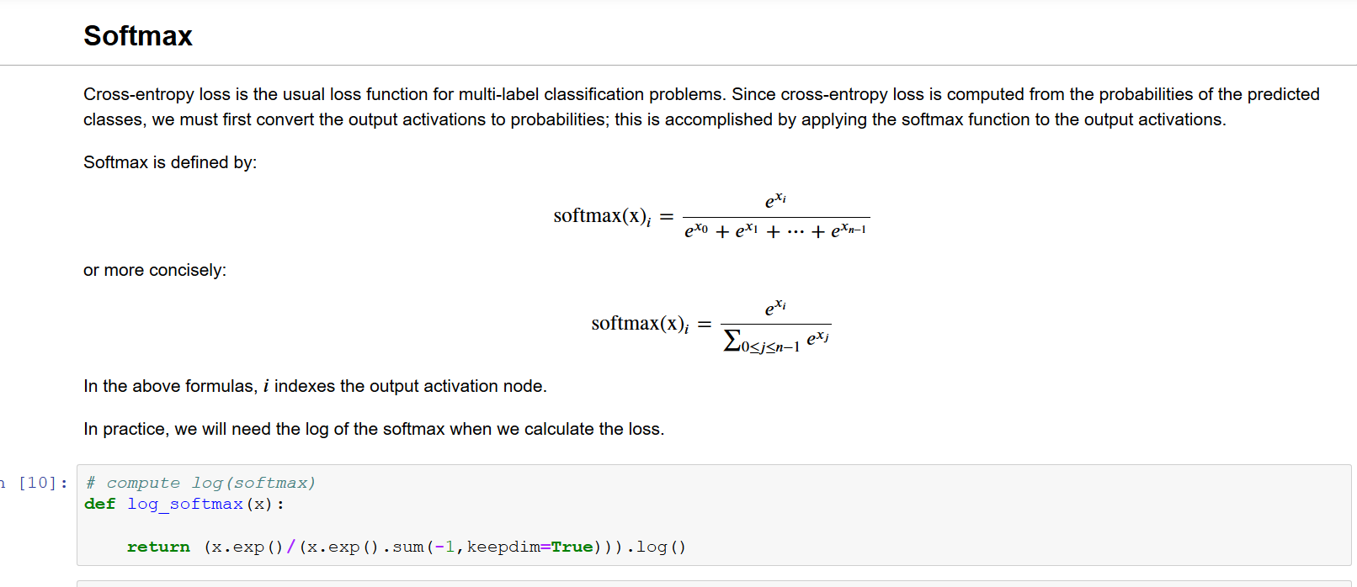
Softmax definition and implementation

Slide 6
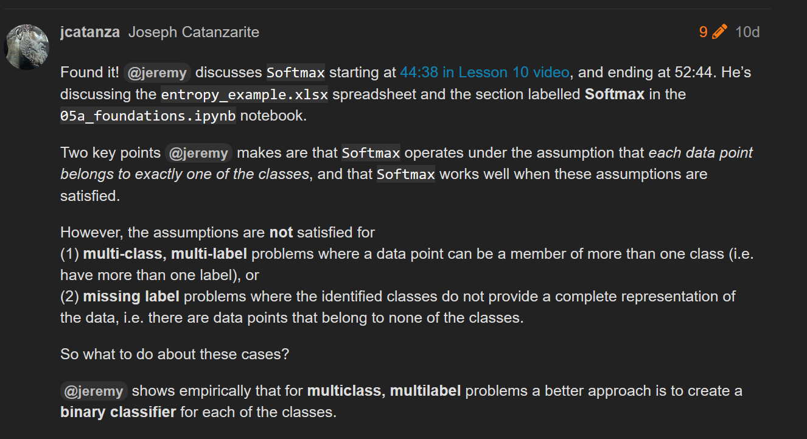

Slide 7
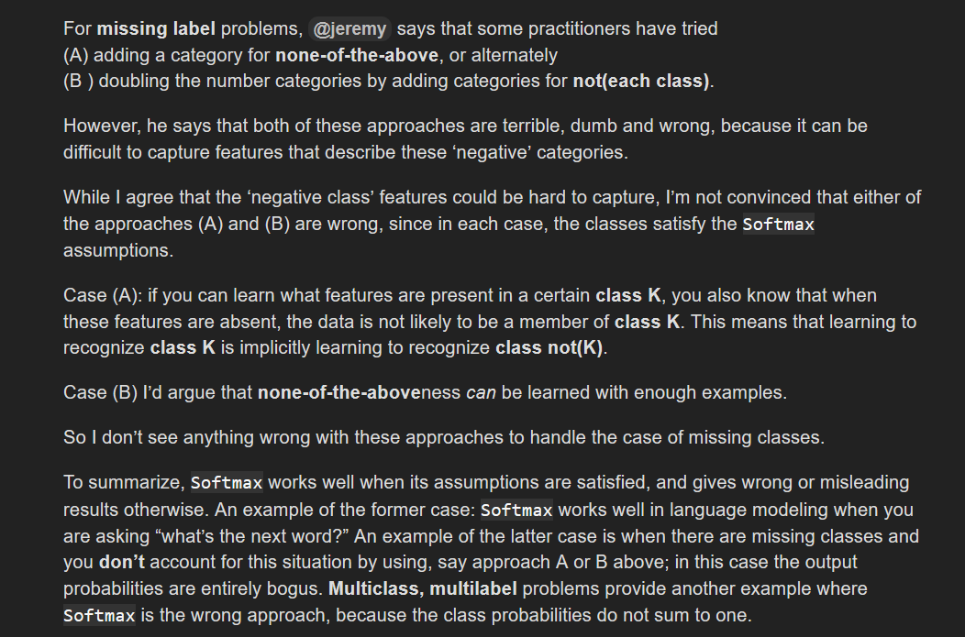

Slide 8
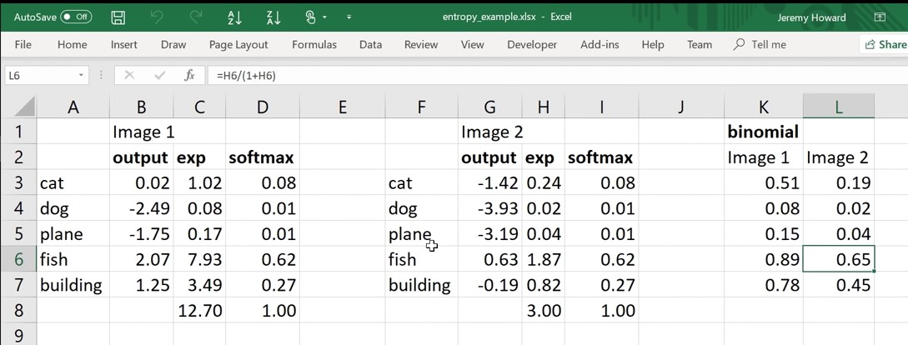
When to use a binary classifier for each class instead of softmax
binary

Slide 9
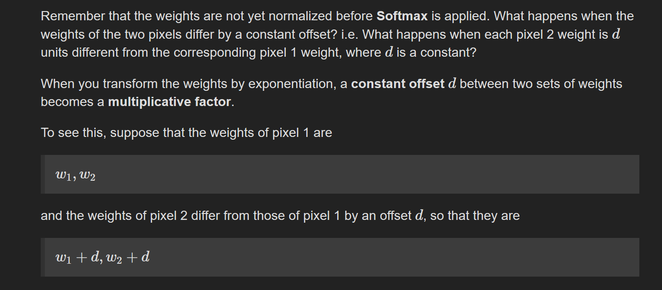
What does softmax do when two samples have weights that differ by a constant?

Slide 10
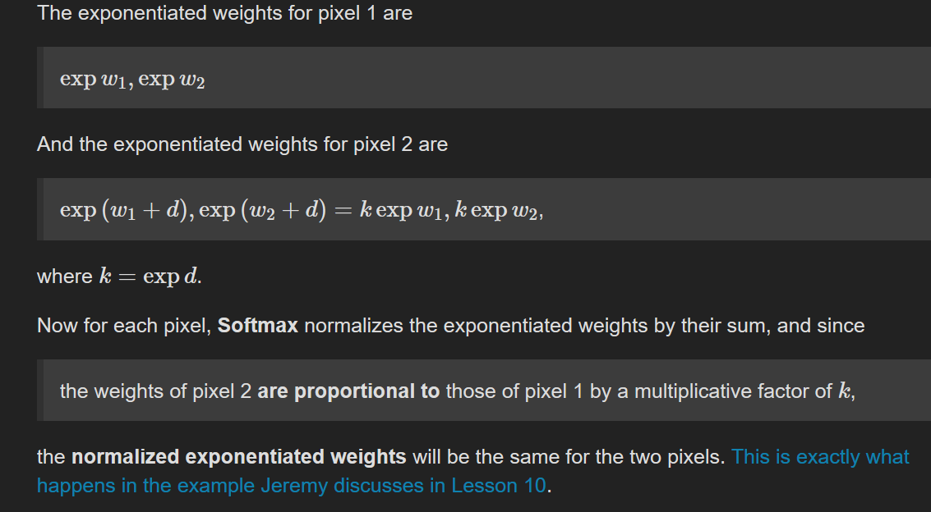
What does softmax do when two samples have weights that differ by a constant? cont’d

Slide 11
Review notebooks (live, in Zoom chat)
Notebooks:
05_anneal
05a_foundations
05b_early_stopping
We’ll stop at 1:00:40 in Lesson 10 video
We’ll cover the rest of Lesson 10 next week

