Slide 1
Fastai Lesson 11b review
Joseph Catanzarite
Fastai Deep Learning From The Foundations
TWiML Study Group Meetup
Saturday, 10/19/2019

Slide 2
Overview
Today
Continue in Lesson 11
Watch video, from 1:05:15 to 1:49:51
Study, run and play with notebooks
08_data_block
09_optimizers
Next meeting
Continue in Lesson 11
Watch video, from 1:49:51 to end
Study, run and play with notebooks
09b_learner
09c_add_progress_bar
10_augmentation

Slide 3
Fastai Forum post: Questions about RunningBatchNorm class in Lesson 10
https://forums.fast.ai/t/questions-about-runningbatchnorm-in-lesson-10/56331

Slide 4
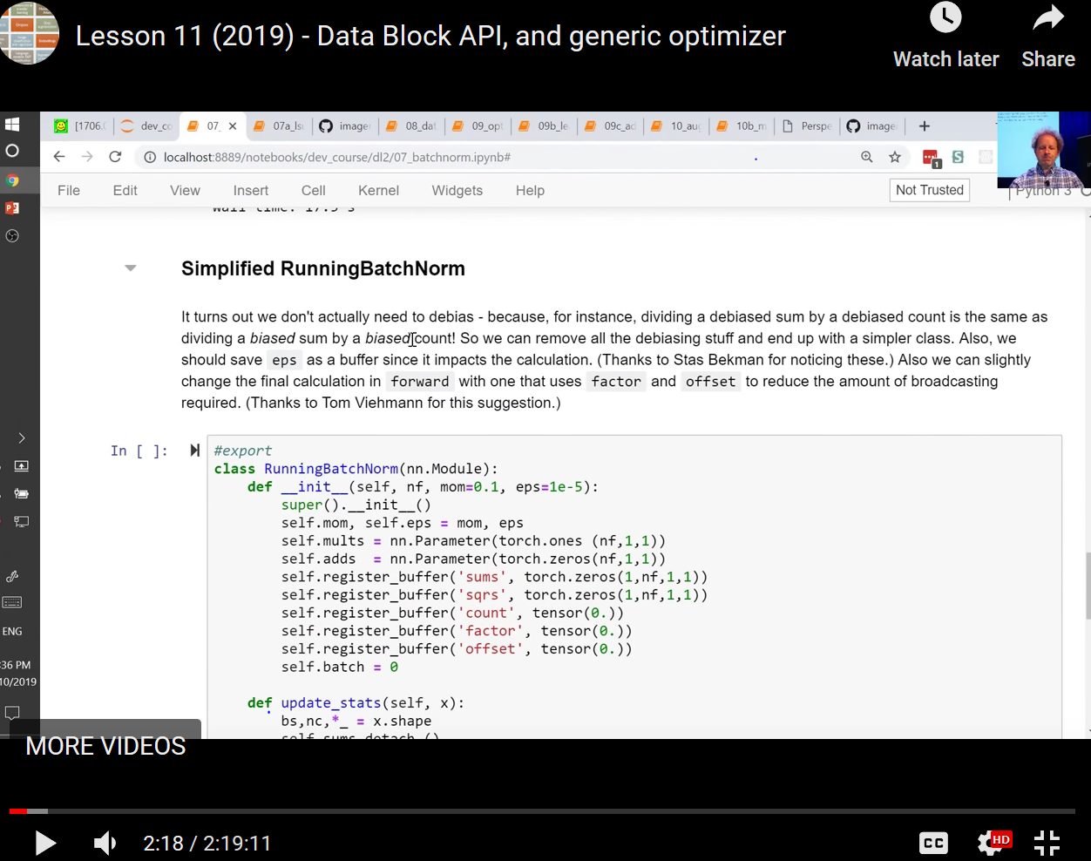

Slide 5
Fastai Forum post re: Simplified RunningBatchNorm in Lesson 11
https://forums.fast.ai/t/simplified-runningbatchnorm-in-lesson-11/56340

Slide 6
Fastai Forum post: Question on the Implementation of LSUV
In the paper “All you need is a good init” the authors say that their Algorithm 1 is intended to follow a certain orthonormal initialization procedure: “We thus extend the orthonormal initialization Saxe et al. (2014) to an iterative procedure, described in Algorithm 1. Saxe et al. (2014) could be implemented in two steps. First, fill the weights with Gaussian noise with unit variance. Second, decompose them to orthonormal basis with QR or SVD decomposition and replace weights with one of the components.”
Question @Sylvain, @stas or anyone else who knows: why did Fastai omit the Saxe et al. (2014) orthonormal initialization procedure?
https://forums.fast.ai/t/lesson-11-discussion-and-wiki/43406/366

Slide 7
Note on a minor tweak that ‘fixes’ the LSUV normalization algorithm
https://forums.fast.ai/t/lesson-11-discussion-and-wiki/43406/365

Slide 8
Running the Lesson 11 notebook 08_data_block.ipynb
https://forums.fast.ai/t/running-the-lesson-11-notebook-08-data-block-ipynb/56346

