Slide 1
Fastai Lesson 12b review
Joseph Catanzarite
Fastai Deep Learning From The Foundations
TWiML Study Group Meetup
Saturday, 11/09/2019

Slide 2
Overview
Today
Lesson 12
Watch video, up to 48:45
Study, run and play with notebooks
10b_mixup_label_smoothing
10c_fp16
11_train_imagenette
Next 3 meetings: continue in Lesson 12
Nov 9th:
11_train_imagenette
Nov 16th:
Watch video, 48:45 up to 1:15:12
Study, run and play with notebooks
11a_transfer_learning
12_text
Nov 23th:
Watch video, 1:15:12 to end
Study, run and play with notebooks
12_awd_lstm
12c_ulmfit

Slide 3
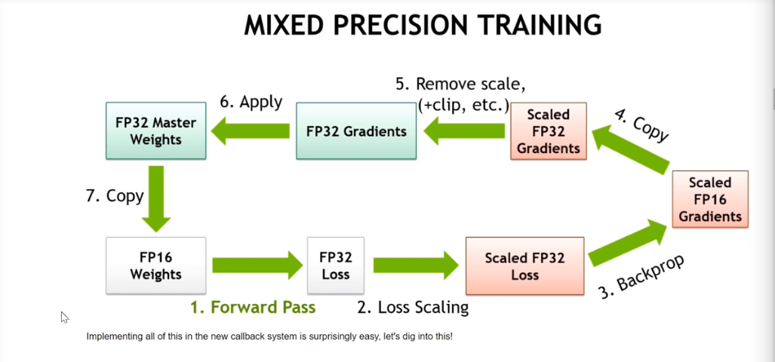
Mixed Precision

Slide 4
Notes on Mixed Precision
Loss Scaling
Fixed scale default = 512
Scale loss function
Scales gradients
Dynamic Loss Scaling
If gradients haven’t overflowed for set umber of batches, keep doubling scale until gradients overflow, then
Halve the scale

Slide 5
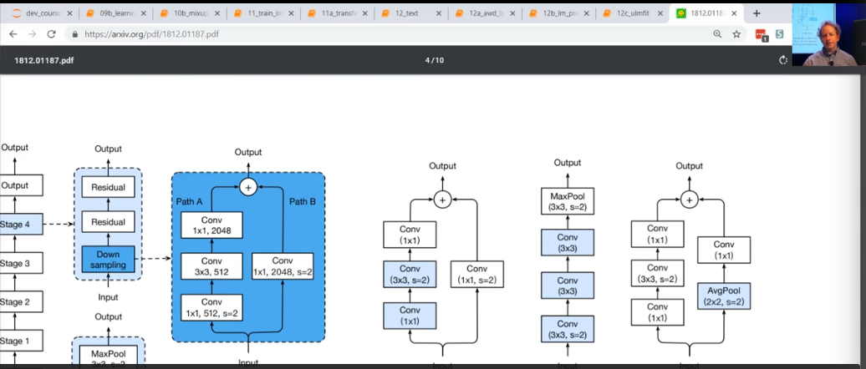
ResNet

