Slide 1
Fast.ai Lesson 8b
Joseph Catanzarite
For TWiML study group
13 July, 2019

Slide 2
Overview
Normalization & initialization
Forward pass – compute predictions
Backward pass – compute gradients
Construct functions needed for backward pass
mse_grad
relu_grad
lin_grad
forward_and_backward
Refactoring, using classes

Slide 3
Backward pass
In general, gradients measure the sensitivity of a function to changes in its parameters
The backward pass computes the gradients that measure the sensitivity of the loss function to the neural network parameters (weights and biases)
Gradients tell you how the parameters should be updated to make the loss function smaller.
During training, you iterate through forward and backward passes, each time adjusting the weights and biases a bit, in order to minimize the loss function.

Slide 4
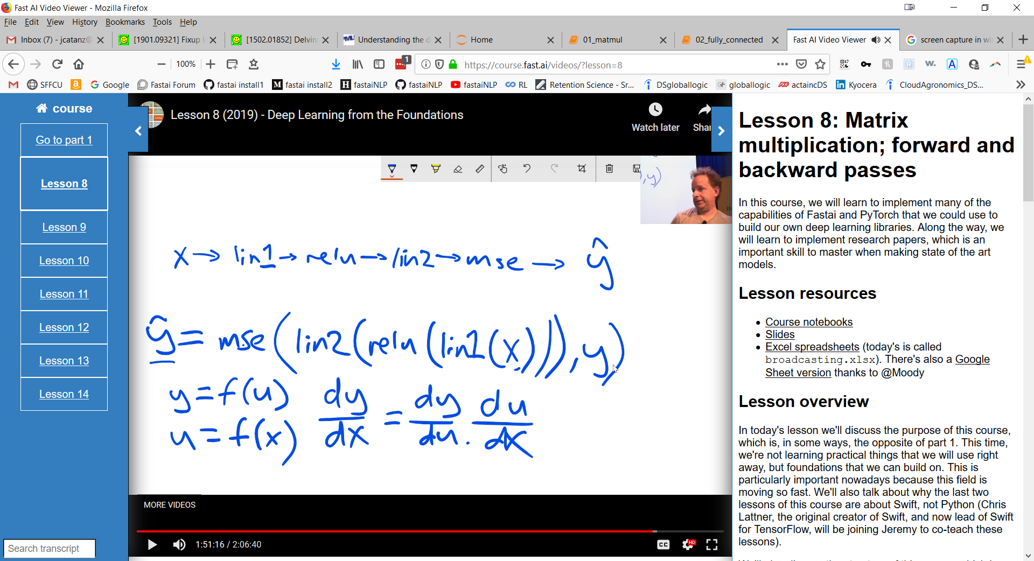

Slide 5
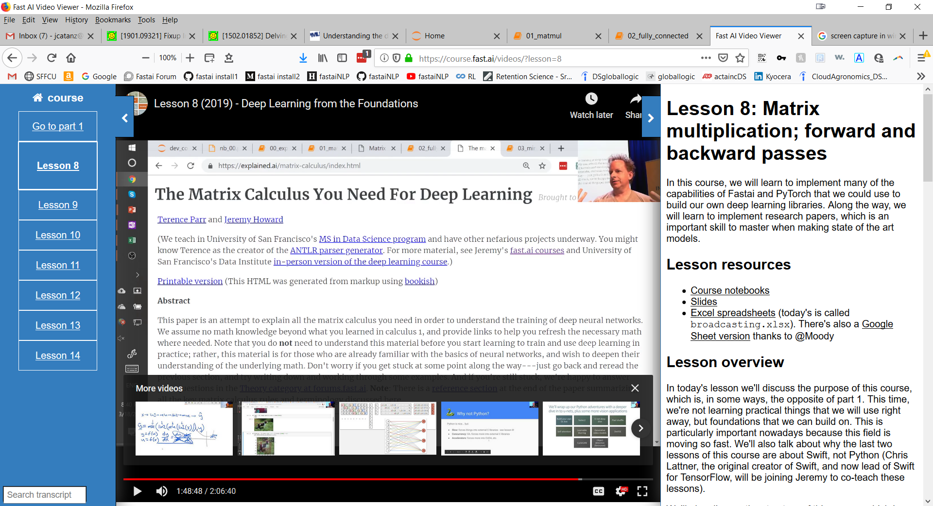

Slide 6
Next up
Lesson 9: build resnet

