Slide 1
Fastai Lesson 9 Review, part c
Joseph Catanzarite
Fastai Deep Learning From The Foundations
TWiML Study Group meetup
Saturday, 8/10/2019

Slide 2
Overview
Finish review of notebook 03_minibatch_training.ipynb
Review notebook 04_callbacks.ipynb
Review notebook 05_annealing.ipynb

Slide 3
PyTorch Classes
Class torch.nn()
Class torch.nn.Module()
Class torch.nn.Linear()
Class torch.nn.functional()
torch.nn.parameter()
Class Optimizer: torch.optim()
Class Data set: TensorDataSet()
Class Data loader: DataLoader():
shuffle option
batch size
**kwargs()

Slide 4
PyTorch Functions
PyTorch torch.nn.functional module contains
activation functions, loss functions, etc.
non-stateful versions of layers, such as convolutional and linear layers
import torch.nn.functional as F
F.relu()
F.nll_loss()
F.log_softmax()
F.cross_entropy() is the same as F.nll_loss(F.log_softmax(pred,-1),y_train)
loss_func = F.cross_entropy()

Slide 5
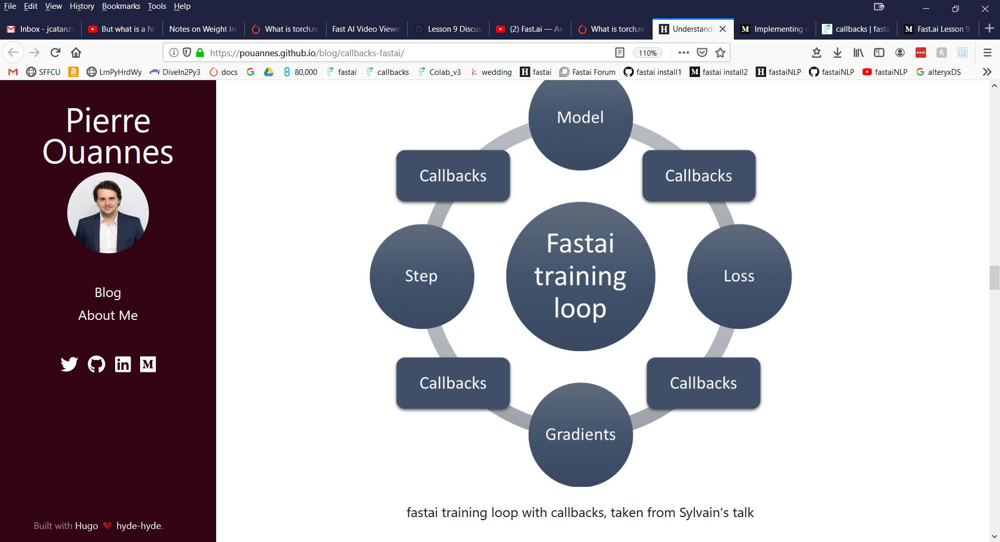

Slide 6
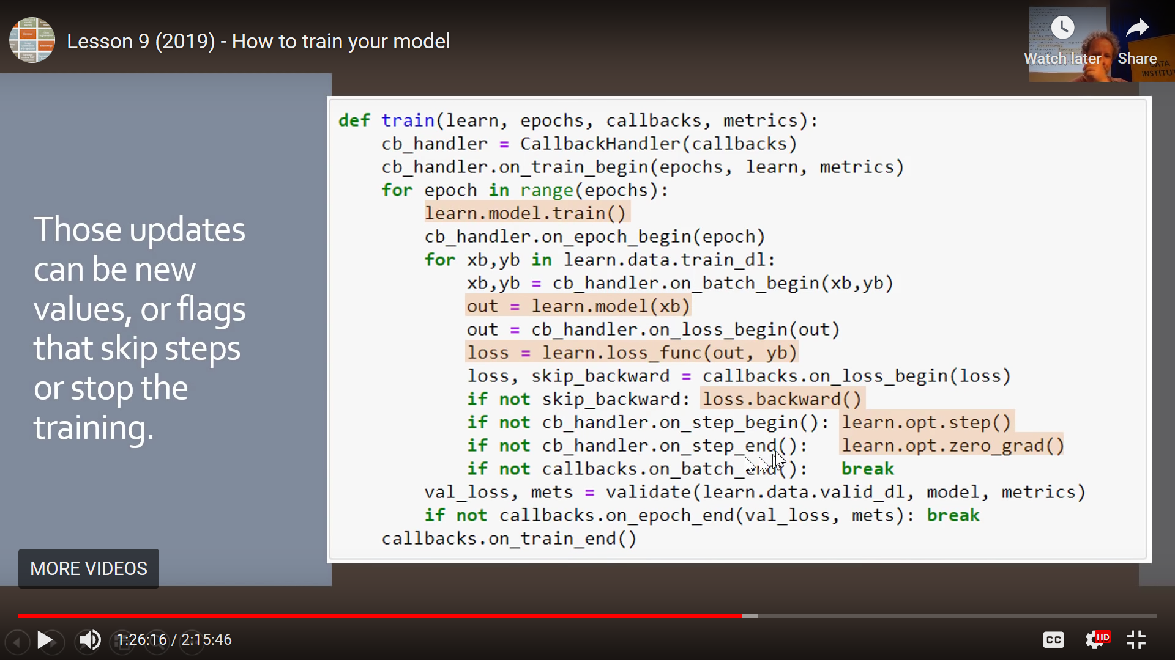

Slide 7
