Slide 1
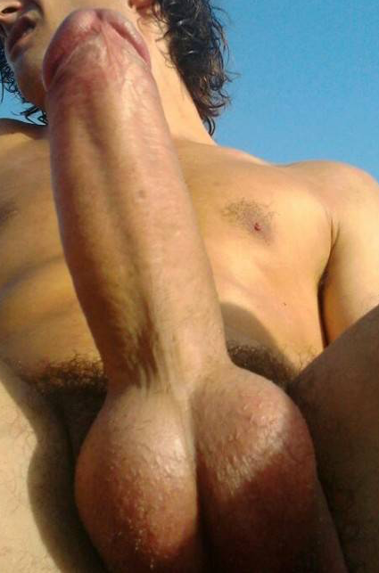
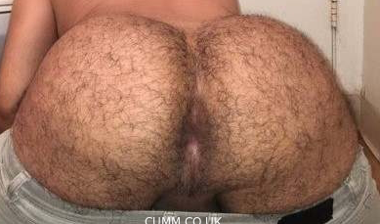
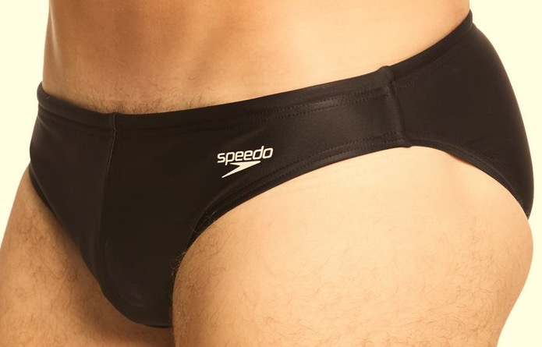
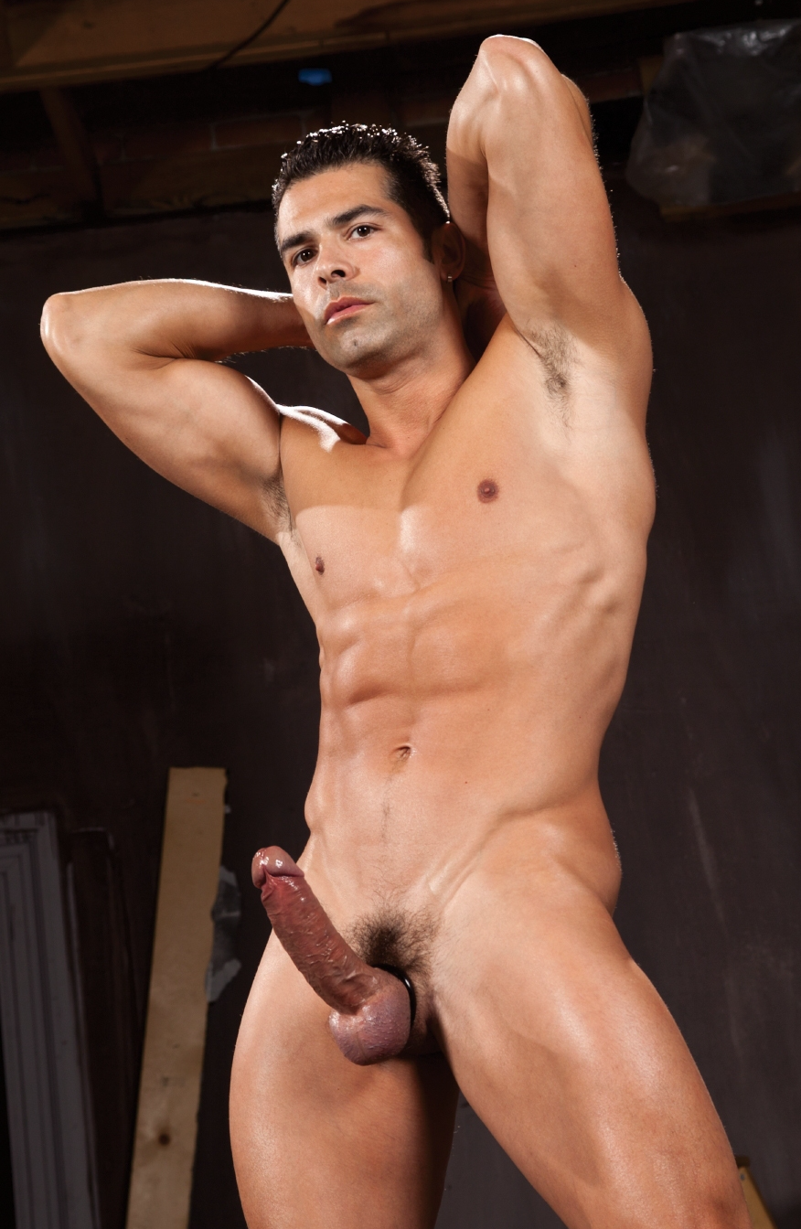

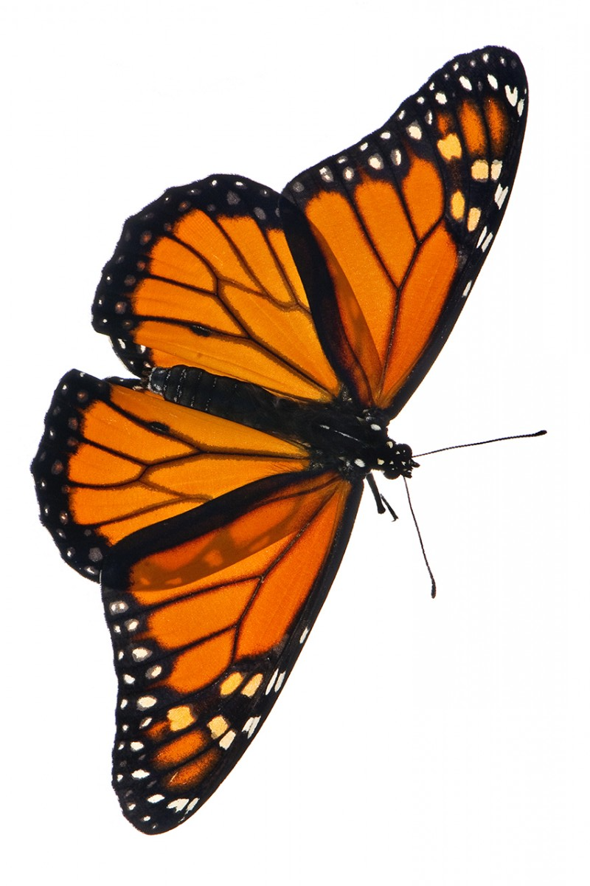
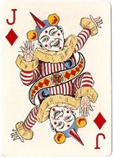
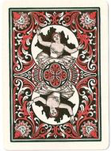
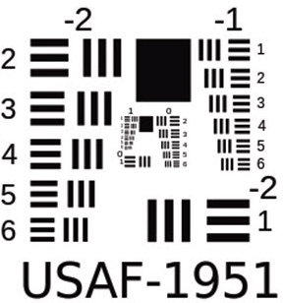
Words Words
Words Words
Words Words
Words Words
6 pt
6 pt
8 pt
8 pt
10 pt
10 pt
12 pt
12 pt
13 pt
13 pt
15 pt
15 pt
18 pt
18 pt
20 pt
20 pt
24 pt
24 pt
30 pt
30 pt
A closed mouth gathers no feet.
Actions speak louder than fortune cookies.
A closed mouth gathers no feet.

Slide 2
I'd like to be rich enough so I could throw soap away after the letters are worn off
-Andy Rooney
I'm a plain soap kind of guy
-Alan Greenspan
In this age of selfishness, selfless service is the only soap that truly purifies
-Mata Amritanandamayi
At the end of the day, every media entity is in the business of selling soap. They're not afraid of being popular
-Lino Rulli
Zen is like soap. First you wash with it, and then you wash off the soap.
-Yamaoka Tesshu
Wash four distinct and separate times, using lots of lather each time from individual bars of soap.
-Howard Hughes
Memories are like mercury. Every time you sort of try to get near them, they slip out of your hand like a bar of soap.
-Daphne Guinness
speech is free,
but lies you have to pay for
-Louis Tompros
Soap and water and common sense are the best disinfectants.
-William Osler
I wonder how much it would take to buy a soap bubble, if there were only one in the world
-Mark Twain
The truth isn't easily pinned to a page. In the bathtub of history the truth is harder to hold than the soap and much more difficult to find.
-Terry Pratchett
Any fool can make soap. It takes a clever man to sell it.
-Thomas J. Barratt
Justification is a remarkable thing-takes all those solid lines and blurs them, so that honor becomes as supple as a willow, and ethics burst like soap bubbles.
-Jodi Picoult
My friend has hand soap that smells like coconut. It's nice. Unless your hands are dirty from coconuts.
-Demetri Martin

