Slide 1

SF Salaries
– TEAM 3 –
Andrew Pistole
James Bain
Keevey Song
Rasha Gargees
Peng Zhao

Slide 2


CONTENTS
Introduction of dataset
01
Salary trend from 2011 - 2014
02
Job title compared to LA
03
Job analysis based on gender
04

Slide 3
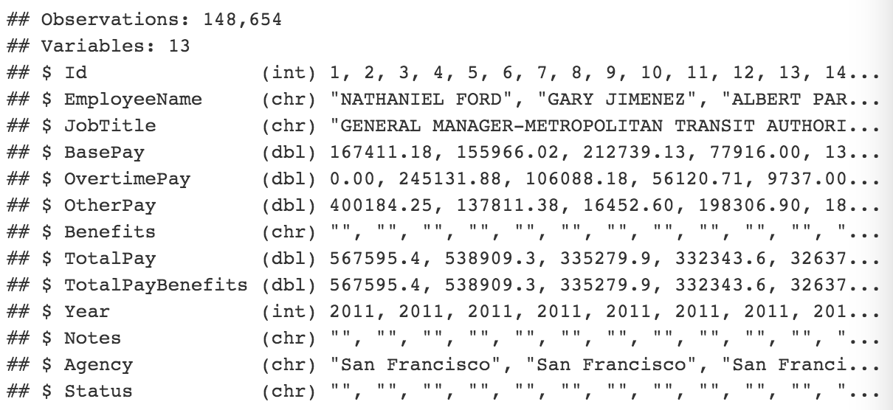
Introduction of dataset
A record of salaries of people working in San Francisco, including base pay, overtime pay, benefits and other pay.
Some of them get pay of 0, even negative pay. Perhaps people who get pay of 0 are retired, on disability, or something else.
We can tell job level and job field from job title.

Slide 4
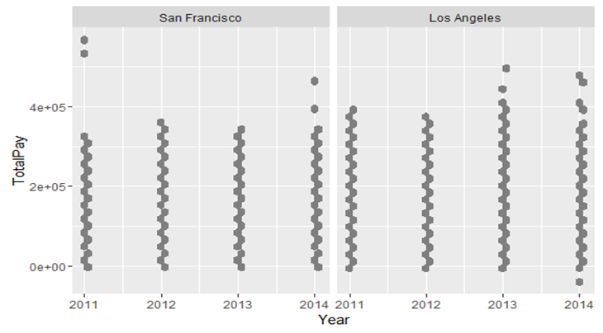
Salary trend from 2011 - 2014
•The graph shows a comparison between the total pay of San Francisco and Los Angeles grouped by year.
•In total the salaries are similar to each other. However, there are some salaries in Los Angeles larger than that of San Francisco with some exception in the year 2011.

Slide 5
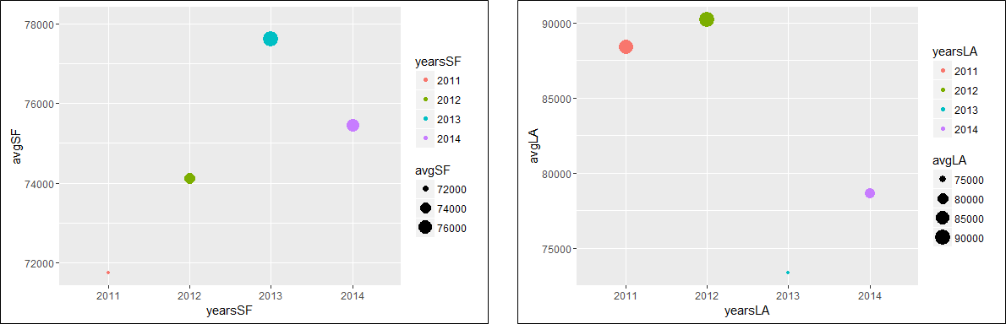
Total Pay Average
San Francisco
Los Angeles
The graph is the virtualization of average total salary for SF and LA.
The average salaries for all years was larger for Los Angeles than San Francisco except for the year 2013.

Slide 6
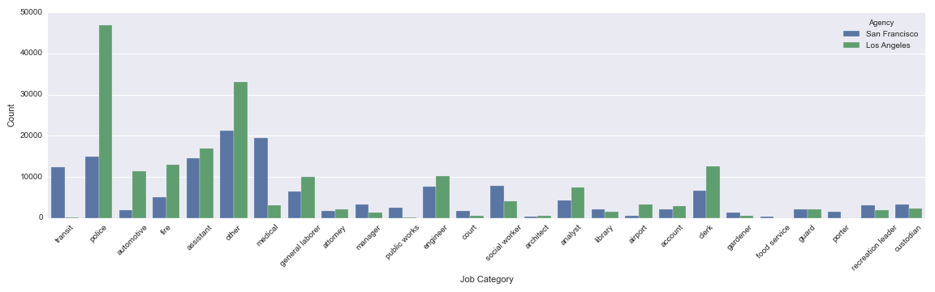
SF vs LA: # of Employees in Each Job Category
SF
LA
The number of employees in Police category in LA is almost 3 times that of SF. Is LA a more dangerous place to live? The actual criminal rates are similar in these two cities.
Population of LA is about 12 times larger than SF.
Many people work in the Transit category in SF and very few in LA although LA has a much larger population. SF has a very good public transportation system which can create many positions.
There are many more people working in medical field in SF than LA given the fact LA has a much larger population. Is the health care service in SF better than LA?

Slide 7
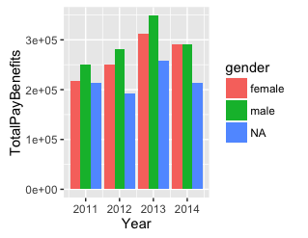
Job analysis based on gender
It shows the trend of total pay of each gender from 2012 - 2014. Generally speaking, people would think that men would earn more money than women and the data before 2014 says so as well. However, in 2014, pay of women is almost equal to pay of men.

Slide 8
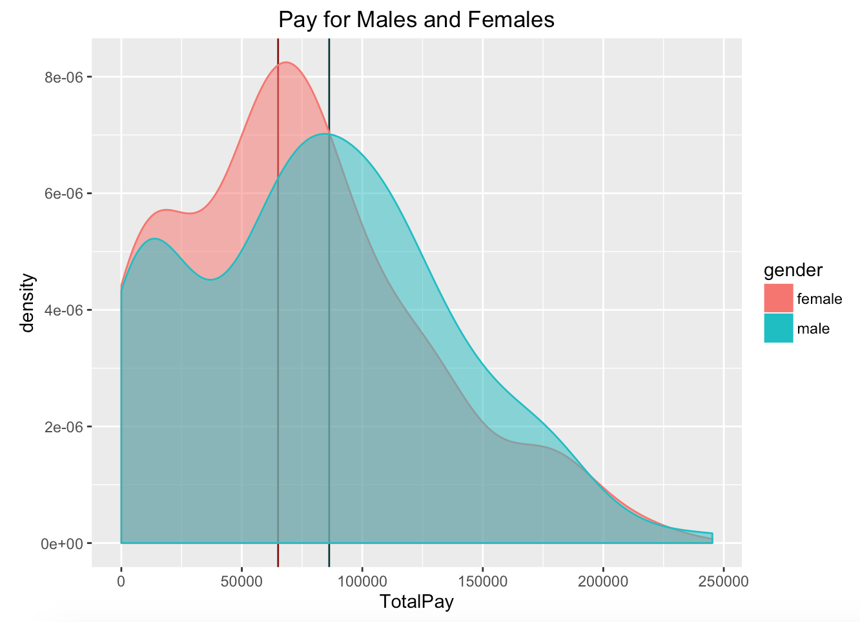
Gender and Pay
Find predicted gender based off of first name with gender package in R.
Mean male pay: $65,000
Mean female pay: $86,000
Difference: $21,000

Slide 9
Conclusion
In general, total salary averages are higher for men (Payment Bias)
Looking at other datasets, LA tends to have a higher average pay than SF.
LA has a greater amount of jobs compared to SF in the same categories.
No trend YET as to why LA has higher salaries than SF
In The Future?
Create visualization of wealth of all cities in California
Analyze gender bias of salary inequality

