Slide 1

Web Query Categorization
James Bain
Final Presentation

Slide 2
Outline
Motivation
Data Set
Feature Generation
Data Preprocessing
Algorithms
Results
Conclusion

Slide 3
Motivation
When an internet user queries the web, results pertaining to that user’s querying interests are desirable.
Problem:
Web queries are often short (between 3 and 5 words)
Individual words can be ambiguous without any context

Slide 4
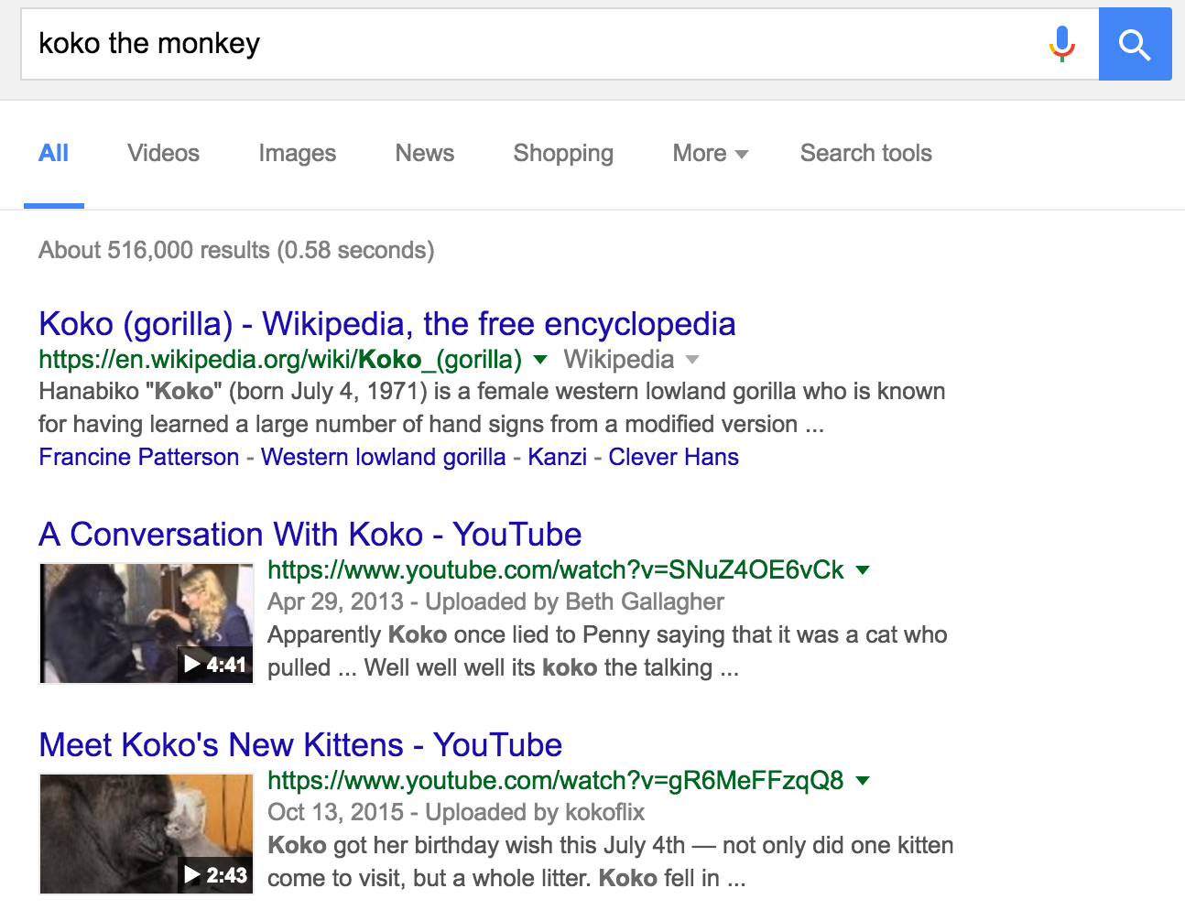
Motivation
Question:
Can algorithms predict predefined categories for a user’s query?

Slide 5
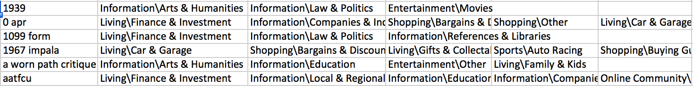
Data Set
2400 Queries
Up to 5 manually assigned categories labels/query
7 super-categories = Computers, Entertainment, Information, Living, Online Community, Shopping, Sports

Slide 6


Feature Generation
Counted the number of words in a query
Number of characters
Number of characters per word
Number of nouns
Number of prepositions
Number of verbs
Whether or not the query contained a number
Libraries: pandas, numpy, re, nltk

Slide 7

Algorithms
Multi-label classification transformed into a binary classification
mlr package
Decision Tree
rpart package
Neural Network
nnet package
5-fold Cross Validation
Runs for 100 iterations (default) or until error is no longer decreasing

Slide 8
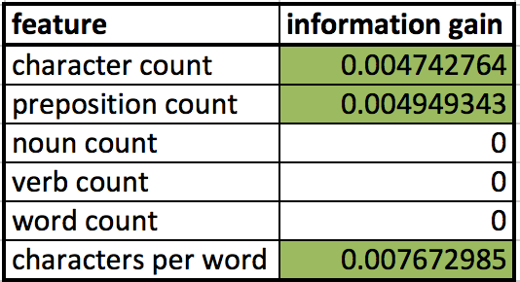
Feature Selection
Final Model
Target ~ character count, preposition count, char per word, has a number
Target = (Computers, Entertainment, Information, Living, Online Community, Shopping, Sports)

Slide 9
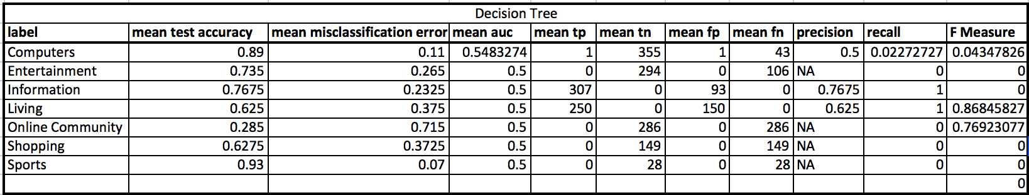
Results
Decision Tree Performance

Slide 10
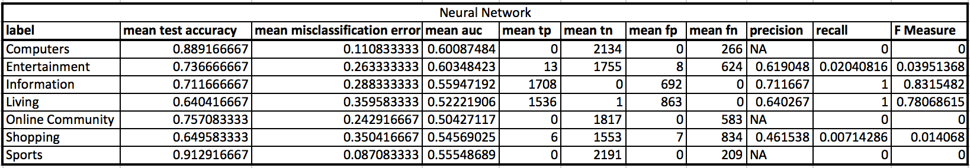
Results
Neural Network Performance

