Slide 1

Web Query Categorization
James Bain
Final Presentation

Slide 2
Outline
Motivation
Data Set
Feature Generation
Data Preprocessing
Algorithms
Results
Conclusion

Slide 3
Motivation
When an internet user queries the web, results pertaining to that user’s querying interests are desirable.
Problem:
Web queries are often short (between 1 and 3 words)
Individual words can be ambiguous without any context

Slide 4
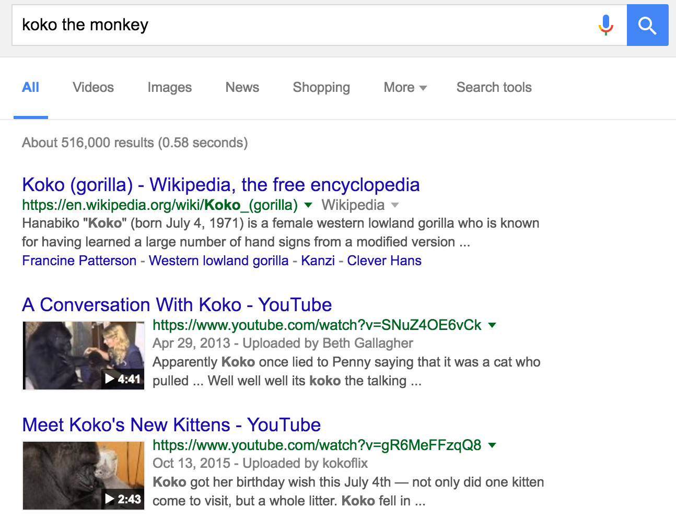
Motivation
Question:
Can algorithms predict predefined categories for a user’s query?

Slide 5
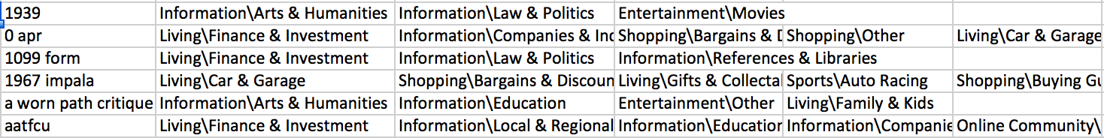
Data Set
2400 Queries
Up to 5 manually assigned categories labels/query
7 super-categories = Computers, Entertainment, Information, Living, Online Community, Shopping, Sports

Slide 6


Feature Generation
Counted the number of words in a query
Number of characters
Number of characters per word
Number of nouns
Number of prepositions
Number of verbs
Whether or not the query contained a number
Libraries: pandas, numpy, re, nltk

Slide 7
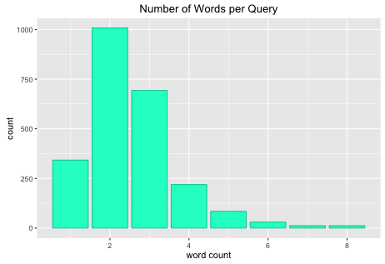
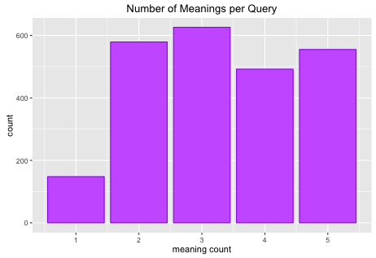
Number of Words per Query
Number of Meanings Assigned to Query
Mean: 2.53875
Median: 2
Mean: 3.302917
Median: 3

Slide 8
Preprocessing
Extract super-categories assigned to each query
Remember, those were (Computers, Entertainment, Information, Living, Online Community, Shopping, Sports)
Then create separate columns for each category (7 new columns)
Assign true for that column where the query is classified as such and a false otherwise

Slide 9

Algorithms
Multi-label classification transformed into a binary classification
mlr package
Decision Tree
rpart package
Neural Network
nnet package
5-fold Cross Validation
Runs for 100 iterations (default) or until error is no longer decreasing
Notes:
How much data was used for training and testing

Slide 10
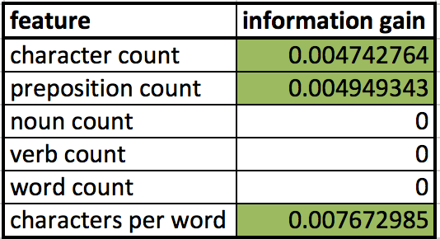
Feature Selection
Final Model
Target ~ character count, preposition count, char per word, has a number
Target = (Computers, Entertainment, Information, Living, Online Community, Shopping, Sports)

Slide 11
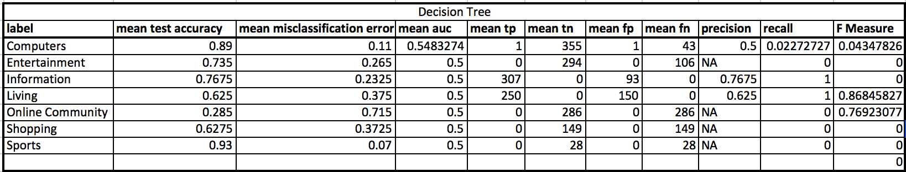
Results
Decision Tree Performance
Notes:
Precision: TP/(TP/FP) percent of predictions correct
Recall: TP/(TP+FN) percent of positive cases caught

Slide 12
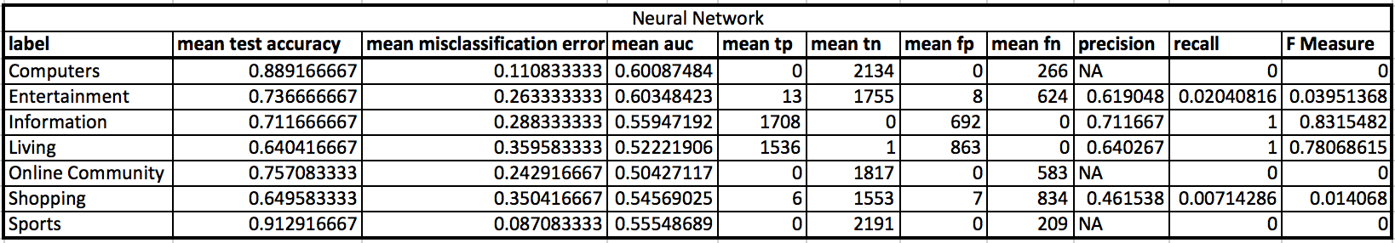
Results
Neural Network Performance
Notes:
Precision: TP/(TP/FP) percent of predictions correct
Recall: TP/(TP+FN) percent of positive cases caught

Slide 13
Conclusion
Neural Network outperforms Decision Tree
General structure of the query has some predictive capabilities
More features would be useful (ie. session data)
Future Work
Take into account sub-categorizations
More feature generation (parts of speech per query rather than absolute number)

