Slide 1


Kubernetes in
30 minutes
Mar 5, 2019
Jose Carlos Barrales
https://github.com/jcbarrrales/kubernetes_in_30_minutes

Slide 2

Netscape Navigator

Slide 3
Netscape Navigator

Slide 4

Kubernetes

Slide 5
κυβερνήτης

Slide 6
k8s

Slide 7
“Something to do with containers…?

Slide 8
Assumptions
You know about containers
You know about orchestration
You know about the painful art of deploying stuff

Slide 9

Docker

Slide 10

“Random containers doing their own sh*t”

Slide 11
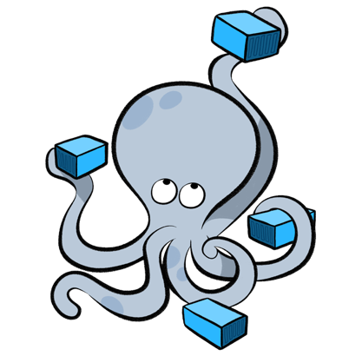
Compose

Slide 12
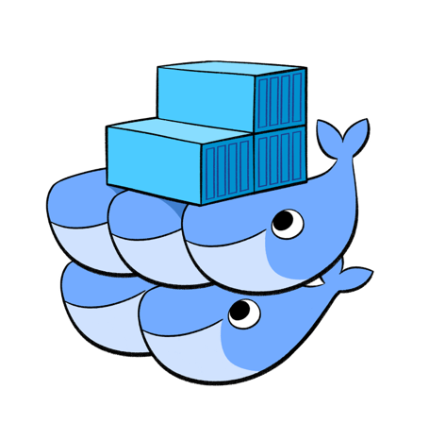
Swarm

Slide 13

“Clustering and Discovery”
(hey, we’re getting somewhere!)

Slide 14
=

Slide 15
“Batteries Sold Separately”

Slide 16
“Batteries Included”

Slide 17



K8s on GCP
GKE
GCE
Networking
…and others

Slide 18
Basic Concepts

Slide 19
Node

Slide 20
Hosts running k8s daemons

Slide 21
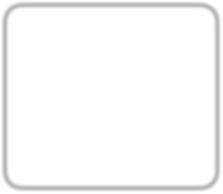


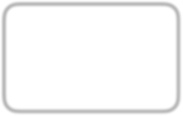
Master
API
Scheduler etc..
N de
kubelet
N de
kubelet
N de
kubelet

Slide 22
Pod

Slide 23
基本
Basic unit of deployment in k8s

Slide 24
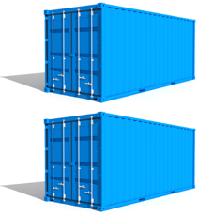
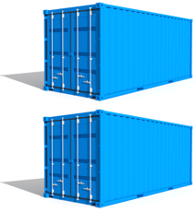
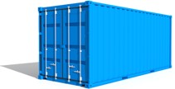

Group of Containers

Slide 25
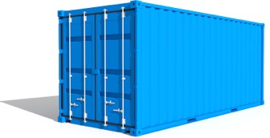


Container configurations

Slide 26

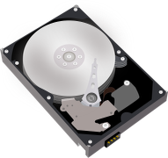
Shared storage

Slide 27




c ntainer
P d

Slide 28
P d
c ntainer
c ntainer

Slide 29
P d
c ntainer
c ntainer c ntainer

Slide 30
P d
e.g.
c ntainer
nginx
c ntainer
app
c ntainer
redis/cache

Slide 31
Scheduled together
(“co-scheduled”)

Slide 32
Guaranteed to be on the same node
(“co-located”)

Slide 33

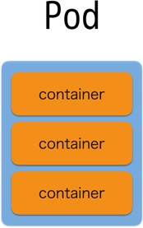
N de
N de
N de

Slide 34
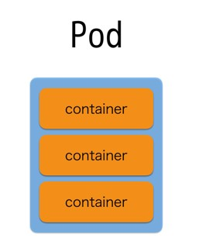
N de
N de
N de
Depends on each node’s resource availability and each pod’s resource requirements

Slide 35




N de
N de
c ntainer
c ntainer
c ntainer

Slide 36





N de N de
This will NEVER happen
c ntainer
cntainer
c ntainer

Slide 37
Miscellaneous
Each pod has its own IP address
Pods are expected to be stateless

Slide 38
Replica Set

Slide 39
Keeps track of Pod replicas

Slide 40
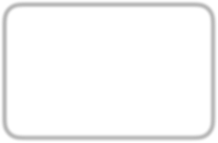
Replica Set
replicas: 3 template:

Slide 41
Replica Set
replicas: 3 template:
A

Slide 42
Replica Set
replicas: 3 template:
A
B

Slide 43
Replica Set
replicas: 3 template:
A
B
C

Slide 44

Replica Set
replicas: 3 template:
A
B
C

Slide 45
Replica Set
replicas: 3 template:
A
B

Slide 46
Replica Set
replicas: 3 template:
A
B
D

Slide 47
Deployment

Slide 48
Manages Replica Set state transitions

Slide 49
Depl yment
replicas: 3 template:

Slide 50
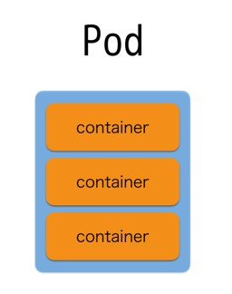
Depl yment
replicas: 3 template:
Replica Set A
replicas: 3 template:

Slide 51
Depl yment
replicas: 3 template:
Change s me settings, please!
Replica Set A
replicas: 3 template:

Slide 52
Depl yment
replicas: template:
2
3
Change s me settings, please!
Replica Set A
replicas: 3 template:

Slide 53

Depl yment
replicas: template:
2
3
Change s me settings, please!
Replica Set A
replicas: 3 template:
Replica Set B
replicas: 2 template:

Slide 54

Depl yment
replicas: template:
2
3
Change s me settings, please!
Replica Set A
Replica Set B
replicas: 2 template:
replicas: 3
template:

Slide 55
Depl yment
replicas: template:
2
3
Change s me settings, please!
Replica Set B
replicas: 2 template:

Slide 56
Keeps track of state change history

Slide 57
Depl yment
replicas: 3 template:

Slide 58
Depl yment
replicas: 3 template:
A
replicas: 3 template:

Slide 59
Depl yment
replicas: 3 template:
Change s me settings, please!
A
replicas: 3 template:

Slide 60
Depl yment
replicas: template:
2
3
Change s me settings, please!
A
replicas: 3 template:

Slide 61
Depl yment
replicas: template:
2
3
Change s me settings, please!
A
replicas: 3 template:
B
replicas: 2 template:

Slide 62
Depl yment
replicas: template:
2
3
Change s me settings, please!
A
B
replicas: 2 template:
replicas: 3
template:

Slide 63
Depl yment
replicas: template:
2
3
Change s me settings, please!
B
replicas: 2 template:

Slide 64
Depl yment
replicas: template:
2
3
Oh wait, I actually didn’t want t d that…
B
replicas: 2 template:

Slide 65
Depl yment
replicas: template:
3
2
3
Oh wait, I actually didn’t want t d that…
B
replicas: 2 template:

Slide 66


Depl yment
replicas: template:
3
2
3
Oh wait, I actually didn’t want t d that…
B
replicas: 2 template:
r llback

Slide 67

Depl yment
replicas: template:
3
2
3
Oh wait, I actually didn’t want t d that…
A
replicas: 3 template:
B
replicas: 2 template:
r llback

Slide 68

Depl yment
replicas: template:
3
2
3
Oh wait, I actually didn’t want t d that…
A
replicas: 3 template:
B
r llback
replicas: 2
template:

Slide 69
Depl yment
replicas: template:
3
2
3
Oh wait, I actually didn’t want t d that…
A
replicas: 3 template:

Slide 70
Services

Slide 71
Logical set of Pods
(and ways to access them)

Slide 72
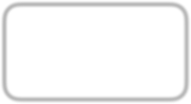


Raw Pod Access
P d
10.0.96.2
P d
10.0.96.3
P d
10.0.96.3

Slide 73
Raw Pod Access
P d
10.0.96.2
P d
10.0.96.3
P d
10.0.96.3

Slide 74
Raw Pod Access
P d
10.0.96.2
_{Pd} 10.0.96.3
P d
10.0.96.3

Slide 75
Raw Pod Access
P d
10.0.96.2
P d
10.0.96.3

Slide 76
Raw Pod Access
P d
10.0.96.2
P d
10.0.96.3

Slide 77

Access Via Service
P d
10.0.96.2
r le=web
Service
match r le=web
P d
10.0.96.3
r le=web
P d
10.0.96.4
r le=web
P d
10.0.96.5
r le=db

Slide 78
Access Via Service
P d
10.0.96.2
r le=web
Service
match r le=web
P d
10.0.96.3
r le=web
P d
10.0.96.4
r le=web
P d
10.0.96.5
r le=db

Slide 79
Access Via Service
P d
10.0.96.2
r le=web
Service
match r le=web
P d
10.0.96.3
r le=web
P d
10.0.96.4
r le=web
P d
10.0.96.5
r le=db

Slide 80
Access Via Service
P d
10.0.96.2
r le=web
Service
match r le=web
_{Pd} 10.0.96.3
rle=w
eb
P d
10.0.96.4
r le=web
P d
10.0.96.5
r le=db

Slide 81
Access Via Service
P d
10.0.96.2
r le=web
Service
match r le=web
P d
10.0.96.4
r le=web
P d
10.0.96.5
r le=db

Slide 82
Access Via Service
P d
10.0.96.2
r le=web
Service
match r le=web
P d
10.0.96.4
r le=web
P d
10.0.96.5
r le=db

Slide 83
Access Via Service
P d
10.0.96.2
r le=web
Service
match r le=web
P d
10.0.96.6
r le=web
P d
10.0.96.4
r le=web
P d
10.0.96.5
r le=db

Slide 84
Access Via Service
P d
10.0.96.2
r le=web
Service
match r le=web
P d
10.0.96.6
r le=web
P d
10.0.96.4
r le=web
P d
10.0.96.5
r le=db

Slide 85
Secrets

Slide 86
Store pieces of data in k8s

Slide 87
e.g. Identity Information

Slide 88
(securely)

Slide 89
(…in the future)

Slide 90

Secret
key1 → base64 value
key2 → base64 value
key3 → base64 value

Slide 91


P d
c ntainer:
v lumeM unts:
- name: certificates
m untPath: /etc/ssl/certs
c ntainer
v lumes:
- name: certificates secret:
secretName: ca-certificates
v lumes

Slide 92
P d
env:
- name: foo-secret valueFrom: secretKeyRef:
name: f
value: secret-value
c ntainer
v lumes

Slide 93
ConfigMaps

Slide 94
Same as Secrets (Unprotected)

Slide 95
Ingress

Slide 96
Services are for within the cluster only
(external IPs allowed, but don’ use that to serve external requests)

Slide 97
Inbound connections to internal cluster services
(New since 1.2)

Slide 98
DaemonSets

Slide 99



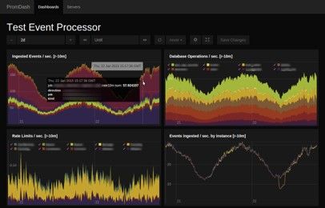
Ensure nodes run a copy of a Pod
N de N de N de
pr metheus-exp rter
pr metheus-exp rter
pr metheus-exp rter

Slide 100
Sh*tSets

Slide 101
StatefulSets
Sh*tSets

Slide 102
Use only when *really* needed

Slide 103
…and with *really* I mean never

Slide 104
Keeps unique IDs in replicas (x-0, x-1, x-2,…)

Slide 105
Questions?

