Slide 1

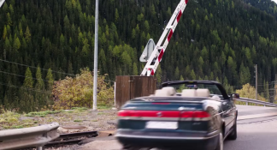
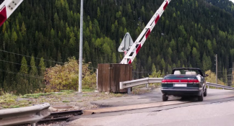
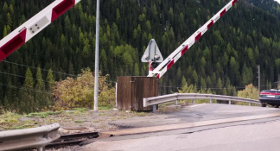
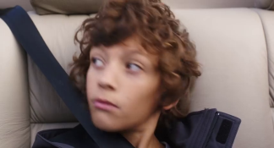
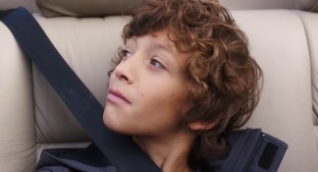
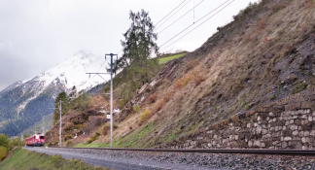
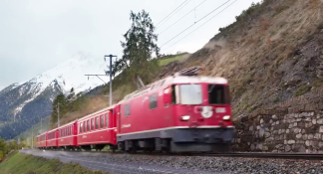
Input video
Input text
The car passes the crossing as the barriers go down. Gabriel looks out from the car with fastened seatbelt. A train passes by the hills.
Output (video-sentence alignment with timestamp information)
Sentence: The car passes the crossing as the barriers go down.
Timestamp: 02’03’’ – 02’06’’
Sentence: Gabriel looks out from the car with fastened seatbelt.
Timestamp: 02’06’’ – 02’08’’
Sentence: A train passes by the hills
Timestamp: 02’08’’ – 02’11’’

Slide 2
“The car passes the crossing as the barriers go down”

