Slide 1


Lesson
SIX
Getting SASS-y with CSS
Jacob L. Buller
(Not a developer)
Kasey A. Stolba
(An actual developer)

Slide 2
What we’re doing…
Reviewing the intro to SASS from last lesson
Make sure we have the SASS compiler installed in VS Code
Talk through common examples of using SASS in code
Notes:
File structure: In the first lesson, we have in-line CSS. In a project, we split out the CSS into its own file
Media breakpoints

Slide 3
So what is SASS?
Sass stands for Syntactically Awesome Stylesheet and it’s an extension of CSS.
The main goal of SASS is to reduce repetition in CSS
It’s a CSS pre-processor language - A CSS preprocessor is a scripting language that extends CSS by allowing developers to write code in one language and then compile it into CSS
Sass lets you use features that do not exist in CSS, like variables, nested rules, mix-ins, imports, inheritance, built-in functions, and other stuff
Now, to compile SASS we’re going to download a simple extension on Visual Studio code
Notes:
https://marketplace.visualstudio.com/items?itemName=ritwickdey.live-sass

Slide 4
Why do we use SASS?
As mentioned previously, the main purpose of SASS is to reduce repetition in code
We’re going to look at two common use cases of SASS that promote this mind set

Slide 5
SASS Variables
In a typical web development project, the SASS code is split amongst many different files
We’ll take a deeper look into this in an upcoming lesson!
We can create SASS variables in a theme file which can be use throughout the project
When you need to make a change to one of these variables, you only have to do it in one place!
Now let’s look at a common use case for this…

Slide 6
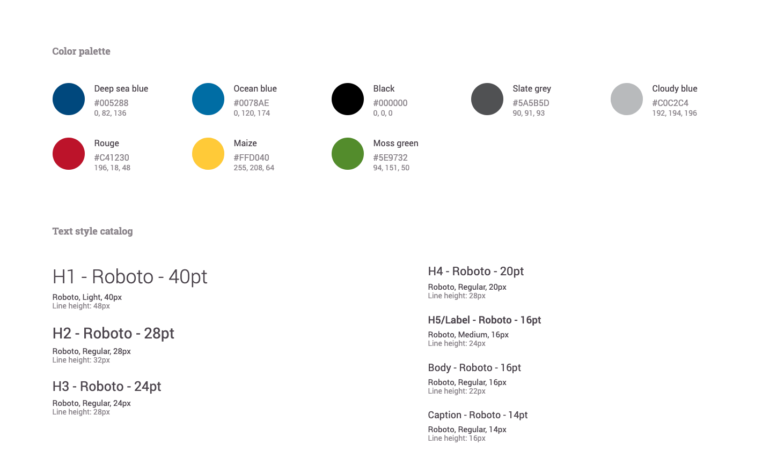
Style Guide
Notes:
Adhoc style guide from the CISA demo that we worked on– see how this translates to code

Slide 7
Nesting CSS Selectors
In previous lessons we’ve learned about HTML structure and how elements are nested within one another
SASS allows you to follow the HTML tree within your CSS
This leads to cleaner code and less repetition!

