Slide 1


Lesson
SEVEN
Building a Dashboard Part 1
Jacob L. Buller
(Not a developer)
Kasey A. Stolba
(An actual developer)

Slide 2
What we’re doing…
Download and explore the free AmdinLTE template
Get all assets ready
Setup our own dashboard template structure based on a page from the theme
Removing excessive data
https://adminlte.io/
https://github.com/ColorlibHQ/AdminLTE/releases

Slide 3
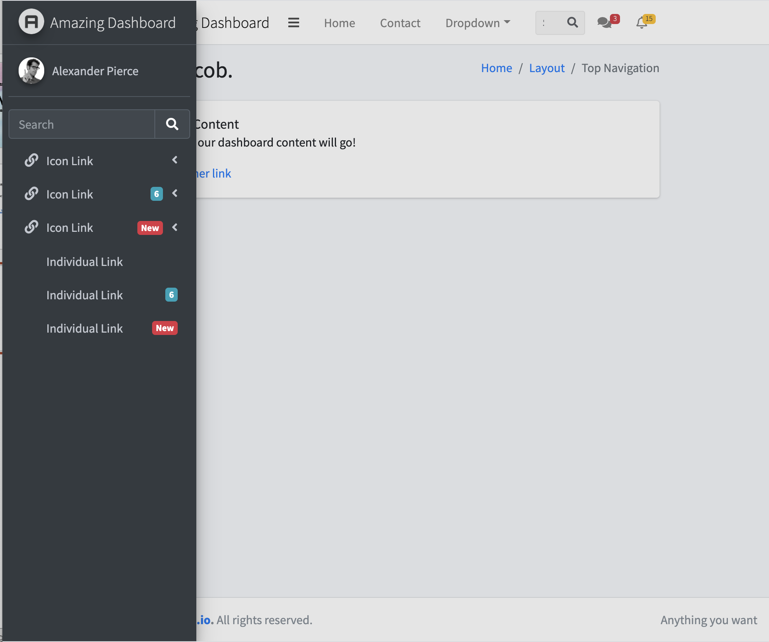
Requirements
We need a amazing dashboard to feature some amazing states, forms, videos, etc.
We know we need a mobile-friendly navigation that has single and multiple dropdown links, links with icons, and also links notification banners
We want a way to identify who is logged in and a way to easily search
We also need a breadcrumb, a notification feature, and a way to message with admin/staff.

