Slide 1

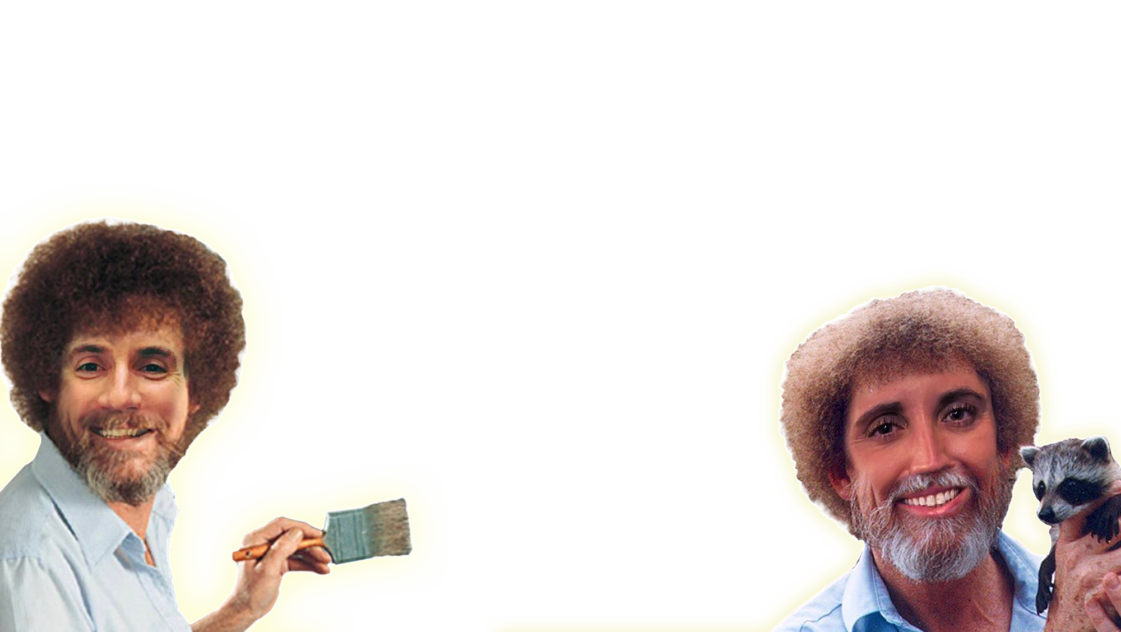
Lesson
EIGHT
A Blast From The Past &
Dashboard Build Out
Jacob L. Buller
(Not a developer)
Kasey A. Stolba
(An actual developer)

Slide 2
Welcome New Joiners!
We are so happy to have you!
As much as we love recording these sessions for you, we’re always happy to have ~live audience participation~
Feel free to stop us and ask questions at any point
Yes, our font of choice is Comic Sans
It’s making a comeback ok?

Slide 3
Getting You Up to Speed
We’re going to setup your developer environment!
First, we download the IDE (Integrated Development Environment)
We’re using Visual Studio Code https://code.visualstudio.com/
Great! Now that we’ve done that, lets download some useful extensions
HTML CSS Support
Live Server
Wow! You’re f@*#ing amazing, that’s what you are! Now, let’s open our first “site” folder and see what is inside.
If you didn’t already download it from our email, you can find a copy of it on our github.
Notes:
CSS Selectors are elements within the HTML

Slide 4
Now that you’re all set up…
We’re going to move on to our dashboard build out!
This will be a good exercise on how, as developers, we can re-use code we have developed in the past to decrease our time spent on development
Note: For AFS projects, this might not always be possible as we must adhere to client roll-off guidelines, which most times do not allow you to keep the code you developed for them on your local machnine

