Slide 1


Lesson
FIVER
Working with our nav and
injecting stuff from Codepen.
Jacob L. Buller
(Not a developer)
Kasey A. Stolba
(An actual developer)

Slide 2
Warning! Please do not do personal web design on your Accenture Laptop.
I was informed that this is not the correct thing to do, since our laptops are part of Accenture and when we’re using them we are technically using them on Accenture’s time.

Slide 3
What we’re doing…
Wrapping up our portfolio page
We’re going to:
Update the footer
Update the navigation
Make some font adjustments
Link our feature projects to their individual landing page.
Go into more detail on how powerful CodePen is
Introduce you to SASS and download the SASS compiler extension
For this lesson we’re going to build off what we did in the last lesson! So you can either open the file you worked on before, or download it from github - https://github.com/jcbbuller/building-with-jasey/tree/Lesson-5

Slide 4
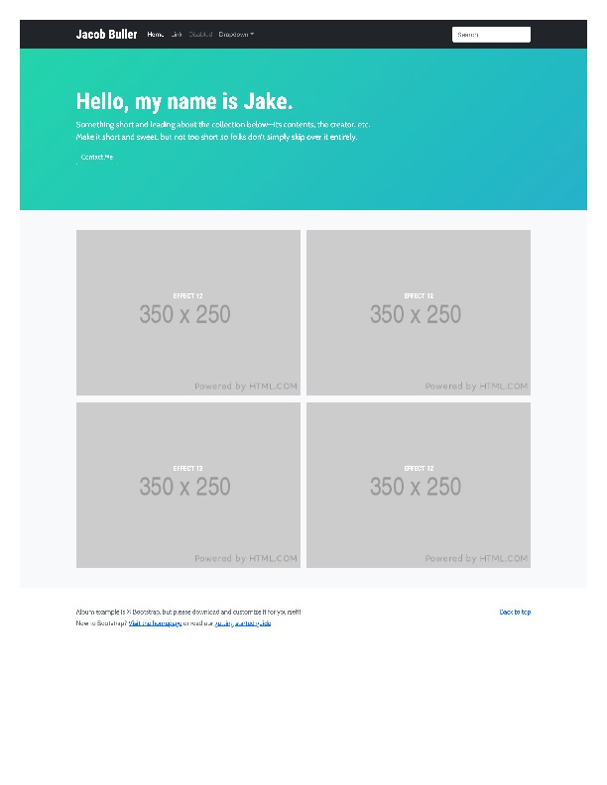
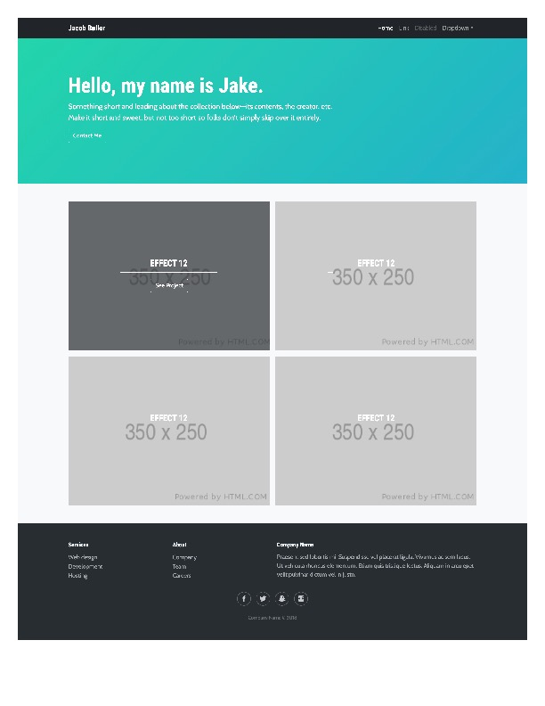
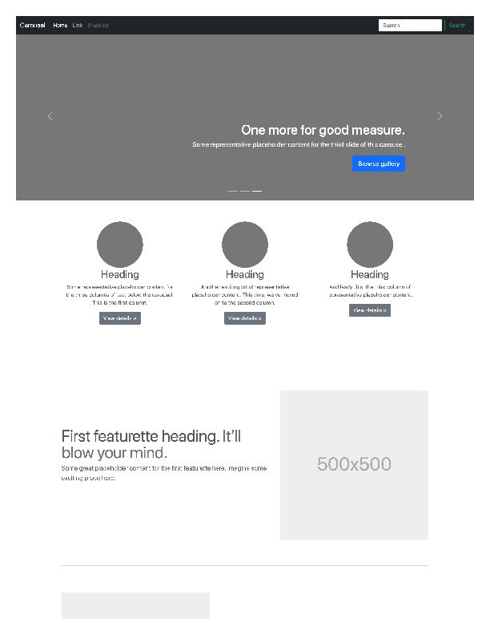
Before
After

Slide 5
So what is SASS?
Sass stands for Syntactically Awesome Stylesheet and it’s an extension of CSS. The main goal of SASS is to reduce repetition in CSS.
It’s a CSS prepocessor language - A CSS preprocessor is a scripting language that extends CSS by allowing developers to write code in one language and then compile it into CSS.
Sass lets you use features that do not exist in CSS, like variables, nested rules, mixins, imports, inheritance, built-in functions, and other stuff
Let’s see some examples - https://www.mugo.ca/Blog/7-benefits-of-using-SASS-over-conventional-CSS
Now, to compile SASS we’re going to download a simple extension on Visual Studio code

