Slide 1
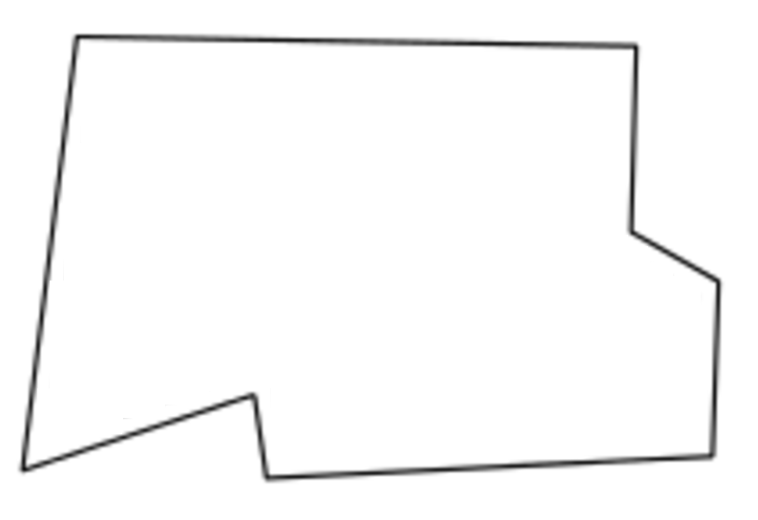
Find “Point Nemo” or “Pole of Inaccessibility”

Slide 2
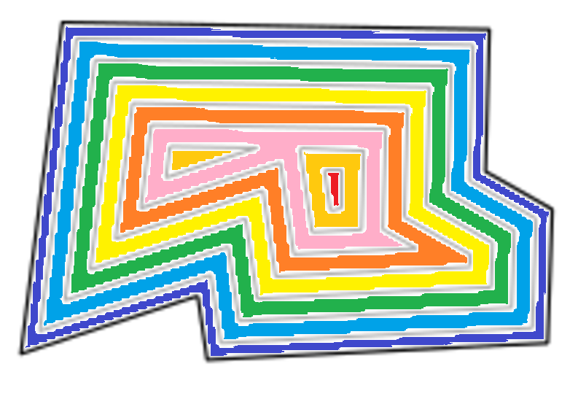


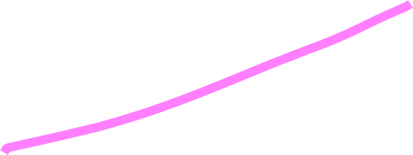
Flood Fill: Start from outside and visit EVERY location until nothing remains. The last point that remains is the answer!

Slide 3
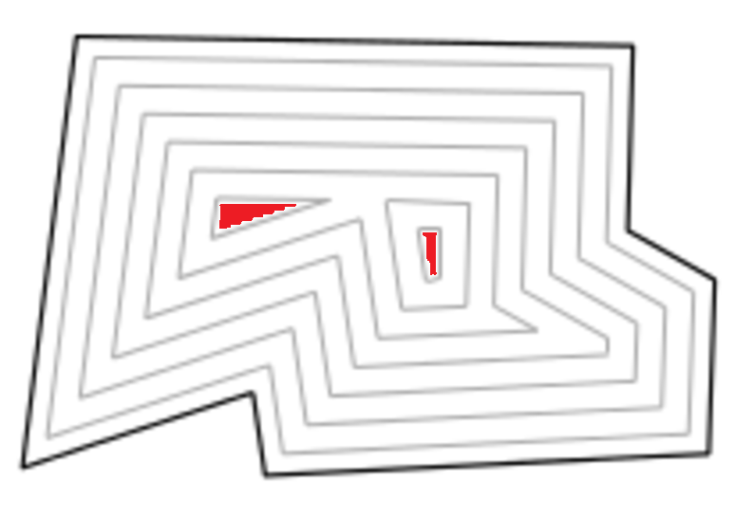
Most techniques skip processing EVERY layer and jump to the best candidate regions quickly

Slide 4
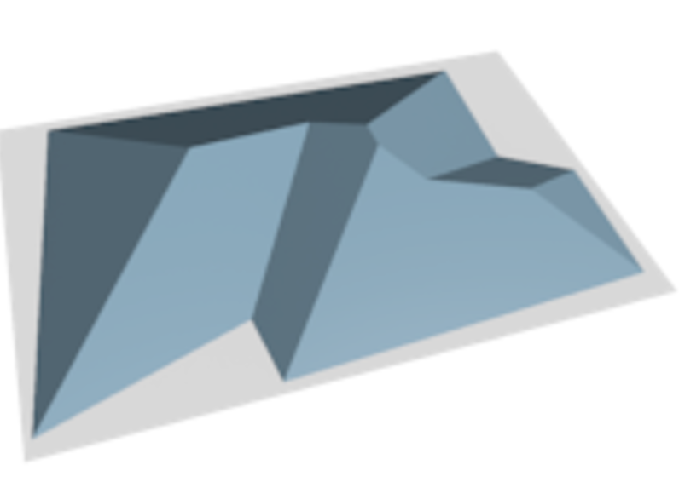
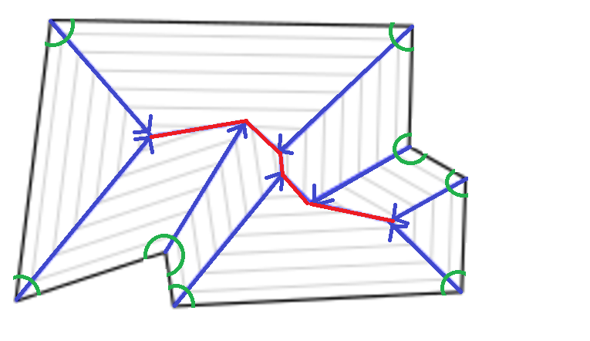
Method 1: Straight Skeleton The Nemo Point lies somewhere near the “top”
The redline is the “top”
Note: The runtime of this approach depends on the number of edge vertices instead of volume. This is USUALLY a good thing.

Slide 5
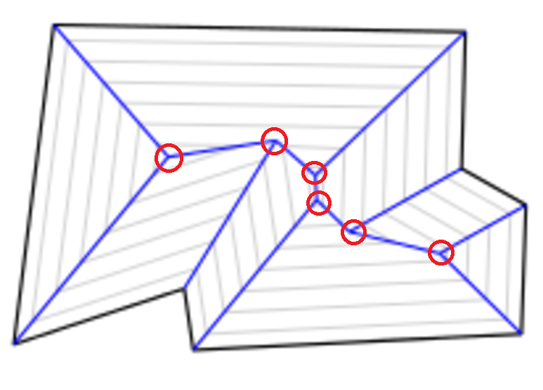
We are interested in calculating these points.
I can make more slides if you need help figuring this out.
I found the Wikipedia page helpful: https://en.wikipedia.org/wiki/Straight_skeleton

Slide 6
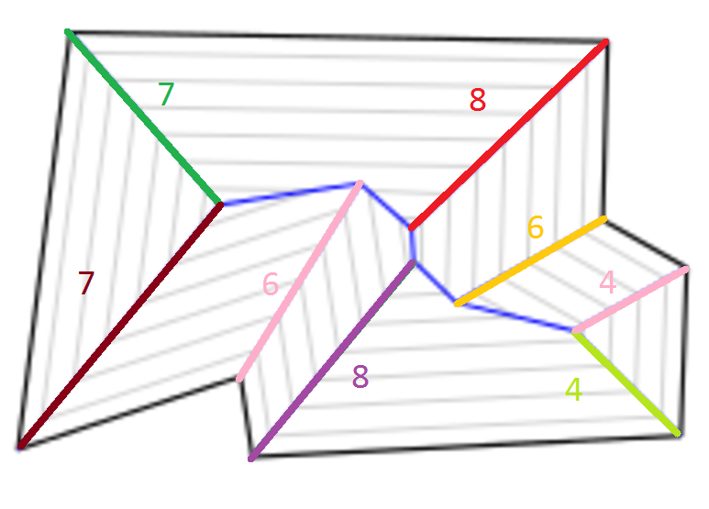
Measure the distance from a vertex to the top

Slide 7
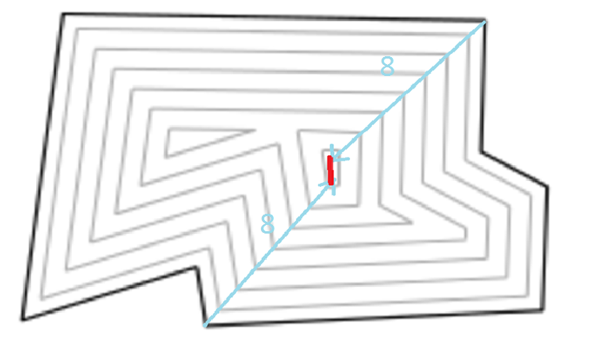
You can easily determine which point or segment of the straight skeleton is the highest
We now need to find where in this region the answer lies.
The challenge did NOT ask for a precise decimal answer, so you could can just naively flood fill on the this small region to solve the challenge.

Slide 8
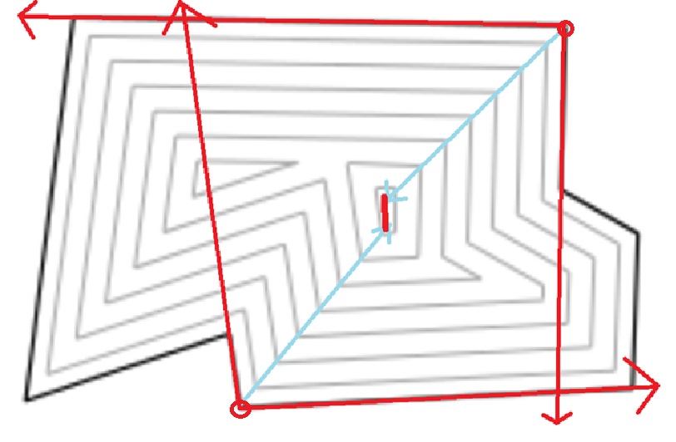
The sides of the two vertices that were used to find the “top” create a bounding box
No other edges or vertices of the polygon will be in this region

Slide 9
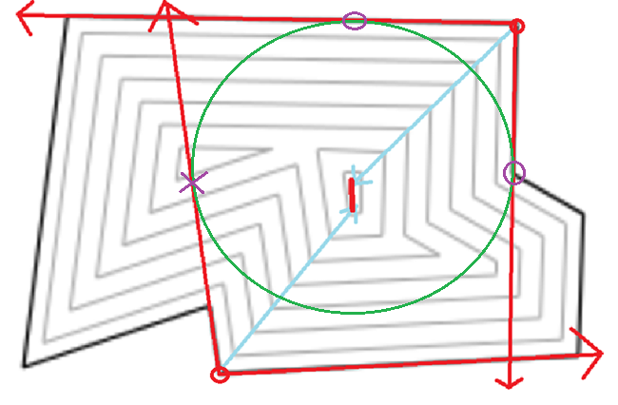
Find largest incircle of the bounding box
Note: the largest in circle needs to intersect the polygon in 3 places. We only have 2 here.

Slide 10
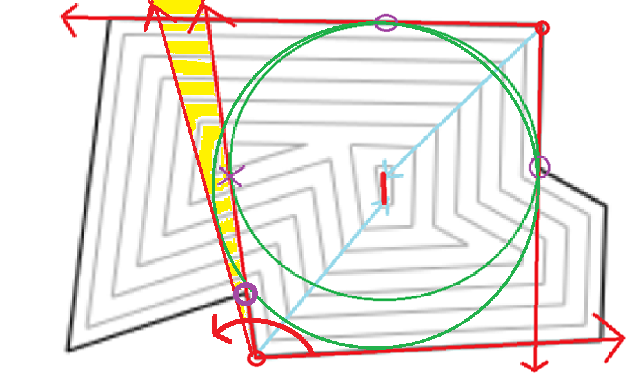
“Grow” the circle until it hits the polygon
The side of the bounding box that isn’t on the polygon will need to conceptually “swing out” to find the first point the circle will bump into as it grows. You will either find a point in this yellow region marked above (sort vertices based on angle they create with that corner of the bounding box) or the circle will grow to hit an edge from that corner of the original bounding box. This also provides a maximum angle to sweep when looking for points in the yellow.

Slide 11
Method 2: Use spatial trees
You can store the data in spatial trees and form a “binary search” on the candidate regions recursively until the region is smaller than the desired precision.
If a precise, decimal point is needed, you can then perform any of the previous methods on the region found to limit the size of the data set.
For an intro: https://www.mapbox.com/blog/polygon-center/
This technique is trivial to parallelize!
The linked page uses quadtrees. There’s potential to use R-Trees instead with efficient Bulk-Loading based on Hilbert Curves to greatly speed up parsing and loading the data from the challenge into the tree: http://repository.cmu.edu/cgi/viewcontent.cgi?article=1586&context=compsci

Slide 12
Method 3: Voronoi Diagram/Delaunay Triangulation
Construct a Voronoi Diagram of the EDGES of the polygon
The edges will be every point from the challenge input
The challenge’s input format lends itself to this approach because it doesn’t need to be transformed into a polygon first!
I’d use the sweep line algorithm from a previous challenge: https://en.wikipedia.org/wiki/Sweep_line_algorithm
The Nemo Point is at the vertex inside the polygon with the largest radius!

