Slide 1
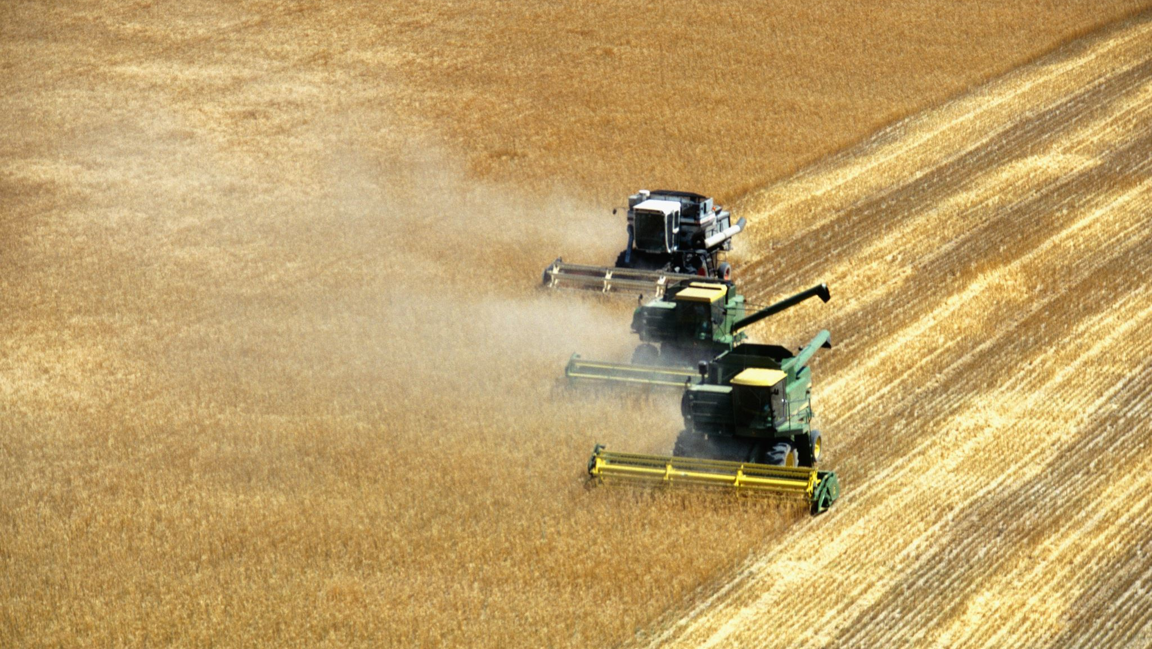
Financing and Training to Address the Gender Gap in Agriculture in Peru
A supervised learning, random forest prediction model
Python for Data Analytics, Final Assignment Jose Carlo Burga

Slide 2
LaGuardia Community College
Continuing Education
Data Analytics Program
Python for Data Analytics: Final Assignment
Financing and Training to Address the Gender Gap in Agriculture in Peru
A supervised learning, random forest model trained to predict locations where the gender gap is most pronounced
Jose Carlo Burga
GitHub Repository
#Peru #Agriculture #Gender_Gap #Financing_Access #Training_Access #Machine_Learning #Supervised_Learning #Regression #Random_Forest #Scikit_Learn #Pandas #Jupyter_Notebooks #Studio_Visual_Code #Python
Financing and Training to Address the Gender Gap in Agriculture in Peru
A supervised learning, random forest model trained to predict locations where the gender gap is most pronounced
Abstract
This project addresses the gender gap in agriculture in Peru by focusing on financing and training. It explores the disparities faced by women in accessing agricultural resources and the impact of targeted financial support and training programs. Using a combination of statistical analysis and machine learning models, the research highlights significant barriers women encounter, such as high interest rates, lack of collateral, and red tape. The findings suggest that improving financial inclusion and providing tailored training can enhance women’s productivity and economic empowerment in the agricultural sector.
The machine learning model, specifically a Random Forest model, is trained to predict locations where the gender gap is most pronounced. This prediction is based on various features such as socio-economic indicators, agricultural productivity, access to financial services, and availability of training programs. The model’s predictions are based on public data from Peru’s National Agrarian Census of 2012, and the strategy will be adjusted as necessary based on new data, model feedback, and results.
This approach combines data-driven insights with practical interventions, providing a powerful tool for tackling gender inequality in agriculture. By accurately predicting the locations where the gender gap is most severe initially to the region level, for resources can be allocated more effectively, thus leading to greater impact.

Slide 3

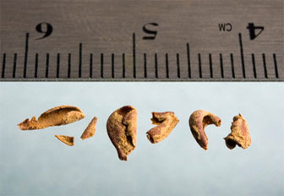
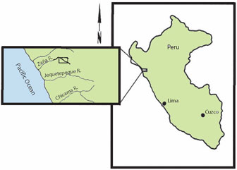
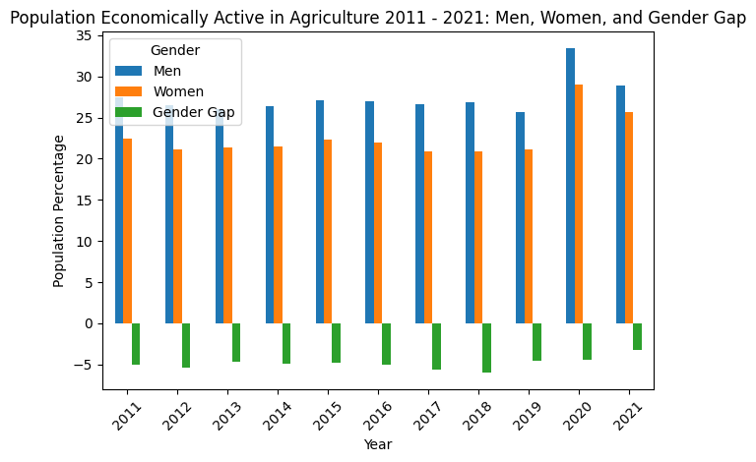
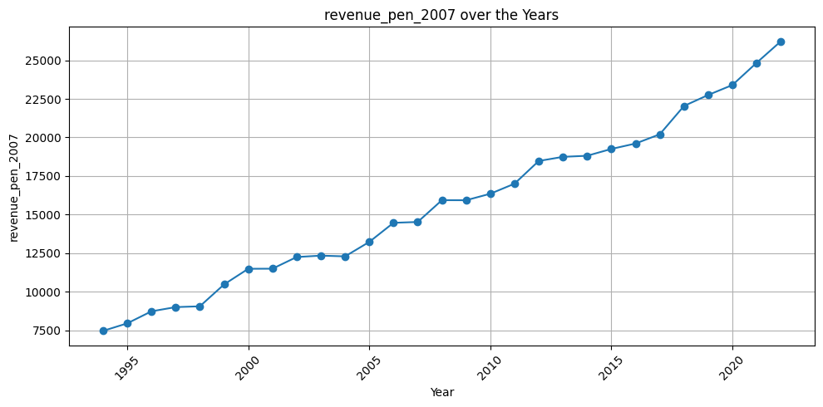
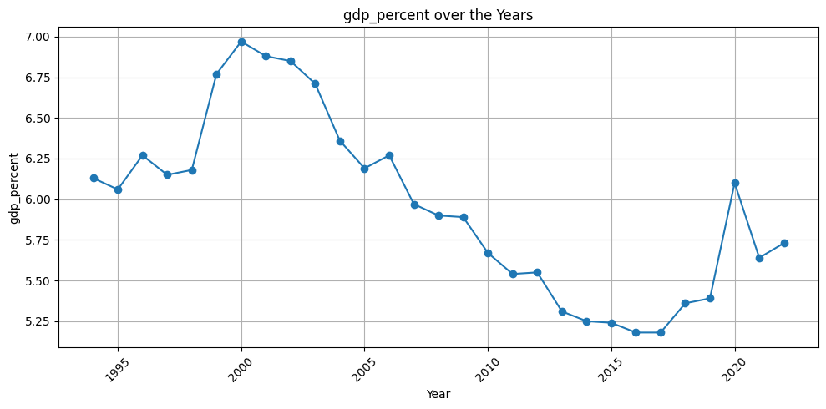
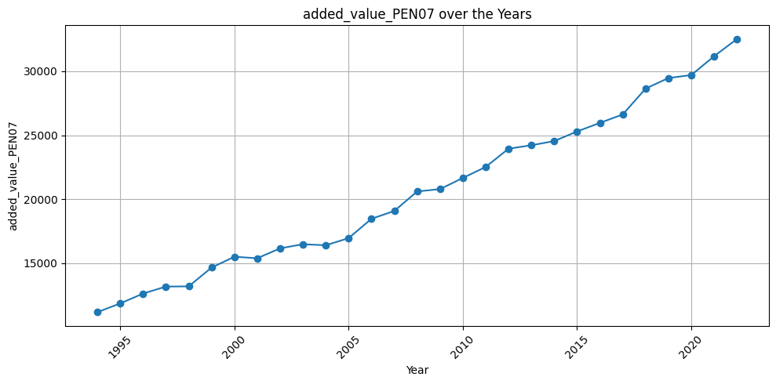
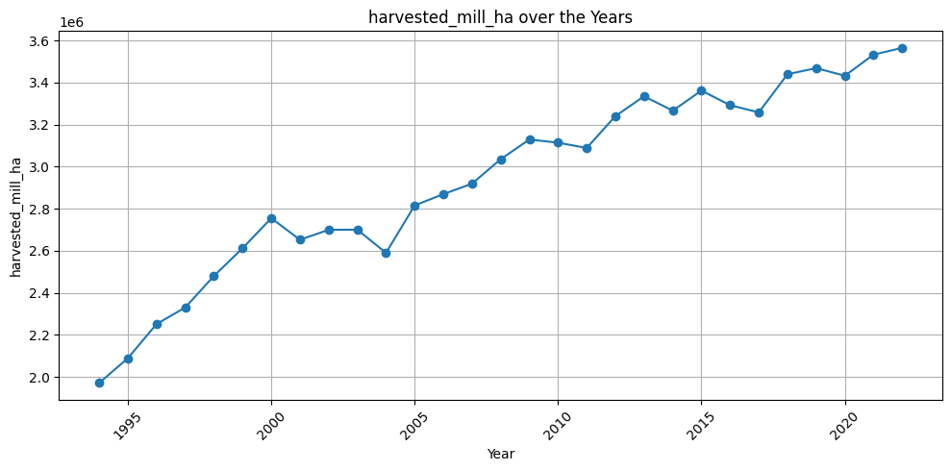
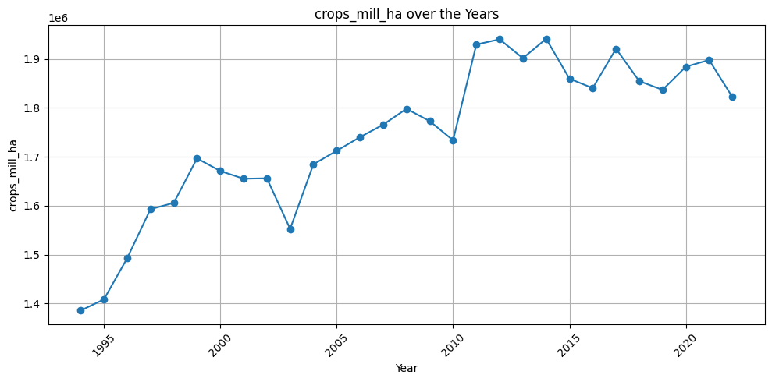
Agriculture in Peru
- Timeline: 10 millennia of agricultural development in Peru
Demographics: 25% of the population is dedicated to agriculture as of 2022
Gender Gap in Agriculture: Python Data Analysis: Jupyter Notebooks via GitHub Repositories
- Women in agriculture have limited access to training and financing
- Women in agriculture have a limited participation in producer associations
Agriculture in Peru: 9,240 – 5,500 years ago
Preceramic Adoption of Peanut, Squash, and Cotton in Northern Peru
Tom D. Dillehay , Jack Rossen, Thomas C. Andres, And David E. Williams
The early development of agriculture in the New World has been assumed to involve early farming in settlements in the Andes, but the record has been sparse. Peanut (Arachis sp.), squash (Cucurbita moschata), and cotton (Gossypium barbadense) macrofossils were excavated from archaeological sites on the western slopes of the northern Peruvian Andes. Direct radiocarbon dating indicated that these plants grew between 9240 and 5500 14C years before the present. These and other plants were recovered from multiple locations in a tropical dry forest valley, including household clusters, permanent architectural structures, garden plots, irrigation canals, hoes, and storage structures. These data provide evidence for early use of peanut and squash in the human diet and of cotton for industrial purposes and indicate that horticultural economies in parts of the Andes took root by about 10,000 years ago.
Irrigation and Land Use on the Arid North Coast of Peru: Assessing Ancient Agricultural Systems Through Drone Photography, Soil Analysis, and Local Knowledge
Authors: C. Prado, J. Eerkens, R. Beresford-Jones, and E. Van Valkenburgh
This paper explores the historical development of agriculture along Peru's arid north coast, focusing on the prehispanic timeline and agricultural products of different cultures. Intensive irrigation-based farming began in the second millennium BCE, featuring early canals and check dams. Early Andean cultures grew crops like squash, beans, and cotton. From the first millennium BCE to the first millennium CE, advanced water management techniques were developed, crucial for handling the El Niño Southern Oscillation (ENSO). Key crops included maize, beans, and manioc. Significant hydraulic engineering advancements and irrigation network expansions occurred from the first millennium CE to the 15th century. The Moche civilization (100-800 CE) built extensive canal systems, cultivating maize, beans, squash, and peanuts. The Chimu civilization (11th-15th century) further developed these systems, creating interconnected canals for diverse crops such as maize, cotton, and quinoa. These innovations supported large populations and complex societies. The paper concludes that the prehispanic agricultural timeline in Peru showcases a continuous evolution of water management and farming practices. By examining the specific crops and techniques used by different cultures, we gain insights into the adaptability and resilience of ancient agricultural systems. These historical practices offer valuable lessons for sustainable agriculture in arid regions globally, demonstrating effective responses to environmental challenges
Agriculture during the Colony
Title: Crecimiento Económico en el Espacio Peruano
Carlos Newland, Universidad Argentina de la Empresa
John Coatsworth, Rockefeller Center for Latin American Studies, Harvard University
In-depth analysis of the evolution of agriculture in Peru from 1681 to 1800. The authors highlight a period of economic crisis and agricultural decline from 1681 to 1750. This was followed by an improvement and overall growth in agriculture from 1750 to 1800.
In conclusion, despite the initial collapse, there was a subsequent expansion of agricultural production in the 18th century. This expansion was not homogeneous across regions, with Lima experiencing a decline. However, the overall trend suggests stability or improvement in per capita agricultural production and likely increases in real wages for the region, except in Lima.
Total Population Dedicated to Agriculture
Total Agricultural Revenue
Agricultural GDP
Agriculture during the Republic
Title: Plantation Agriculture and Social Control in Northern Peru, 1875–1933
Author: Michael J. Gonzales
The author explores the development of plantation agriculture in Northern Peru from 1875 to 1933. Beginning with the economic and political transformation during the 1860s and 1870s, marked by the decline of the guano boom and the rise of coastal agriculture. By the late 19th century, sugarcane plantations had become significant economic entities, driven by technological advancements and the influx of capital from former guano traders.
In the early 20th century, the sugar industry continued to expand, with plantations adopting modern agricultural practices and machinery.
Author concludes with the impact of the War of the Pacific and the subsequent recovery of Peru’s agricultural sector, as wells as the transition from traditional to modern practices, reflecting broader economic and social changes in Northern Peru.
Agricultural Added Value
Harvest
Crops

Slide 4
Referential Research: Finance and Training in Peru
Access to Credit and Credit Risk
Financial Inclusion (Services & Literacy)
Training in Agriculture in Peru?
 | Study on Peruvian Microfinance Institution | Financial Inclusion in Peru | Gender Equality in Peru: Unleashing the Potential of Women (2022)
Summary | This study was conducted at a Peruvian microfinance institution specializing in rural microcredits. The authors proposed a model for assessing microcredit applications using machine learning techniques. The goal was to improve the assertiveness of the credit granting process and reduce the default rate. | This paper by Rocío Maehara et al. explores the application of machine learning (ML) methods to assess financial inclusion in Peru. The study uses data from the National Survey of Demand for Financial Services and Financial Literacy 2019, covering a sample of 1205 Peruvian citizens. | This OECD’s report outlines significant data on women's access to training in the agricultural sector. The report highlights that women in Peru's agricultural sector face substantial barriers to accessing training, which impacts their productivity and economic opportunities.
Methods | Data Pre-processing, Cross-validation, Supervised Learning | Data Pre-processing, Grid Search Procedure, Supervised Learning | Surveys and Questionnaires, Statistical Analysis, Regression Models, Qualitative Interviews, Focus Groups.
Techniques | Handling missing data, Normalizing variables, One Hot coding | 10-fold cross-validation | n/a
Models | Logistic Regression (LR), Random Forest (RF), Support Vector Machine (SVM), Artificial Neural Network (ANN), Decision Tree (dTree), k-Nearest Neighbors (kNN) | Logistic Regression (LR), Artificial Neural Networks (ANNs), Decision Trees (DTs), Random Forest (RF), XGBoost, Support Vector Machine with RBF kernel (SVC RBF) | n/a
Tools | Scikit Learn, Keras, Pandas, Numpy, Matplotlib | Not explicitly mentioned | n/a

Slide 5

Supervised Learning Model

Slide 6
Python Data Exploration &
Feature Preparation: Jupyter
Notebook via GitHub Repositories
# Column Non-Null Count Dtype
--- ------ -------------- -----
0 index 52 non-null int64
1 year 52 non-null int64
2 region_id 52 non-null int64
3 region 52 non-null object
4 gender_id 52 non-null int64
5 gender 52 non-null object
6 producers_thousands 52 non-null float64
7 granted_loans_thousands 52 non-null float64
8 illiteracy_percent 52 non-null float64
9 postgraduate_percent 52 non-null float64
10 primary_percent 52 non-null float64
11 secondary_percent 52 non-null float64
12 dont_need_loans_percent 52 non-null float64
13 high_interest_percent 52 non-null float64
14 no_collateral_percent 52 non-null float64
15 or_reasons_percent 52 non-null float64
16 red_tape_percent 52 non-null float64
17 will_not_get_it_percent 52 non-null float64
18 affiliation_percent 52 non-null float64
19 Spanish 52 non-null float64
20 Quechua 52 non-null float64
21 Aymara 52 non-null float64
22 Amazonia 52 non-null float64
23 requested_loans_percent 52 non-null float64
24 trained_thousands 52 non-null float64
25 purpose_sales 52 non-null float64
26 purpose_self_consumption 52 non-null float64
27 purpose_self_provision 52 non-null float64
28 purpose_animal_food 52 non-null float64
Dataframes
Relevant Columns
Data source: Peru National Agricultural Census 2012
Microdata, INEI Peru (National Institute of Statistics of Peru
6 producers_thousands 52 non-null float64
7 granted_loans_thousands 52 non-null float64
8 illiteracy_percent 52 non-null float64
9 postgraduate_percent 52 non-null float64
10 primary_percent 52 non-null float64
11 secondary_percent 52 non-null float64
12 dont_need_loans_percent 52 non-null float64
13 high_interest_percent 52 non-null float64
14 no_collateral_percent 52 non-null float64
15 or_reasons_percent 52 non-null float64
16 red_tape_percent 52 non-null float64
17 will_not_get_it_percent 52 non-null float64
18 affiliation_percent 52 non-null float64
19 Spanish 52 non-null float64
20 Quechua 52 non-null float64
21 Aymara 52 non-null float64
22 Amazonia 52 non-null float64
23 requested_loans_percent 52 non-null float64
24 trained_thousands 52 non-null float64
25 purpose_sales 52 non-null float64
26 purpose_self_consumption 52 non-null float64
27 purpose_self_provision 52 non-null float64
28 purpose_animal_food 52 non-null float64
Datasets
Common Columns
Features
Agriculture: Producer Profile
# Column Non-Null Count Dtype
--- ------ -------------- -----
0 index 52 non-null int64
1 year 52 non-null int64
2 region_id 52 non-null int64
3 region 52 non-null object
4 gender_id 52 non-null int64
5 gender 52 non-null object
Concatenation / Final Columns
# Column Non-Null Count Dtype
--- ------ -------------- -----
0 index 52 non-null int64
1 year 52 non-null int64
2 region_id 52 non-null int64
3 region 52 non-null object
4 gender_id 52 non-null int64
5 gender 52 non-null object
6 producers_thousands 52 non-null float64
7 granted_loans_thousands 52 non-null float64
8 illiteracy_percent 52 non-null float64
9 postgraduate_percent 52 non-null float64
10 primary_percent 52 non-null float64
11 secondary_percent 52 non-null float64
12 dont_need_loans_percent 52 non-null float64
13 high_interest_percent 52 non-null float64
14 no_collateral_percent 52 non-null float64
15 or_reasons_percent 52 non-null float64
16 red_tape_percent 52 non-null float64
17 will_not_get_it_percent 52 non-null float64
18 affiliation_percent 52 non-null float64
19 Spanish 52 non-null float64
20 Quechua 52 non-null float64
21 Aymara 52 non-null float64
22 Amazonia 52 non-null float64
23 requested_loans_thousands 52 non-null float64
24 trained_thousands 52 non-null float64
25 purpose_sales 52 non-null float64
26 purpose_self_consumption 52 non-null float64
27 purpose_self_provision 52 non-null float64
28 purpose_animal_food 52 non-null float64
29 agriculture_employment 7140 non-null float64
Drop
4 sector_id 7140 non-null int64
5 sector 7140 non-null object
# Column Non-Null Count Dtype
--- ------ -------------- -----
0 index 7140 non-null int64
1 year 7140 non-null int64
2 region_id 7140 non-null float64
3 region 7140 non-null object
4 sector_id 7140 non-null int64
5 sector 7140 non-null object
6 gender_id 7140 non-null int64
7 gender 7140 non-null object
8 agriculture_employment 7140 non-null float64
Agriculture: Employment
# Column Non-Null Count Dtype
--- ------ -------------- -----
0 index 7140 non-null int64
1 year 7140 non-null int64
2 region_id 7140 non-null float64
3 region 7140 non-null object
6 gender_id 7140 non-null int64
7 gender 7140 non-null object
8 agriculture_employment 7140 non-null float64
# Column Non-Null Count Dtype
--- ------ -------------- -----
0 index 29 non-null int64
1 year 29 non-null int64
2 region_id 29 non-null int64
3 region 29 non-null object
4 revenue_pen_2007 29 non-null float64
5 gdp_percent 29 non-null float64
6 added_value_PEN07 29 non-null int64
7 harvested_mill_ha 29 non-null float64
8 crops_mill_ha 29 non-null float64
Agriculture: Main Indicators
# Column Non-Null Count Dtype
--- ------ -------------- -----
0 index 29 non-null int64
1 year 29 non-null int64
2 region_id 29 non-null int64
3 region 29 non-null object
4 revenue_pen_2007 29 non-null float64
5 gdp_percent 29 non-null float64
6 added_value_PEN07 29 non-null int64
7 harvested_mill_ha 29 non-null float64
8 crops_mill_ha 29 non-null float64
# Column Non-Null Count Dtype
--- ------ -------------- -----
0 index 29 non-null int64
1 year 29 non-null int64
2 region_id 29 non-null int64
3 region 29 non-null object
4 revenue_pen_2007 29 non-null float64
5 gdp_percent 29 non-null float64
6 added_value_PEN07 29 non-null int64
7 harvested_mill_ha 29 non-null float64
8 crops_mill_ha 29 non-null float64
4 crops_affected_by_disasters 470 non-null float64
Agriculture: Natural Disasters
# Column Non-Null Count Dtype
--- ----- -------------- -----
0 index 470 non-null int64
1 year 470 non-null int64
2 region_id 470 non-null int64
3 region 470 non-null object
4 crops_affected_by_disasters 470 non-null float64
# Column Non-Null Count Dtype
--- ----- -------------- -----
0 index 470 non-null int64
1 year 470 non-null int64
2 region_id 470 non-null int64
3 region 470 non-null object
4 crops_affected_by_disasters 470 non-null float64

Slide 7
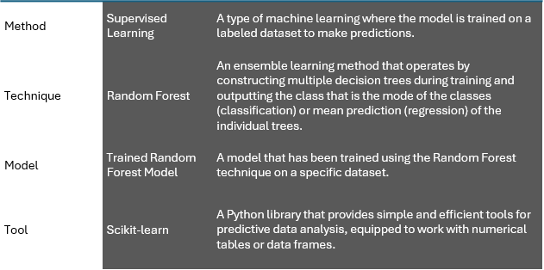
Statistical Analysis
mean
std
minimum
maximum
Methodology
Category vs Features
Feature Selection & Importance
# | Column | Non-Null Count | Dtype | Final Feature
0 | index | 52 non-null | int64 | category_index
1 | year | 52 non-null | int64 | category_year
2 | region_id | 52 non-null | int64 | category_region_id
3 | region | 52 non-null | object | category_region
4 | gender_id | 52 non-null | int64 | category_gender_id
5 | gender | 52 non-null | object | category_gender
6 | producers_thousands | 52 non-null | float64 | producers_numerical
7 | granted_loans_percent | 52 non-null | float64 | granted_loans_percent
8 | illiteracy_percent | 52 non-null | float64 | illiteracy_percent
9 | postgraduate_percent | 52 non-null | float64 | education_postgraduate_completed_percent
10 | primary_percent | 52 non-null | float64 | education_primary_completed_percent
11 | secondary_percent | 52 non-null | float64 | education_secondary_completed_percent
12 | dont_need_loans_percent | 52 non-null | float64 | don’t_need_loans_percent
13 | high_interest_percent | 52 non-null | float64 | high_interests_percent
14 | other_reasons_percent | 52 non-null | float64 | other_reasons_percent
15 | no_collateral_percent | 52 non-null | float64 | no_collateral_percent
16 | red_tape_percent | 52 non-null | float64 | red_tape_percent
17 | will_not_get_it_percent | 52 non-null | float64 | will_not_get_it_percent
18 | affiliation_percent | 52 non-null | float64 | belongs_producers_association_percent
19 | Spanish | 52 non-null | float64 | language_spanish_percent
20 | Quechua | 52 non-null | float64 | language_quechua_percent
21 | Aymara | 52 non-null | float64 | language_aymara_percent
22 | Amazonia | 52 non-null | float64 | language_amazonia_percent
23 | requested_loans_thousands | 52 non-null | float64 | requested_loans_percent
24 | trained_thousands | 52 non-null | float64 | trained_percent
25 | purpose_sales | 52 non-null | float64 | purpose_sales_percent
26 | purpose_self_consumption | 52 non-null | float64 | purpose_self_consumption_percent
27 | purpose_self_provision | 52 non-null | float64 | purpose_self_provision_percent
28 | purpose_animal_food | 52 non-null | float64 | purpose_animal_food_percent
29 | employment_agriculture_percent | 7140 non-null | float64 | employment_agriculture_percent
category_region_id
producers_numerical
granted_loans_percent
requested_loans_percent
trained_percent
belongs_producers_association_percent
Model Implementation
The main objective of the Random Forest model is to improve prediction accuracy by reducing overfitting of the model and handling large data with higher dimensionality. It does this by creating multiple decision trees and merging them together.
Formula
There isn’t a specific formula for Random Forest like there is for some other models. Instead, it’s a collection of decision trees, each created from a different subset of your data. The final prediction is made by averaging the predictions of each tree if it’s a regression problem, or by majority voting if it’s a classification problem.
Steps
Bootstrap the data: Create multiple subsets of the original dataset, selecting observations with replacement.
Create the Random Forest: For each new data subset, create a decision tree. The optimal split at each node is found from a random subset of features.
Make a prediction: Each individual tree in the Random Forest spits out a class prediction and the class with the most votes becomes the model’s prediction.
illiteracy_percent
education_primary_completed_percent
education_secondary_completed_percent
employment_agriculture_percent
language_spanish_percent
language_quechua_percent
language_aymara_percent
language_aymara_percent

Slide 8
https://github.com/jcburga/python_final_research/blob/main/%232B_ml_producer_preparation.ipynb
Supervised Learning (Random Forest) Predictive Model
 | Description | Code
1 | Data Collection Data Collection Statistical Analysis | https://github.com/jcburga/python_final_research/blob/main/concatenate_clean_agriculture_producer_employment.csv https://github.com/jcburga/python_final_research/blob/main/ml_producer_profile_selected_features.csv https://github.com/jcburga/python_final_research/blob/main/%231_ml_producer__statistical.ipynb
2 | Data Exploration: Data Preparation: | https://github.com/jcburga/python_final_research/blob/main/%232A_ml_producer_exploration.ipynb https://github.com/jcburga/python_final_research/blob/main/%232B_ml_producer_preparation.ipynb
3 | Feature Selection & Importance Data Pre-Processing: | https://github.com/jcburga/python_final_research/blob/main/%233B_ml_producer_feature_selection_importance.ipynb https://github.com/jcburga/python_final_research/blob/main/%234_ml_producer_pre_processing.ipynb
4 | Model Training: Split, | https://github.com/jcburga/python_final_research/blob/main/%234_5_6_ml_producer_train_predict_evaluate.ipynb
5 | Prediction:
6 | Model Evaluation:
 | References
1 | Data Collection: | Kelleher, J. D., Mac Namee, B., & D’Arcy, A. (2015). Fundamentals of Machine Learning for Predictive Data Analytics: Algorithms, Worked Examples, and Case Studies. MIT Press.
2 | Data Preprocessing: | Garcia, S., Luengo, J., & Herrera, F. (2015). Data Preprocessing in Data Mining. Springer.
3 | Feature Selection: | Guyon, I., & Elisseeff, A. (2003). An Introduction to Variable and Feature Selection. Journal of Machine Learning Research, 3, 1157-1182.
4 | Model Training: | Bishop, C. M. (2006). Pattern Recognition and Machine Learning. Springer.
5 | Model Evaluation: | Sokolova, M., & Lapalme, G. (2009). A Systematic Analysis of Performance Measures for Classification Tasks. Information Processing & Management, 45(4), 427-437.
6 | Prediction: | Hastie, T., Tibshirani, R., & Friedman, J. (2009). The Elements of Statistical Learning: Data Mining, Inference, and Prediction. Springer.

Slide 9

Research

Slide 10
Comparative Hierarchical Methodological Decision-Making Matrix
selected
Method | Supervised Learning | A type of machine learning where the model is trained on a labeled dataset to make predictions. | Supervised Learning | A type of machine learning where the model is trained on a labeled dataset to make predictions. | Supervised Learning | A type of machine learning where the model is trained on a labeled dataset to make predictions. | Supervised Learning | A type of machine learning where the model is trained on a labeled dataset to make predictions.
Technique | Random Forest | An ensemble learning method that operates by constructing multiple decision trees during training and outputting the class that is the mode of the classes (classification) or mean prediction (regression) of the individual trees. | Support Vector Machines (SVM) | A set of supervised learning methods used for classification, regression and outliers detection. | Logistic Regression | A statistical model that uses a logistic function to model a binary dependent variable. | Neural Networks | A series of algorithms that endeavors to recognize underlying relationships in a set of data through a process that mimics the way the human brain operates.
Model | Trained Random Forest Model | A model that has been trained using the Random Forest technique on a specific dataset. | Trained SVM Model | A model that has been trained using the SVM technique on a specific dataset. | Trained Logistic Regression Model | A model that has been trained using the Logistic Regression technique on a specific dataset. | Trained Neural Network Model | A model that has been trained using the Neural Network technique on a specific dataset.
Tool | Scikit-learn | A Python library that provides simple and efficient tools for predictive data analysis, equipped to work with numerical tables or data frames. | Scikit-learn | A Python library that provides simple and efficient tools for predictive data analysis, equipped to work with numerical tables or data frames. | Scikit-learn | A Python library that provides simple and efficient tools for predictive data analysis, equipped to work with numerical tables or data frames. | TensorFlow | An open-source platform for machine learning that provides a comprehensive ecosystem of tools, libraries, and community resources for developing and deploying ML models.
References:
1. Kotsiantis, S. B. (2007). Supervised Machine Learning: A Review of Classification Techniques. Informatica, 31, 249-268.
2. Breiman, L. (2001). Random Forests. Machine Learning, 45(1), 5-32.
3. Cortes, C., & Vapnik, V. (1995). Support-Vector Networks. Machine Learning, 20(3), 273-297.
4. Cox, D. R. (1958). The Regression Analysis of Binary Sequences. Journal of the Royal Statistical Society: Series B (Methodological), 20(2), 215-242.
5. Goodfellow, I., Bengio, Y., & Courville, A. (2016). Deep Learning. MIT Press.
6. Pedregosa, F., Varoquaux, G., Gramfort, A., Michel, V., Thirion, B., Grisel, O., … & Vanderplas, J. (2011). Scikit-learn: Machine Learning in Python. Journal of Machine Learning Research, 12, 2825-2830.
7. Abadi, M., Barham, P., Chen, J., Chen, Z., Davis, A., Dean, J., … & Kudlur, M. (2016). TensorFlow: A System for Large-Scale Machine Learning. In OSDI (Vol. 16, pp. 265-283).

Slide 11
Data from CSV/XLSX
Step | Method | Description | Example Code
1 | Databases | Data is extracted from a database using SQL queries or a database API. | import sqlite3<br>import pandas as pd<br>conn = sqlite3.connect('database.db')<br>df = pd.read_sql_query("SELECT * FROM table_name", conn)
2 | Web Scraping | Data is extracted from a website using web scraping tools. | import requests<br>from bs4 import BeautifulSoup<br>response = requests.get("https://www.website.com")<br>soup = BeautifulSoup(response.content, 'html.parser')<br>data = soup.find_all('div', class_='class-name')
3 | APIs | Data is accessed in a structured format using APIs provided by websites and platforms. | import requests<br>response = requests.get("https://api.website.com/data")<br>data = response.json()
4 | Surveys and Questionnaires | Data is collected using surveys or questionnaires. | N/A
5 | CSV/Excel Files | Data is loaded from CSV or Excel files into a DataFrame. | import pandas as pd<br>df = pd.read_csv('data.csv')
6 | Preexisting Datasets | Data is collected from preexisting datasets available on the internet. | N/A
References:
Garcia-Molina, H., Ullman, J. D., & Widom, J. (2009). Database Systems: The Complete Book. Pearson.
Mitchell, R. (2015). Web Scraping with Python: Collecting More Data from the Modern Web. O’Reilly Media.
Pautasso, C., Zimmermann, O., & Leymann, F. (2008). Restful Web Services vs. Big Web Services: Making the Right Architectural Decision. In Proceedings of the 17th International Conference on World Wide Web (pp. 805-814).
Fink, A. (2013). How to Conduct Surveys: A Step-by-Step Guide. Sage Publications.
McKinney, W. (2012). Python for Data Analysis: Data Wrangling with Pandas, NumPy, and IPython. O’Reilly Media.
Kelleher, J. D., Mac Namee, B., & D’Arcy, A. (2015). Fundamentals of Machine Learning for Predictive Data Analytics: Algorithms, Worked Examples, and Case Studies. MIT Press.

