Slide 1

Turbustat
Data exploration – part 1
Jullian Williams & Dean Kaialau

Slide 2
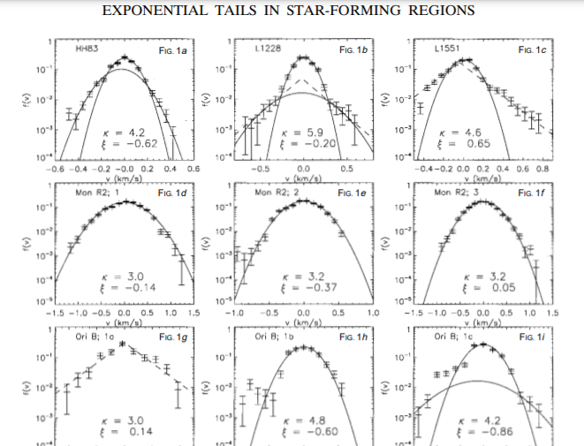
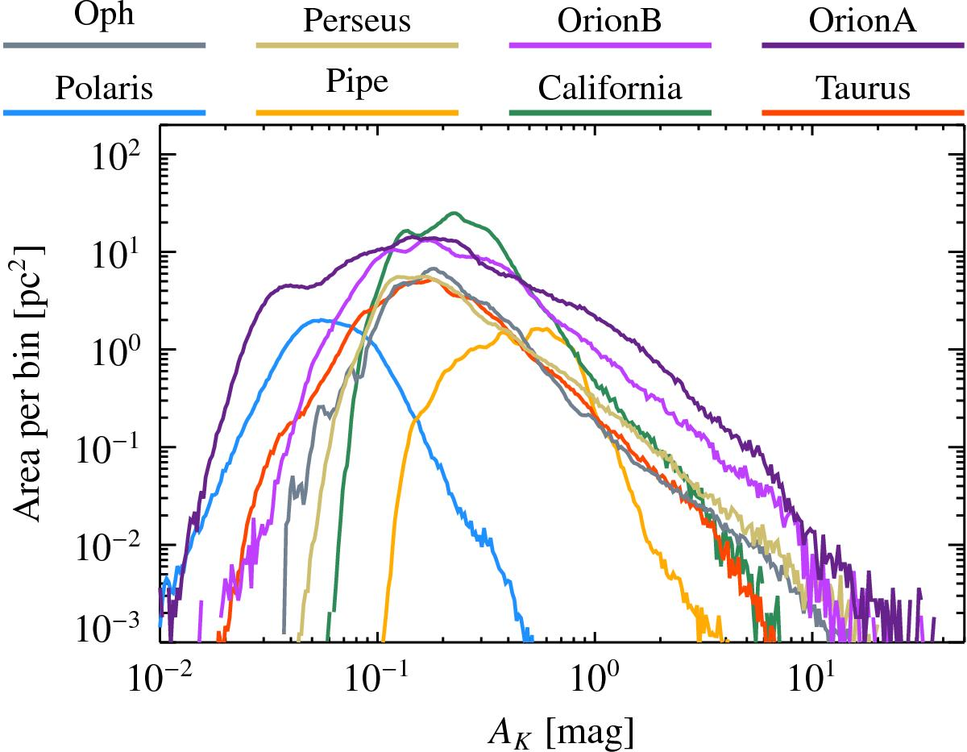
TURBUSTAT PDF
TurbuStat PDF is modified to emphasize flexibility on treatment and modeling of the PDF.
Both images and data cubes can be used.
Turbu-PDF is used to recover the PDF’s Empirical Cumulative Distribution Function.
Handles non-parametric data.
Works with SciPy.Stats for normal, log-normal and power-law distributions.
May be able to make statistical comparisons for treatments in the model.
Velocities of star forming regions.
Stability and rotational motion of celestial bodies.
Cause and effect relationship between the position of celestial bodies (moon) and Earth’s natural events.
Classification of celestial bodies by weight, velocity and shape.
Adapted from: Miesch & Scalo., 1995
Adapted from: Lombardi, et al., 2015

Slide 3
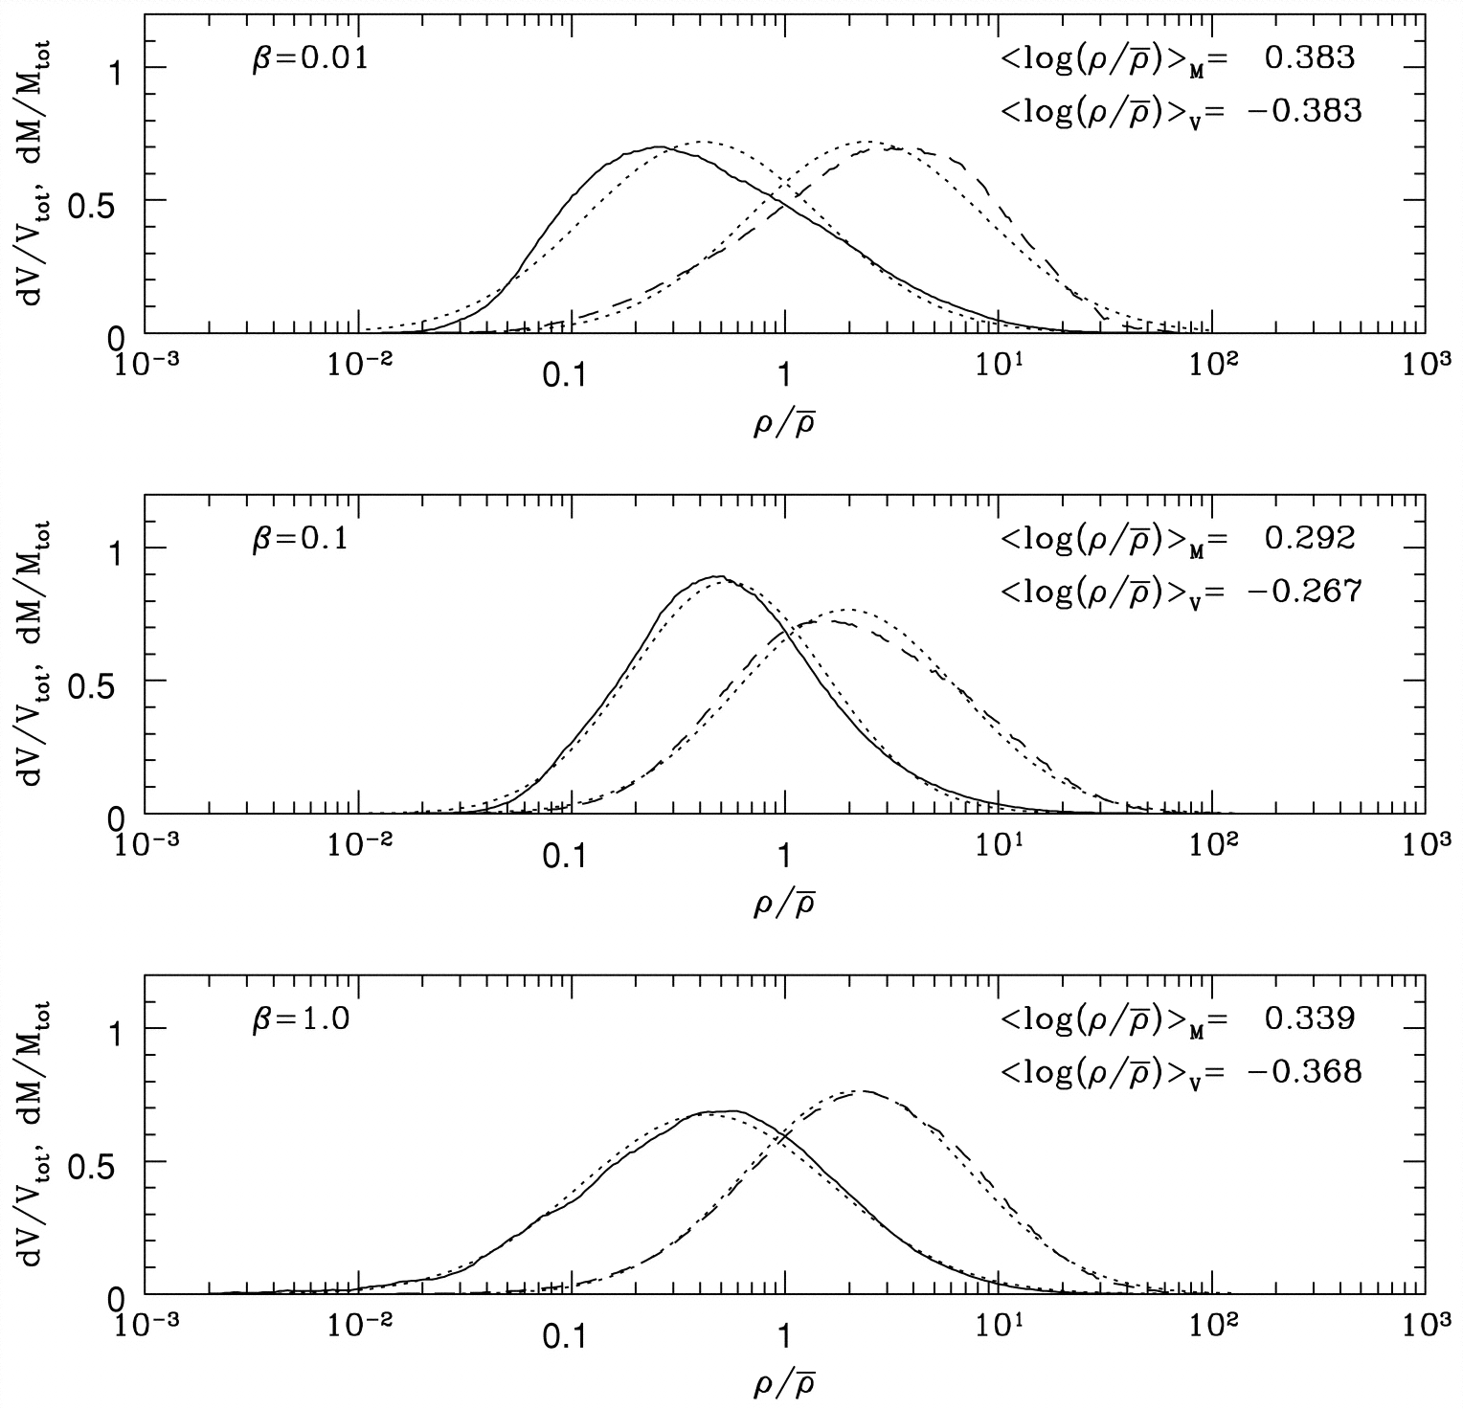
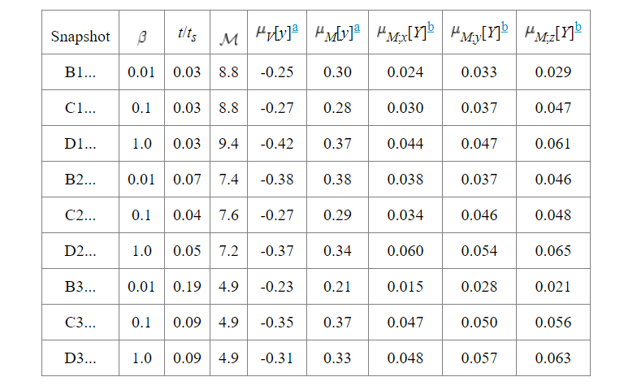
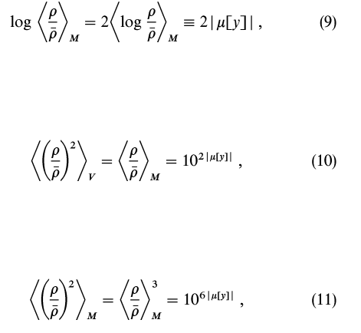
Turbulent Molecular cloud models

Slide 4
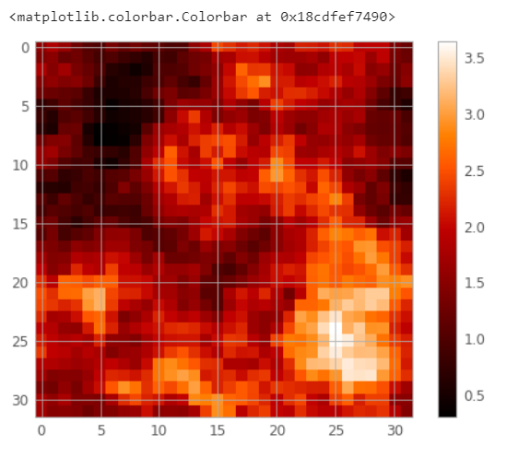
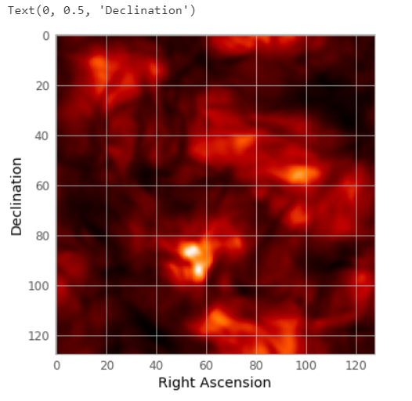
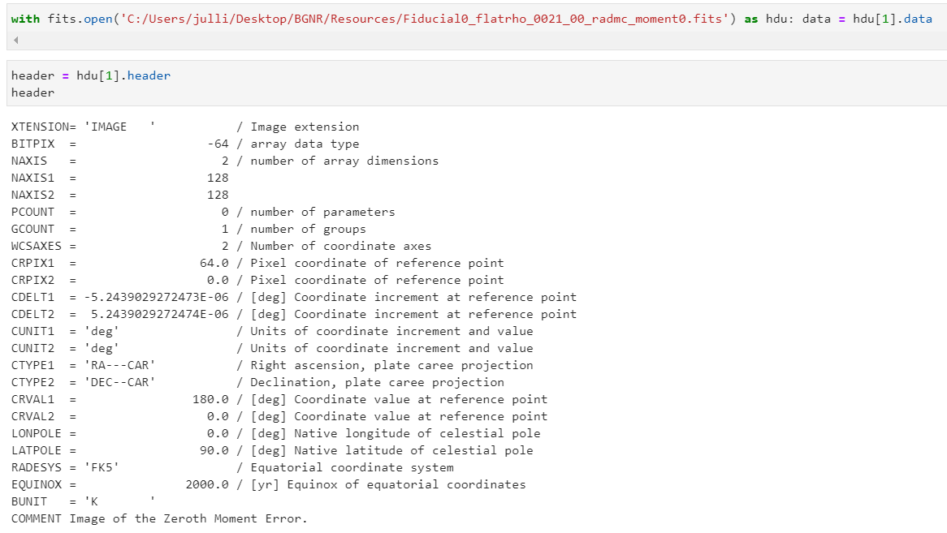
What’s in the data?
As data cube
As Image

Slide 5
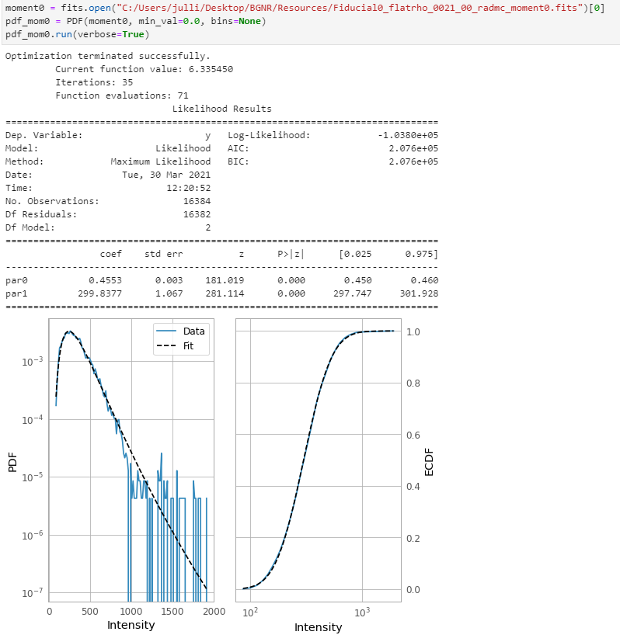
TURBUSTAT PDF
1. Often used in interstellar medium and molecular cloud studies.
2. Column density, intensities or extinction values can be used to construct the PDF.
3. Properties of the PDF, when related to an analytical form, have been found to correlate with changes in the turbulent properties and gravity.
The PDF and ECDF of the data are plotted, along with a log-normal fit to the PDF.
* ECDF is the empirical cumulative distribution function defined as the cumulative sum of the data.

Slide 6
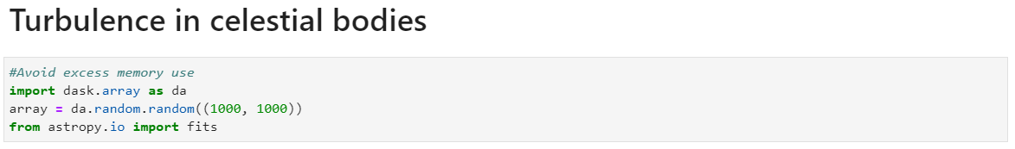
Managing Memory

Slide 7
References
Burkhart, B., Stalpes, K., & Collins, D. (2016). The Razor’s edge of collapse: The transition point from Lognormal to Power-Law distributions in molecular clouds. The Astrophysical Journal, 834(1), L1. doi: 10.3847/2041-8213/834/1/l1
Koch, E., Rosolowsky, E., Boyden, R., Burkhart, B., Ginsburg, A., Loeppky, J., & Offner, S. (2019). TurbuStat: Turbulence Statistics in Python. The Astronomical Journal, 158(1), 1. doi: 10.3847/1538-3881/ab1cc0
Lombardi, M., Alves, J., & Lada, C. (2015). Molecular clouds have power-law probability distribution functions. Astronomy & Astrophysics, 576, L1. doi: 10.1051/0004-6361/201525650
Miesch, M., & Scalo, J. (1995). Exponential Tails in the Centroid Velocity Distributions of Star-forming Regions. The Astrophysical Journal, 450(1). doi: 10.1086/309661
Ostriker, E., Stone, J., & Gammie, C. (2001). Density, Velocity, and Magnetic Field Structure in Turbulent Molecular Cloud Models. The Astrophysical Journal, 546(2), 980-1005. doi: 10.1086/318290
PDF — turbustat v1.3.dev16+g354d02e. (2021). Retrieved 30 March 2021, from https://turbustat.readthedocs.io/en/latest/tutorials/statistics/pdf_example.html#overview

