Slide 1
Regular Expressions 101
Or
How I Learned to Stop Worrying
and Love the Regex
Jacob Walker
For Upfront Wichita
2013-03-28

Slide 2
Overview
Introduction to Regex
Basic Usage
Advanced Features

Slide 3








About Me
#!/bin/bash

Slide 4


About Me

Slide 5
What I Love (In Order)
Vim
Regular Expressions
My Wife and Kids
Linux / Bash / GNU-Utils
Carbs / Beer
(Sorry, Honey! At least you beat Linux!)

Slide 6
About You
Introduce Yourself!
  Name
  Student / Professional
  Preferred Languages / Tools
  Goals / Hopes / Aspirations / Dreams

Slide 7
What are Regular Expressions?
“A regular expression is a specific pattern that provides concise and flexible means to 'match' (specify and recognize) strings of text, such as particular characters, words, or patterns of characters.”
-- Wikipedia.org

Slide 8
Put Simply
“wildcards on steroids”
-- regular-expressions.info
*.txt
foo.*
*bar*

Slide 9
Not all Equal
Different engines
  Perl
  PCRE (Perl Compatible Regular Expression)
  POSIX: BRE (Basic)
  POSIX: ERE (Extended)
  JavaScript
  10 others listed on regular-expresions.info

Slide 10
Uses
Input validation
String manipulation
Finding information
Confusing developers

Slide 11
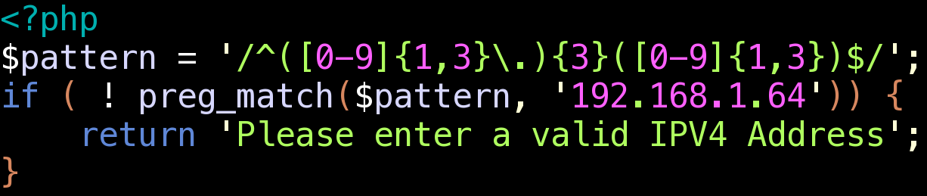
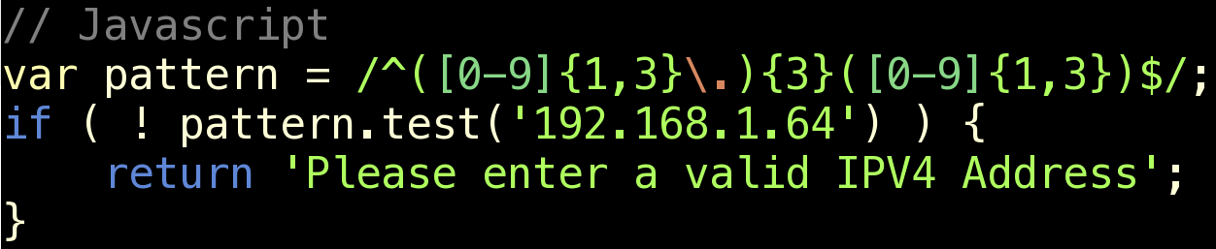
Uses :: Input Validation

Slide 12
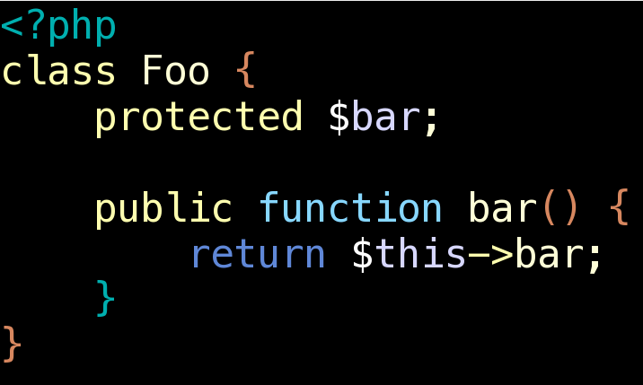
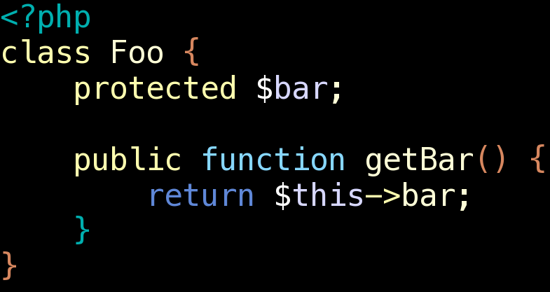
Uses :: String Manipulation

Slide 13
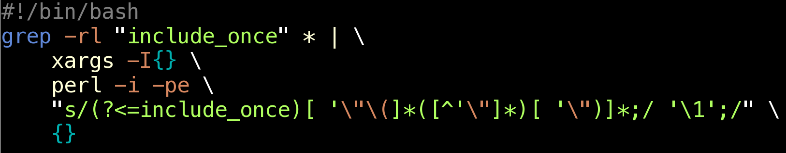
Uses :: String Manipulation

Slide 14

Uses :: Finding Information
http://xkcd.com/208

Slide 15
Uses :: Confusing Developers
Some people, when confronted with a problem, think
“I know, I'll use regular expressions.”
Now they have two problems.

Slide 16
Uses :: Confusing Developers
RFC 82
(?:(?:\r\n)?[ \t])*(?:(?:(?:[^()<>@,;:\\".\[\] \000-\031]+(?:(?:(?:\r\n)?[ \t])+|\Z|(?=[\["()<>@,;:\\".\[\]]))|"(?:[^\"\r\\]|\\.|(?:(?:\r\n)?[ \t]))*"(?:(?:\r\n)?[ \t])*)(?:\.(?:(?:\r\n)?[ \t])*(?:[^()<>@,;:\\".\[\] \000-\031]+(?:(?:(?:\r\n)?[ \t])+|\Z|(?=[\["()<>@,;:\\".\[\]]))|"(?:[^\"\r\\]|\\.|(?:(?:\r\n)?[ \t]))*"(?:(?:\r\n)?[ \t])*))*@(?:(?:\r\n)?[ \t])*(?:[^()<>@,;:\\".\[\] \000-\031]+(?:(?:(?:\r\n)?[ \t])+|\Z|(?=[\["()<>@,;:\\".\[\]]))|\[([^\[\]\r\\]|\\.)*\](?:(?:\r\n)?[ \t])*)(?:\.(?:(?:\r\n)?[ \t])*(?:[^()<>@,;:\\".\[\] \000-\031]+(?:(?:(?:\r\n)?[ \t])+|\Z|(?=[\["()<>@,;:\\".\[\]]))|\[([^\[\]\r\\]|\\.)*\](?:(?:\r\n)?[ \t])*))*|(?:[^()<>@,;:\\".\[\] \000-\031]+(?:(?:(?:\r\n)?[ \t])+|\Z|(?=[\["()<>@,;:\\".\[\]]))|"(?:[^\"\r\\]|\\.|(?:(?:\r\n)?[ \t]))*"(?:(?:\r\n)?[ \t])*)*\<(?:(?:\r\n)?[ \t])*(?:@(?:[^()<>@,;:\\".\[\] \000-\031]+(?:(?:(?:\r\n)?[ \t])+|\Z|(?=[\["()<>@,;:\\".\[\]]))|\[([^\[\]\r\\]|\\.)*\](?:(?:\r\n)?[ \t])*)(?:\.(?:(?:\r\n)?[ \t])*(?:[^()<>@,;:\\".\[\] \000-\031]+(?:(?:(?:\r\n)?[ \t])+|\Z|(?=[\["()<>@,;:\\".\[\]]))|\[([^\[\]\r\\]|\\.)*\](?:(?:\r\n)?[ \t])*))*(?:,@(?:(?:\r\n)?[ \t])*(?:[^()<>@,;:\\".\[\] \000-\031]+(?:(?:(?:\r\n)?[ \t])+|\Z|(?=[\["()<>@,;:\\".\[\]]))|\[([^\[\]\r\\]|\\.)*\](?:(?:\r\n)?[ \t])*)(?:\.(?:(?:\r\n)?[ \t])*(?:[^()<>@,;:\\".\[\] \000-\031]+(?:(?:(?:\r\n)?[ \t])+|\Z|(?=[\["()<>@,;:\\".\[\]]))|\[([^\[\]\r\\]|\\.)*\](?:(?:\r\n)?[ \t])*))*)*:(?:(?:\r\n)?[ \t])*)?(?:[^()<>@,;:\\".\[\] \000-\031]+(?:(?:(?:\r\n)?[ \t])+|\Z|(?=[\["()<>@,;:\\".\[\]]))|"(?:[^\"\r\\]|\\.|(?:(?:\r\n)?[ \t]))*"(?:(?:\r\n)?[ \t])*)(?:\.(?:(?:\r\n)?[ \t])*(?:[^()<>@,;:\\".\[\] \000-\031]+(?:(?:(?:\r\n)?[ \t])+|\Z|(?=[\["()<>@,;:\\".\[\]]))|"(?:[^\"\r\\]|\\.|(?:(?:\r\n)?[ \t]))*"(?:(?:\r\n)?[ \t])*))*@(?:(?:\r\n)?[ \t])*(?:[^()<>@,;:\\".\[\] \000-\031]+(?:(?:(?:\r\n)?[ \t])+|\Z|(?=[\["()<>@,;:\\".\[\]]))|\[([^\[\]\r\\]|\\.)*\](?:(?:\r\n)?[ \t])*)(?:\.(?:(?:\r\n)?[ \t])*(?:[^()<>@,;:\\".\[\] \000-\031]+(?:(?:(?:\r\n)?[ \t])+|\Z|(?=[\["()<>@,;:\\".\[\]]))|\[([^\[\]\r\\]|\\.)*\](?:(?:\r\n)?[ \t])*))*\>(?:(?:\r\n)?[ \t])*)|(?:[^()<>@,;:\\".\[\] \000-\031]+(?:(?:(?:\r\n)?[ \t])+|\Z|(?=[\["()<>@,;:\\".\[\]]))|"(?:[^\"\r\\]|\\.|(?:(?:\r\n)?[ \t]))*"(?:(?:\r\n)?[ \t])*)*:(?:(?:\r\n)?[ \t])*(?:(?:(?:[^()<>@,;:\\".\[\] \000-\031]+(?:(?:(?:\r\n)?[ \t])+|\Z|(?=[\["()<>@,;:\\".\[\]]))|"(?:[^\"\r\\]|\\.|(?:(?:\r\n)?[ \t]))*"(?:(?:\r\n)?[ \t])*)(?:\.(?:(?:\r\n)?[ \t])*(?:[^()<>@,;:\\".\[\] \000-\031]+(?:(?:(?:\r\n)?[ \t])+|\Z|(?=[\["()<>@,;:\\".\[\]]))|"(?:[^\"\r\\]|\\.|(?:(?:\r\n)?[ \t]))*"(?:(?:\r\n)?[ \t])*))*@(?:(?:\r\n)?[ \t])*(?:[^()<>@,;:\\".\[\] \000-\031]+(?:(?:(?:\r\n)?[ \t])+|\Z|(?=[\["()<>@,;:\\".\[\]]))|\[([^\[\]\r\\]|\\.)*\](?:(?:\r\n)?[ \t])*)(?:\.(?:(?:\r\n)?[ \t])*(?:[^()<>@,;:\\".\[\] \000-\031]+(?:(?:(?:\r\n)?[ \t])+|\Z|(?=[\["()<>@,;:\\".\[\]]))|\[([^\[\]\r\\]|\\.)*\](?:(?:\r\n)?[ \t])*))*|(?:[^()<>@,;:\\".\[\] \000-\031]+(?:(?:(?:\r\n)?[ \t])+|\Z|(?=[\["()<>@,;:\\".\[\]]))|"(?:[^\"\r\\]|\\.|(?:(?:\r\n)?[ \t]))*"(?:(?:\r\n)?[ \t])*)*\<(?:(?:\r\n)?[ \t])*(?:@(?:[^()<>@,;:\\".\[\] \000-\031]+(?:(?:(?:\r\n)?[ \t])+|\Z|(?=[\["()<>@,;:\\".\[\]]))|\[([^\[\]\r\\]|\\.)*\](?:(?:\r\n)?[ \t])*)(?:\.(?:(?:\r\n)?[ \t])*(?:[^()<>@,;:\\".\[\] \000-\031]+(?:(?:(?:\r\n)?[ \t])+|\Z|(?=[\["()<>@,;:\\".\[\]]))|\[([^\[\]\r\\]|\\.)*\](?:(?:\r\n)?[ \t])*))*(?:,@(?:(?:\r\n)?[ \t])*(?:[^()<>@,;:\\".\[\] \000-\031]+(?:(?:(?:\r\n)?[ \t])+|\Z|(?=[\["()<>@,;:\\".\[\]]))|\[([^\[\]\r\\]|\\.)*\](?:(?:\r\n)?[ \t])*)(?:\.(?:(?:\r\n)?[ \t])*(?:[^()<>@,;:\\".\[\] \000-\031]+(?:(?:(?:\r\n)?[ \t])+|\Z|(?=[\["()<>@,;:\\".\[\]]))|\[([^\[\]\r\\]|\\.)*\](?:(?:\r\n)?[ \t])*))*)*:(?:(?:\r\n)?[ \t])*)?(?:[^()<>@,;:\\".\[\] \000-\031]+(?:(?:(?:\r\n)?[ \t])+|\Z|(?=[\["()<>@,;:\\".\[\]]))|"(?:[^\"\r\\]|\\.|(?:(?:\r\n)?[ \t]))*"(?:(?:\r\n)?[ \t])*)(?:\.(?:(?:\r\n)?[ \t])*(?:[^()<>@,;:\\".\[\] \000-\031]+(?:(?:(?:\r\n)?[ \t])+|\Z|(?=[\["()<>@,;:\\".\[\]]))|"(?:[^\"\r\\]|\\.|(?:(?:\r\n)?[ \t]))*"(?:(?:\r\n)?[ \t])*))*@(?:(?:\r\n)?[ \t])*(?:[^()<>@,;:\\".\[\] \000-\031]+(?:(?:(?:\r\n)?[ \t])+|\Z|(?=[\["()<>@,;:\\".\[\]]))|\[([^\[\]\r\\]|\\.)*\](?:(?:\r\n)?[ \t])*)(?:\.(?:(?:\r\n)?[ \t])*(?:[^()<>@,;:\\".\[\] \000-\031]+(?:(?:(?:\r\n)?[ \t])+|\Z|(?=[\["()<>@,;:\\".\[\]]))|\[([^\[\]\r\\]|\\.)*\](?:(?:\r\n)?[ \t])*))*\>(?:(?:\r\n)?[ \t])*)(?:,\s*(?:(?:[^()<>@,;:\\".\[\] \000-\031]+(?:(?:(?:\r\n)?[ \t])+|\Z|(?=[\["()<>@,;:\\".\[\]]))|"(?:[^\"\r\\]|\\.|(?:(?:\r\n)?[ \t]))*"(?:(?:\r\n)?[ \t])*)(?:\.(?:(?:\r\n)?[ \t])*(?:[^()<>@,;:\\".\[\] \000-\031]+(?:(?:(?:\r\n)?[ \t])+|\Z|(?=[\["()<>@,;:\\".\[\]]))|"(?:[^\"\r\\]|\\.|(?:(?:\r\n)?[ \t]))*"(?:(?:\r\n)?[ \t])*))*@(?:(?:\r\n)?[ \t])*(?:[^()<>@,;:\\".\[\] \000-\031]+(?:(?:(?:\r\n)?[ \t])+|\Z|(?=[\["()<>@,;:\\".\[\]]))|\[([^\[\]\r\\]|\\.)*\](?:(?:\r\n)?[ \t])*)(?:\.(?:(?:\r\n)?[ \t])*(?:[^()<>@,;:\\".\[\] \000-\031]+(?:(?:(?:\r\n)?[ \t])+|\Z|(?=[\["()<>@,;:\\".\[\]]))|\[([^\[\]\r\\]|\\.)*\](?:(?:\r\n)?[ \t])*))*|(?:[^()<>@,;:\\".\[\] \000-\031]+(?:(?:(?:\r\n)?[ \t])+|\Z|(?=[\["()<>@,;:\\".\[\]]))|"(?:[^\"\r\\]|\\.|(?:(?:\r\n)?[ \t]))*"(?:(?:\r\n)?[ \t])*)*\<(?:(?:\r\n)?[ \t])*(?:@(?:[^()<>@,;:\\".\[\] \000-\031]+(?:(?:(?:\r\n)?[ \t])+|\Z|(?=[\["()<>@,;:\\".\[\]]))|\[([^\[\]\r\\]|\\.)*\](?:(?:\r\n)?[ \t])*)(?:\.(?:(?:\r\n)?[ \t])*(?:[^()<>@,;:\\".\[\] \000-\031]+(?:(?:(?:\r\n)?[ \t])+|\Z|(?=[\["()<>@,;:\\".\[\]]))|\[([^\[\]\r\\]|\\.)*\](?:(?:\r\n)?[ \t])*))*(?:,@(?:(?:\r\n)?[ \t])*(?:[^()<>@,;:\\".\[\] \000-\031]+(?:(?:(?:\r\n)?[ \t])+|\Z|(?=[\["()<>@,;:\\".\[\]]))|\[([^\[\]\r\\]|\\.)*\](?:(?:\r\n)?[ \t])*)(?:\.(?:(?:\r\n)?[ \t])*(?:[^()<>@,;:\\".\[\] \000-\031]+(?:(?:(?:\r\n)?[ \t])+|\Z|(?=[\["()<>@,;:\\".\[\]]))|\[([^\[\]\r\\]|\\.)*\](?:(?:\r\n)?[ \t])*))*)*:(?:(?:\r\n)?[ \t])*)?(?:[^()<>@,;:\\".\[\] \000-\031]+(?:(?:(?:\r\n)?[ \t])+|\Z|(?=[\["()<>@,;:\\".\[\]]))|"(?:[^\"\r\\]|\\.|(?:(?:\r\n)?[ \t]))*"(?:(?:\r\n)?[ \t])*)(?:\.(?:(?:\r\n)?[ \t])*(?:[^()<>@,;:\\".\[\] \000-\031]+(?:(?:(?:\r\n)?[ \t])+|\Z|(?=[\["()<>@,;:\\".\[\]]))|"(?:[^\"\r\\]|\\.|(?:(?:\r\n)?[ \t]))*"(?:(?:\r\n)?[ \t])*))*@(?:(?:\r\n)?[ \t])*(?:[^()<>@,;:\\".\[\] \000-\031]+(?:(?:(?:\r\n)?[ \t])+|\Z|(?=[\["()<>@,;:\\".\[\]]))|\[([^\[\]\r\\]|\\.)*\](?:(?:\r\n)?[ \t])*)(?:\.(?:(?:\r\n)?[ \t])*(?:[^()<>@,;:\\".\[\] \000-\031]+(?:(?:(?:\r\n)?[ \t])+|\Z|(?=[\["()<>@,;:\\".\[\]]))|\[([^\[\]\r\\]|\\.)*\](?:(?:\r\n)?[ \t])*))*\>(?:(?:\r\n)?[ \t])*))*)?;\s*)

Slide 17
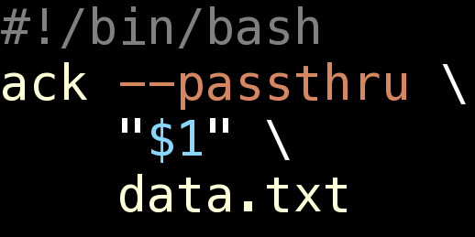
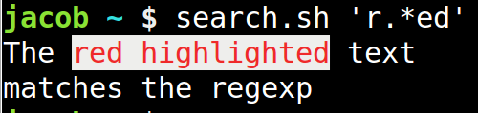
The Syntax
Following examples written with Perl syntax
Using this script
Results shown like
this

Slide 18
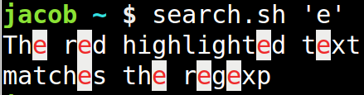
Single Characters :: Regular
Non special characters match themselves
  Anything except [\^$.|?*+()

Slide 19
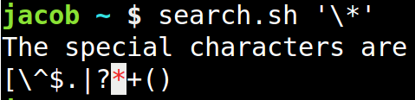
Single Characters :: Special
Special characters control the syntax of Regex
Escape with backslash \ to make a literal match

Slide 20
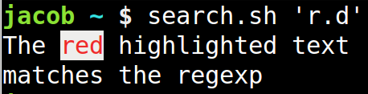
Single Characters :: The Dot
Matches (almost) any character
Will not match new line character
  Unless you turn that option on

Slide 21
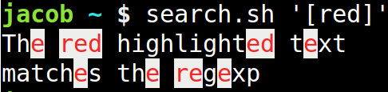
Character Classes
Characters within square brackets
Match a single character that matches anything in the class

Slide 22
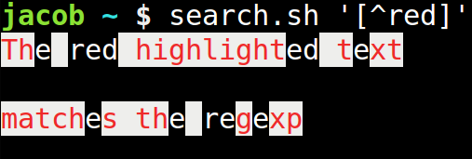
Negated Character Classes
A caret in the first position negates the class
Will match any character that does not match anything in the class

Slide 23
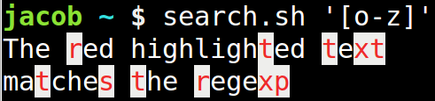
Character Class Ranges
Match any character in a range such as
  A-Z a-z 0-9

Slide 24
Character Shorthands
\d = Digit
\D = Not a digit
\w = Word characters
\W = Not a word character
\s = Whitespace
\S = Not whitespace

Slide 25
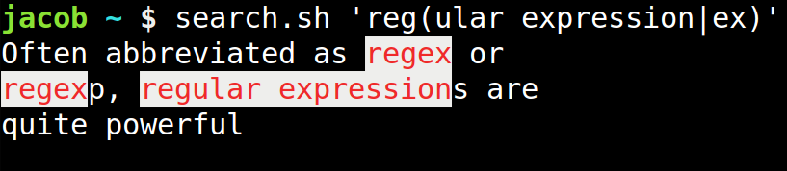
Groups and Or
Use parentheses to group characters together
Use bars to specify OR
We will come back to these later (backreferences)

Slide 26
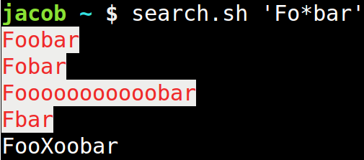
Repeating Matches :: *
Use * to repeat a match 0 or more times
  0 means the match is optional

Slide 27
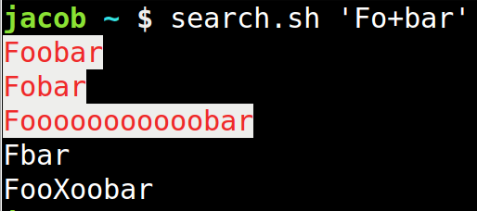
Repeating Matches :: +
Use + to repeat a match 1 or more times
  “At least once”

Slide 28
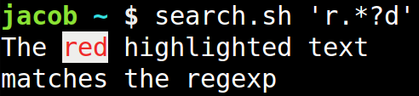
Repeating :: Greedy vs Lazy
* and + are greedy and will match as much as they can
Make them lazy with ?

Slide 29
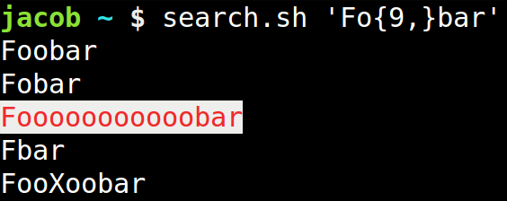
Repeating Matches :: {}
Can specify the number of matches with braces
{4} = 4 matches
{2,5} = 2, 3, 4, or 5 matches
{2,} = At least 2 matches

Slide 30
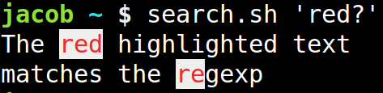
Optional Matches
The “0 or more” behavior of *
When not quantifying greediness, ? makes previous match optional

Slide 31
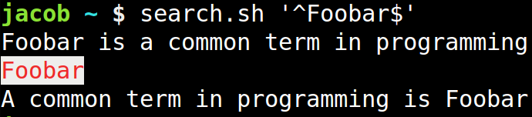
Anchoring
Caret ^ matches the start of a string
Dollar $ matches the end of the string

Slide 32
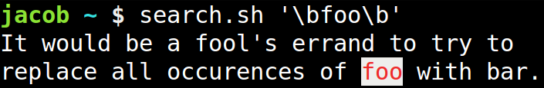
Boundaries
\b matches position between word characters
Use it to match whole words or words that start or end with a string

Slide 33
Assertions
Lookaheads and Lookbehinds
Match that a pattern:
  does / does not
  follow / proceed
  Another pattern
The following/proceeding pattern is not included in the matched set

Slide 34
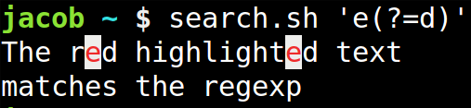
Positive Lookahead
(?=pattern)
Match an 'e' that is followed by a 'd'

Slide 35
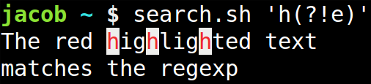
Negative Lookahead
(?!pattern)
Math an 'h' that is not followed by an 'e'

Slide 36
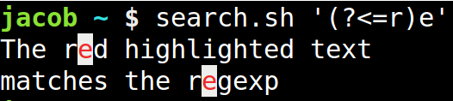
Positive Lookbehind
(?<=pattern)
Match an 'e' that comes after an 'r'

Slide 37
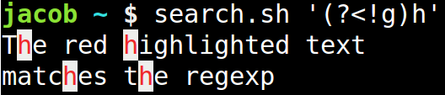
Negative Lookbehind
(?<!pattern)
Math an 'h' that is proceeded by something that is not a 'g'

Slide 38
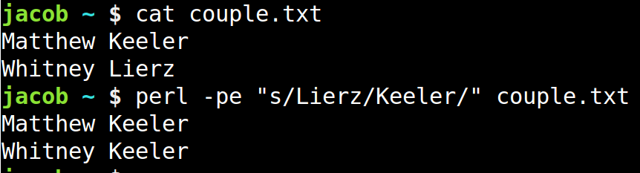
Replacing Text
Done in the form of
  s/pattern/replacement/(flags)

Slide 39
Backreferences
Groups (in parens) from the subject can be reused in the replacement.
Usually \1 through \9 based on their position
Some languages support more than 9
Some languages let you name groups

Slide 40
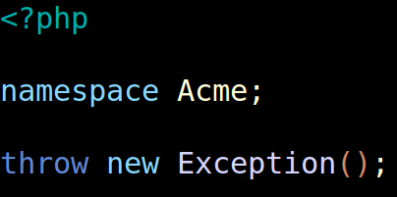
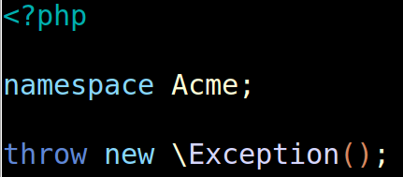
Backreferences

Slide 41
Non Capturing Groups
Prevent capturing by starting the group with ?:
(?:regex)

Slide 42
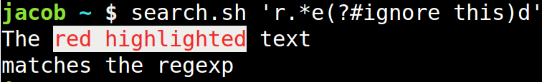
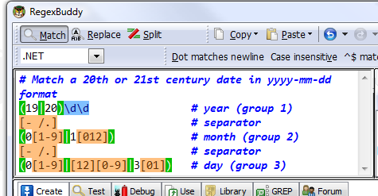
Comments and Whitespace
Can embed comments with (?#comment)
Also comment with # in free spacing mode

Slide 43
Flags (Language Dependent)
g: Global match
i: Case insensitive
x: Free spacing mode
m: Multi line mode

Slide 44
Resources
http://www.regular-expressions.info
http://refiddle.com/
http://gskinner.com/RegExr/

Slide 45
To Conclude
*nix?
You mean (Linu|Uni)x

Slide 46
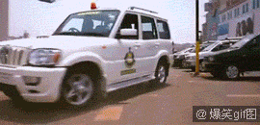
When my Regex Works

