Slide 1
Cs445 fall 2017
Binary Trees

Slide 2
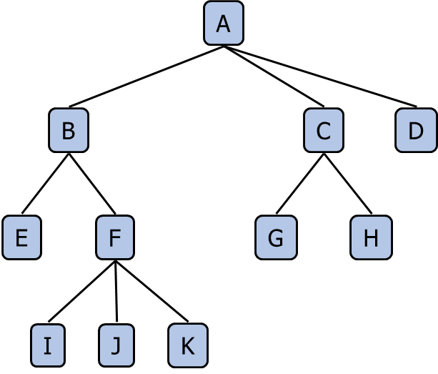
trees
Efficient search and insert
Flexible
Used in file systems and databases
Good for organization

Slide 3
Trees
Unlike bags, stacks, or queues, trees are hierarchical
root
A
B
C
E
F
H
branches
I
leaves
G
nodes
J

Slide 4
Binary trees
Each node has at most 2 children
A
A
B
C
B
C
D
E
F
E
F
G
G
H
I
H
I

Slide 5
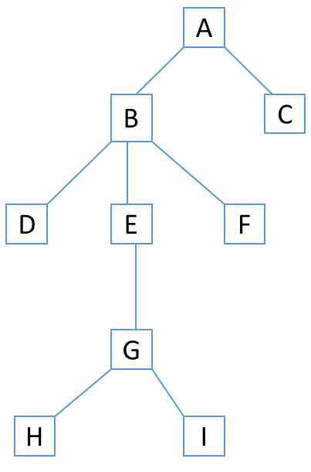
A Recursive Data Structure
Trees are structured in such a way that using recursive methods makes sense
A tree can almost be defined in terms of itself
A node can have children which are themselves trees

Slide 6
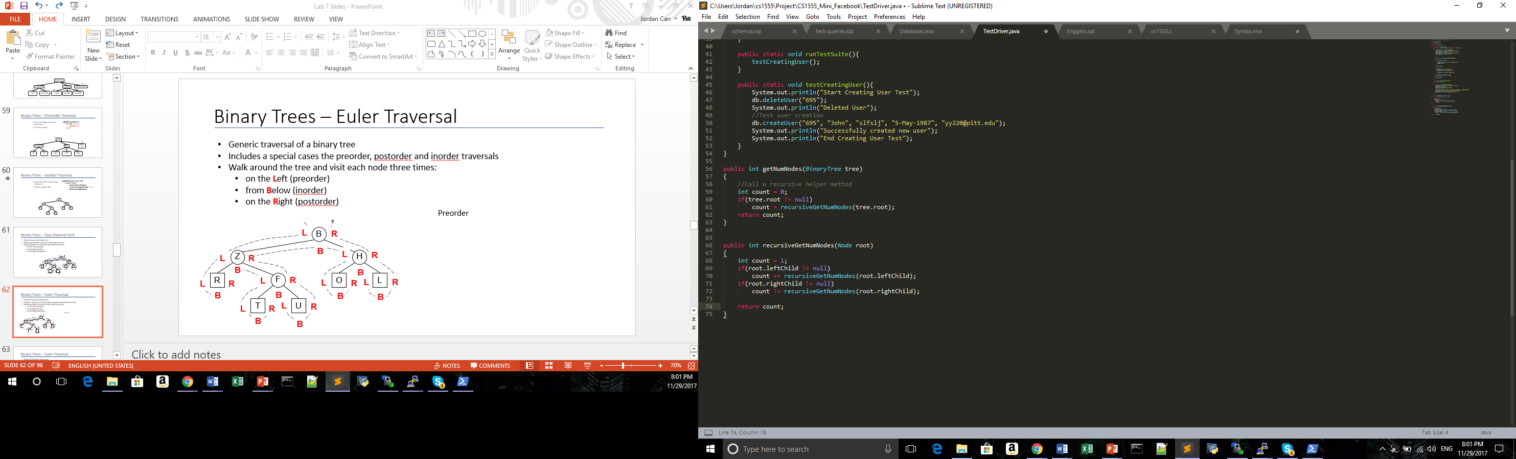
Recursive Method: getNumberOfNodes

Slide 7
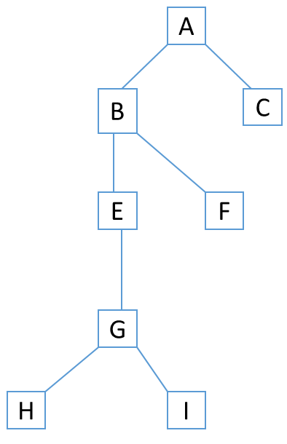
GetNumberofNodes

Slide 8
GetNumberofNodes

Slide 9
GetNumberofNodes

Slide 10
GetNumberofNodes

Slide 11
GetNumberofNodes
1

Slide 12
GetNumberofNodes
1

Slide 13
GetNumberofNodes
3

Slide 14
GetNumberofNodes
4

Slide 15
GetNumberofNodes
1

Slide 16
GetNumberofNodes
6

Slide 17
GetNumberofNodes
1

Slide 18
GetNumberofNodes
8

Slide 19
GetNumberofNodes
8

Slide 20
Traversal
Preorder:
Visit the parent then
Left and right children (subtrees)
Postorder:
Visit left child, then right child
Visit parent
Inorder:
Visit left child, then parent
Visit right child

Slide 21
Preorder Traversal
Algorithm preOrder(v)
visit(v)
for each child w of v
preorder (w)
1
Become Rich
2
5
9
1. Motivations
2. Methods
3. Success Stories
3
4
6
7
8
1.1 Enjoy Life
1.2 Help Poor Friends
2.1 Get a CS PhD
2.2 Start a Web Site
2.3 Acquired by Google

Slide 22
Postorder Traversal
Algorithm postOrder(v)
for each child w of v
postOrder (w)
visit(v)
9
cs445/
8
3
7
homeworks/
lab8/
Rules.txt 1K
1
2
4
5
6
l1c.doc 3K
l1nc.doc 2K
Trees.java 10K
ITrees.java 25K
Stack.java 20K

Slide 23
Inorder Traversal
Algorithm inOrder( node root)
If (root != null) {
inOrder(root.leftChild());
System.out.print(root.data + “ “);
inOrder(root.rightChild());
B
Z
H
R
F
O
L
T
U

Slide 24
Traversal Memorization Trick
On the Left: preorder
On the Bottom: inorder
On the Right: postorder
B
B
Z
H
L
Z
R
H
B
R
F
O
L
R
F
O
L
T
U
T
U

Slide 25
Your Tasks
Build a binary tree from given preorder and inorder sequences
From both of these strings we can determine how a tree is built
We know the first node in preorder sequence is always the root
Knowing that, we can find where it is in the inorder sequence
Everything to the right of the root is in the right child’s subtree
Everything to the left of the root is in the left child’s subtree
Once we determine what the subtrees are, we can recursively call the method on the subtrees of the root’s child and build our tree from that

Slide 26
Algorithm
Root: First character in the sequence
Get index of the root node (root_index) in the inorder sequence
Left inorder= index 0 to root_index
Right inorder= root_index to end of sequence
Left preorder= index 1 to root_index
Right preorder= root_index to end of sequence
Recursively call the method on (left inorder, left preorder) and (right inorder, right inorder) to build all subtrees
Base case: sequence is of size 1

Slide 27
Example
String preorder = "BZRFTUHOL";
String inorder = "RZTFUBOHL";
Root is B
Left inorder: “RZTFU”
Right inorder: “OHL”
Left preorder: “ZRFTU”
Right preorder: “HOL”
B

Slide 28
Example-Recurse to Left Subtree
String preorder = "ZRFTU";
String inorder = "RZTFU";
Root is Z
Left inorder: “R”
Right inorder: “TFU”
Left preorder: “R”
Right preorder: “FTU”
B
Z

Slide 29
Example-Recurse to Left Subtree
String preorder = “R";
String inorder = "R";
Root is R
Left inorder: NULL
Right inorder: NULL
Left preorder: NULL
Right preorder: NULL
B
Z
R

Slide 30
Example-Recurse to Left Subtree
String preorder = “FTU";
String inorder = “TFU";
Root is F
Left inorder: “T”
Right inorder: “U”
Left preorder: “T”
Right preorder: “U”
B
Z
R
F

Slide 31
Example-Recurse to Left Subtree
String preorder = “T";
String inorder = “T";
Root is T
Left inorder: NULL
Right inorder: NULL
Left preorder: NULL
Right preorder: NULL
B
Z
R
F
T

Slide 32
Example-Recurse to Left Subtree
String preorder = “U";
String inorder = “U";
Root is U
Left inorder: NULL
Right inorder: NULL
Left preorder: NULL
Right preorder: NULL
B
Z
R
F
T
U

Slide 33
Eventual REsult
Keep following the algorithm and you will get the following tree
B
O
Z
H
L
R
F
T
U

